Slide 1
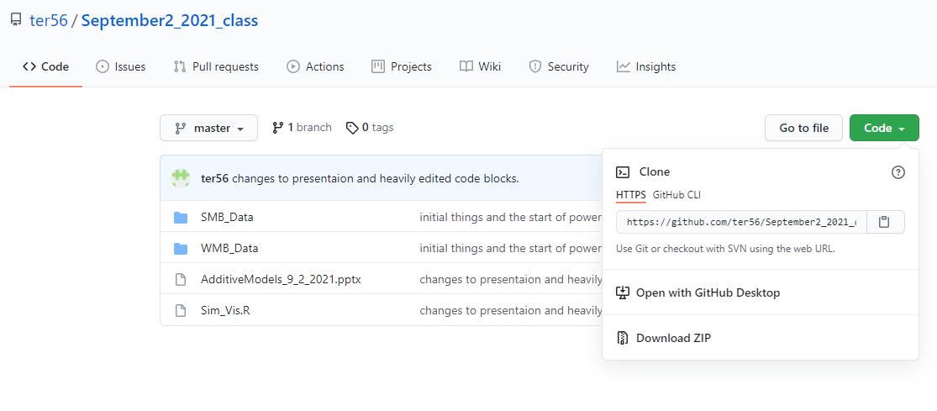
Go to https://github.com/ter56/September2_2021_class
If you have git integrated into R go ahead and clone into it - if not download the contents ad open ‘Sim_Vis.R’ in R

Slide 2
Additive models and genomic prediction
Travis Rooney
September 2, 2021
PLBRG 4080

Slide 3

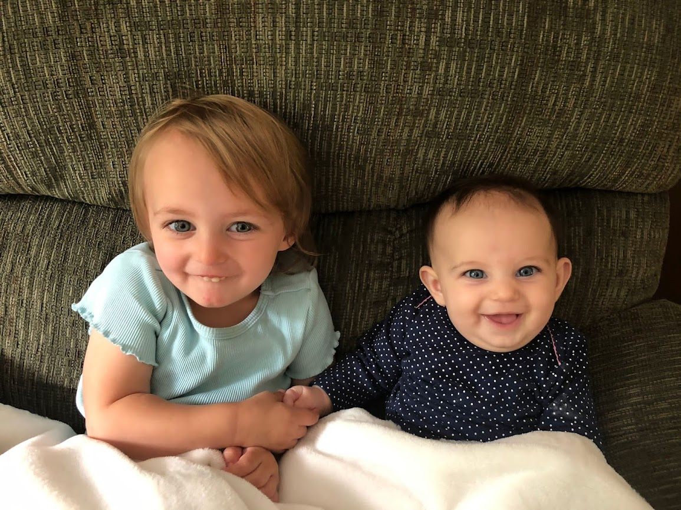
About me
4th year PhD Candidate in Mark’s program as well as co-advised with Ed Buckler.
Maize-nutrient systems/circular economies
Malting barley – focused on germination and malting quality
Wife and children →

Slide 4
Outline
Breeders Job and Breeding values
Build up from what we observe when we cross parents to a general understanding of the additive genetic model, how it is applied, regression, regularization, and how it can estimate a plants phenotype.
Example genomic prediction with barley data.
Break at some point
Longitudinal genomic prediction
Association analysis
Please stop me and ask questions at any time!
Ask questions in context!

Slide 5
Outline
What is a breeders job?
What do trait distributions look like?
How can we conceptualize them under a mathematical model?
Additive genetic model
Basis of regression, regularization, and marker effects
Break
Genomic prediction
Quick introduction of association mapping
Longitudinal analysis
Functional PCA
Logistic regression
Please stop me and ask questions at any time!
Ask questions in context!

Slide 6
What is a plant breeders job?
Create value by selecting or creating improved plant varieties.
Tools?
Making crosses (breeding - duh)
Modification/mutagenesis
Statistics and evaluation – Genomic selection is part of this!

Slide 7
Breeding values
The value of any trait a breeder is interested in:
Yield
Height
Color
Metabolites
Breeding values can never be measured per se because measurement is always confounded with error (but also other reasons)– they must be estimated statistically.
Summary: Breeding value = a line’s estimated value for your trait of choice

Slide 8
What happens when a cross is made?
Two parents are crossed: P1 and P2
Lets deal primarily with a self pollinated, diploid species today for simplicity

Slide 9
What happens with a cross?
P1
P2
Recombination of chromosomes.
We know this from plant physiology and, more recently, through genomic sequencing.
We also know that these chromosomes contain the genetic material and that this sequence underlies the vast majority of heritable variation.
F1
Self Pollination
Generations of descent to create inbred lines

Slide 10
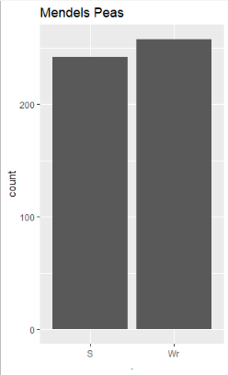
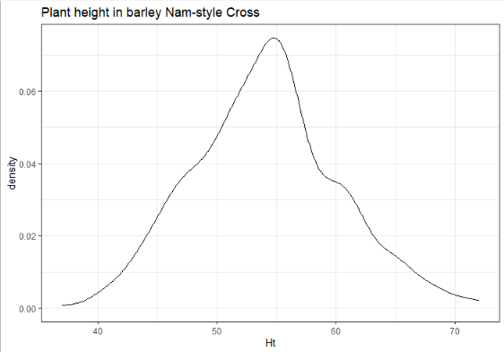
When a cross is made what sorts of trait distributions do we get?

Slide 11
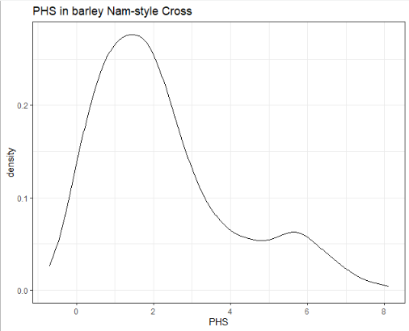
When a cross is made what sorts of trait distributions do we get?

Slide 12
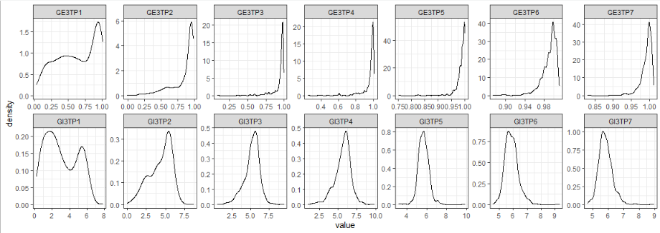
When a cross is made what sorts of trait distributions do we get?

Slide 13
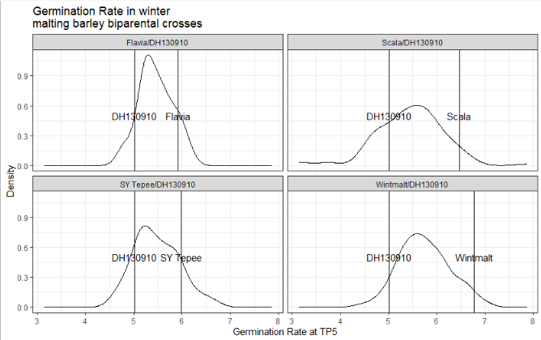

Slide 14
How can we integrate these observed trait distributions, and the known physiology to estimate the phenotypes of lines?
We need to develop a model based on what we know about these things that can at least mimic the trait distributions, then we can move on to testing it.
We want to estimate the phenotype or breeding value without having to observe all lines as cost of genotyping is now < cost of field evaluation.

Slide 15
P1
P2
Lets imagine that there are polymorphism between the two parental lines (well… we do not have to imagine – sequencing tells us there are!)
Remember we need to use variables or numbers so we can model thing mathematically!
P1 SNP = 1
P2 SNP = 0
F1
Self Pollination
Generations of descent to create inbred lines

Slide 16
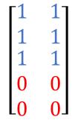


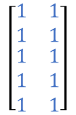
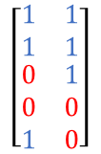

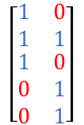
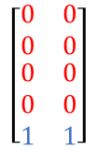
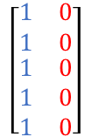
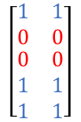
$$\left[\begin{matrix}1 & 1 \\ 1 & 1 \\ \begin{aligned}1 \\ 1 \\ 1\end{aligned} & \begin{aligned}1 \\ 1 \\ 1\end{aligned}\end{matrix}\right]$$
$$\left[\begin{matrix}0 & 0 \\ 0 & 0 \\ \begin{aligned}0 \\ 0 \\ 0\end{aligned} & \begin{aligned}0 \\ 0 \\ 0\end{aligned}\end{matrix}\right]$$
P1
P2
P1
P2
$$\left[\begin{matrix}1 & 0 \\ 1 & 0 \\ \begin{aligned}1 \\ 1 \\ 1\end{aligned} & \begin{aligned}0 \\ 0 \\ 0\end{aligned}\end{matrix}\right]$$
<- We can convert this
Into this ->
F1
F1
Self Pollination
Self Pollination
$$\left[\begin{matrix}1 & 0 \\ 1 & 1 \\ \begin{aligned}1 \\ 0 \\ 0\end{aligned} & \begin{aligned}0 \\ 1 \\ 1\end{aligned}\end{matrix}\right]$$
$$\left[\begin{matrix}1 & 1 \\ 1 & 1 \\ \begin{aligned}0 \\ 0 \\ 1\end{aligned} & \begin{aligned}1 \\ 0 \\ 0\end{aligned}\end{matrix}\right]$$
$$⋯$$
Generations of descent to create inbred lines
Generations of descent to create inbred lines
$$\left[\begin{matrix}1 & 1 \\ 1 & 1 \\ \begin{aligned}1 \\ 0 \\ 0\end{aligned} & \begin{aligned}1 \\ 0 \\ 0\end{aligned}\end{matrix}\right]$$
$$\left[\begin{matrix}1 & 1 \\ 0 & 0 \\ \begin{aligned}0 \\ 1 \\ 1\end{aligned} & \begin{aligned}0 \\ 1 \\ 1\end{aligned}\end{matrix}\right]$$
$$\left[\begin{matrix}0 & 0 \\ 0 & 0 \\ \begin{aligned}0 \\ 0 \\ 1\end{aligned} & \begin{aligned}0 \\ 0 \\ 1\end{aligned}\end{matrix}\right]$$
$$⋯$$

Slide 17
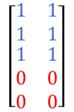

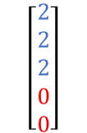



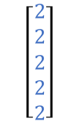

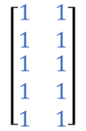
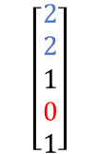
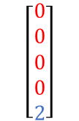
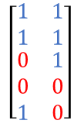

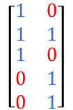
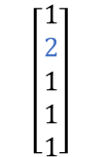
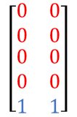
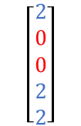
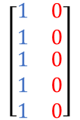
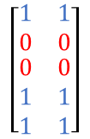
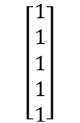
$$\left[\begin{matrix}1 & 1 \\ 1 & 1 \\ \begin{aligned}1 \\ 1 \\ 1\end{aligned} & \begin{aligned}1 \\ 1 \\ 1\end{aligned}\end{matrix}\right]$$
$$\left[\begin{matrix}0 & 0 \\ 0 & 0 \\ \begin{aligned}0 \\ 0 \\ 0\end{aligned} & \begin{aligned}0 \\ 0 \\ 0\end{aligned}\end{matrix}\right]$$
$$\left[\begin{aligned}2 \\ 2 \\ 2 \\ 2 \\ 2\end{aligned}\right]$$
$$\left[\begin{aligned}0 \\ 0 \\ 0 \\ 0 \\ 0\end{aligned}\right]$$
P1
P2
P1
P2
$$\left[\begin{matrix}1 & 0 \\ 1 & 0 \\ \begin{aligned}1 \\ 1 \\ 1\end{aligned} & \begin{aligned}0 \\ 0 \\ 0\end{aligned}\end{matrix}\right]$$
$$\left[\begin{aligned}1 \\ 1 \\ 1 \\ 1 \\ 1\end{aligned}\right]$$
<- We can convert this
Into this ->
F1
F1
Self Pollination
Self Pollination
$$\left[\begin{matrix}1 & 0 \\ 1 & 1 \\ \begin{aligned}1 \\ 0 \\ 0\end{aligned} & \begin{aligned}0 \\ 1 \\ 1\end{aligned}\end{matrix}\right]$$
$$\left[\begin{matrix}1 & 1 \\ 1 & 1 \\ \begin{aligned}0 \\ 0 \\ 1\end{aligned} & \begin{aligned}1 \\ 0 \\ 0\end{aligned}\end{matrix}\right]$$
$$\left[\begin{aligned}1 \\ 2 \\ 1 \\ 1 \\ 1\end{aligned}\right]$$
$$\left[\begin{aligned}2 \\ 2 \\ 1 \\ 0 \\ 1\end{aligned}\right]$$
$$⋯$$
$$⋯$$
In this case:
2 represents homozygous at a SNP for the P1 allele
1 would indicate heterozygous
0 indicates homozygous for the P2 allele!
Generations of descent to create inbred lines
Generations of descent to create inbred lines
$$\left[\begin{matrix}1 & 1 \\ 1 & 1 \\ \begin{aligned}1 \\ 0 \\ 0\end{aligned} & \begin{aligned}1 \\ 0 \\ 0\end{aligned}\end{matrix}\right]$$
$$\left[\begin{matrix}1 & 1 \\ 0 & 0 \\ \begin{aligned}0 \\ 1 \\ 1\end{aligned} & \begin{aligned}0 \\ 1 \\ 1\end{aligned}\end{matrix}\right]$$
$$\left[\begin{matrix}0 & 0 \\ 0 & 0 \\ \begin{aligned}0 \\ 0 \\ 1\end{aligned} & \begin{aligned}0 \\ 0 \\ 1\end{aligned}\end{matrix}\right]$$
$$\left[\begin{aligned}2 \\ 2 \\ 2 \\ 0 \\ 0\end{aligned}\right]$$
$$\left[\begin{aligned}2 \\ 0 \\ 0 \\ 2 \\ 2\end{aligned}\right]$$
$$\left[\begin{aligned}0 \\ 0 \\ 0 \\ 0 \\ 2\end{aligned}\right]$$
$$⋯$$
$$⋯$$

Slide 18

Now we have a numeric vector that tells us which allele (P1 or P2) is present at each SNP. What’s Next?
Now let’s assume that each SNP is in linkage (ie high LD or high correlation) to a region of the genome that effects the trait.
For simplicity, lets assume that:
P1 always contributes the positive allele.
All allele substitutions of P1 for P2 allele have equal effects of value a
Ie all markers have equal effects
All markers are unlinked from each other.
In this case the breeding value (BV) of this: can be estimated as:
$$\left[a a a a a\right]∗\left[\begin{aligned}2 \\ 0 \\ 0 \\ 2 \\ 2\end{aligned}\right]=2∗a+0∗a+0∗a+2∗a+2∗a=6a$$
Notes:
All fine and good, lets see if this can actually give us the trait distributions that we want to get out.

Slide 19
Let’s jump to R
We are going to simulate:
Our 5 loci model with equal marker effects,
Our 5 loci model with random effects
Extend this to 200 loci with
Equal marker effects
Single large effect markers
Randomly assigned marker effects

Slide 20
We’ve seen we can make models based on the physiology and the sequence information and these models mimic the phenotypic distribution we see.
Congratulations, This is the additive genetic model.

Slide 21
The additive genetic model:
The phenotype (or breeding value) of the individual is a result of the additive combination of many polymorphisms across the genome each with their own effect on the phenotype.
The additive model assumes that epistasis and dominance do not play large roles in determining an organisms phenotype, however, in entirely inbred populations dominance is typically not an issue, as there are no heterozygotes. Epistasis or interactions between genes can still cause deviation within inbred species though.
Notes:
White board on what is additive mean from the PoV of the x-y plot with allele scoring.
Dominance, epistasis, and Overdominance.

Slide 22
A quick aside
Mathematical concept of ‘additivity’ and ‘dominance’
Whiteboard!

Slide 23
How can we apply the additive model to real breeding populations?
How do we proceed next?
In reality we will have the phenotypes (estimated breeding values) and our genotypes
We do not know the marker effects – can we estimate them?
That is where regression comes in!

Slide 24
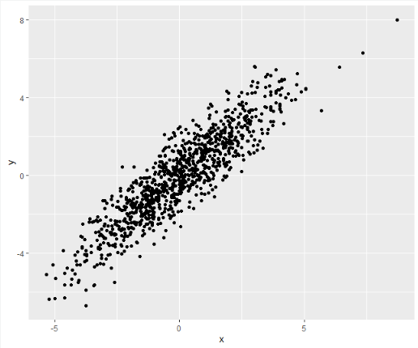
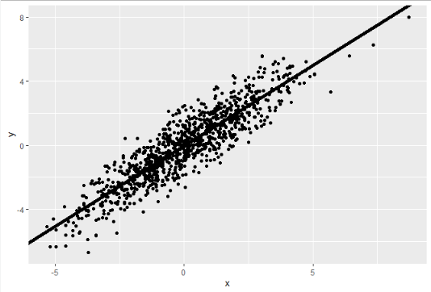
What is regression?
Fitting a line to data:

Slide 25
How do we do that?
We find the least squares estimator = Maximum likelihood estimator
Lets work out a small example – white board!
Likelihood vs probability

Slide 26
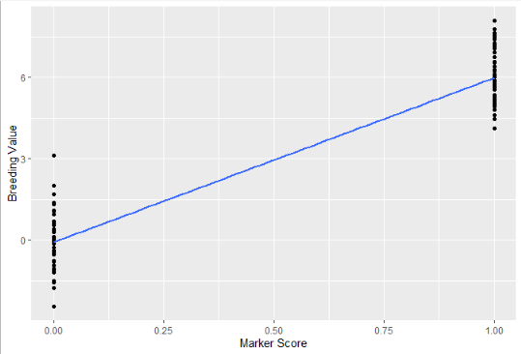
How does this help us find marker effects?
The difference in marker scores is a linear regression where X takes on two (or three in heterozygotes) values {-1,0,1}. Remember though, we may have lots of markers that we need to solve for simultaneously.
This is called multiple linear regression

Slide 27
N < P problem
In a linear system of equations (think back to algebra) one has to have more equations than predictors are being solved for:
In order for a unique solution to exist the number of observations (N) has to be greater than the number of predictors (P).
In the context of genomic selection this means we need more observations of genetically unique individuals than we have markers.
Commonly 1000’s or greater markers are used, but phenotyping any number of individuals can be very challenging.

Slide 28
Can’t we just subset down to N>P markers?
Yes… but
Commonly leads to marker effects being “over-fit” and not well estimated and a model that cannot be used as well to predict other individuals.
Which markers to subset?
N>P to get good estimates of marker effects (how much greater depends)

Slide 29
We can Regularize!
or
“desensitization” ie less sensitive to changes in predictor – introduces a bias during estimation to reduce variance of predictions.
In the least squares fit:
Min(residual²) -> Parameters = (X’X)⁻¹ XY
In a regularized fit:
Min(residual² + penalization process)
In ridge regression this is:
Min(residual² + λ*Slope Parameters²)
Ridge regression is equivalent to a BLUP vs a BLUE.

Slide 30
The difference is in the number of Df and sensitivity
BLUE = Best linear unbiased estimator or fixed effect
BLUP = Best linear unbiased predictor or random effect
BLUEs are assigned per factor or predictor parameter (each marker gets a slope) with no constraint.
BLUPs are assigned per predictor as well, but are constrained based on assumptions, covariance structures, and probabilities of what values those markers can take. For example our marker effects may be estimated based on the normal distribution. (Shrinkage, parameters needed to be estimated)

Slide 31
Formulas
For normal linear regression:
Y ~ BX + error
Where Y is a vector of breeding values, B is a vector of effects, X is a design or marker matrix relating the slopes to the phenotypes, and error is assumed to be N(0,sigma²_{e})
B = Parameters = (X’X)⁻¹ XY
For the regularized linear regression:
Y ~ uZ + error
Where Y is the vector of breeding values, u is a vector of effects assumed to be drawn from a distribution, often N(0,Simga²_{u}*G) where G is a covariance matrix, Z is a marker matrix, and error is assumed to be N(0,sigma²_{e}*E) where E is a error covariance structure (often the identity matrix)

Slide 32
Formulas continued
The normal linear regression is calculated as discussed, the regularized regression uses more complex algorithms, cross-validation, maximum likelihood and restricted maximum likelihood processes to estimate effects. Key to this is estimating lambda.
If you would like to learn more about how that is done Dr. Kelly Robbins is a good source here on campus.

Slide 33
Lets do a little simulation in R

Slide 34
A few caveats
We have been working under the assumption of unlinked markers – Markers are linked!! Especially in a biparental population where there are large LD blocks and limited generations of recombination on the chromosome.
Predictions are only as good as your phenotypes and genotypes: lots of errors in = poor prediction out

Slide 35
We have (hopefully) seen:
That the additive genetic model can reproduce distributions of trait values that we observe in a biparental population.
IE - The additive model is not incongruous with the data we observe.
Regression, specifically regularized regression can be used to estimate marker effects well in the scenarios that we can envision within plant breeding.
We have yet to see if it works (I know y’all probably know if it does)
Let’s see if we can use it to predict within real barley populations.

Slide 36
Genomic prediction in R with real data
Actual data and GS – using the Barley data we have,
cross validation to estimate prediction accuracy.

Slide 37
Break time
What is a pirates favorite programming language?
Why was the geologist’s wife angry?
What do you call a cow jumping over a barbed wire fence?
What do you call the horse next door?
Notes:
(neigh-bor)

Slide 38
Lets talk about something that goes hand in hand with the additive model: Association analysis
White board

Slide 39
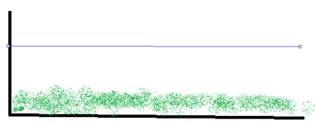
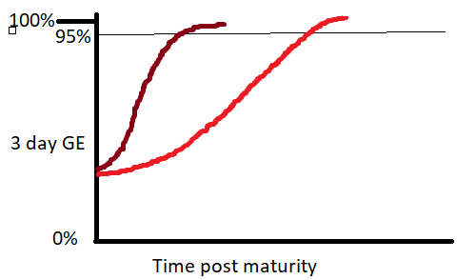
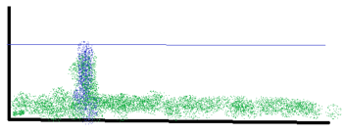
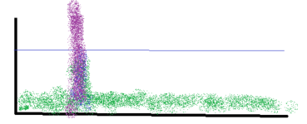
GWAS Manhattan Plots
-log10(p.values)

Slide 40
Time series analysis options and a few examples!

