Slide 1
Additive models and genomic prediction
Travis Rooney
September 2, 2021
PLBRG 4080

Slide 2
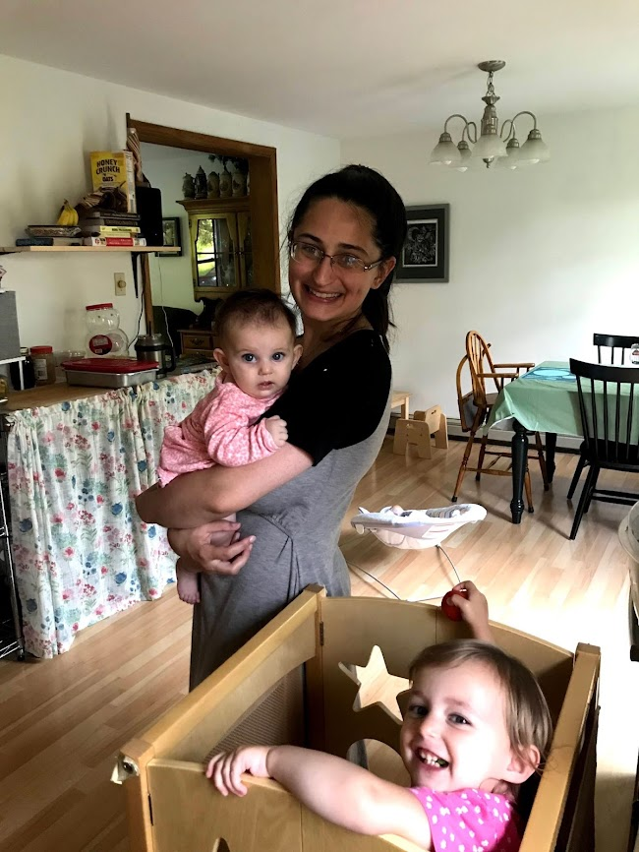
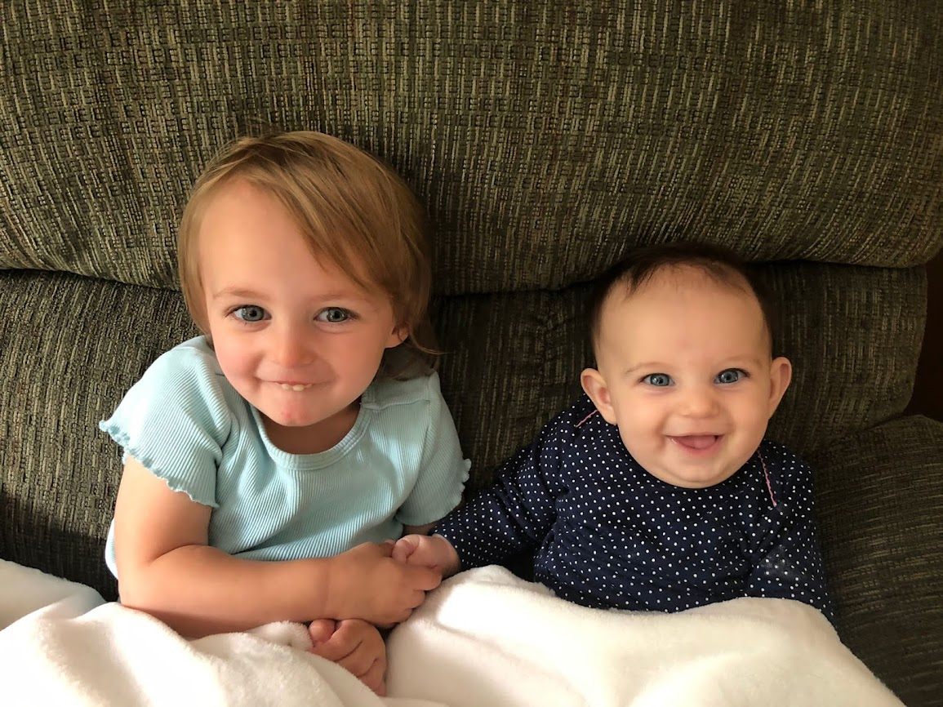
About me
4th year PhD Candidate in Mark’s program as well as co-advised with Ed Buckler.
Maize-nutrient systems/circular economies
Malting barley – focused on germination and malting quality
Wife and children →

Slide 3
Outline
What is a breeders job?
What do trait distributions look like?
How can we conceptualize them under a mathematical model?
Basis of regression, regularization, and marker effects
Break
Quick introduction of association mapping
Genomic prediction
Longitudinal analysis
Functional PCA
Logistic regression
Please stop me and ask questions at any time!
Ask questions in context!

Slide 4
What is a plant breeders job?
Create value by selecting or creating improved plant varieties.
Tools?
Making crosses (breeding - duh)
Modification/mutagenesis
Statistics and evaluation

Slide 5
Breeding values
The value of any trait a breeder is interested in measuring or estimating
Yield
Height
Color
Metabolites
Breeding values can never be measured because measurement is always confounded with error – they must be estimated statistically.
Summary: Breeding value = a line’s estimated value for your trait of choice

Slide 6
What happens when a cross is made?
Two parents are crossed: P1 and P2
The first generation is called the F₁ or filial generation 1. Each successive (if self pollination is performed) is called the F_{n}
Lets deal primarily with a self pollinated, diploid species today for simplicity

Slide 7
What happens with a cross?
P1
P2
Recombination of chromosomes.
We know this from plant physiology and, more recently, through genomic sequencing.
We also know that these chromosome contain the genetic material and that this sequence underlies the vast majority of heritable variation.
F1
Self Pollination
Generations of descent to create inbred lines

Slide 8
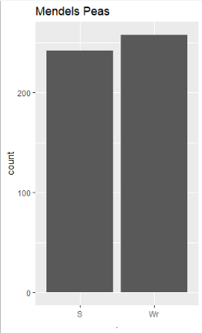
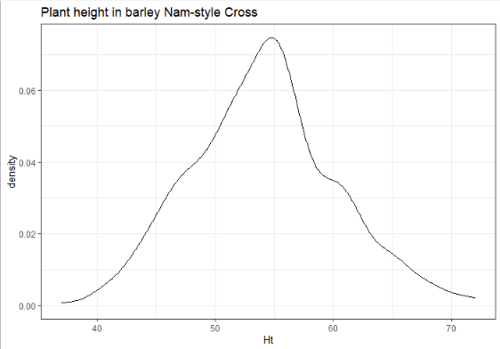
When a cross is made what sorts of trait distributions do we get?

Slide 9
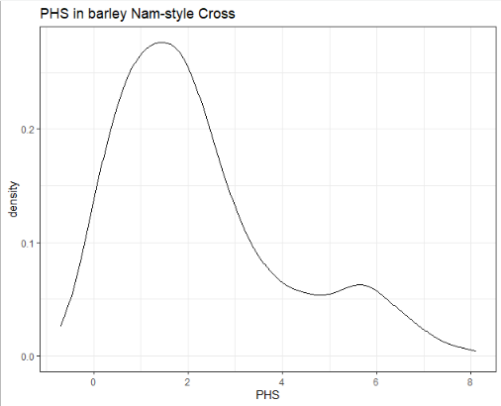
When a cross is made what sorts of trait distributions do we get?

Slide 10
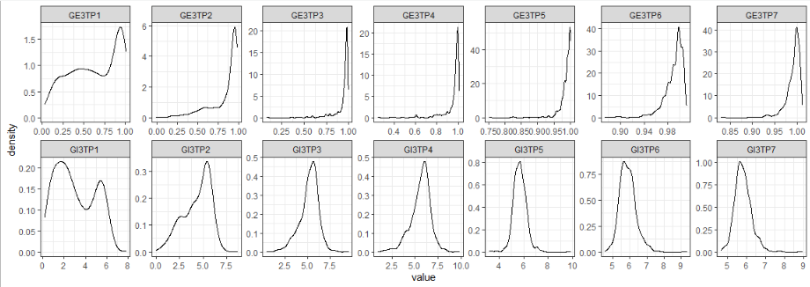
When a cross is made what sorts of trait distributions do we get?

Slide 11
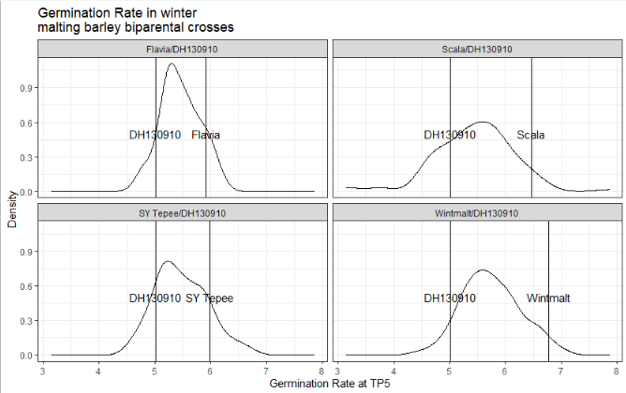

Slide 12
This is where the additive model comes in!
P1
P2
Lets imagine that there are polymorphism between the two parental lines
Remember we need to use variables or numbers so we can model thing mathematically!
P1 SNP = 1
P2 SNP = 0
F1
Self Pollination
Generations of descent to create inbred lines

Slide 13
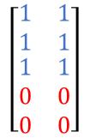


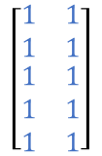
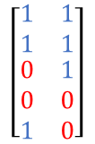

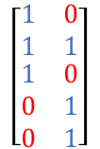
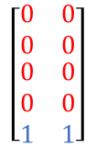
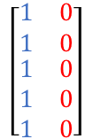
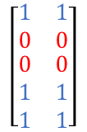
$$\left[\begin{matrix}1 & 1 \\ 1 & 1 \\ \begin{aligned}1 \\ 1 \\ 1\end{aligned} & \begin{aligned}1 \\ 1 \\ 1\end{aligned}\end{matrix}\right]$$
$$\left[\begin{matrix}0 & 0 \\ 0 & 0 \\ \begin{aligned}0 \\ 0 \\ 0\end{aligned} & \begin{aligned}0 \\ 0 \\ 0\end{aligned}\end{matrix}\right]$$
P1
P2
P1
P2
$$\left[\begin{matrix}1 & 0 \\ 1 & 0 \\ \begin{aligned}1 \\ 1 \\ 1\end{aligned} & \begin{aligned}0 \\ 0 \\ 0\end{aligned}\end{matrix}\right]$$
<- We can convert this
Into this ->
F1
F1
Self Pollination
Self Pollination
$$\left[\begin{matrix}1 & 0 \\ 1 & 1 \\ \begin{aligned}1 \\ 0 \\ 0\end{aligned} & \begin{aligned}0 \\ 1 \\ 1\end{aligned}\end{matrix}\right]$$
$$\left[\begin{matrix}1 & 1 \\ 1 & 1 \\ \begin{aligned}0 \\ 0 \\ 1\end{aligned} & \begin{aligned}1 \\ 0 \\ 0\end{aligned}\end{matrix}\right]$$
$$⋯$$
Generations of descent to create inbred lines
Generations of descent to create inbred lines
$$\left[\begin{matrix}1 & 1 \\ 1 & 1 \\ \begin{aligned}1 \\ 0 \\ 0\end{aligned} & \begin{aligned}1 \\ 0 \\ 0\end{aligned}\end{matrix}\right]$$
$$\left[\begin{matrix}1 & 1 \\ 0 & 0 \\ \begin{aligned}0 \\ 1 \\ 1\end{aligned} & \begin{aligned}0 \\ 1 \\ 1\end{aligned}\end{matrix}\right]$$
$$\left[\begin{matrix}0 & 0 \\ 0 & 0 \\ \begin{aligned}0 \\ 0 \\ 1\end{aligned} & \begin{aligned}0 \\ 0 \\ 1\end{aligned}\end{matrix}\right]$$
$$⋯$$

Slide 14
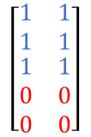

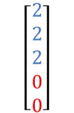



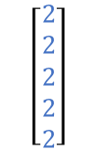

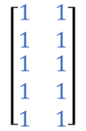
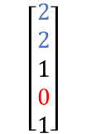
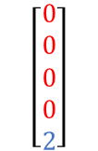
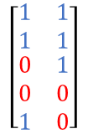

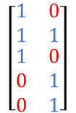
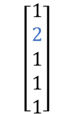
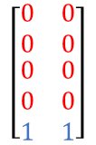
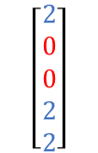
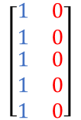
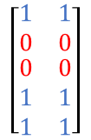
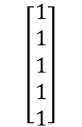
$$\left[\begin{matrix}1 & 1 \\ 1 & 1 \\ \begin{aligned}1 \\ 1 \\ 1\end{aligned} & \begin{aligned}1 \\ 1 \\ 1\end{aligned}\end{matrix}\right]$$
$$\left[\begin{matrix}0 & 0 \\ 0 & 0 \\ \begin{aligned}0 \\ 0 \\ 0\end{aligned} & \begin{aligned}0 \\ 0 \\ 0\end{aligned}\end{matrix}\right]$$
$$\left[\begin{aligned}2 \\ 2 \\ 2 \\ 2 \\ 2\end{aligned}\right]$$
$$\left[\begin{aligned}0 \\ 0 \\ 0 \\ 0 \\ 0\end{aligned}\right]$$
P1
P2
P1
P2
$$\left[\begin{matrix}1 & 0 \\ 1 & 0 \\ \begin{aligned}1 \\ 1 \\ 1\end{aligned} & \begin{aligned}0 \\ 0 \\ 0\end{aligned}\end{matrix}\right]$$
$$\left[\begin{aligned}1 \\ 1 \\ 1 \\ 1 \\ 1\end{aligned}\right]$$
<- We can convert this
Into this ->
F1
F1
Self Pollination
Self Pollination
$$\left[\begin{matrix}1 & 0 \\ 1 & 1 \\ \begin{aligned}1 \\ 0 \\ 0\end{aligned} & \begin{aligned}0 \\ 1 \\ 1\end{aligned}\end{matrix}\right]$$
$$\left[\begin{matrix}1 & 1 \\ 1 & 1 \\ \begin{aligned}0 \\ 0 \\ 1\end{aligned} & \begin{aligned}1 \\ 0 \\ 0\end{aligned}\end{matrix}\right]$$
$$\left[\begin{aligned}1 \\ 2 \\ 1 \\ 1 \\ 1\end{aligned}\right]$$
$$\left[\begin{aligned}2 \\ 2 \\ 1 \\ 0 \\ 1\end{aligned}\right]$$
$$⋯$$
$$⋯$$
In this case:
2 represents homozygous at a SNP for the P1 allele
1 would indicate heterozygous
0 indicates homozygous for the P2 allele!
Generations of descent to create inbred lines
Generations of descent to create inbred lines
$$\left[\begin{matrix}1 & 1 \\ 1 & 1 \\ \begin{aligned}1 \\ 0 \\ 0\end{aligned} & \begin{aligned}1 \\ 0 \\ 0\end{aligned}\end{matrix}\right]$$
$$\left[\begin{matrix}1 & 1 \\ 0 & 0 \\ \begin{aligned}0 \\ 1 \\ 1\end{aligned} & \begin{aligned}0 \\ 1 \\ 1\end{aligned}\end{matrix}\right]$$
$$\left[\begin{matrix}0 & 0 \\ 0 & 0 \\ \begin{aligned}0 \\ 0 \\ 1\end{aligned} & \begin{aligned}0 \\ 0 \\ 1\end{aligned}\end{matrix}\right]$$
$$\left[\begin{aligned}2 \\ 2 \\ 2 \\ 0 \\ 0\end{aligned}\right]$$
$$\left[\begin{aligned}2 \\ 0 \\ 0 \\ 2 \\ 2\end{aligned}\right]$$
$$\left[\begin{aligned}0 \\ 0 \\ 0 \\ 0 \\ 2\end{aligned}\right]$$
$$⋯$$
$$⋯$$

Slide 15

Now we have a numeric vector that tells us which allele (P1 or P2) is present at each SNP. What’s Next?
Now let’s assume that each SNP is in linkage (ie high LD or high correlation) to a region of the genome that effects the trait.
For simplicity, lets assume that:
P1 always contributes the positive allele.
All allele substitutions of P1 for P2 allele have equal effects of value a
Ie all markers have equal effects
All markers are unlinked from each other.
In this case the breeding value (BV) of this can be estimates as:
$$\left[a a a a a\right]∗\left[\begin{aligned}2 \\ 0 \\ 0 \\ 2 \\ 2\end{aligned}\right]=2∗a+0∗a+0∗a+2∗a+2∗a=6a$$

Slide 16
How does this help us model the trait distributions?
R studio demo

Slide 17
Breeding
Parent 1
Parent 2
How do we identify the superior offspring and thereby selecting the next, better variety?
F1
Generations of descent, self-pollinating perhaps
F8
F8
F8
F8
F8
F8
F8
F8
F8
Population of lines for evaluation
F8
F8
F8
F8
F8
F8
F8
F8
F8
F8
F8
F8
F8
F8
F8
F8
F8
F8
F8
F8
F8
F8
F8
F8
F8
F8
F8
F5
F5
F5
F5

Slide 18
Breeding
Parent 1
Parent 2
Make a cross and evaluate the offspring: Workhorse of plant breeding is often the biparental population.
For simplicity most of what we will discuss today will be in the context of biparental populations.
F1
Generations of descent, self-pollinating perhaps
F8
F8
F8
F8
F8
F8
F8
F8
F8
Population of lines
F8
F8
F8
F8
F8
F8
F8
F8
F8
F8
F8
F8
F8
F8
F8
F8
F8
F8
F8
F8
F8
F8
F8
F8
F8
F8
F8
F5
F5
F5
F5

Slide 19
P1
P2
F1
Self Pollination
Generations of descent to create inbred lines

