Slide 1
Innovation in UX/UI
Tech Seminary 2

Slide 2
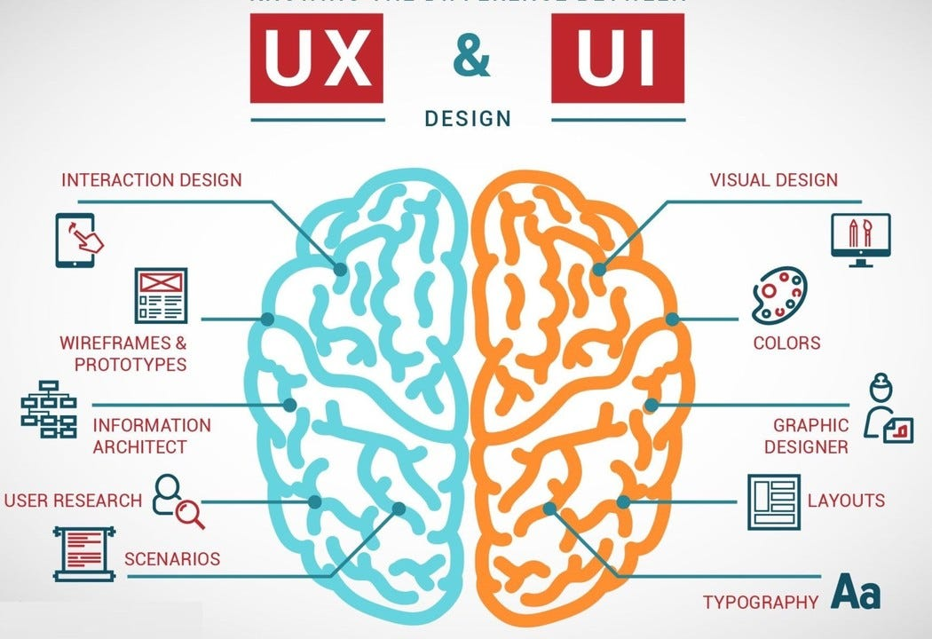
UX vs UI
UX (user experience designer) focuses on all aspects of the USER's interaction with the company, its services, and its products.
UI (user interface designer) is a specialized UX
  UI focus: visuals interaction
*https://miro.medium.com/v2/resize:fit:1050/1*hp-yfKsmzsj711iLbM8eEw.jpeg

Slide 3
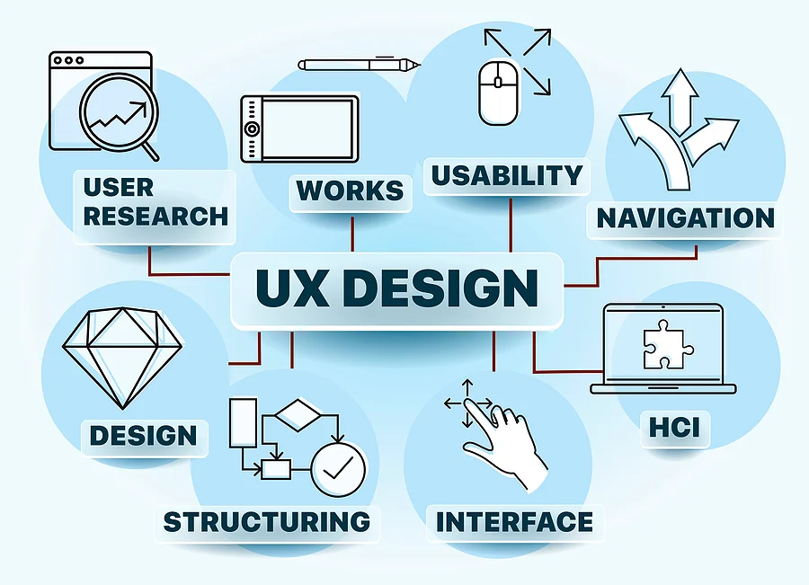
UX
Task and responsibilities:
  Strategy and content
  Wireframing and prototyping
  Execution and analysis
*https://www.keenesystems.com/hs-fs/hubfs/blog-images/ux-design.jpg?width=900&name=ux-design.jpg

Slide 4
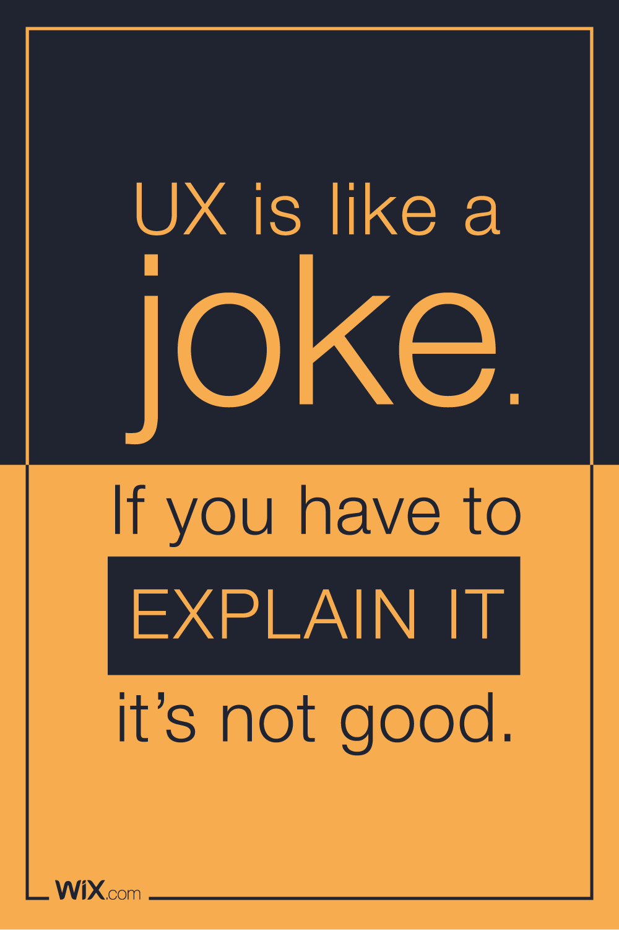
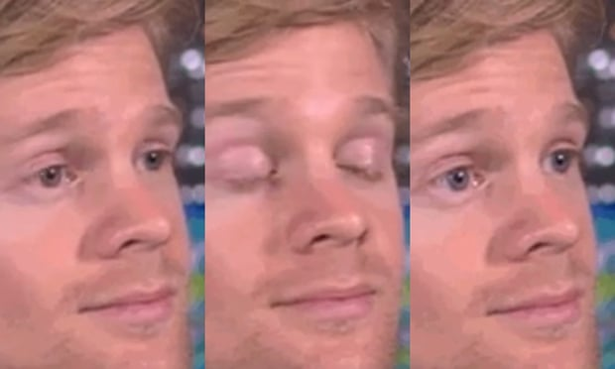
Understanding Good UX: An Important Truth
Image: https://webdesignledger.com/35-design-jokes-will-make-you-laugh/

Slide 5
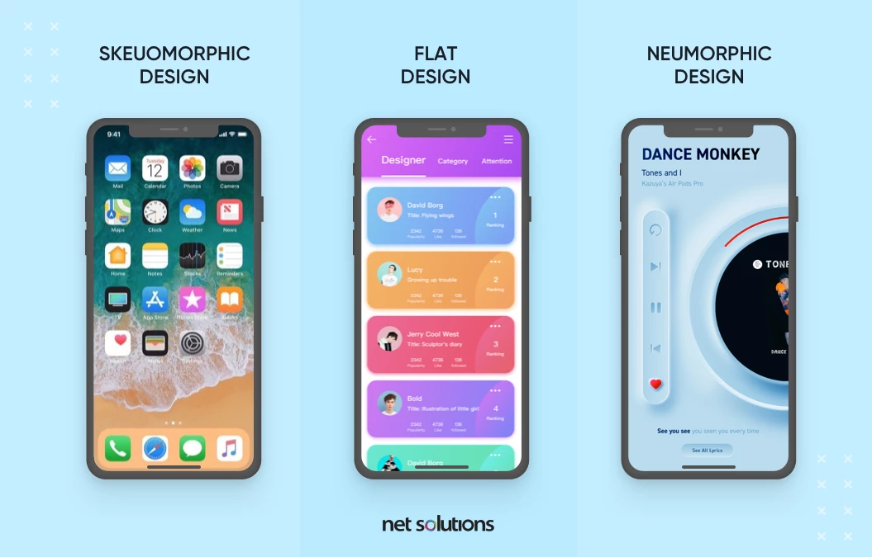
UI
Task and responsibilities:
  The look and feel of the product
  Responsiveness and interactivity
https://www.netsolutions.com/insights/wp-content/uploads/2022/02/neumorphism.webp

Slide 6

10 Usability Heuristics for User Interface Design
Nielsen Norman Group
Ph.D Donald Norman - former VP of research @ Apple
Ph.D Jakob Neilsen – 79 US patents, making the internet easier to use
*https://www.nngroup.com/articles/ten-usability-heuristics/

Slide 7
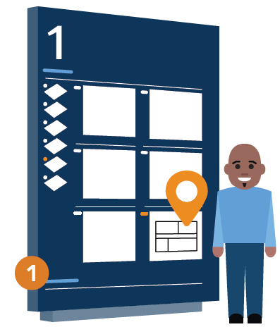
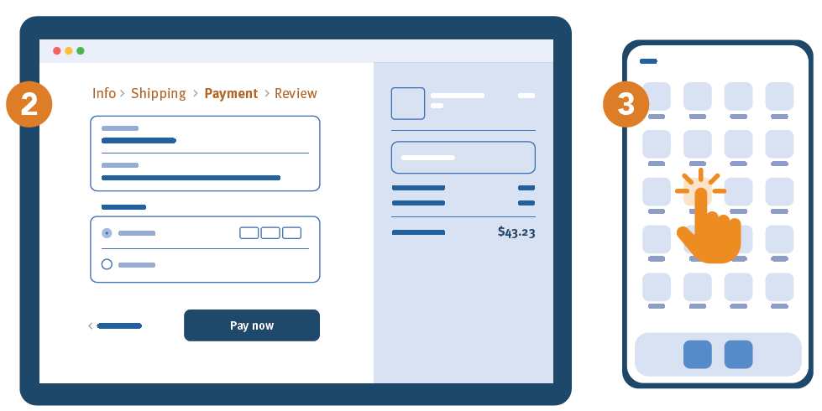
#1: Visibility of system status
keep users informed about what is going on
appropriate feedback within a reasonable amount of time
predictable interactions create trust
*https://www.nngroup.com/articles/visibility-system-status/

Slide 8
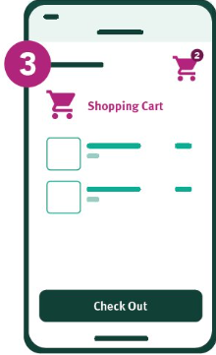
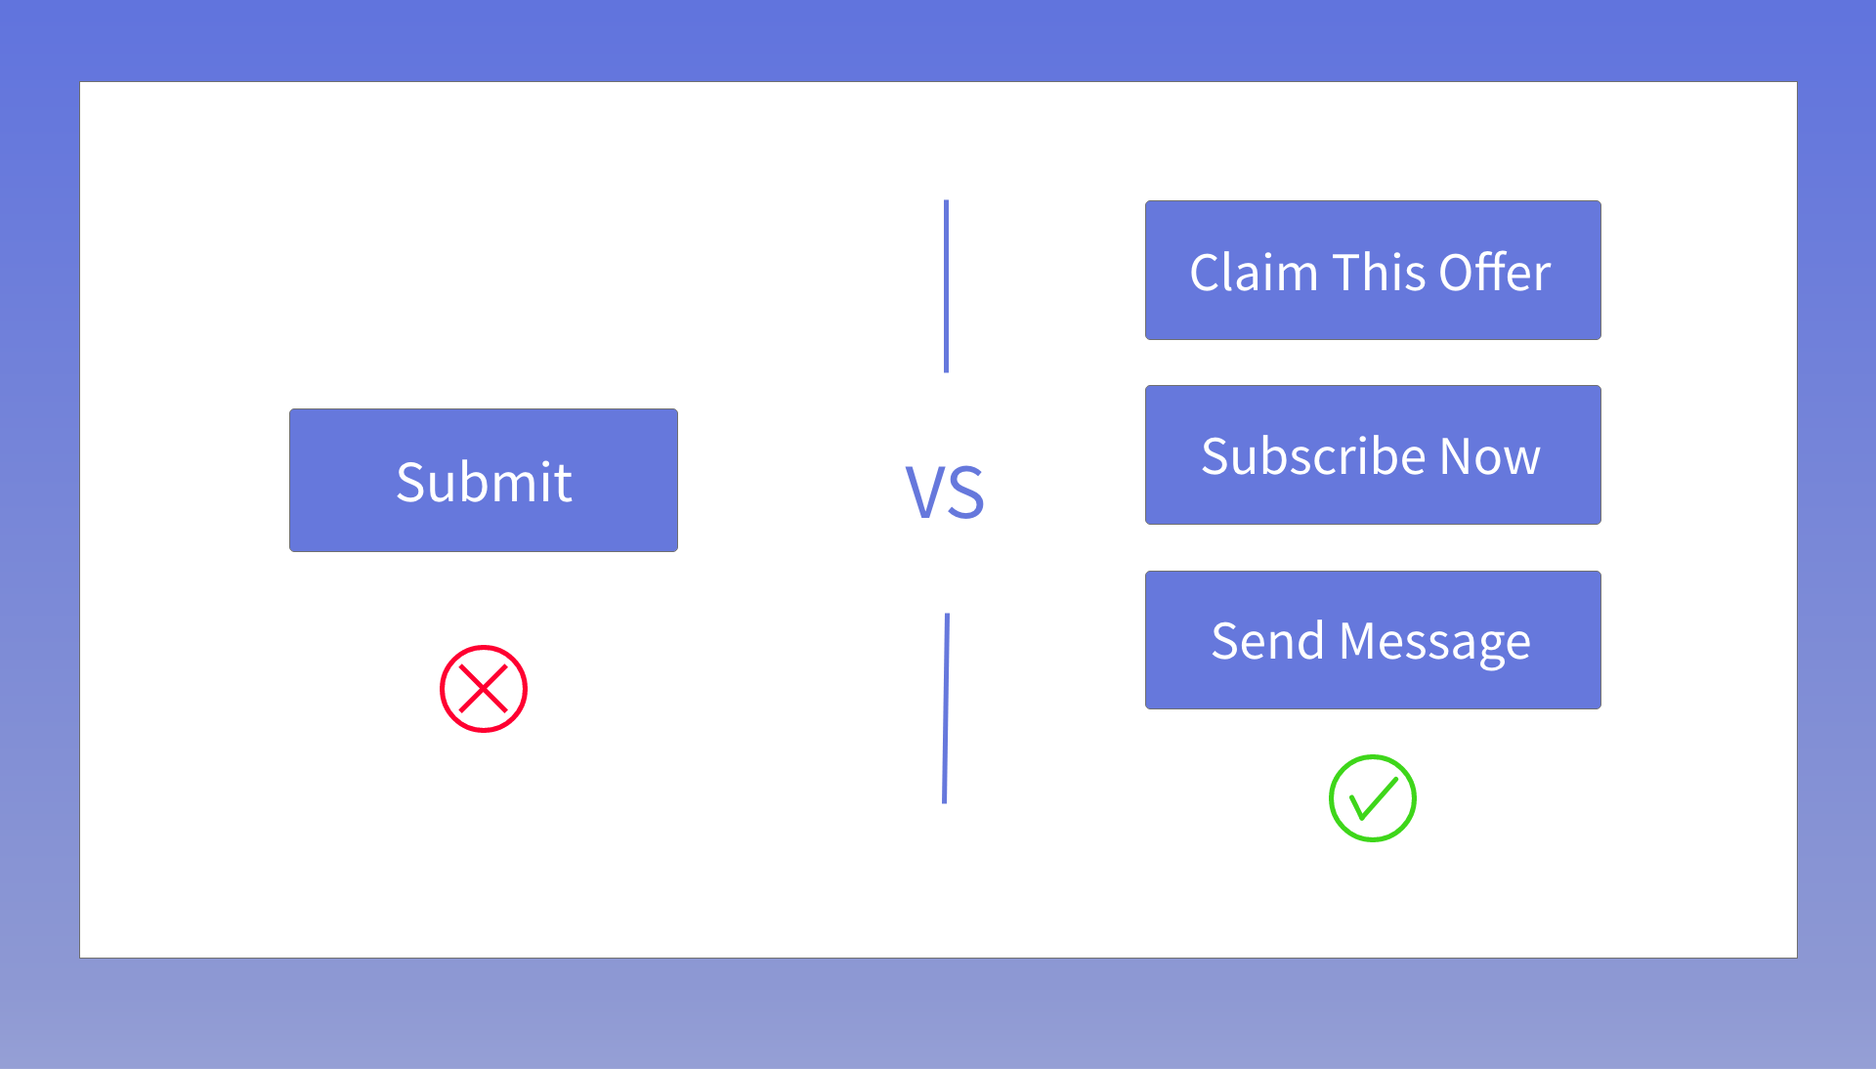
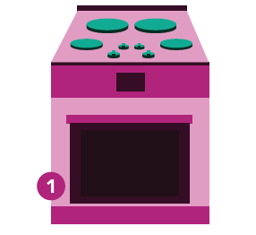
#2: Match between system and the real world
never assume that your own interpretations of words match those of the users
speak the users' language
use real-world conventions ​
    spatial similarity
    conceptual or metaphorical similarity (up is more, green is go)​
    behavioral similarity ("raise to wake” gesture)
*https://www.nngroup.com/articles/match-system-real-world/

Slide 9
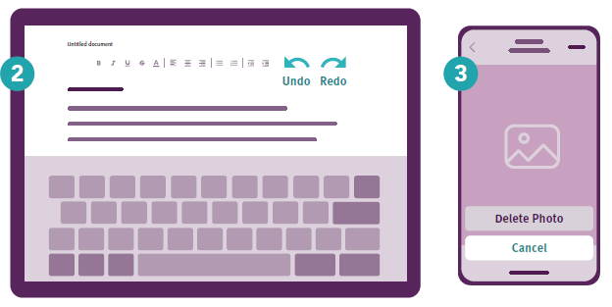
#3: User control and freedom
Support Undo and Redo
Allow Users to Easily Cancel an Action
Show a clear way to exit the current interaction, like a Cancel Button
*https://www.nngroup.com/articles/user-control-and-freedom/

Slide 10
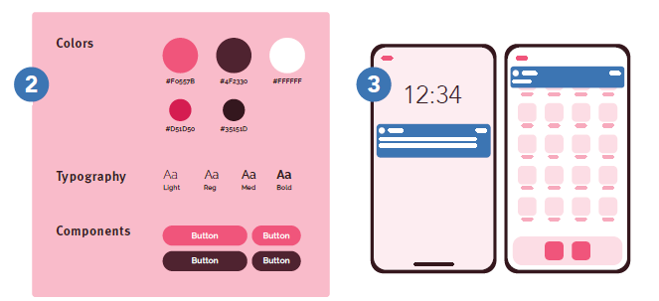
#4: Consistency and standards
Internal Consistency
  within a product or a family of products
    Button Styles, Navigation Patterns, Icons
External Consistency
  conventions in an industry
    Colors: green for environment, blue for airplane
Layers of consistency:
  Visual (icons, symbols, imagery)
  Layout (reuse buttons, headings, navigation)
  User-Entered Data (dates, phone number, location)
  Content (e.g. same style on marketing and site)
*https://www.nngroup.com/articles/consistency-and-standards/

Slide 11
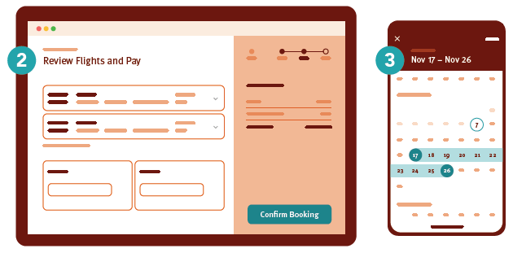
#5: Error prevention
Include Helpful Constraints
  e.g. date picker
Offer Suggestions
  e.g. on search
Choose Good Defaults
  e.g. location, today date
Use Forgiving Formatting
  e.g. phone number
*https://www.nngroup.com/articles/slips/

Slide 12
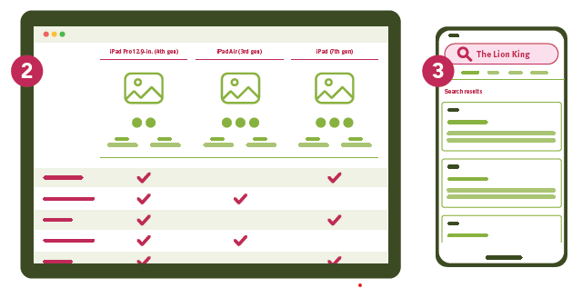
#6: Recognition rather than recall
Reduce the information that users have to remember.
Let people recognize information in the interface, rather than forcing them to remember (“recall”) it.
Offer help in context, instead of giving users a long tutorial to memorize.
*https://www.nngroup.com/articles/recognition-and-recall/

Slide 13
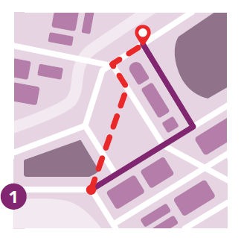
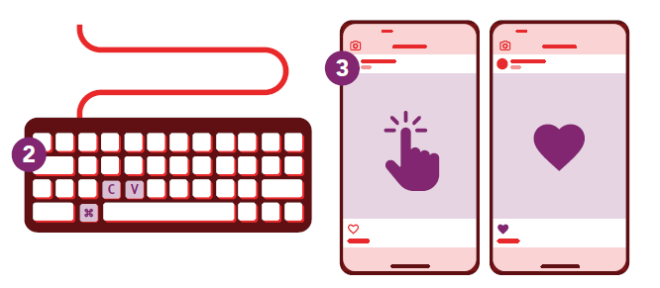
#7: Flexibility and efficiency of use
Multiple methods to accomplish the same task according to one’s preferences
Accelerators that don’t slow down inexperienced users, but speed up advanced users
  Keyboard swipe
  Macros (e.g. excel procedures)
Enable expert users to customize the interface to suit their needs
*https://www.nngroup.com/articles/flexibility-efficiency-heuristic/

Slide 14
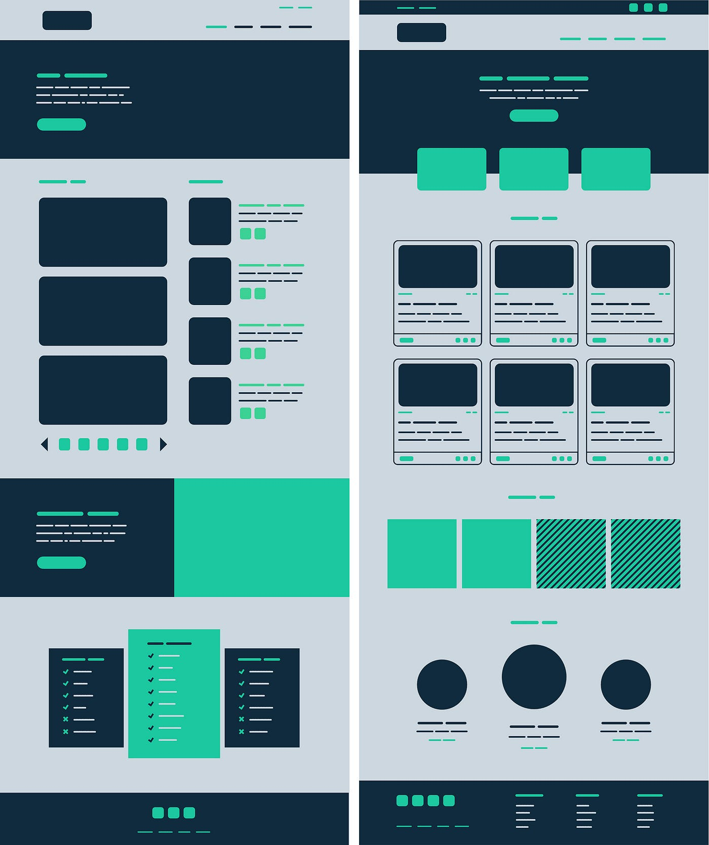

#8: Aesthetic and minimalist design
Keep the content and visual design of UI focused on the essentials.
Principles for visual communication:
gestalt principles tendency to perceive the whole as opposed to the individual:
  grouping is important
scale: use relative size to signal importance​
visual hierarchy: color, spacing, placement​
balance: elements distributed on both side of an imaginary axis​
contrast: emphasize the elements are distinct

Slide 15
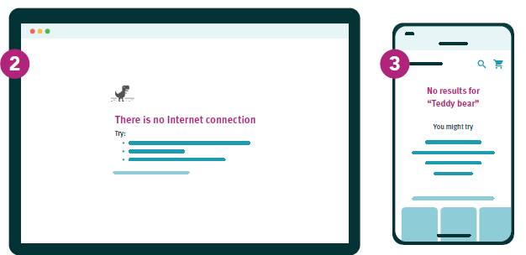
#9: Help users recognize, diagnose, and recover from errors
Use traditional error-messages visuals, like bold, red text
Tell users what went wrong in language they understand
Offer users a solution, like a shortcut that can solve the error immediately.

Slide 16

#10: Help and documentation
Best systems don't require documentation
Ensure that the help documentation is easy to search
Whenever possible, present the documentation in context right at the moment that the user requires it.
Proactive help:
  tutorials
  instruction overlays
  tooltips
  wizards

Slide 17
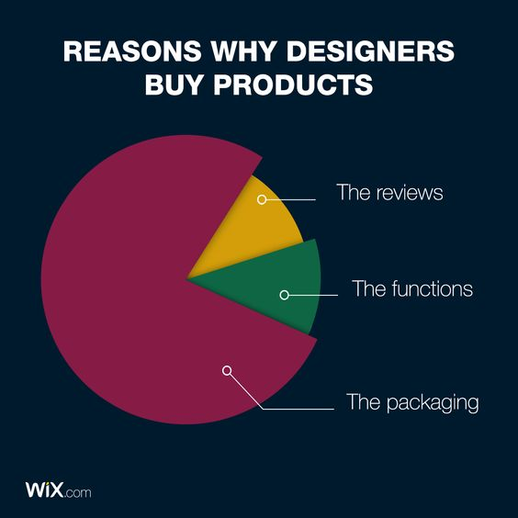
Relevance when buying something
maybe for all of us...

Slide 18
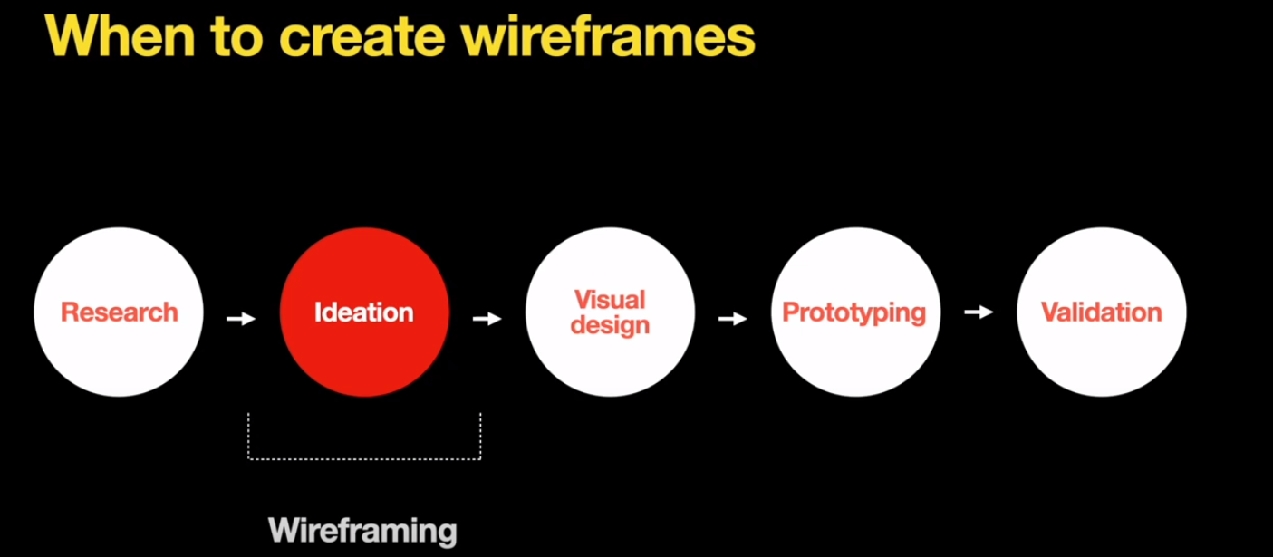
Wireframing
Test an idea and get feedback quickly
Wireframes visualize a user path or flow, as well as page layouts, information hierarchy, and even interactions.
Depending on their purpose, they can vary in fidelity — from quick sketches to detailed representations

Slide 19
Wireframing | questions to ask
What should user do on this page?
What information need?
What should users expect?
How does this page fil in the flow?

Slide 20
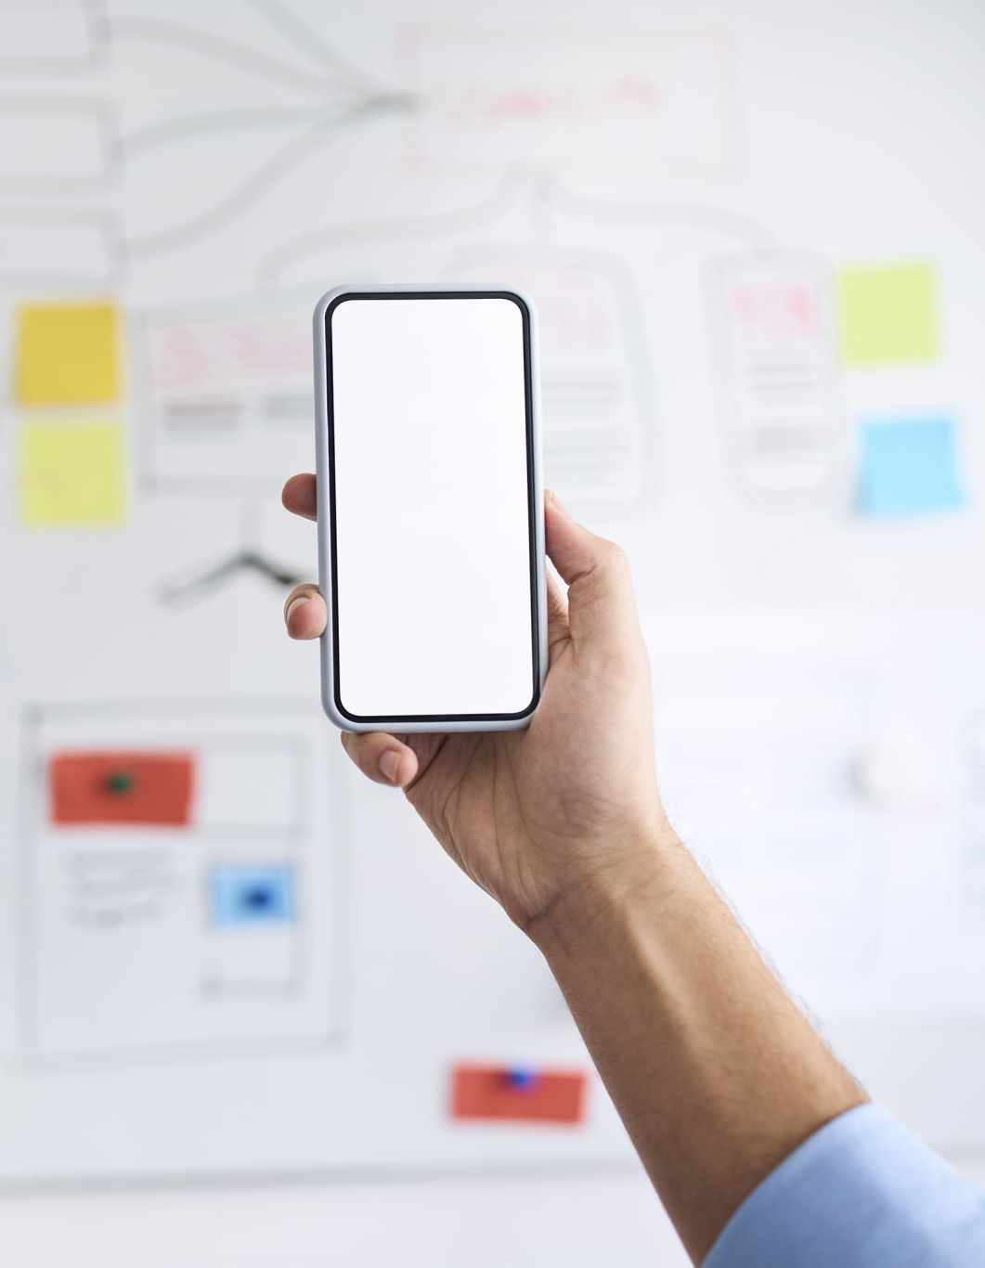
Wireframing| how to?
https://www.nngroup.com/articles/draw-wireframe-even-if-you-cant-draw/
Template https://miro.com/templates
  iPhone App Template
  Low fidelity prototype
  Website Wireframing Template
  App Wireframe Template

Slide 21
Wrap-Up​
Innovation in UI​
Voice user interface (VUI)
Gesture-Based interface
AR / VR
Micro-interaction (single purpose interaction)
Simple/Flat design
Dark Mode
AI-Driven Personalization
Gamification
Biometrics identification
Notes:
Students: think how you may implement one on this in your project

Slide 22

Milestones (week 5,6):
Wireframing (7p)
  Low fidelity wireframing
Establish color theme (2p)
Create a logo (optional)

Slide 23
References
https://www.nngroup.com/articles/ten-usability-heuristics/
https://www.nngroup.com/videos/you-are-not-user-slogan/
https://careerfoundry.com/en/blog/ux-design/the-difference-between-ux-and-ui-design-a-laymans-guide/
https://www.youtube.com/watch?v=1jtQ0uIIs94

