Slide 1
Power and prediction
Innovation using AI
Seminary 3

Slide 2

Contents
Where are we?
Applications
Challenges
Ethics
Milestones

Slide 3
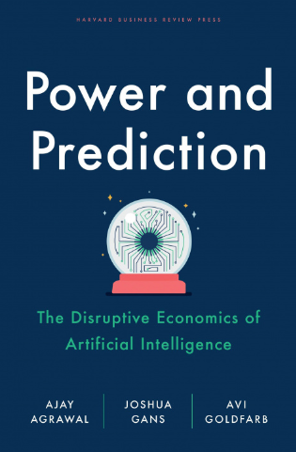
Where are we?
"Power and Prediction" by Ajay Agrawal, Joshua Gans, and Avi Goldfarb
In the Between Times
  Electricity from 1880 to 1920
  Computers from 1960 to 1980
  AI, 2012 – DL can recognize images better

Slide 4

Where to apply?
Today AI is not artificial general intelligence
… it is a prediction technology
Predictions help to make decision
Decisions are made by humans
Examples:
  Insurance costs
  Advertising
  Patients' triage/diagnostics
  Human resources

Slide 5

Challenges
Data quality and availability
Computing power
Integration with existing systems
Deep-learning algorithms are opaque
Security flaws
Lack of expertise
Costs
Ethical and legal considerations
  (data privacy and biases)

Slide 6
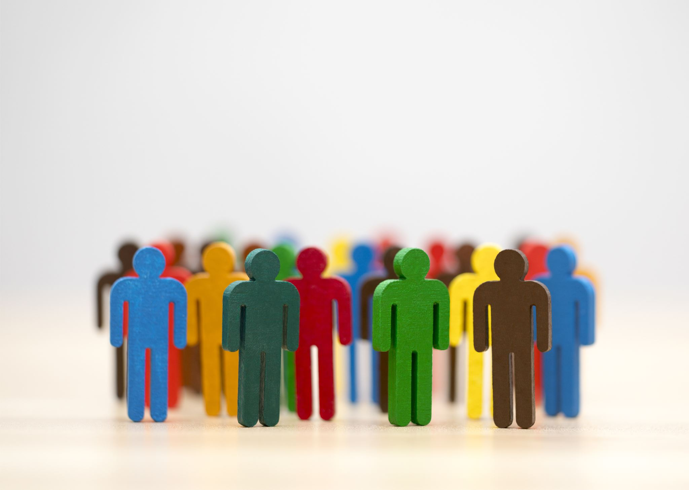
Ethics-Concerns
AI may have embedded bias
Climate degradation
Human rights
  Surveillance
  News feed algorithm (wave of violence faced by Rohingya Muslims in Myanmar)
Inequalities
  Women, minority groups, marginalized people.
  Bank loans
  Hiring process

Slide 7
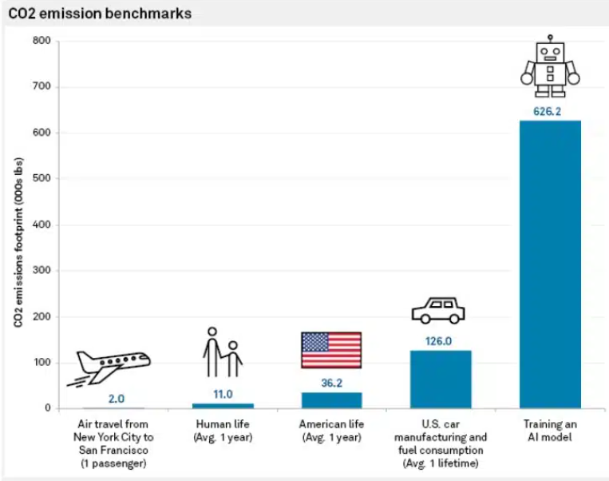
Image: spglobal.com.

Slide 8
Ethics-UNESCO core principles
Risk assessment should be used to prevent harms
Unwanted harms (safety risks) as well as vulnerabilities to attack (security risks) should be avoided
Privacy must be protected
International law & national sovereignty must be respected in the use of data
AI systems should be auditable and traceable.
Ethical deployment of AI systems depends on their transparency & explainability
AI systems do not displace ultimate human responsibility and accountability
AI technologies should be assessed against their impacts on ‘sustainability’,
Public understanding of AI and data should be promoted
AI actors should promote social justice, fairness, and non-discrimination

Slide 9

Train an AI model
Steps:
Requirements
Data collection
Data cleaning
Model training
Validation
Deploy
Integrate in app
Seminary Code: https://github.com/ileniTudor/trainSaveEvaluateModel

Slide 10

Requirements
Input/output
What data do I need (privacy issues)
Metrics
How is the problem solved now?
  Is it accurate?
Non-functional requirements?
  Power, latency?
Cost?

Slide 11
Data collection
https://paperswithcode.com/datasets
https://www.kaggle.com/datasets

Slide 12

2. Data cleaning
  Handle missing data
    Dropping rows
    Fill with mean value of the column
    Fill with a random value
    Multiple imputation prediction (KNN, ANN)
  Remove unnecessary columns
    Variables that only have a single value
    Variables with very few unique values
    Duplicate observations
  Transform any categorical features to numbers/vectors
  Scale numerical features

Slide 13
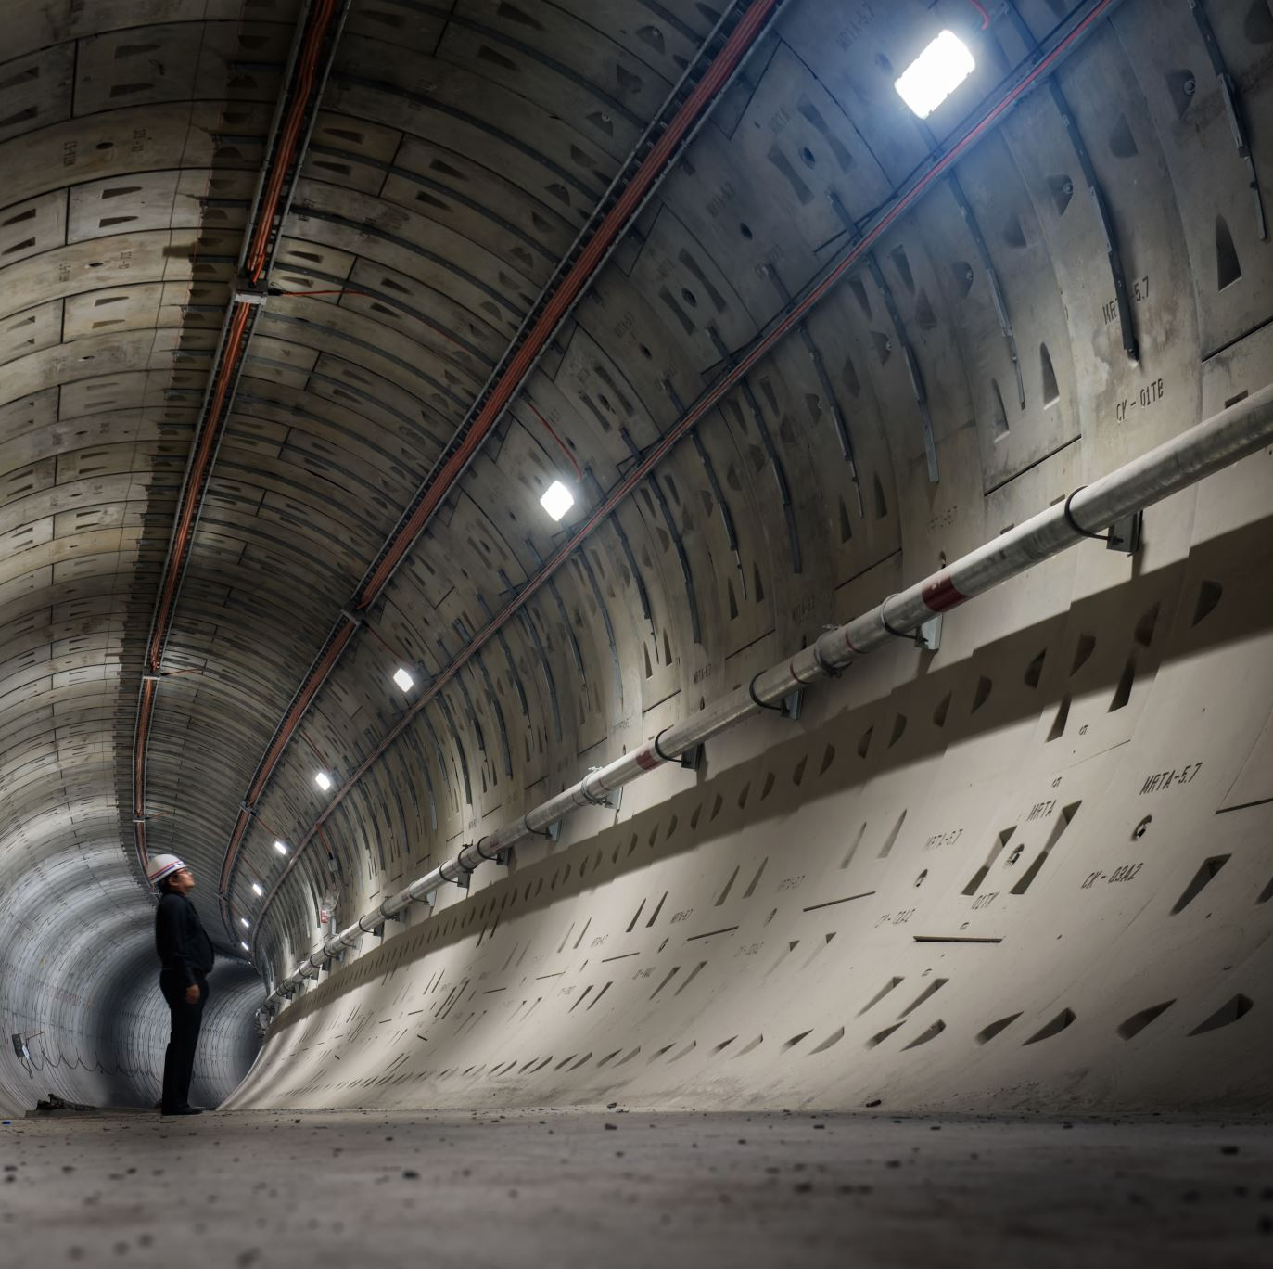
Train Validation Deploy
Training
Validation
Deploy
  cloud
  local
  edge

Slide 14

Game Time

Slide 15

Game Setup
Students are divided in 3 or 4 groups
Each group is assigned a business scenario
Write on the blackboard an innovative AI solution
Create a jury (2+1)
Focus on use case, challenges, ethics (UNESCO principles), user acceptance, cost of implementation, data acquisition, training
Present in 2 minutes using the blackboard

Slide 16
Game challenges
An e-commerce startup looking to improve customer recommendations.
A healthcare app aiming to provide personalized health advice.
A financial service firm needing to detect fraudulent transactions.
A retail store chain wants to optimize its inventory management.
A city planning department aims to use AI to improve traffic management, public safety, and energy efficiency.
A fitness startup wants to integrate AI to offer personalized workout plans, nutrition advice, and mental health support.
A farming cooperative aims to implement AI for precision agriculture to increase crop yields and reduce resource use.

Slide 17
Jury
Define requirements and AI model type (20p)
At least 3 challenges or biases (20p)
How is aligned with the (at least 3) UNESCO principles (20p)
Data acquisition and cleaning (10p)
Training and validation (specify the metrics) (10p)
Cost of implementation (10p)
User acceptance (10p)

Slide 18
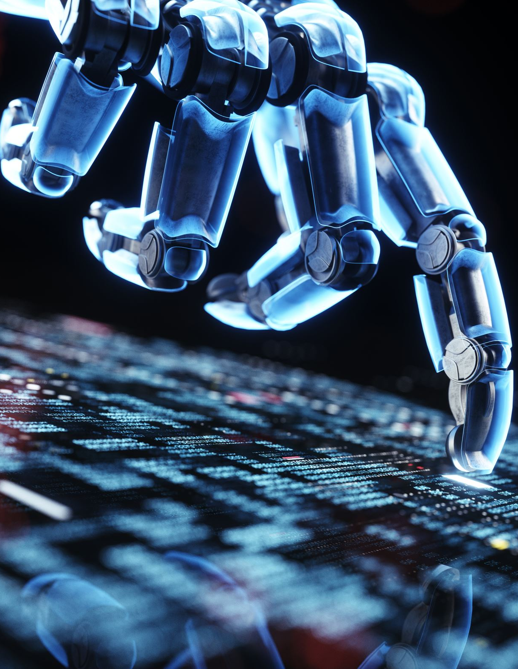
Wrap-Up
Innovation using AI
Personalized Customer Experiences
Chatbots and Virtual Assistants
Robotic Process Automation (RPA):
  Automate repetitive tasks
Enhanced Decision-Making
Customer Insights and Market Research
Enhanced Security and Fraud Detection

Slide 19

Milestones
One page essay how you (will) use AI in your project
  Define your goals (2p)
  Choose a programming language and framework (2p)
  Collecting/cleaning data (2p)
  Training the algorithm (1p)
  Validation dataset and testing (2p)

Slide 20

References
https://srinstitute.utoronto.ca/news/power-and-prediction-avi-goldfarb-on-the-disruptive-economics-of-ai
https://www.forbes.com/sites/bernardmarr/2023/05/10/15-amazing-real-world-applications-of-ai-everyone-should-know-about/
https://ideausher.com/blog/how-to-build-an-ai-application/
https://www.unesco.org/en/artificial-intelligence/recommendation-ethics
https://www.linkedin.com/pulse/challenges-implementing-ai-case-muller/
https://www.datacamp.com/tutorial/techniques-to-handle-missing-data-values

Slide 22
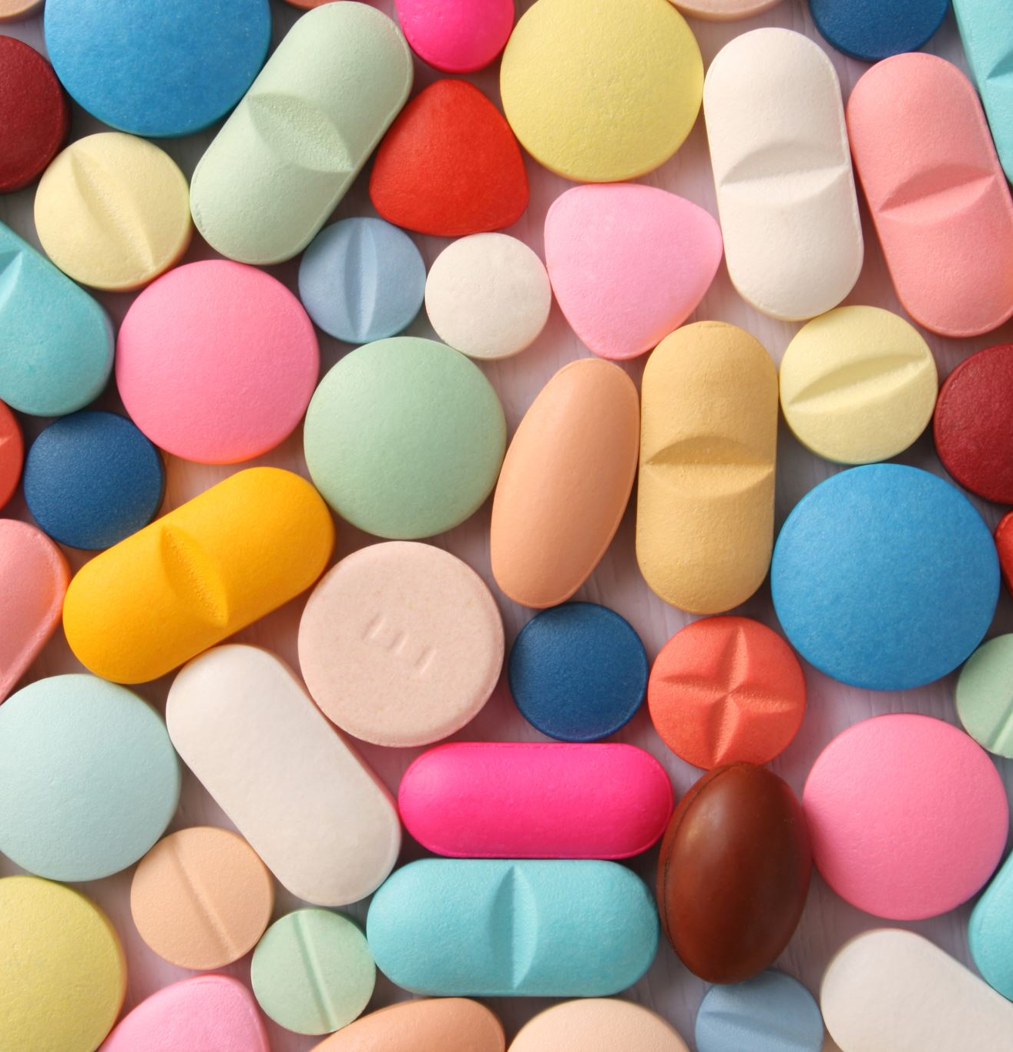
Applications
Healthcare
personalized medicine
drug discovery
telemedicine
integration of wearable devices
improve mental health care
Customer service
virtual assistants
sentiment analysis allows to better understand customer
customized product recommendations

Slide 23

Applications
Finance
fraud detection
algorithmic trading
credit scoring
risk assessment
Manufacturing
quality control
predictive maintenance
supply chain optimization

Slide 24
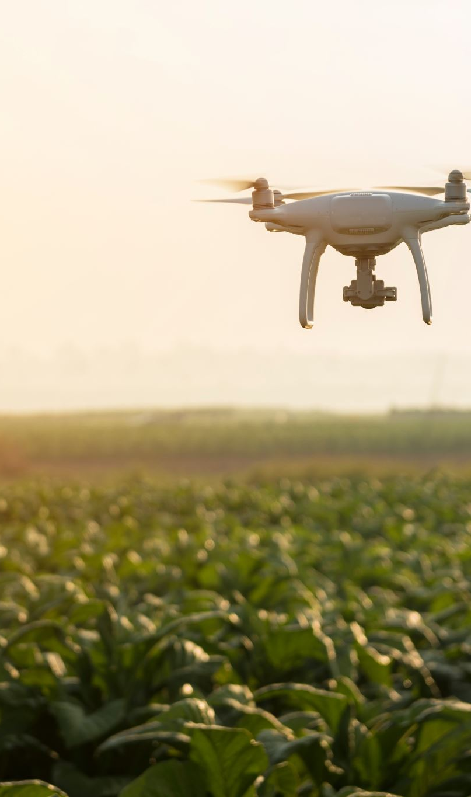
Applications
Transportation
self-driving cars
intelligent traffic management
optimization saves time and fuel
drone delivery
Agriculture
monitor crops
keep pests at bay
optimize irrigation
improve fertilization

Slide 25
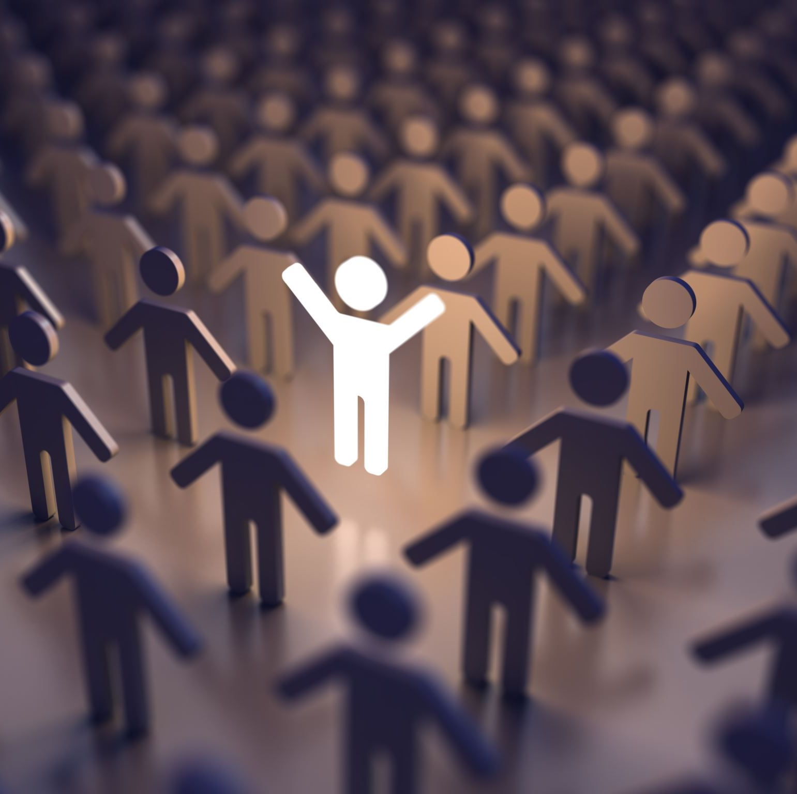
Applications
Entertainment
AI-generated content
personalized and engaging entertainment
virtual concerts
Human Resources
workforce planning
recruitment processes
monitor employee performance
inclusive hiring processes

