Slide 1
Training and Deploying Machine Learning Models
Seminary 4

Slide 2
Content
Low/no code landscape
No-code AI
  Roboflow
  Obviously.ai
  Torch Hub
Local Deploy
  Python Flask

Slide 3

roboflow
Create a workspace and project
Upload/Clone Images
Annotate:
  Model-Assisted Labeling
Create a Dataset Version
Train
Deploy
  inference

Slide 4

Load tabular data
Train model
Request prediction via API

Slide 5

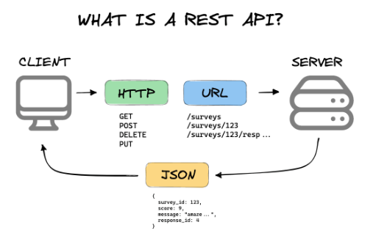
Flask
Python web framework
RESTful request dispatching
  Representational State Transfer
  rules that define how applications or devices can connect to and communicate with each other
Image: https://mannhowie.com/rest-api

Slide 6
References
https://levity.ai/blog/no-code-ai-map
https://blog.roboflow.com/inference-python/
https://github.com/autodistill/autodistill
https://roboflow.com/model/segment-anything-model-sam
https://obviously.ai

