Slide 1
Unleashing the Power of Analytics for App Product Success
Seminary 6

Slide 2
Content
Brief Overview of the Importance of Analytics in the Digital Age
Setting Up Analytics for Your App
  Introduction to Google Analytics and Other Analytics Platforms
Leveraging Analytics for App Growth
  User Behavior Analytics
    Funnel Analysis
    User Journey Mapping
    Cohort Analysis
  Predictive Analytics
  A/B Testing and Experimentation
Next Milestone

Slide 3

DATA DRIVEN INNOVATION
emerging resource for organizations, enabling value creation and the development of new industries, products, and processes
use of data to create value and reach new horizons is called data-driven innovation
Three practices:

Slide 4
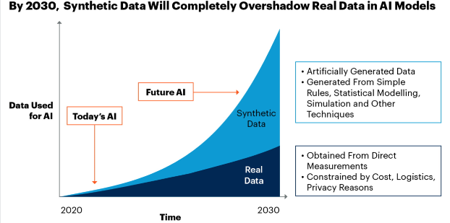
Explaining analysis & insights
Extract business insights:
  Why did sales decrease?
  Where the users mostly stops?
  Best options for user acquisition?
Create synthetic data:
  Test different models with a lot of data
  Automatic data imputation
Source https://ww3.math.ucla.edu/announcements_ugrad/ucla-synthetic-data-workshop/

Slide 5
Analytics Platforms
Microsoft Power BI: Best for data visualization
Tableau: Best for business intelligence (BI)
Qlik Sense: Best for machine learning (ML)
Looker: Best for data exploration
Klipfolio: Best for instant metrics
Zoho Analytics: Best for robust insights
Domo: Best for streamlining workflows
Sisense: Best for integrated analytics solutions
Google Analytics: Best for web traffic insight
SAP Analytics Cloud: Best for enterprise performance management
Source https://www.forbes.com/advisor/business/software/best-data-analytics-tools/

Slide 6
User Behavior Analytics
User behavior analytics (UBA) is the tracking, collecting and assessing of user data and activities using monitoring systems
user is just one category of entities with observable behaviors

Slide 7
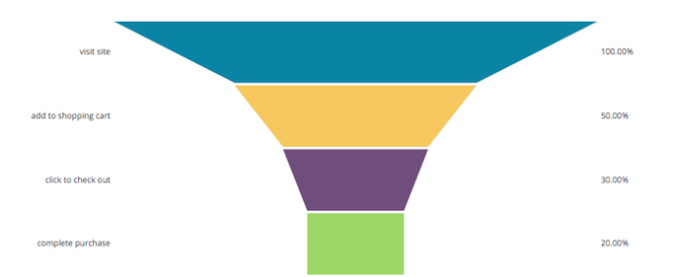
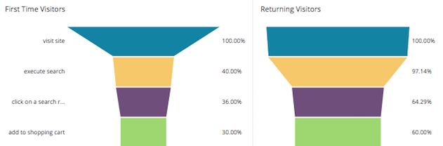
Funnel Analysis
understand the flow of users through the website
shows you where your users are dropping off
  from visiting to adding an item to the shopping cart

Slide 8
User Journey Mapping
understanding the impact of every interaction a customer has with your business
can include analysis of:
  customer needs
  emotional highs and lows
  key metrics per step in the journey
  customer satisfaction scores, customer effort scores, and other survey results

Slide 9
User Journey Mapping - Example
Printing business
The journey:
  A customer has an issue, call customer center, agent arrive, repair is made
Issue:
  When agent arrive, the customer is not present, they need a reschedule
Analysis:
  Using the Net Promoter Score (NPS) the company observe the score drops when reschedule
  Using NLP, there are negative sentiment expressed
Resulting action
  Offering customers a self-service booking system that they can access via their mobile on an app or through the website gives the customers more control

Slide 10
Event Tracking for In-App Actions
In-app events are tracked actions that users perform in an app
used as a tool to optimize the user experience:
  increase stickiness within their app,
  measure performance
  find trends in user behavior
  which users are most valuable and stick around for the longest
  create impactful audience segments
Examples:
  registration, add-to-cart, purchases, opens
  level achievements, tutorial completion, user invites, and social shares

Slide 11
Cohort Analysis
Comparing how different groups of customers act over time
A cohort is a specific group of people with a shared characteristic or criteria:
  First product bought
  Channel they came
  Demographics: age, location, …
Used to analyze:
  buying patterns, conversion trends, product popularity
  Compare add campaigns with different attributes

Slide 12
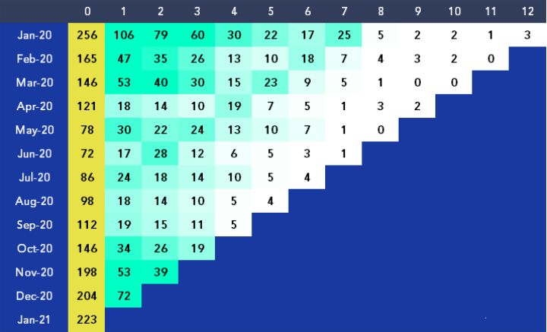
Cohort Analysis - Example
eCommerce store
First column is the number of customers that made a first-time purchase each month
The following columns show how many customers also made another purchase, and in which month
Observation:
  a big drop in numbers for most months between columns three and four (sudden change in shading between those columns)
Source: https://www.adverity.com/blog/is-mastering-cohort-analysis-worth-the-challenge

Slide 13
Predictive Analytics
The process of using data to forecast future outcomes
Steps:
  Define the problem
  Acquire and organize data
  Pre-process data: remove anomalies, missing data
  Develop predictive models: ML, regression models, decision trees, NN
  Validate and deploy: make available to stakeholders
Ex: GPT Analytics

Slide 14
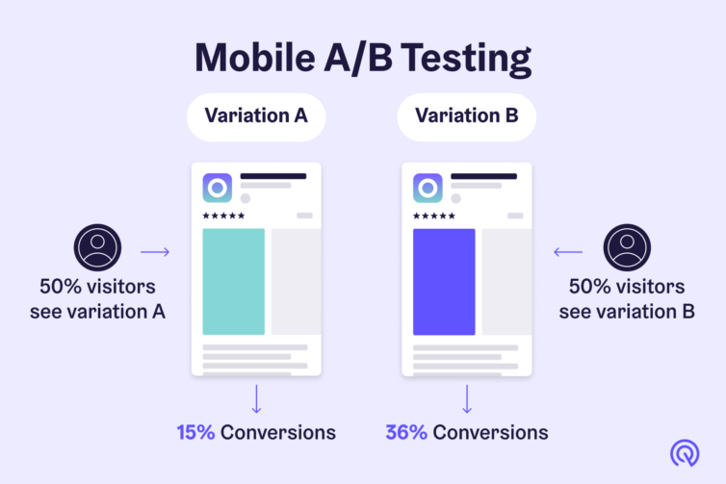
A/B Testing and Experimentation
A/B testing (also known as split testing or bucket testing) is a methodology for comparing two versions of a webpage or app against each other to determine which one performs better.
You keep your current version of the app store listing and create another variation to test one specific aspect
Source: https://appradar.com/academy/app-store-listing-a-b-testing

Slide 15
A/B Testing - Steps
Research.
What is missing in your app? Keep an eye on the competitors.
Hypothesis
"If I change the app icon, we'll get more downloads"
Create your variations
Create the new icon, design new search button
Running the experiment
Never run the experiments before 7 days
Analysis and implement
Collect data: traffic, conversions, engagement, rate, retention rate, etc.
… and make decisions

Slide 16
Milestone 6
-week 12-
One page PDF to design an A/B testing process
  Research
  Hypothesis
  Versions
  Metrics
  How do you deploy the 2 versions in parallel?

Slide 17
References:
https://kaizen.com/insights/analysis-data-innovation-businesses/
https://www.datacamp.com/blog/unique-ways-to-use-ai-in-data-analytics
https://www.forbes.com/advisor/business/software/best-data-analytics-tools/
https://chartio.com/learn/product-analytics/what-is-a-funnel-analysis/
https://www.qualtrics.com/uk/experience-management/customer/customer-journey-analytics/?rid=ip&prevsite=en&newsite=uk&geo=RO&geomatch=uk
https://adjoe.io/glossary/in-app-events/
https://appradar.com/academy/app-store-listing-a-b-testing

