Slide 1

Habit forming products
Tech seminary 7

Slide 2
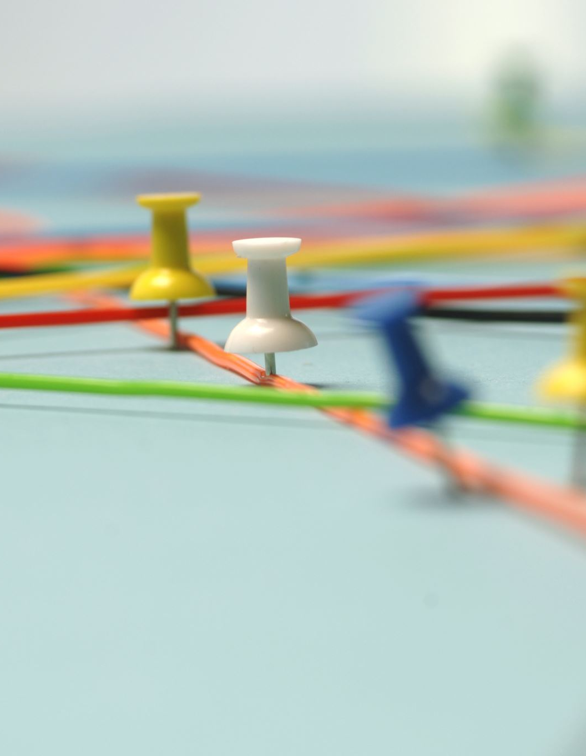
Content
Hooked model
How to Create a Pitch Deck

Slide 3
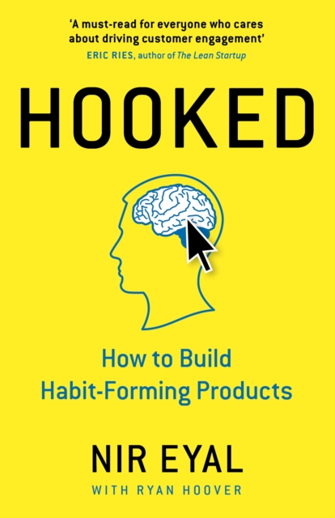
Hooked
NIR EYAL creates, builds, and successfully sells 2 startups
Hook Model
  Building User Engagement​
  Creating Habit-Forming Products (designing features that encourage regular use)​
  Enhancing Customer Retention​
  When Offering Value to Users​
  In Competitive Markets​
  When Building Brand Loyalty

Slide 4

Ethics
Responsibility in design:
  + fitness App encourage healthier lifestyle
  make user obsessively check their progress and compare (negatively) with others
Avoid manipulation:
  + build engaging products
  a social media platform where users spend excessive time, ignoring real-life relationships and responsibilities
Create positive habits:
  + learning app that encourage users for regular practice

Slide 5
Hook Model
The goal should always be to enhance the user's life and provide value, rather than exploiting psychological vulnerabilities for profit.
Hook Model:
  Trigger
  Action
  Variable Rewards
  Investment

Slide 6

Trigger
Externs (what makes the user getting the product):
  Marketing, press releases, videos, newsletters, shares, …
Interns (what does the user really want)
  Fear of losing precious moments (Instagram)
  Social connection (email app, WhatsApp, Facebook)
  Boredom: Twitter, TikTok

Slide 7

Action
For a behavior to be adopted, 3 elements are needed:
Trigger
Motivation: pleasure-seeking, hope, pain avoidance, social acceptance
Possibility of acting:
    Time
    Money
    physical effort
    intellectual effort
    deviation from the social norm
    lack of routine

Slide 8
(Variables) reward
The reward from the tribe:
  Our behavior is influenced by the people we admire
  Facebook, League of Legends, Stack Overflow
Reward from hunting:
  The outcome is important but let's not forget about the process
  This unpredictability stimulates continued usage.
    online shopping, searching for information on the internet
The reward for ourselves:
  Self-progress
  Ex: games, Mailbox (acquired by Dropbox for $100Mil)
Bad example for variability. FarmVille which was very popular, but the next versions (City, Chief) kept the same suspense elements and consequently lost 80% of the users.

Slide 9

Investment
Psychological, we are over-evaluating our work
user puts something into the product (time, data, effort, social capital, or money)
likelihood of returning due to a sense of ownership
Examples:
  IKEA, you have no problem ensemble it, and you care more about it because you “build” it
  Instagram/Facebook account where you “acquire” a lot of followers
  Photoshop (as you grow your competences)
  Stack Overflow (as you grow your reputation)

Slide 10
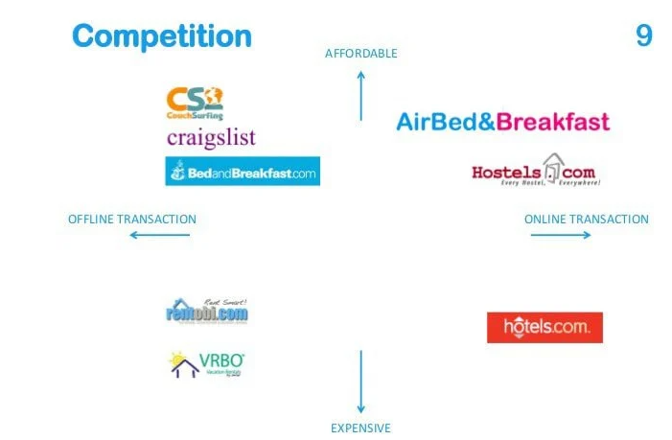
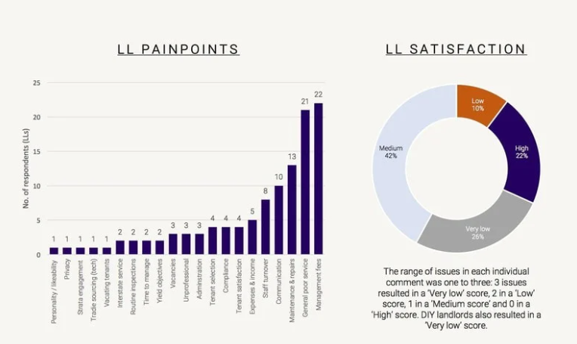
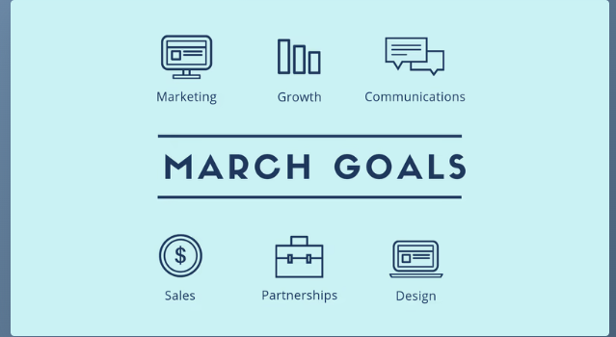

Create a Pitch Deck
Pitch decks typically contain about 10-12 slides
Keep the slides simple, concise
Reduce and simplify text with icons
Accentuate numbers with charts
Compare competitors with an XY graph
Show off the team with professional photographs

Slide 11

Pitch Deck Slides
The problem
Primary Target Market
Your Solution
Numerical results
Competition
Business Model: how to generate revenue
Demo (code, self-made components, AI models)

Slide 12

Conclusions
The main purpose is NOT to create manipulative or destructive products, but tools that frequently connect users’ problems to solutions and create habits.
“Hook Model” includes the following elements: “Trigger”, “Actions”, “Variable Reward”, “Investment”
I hope the "hooked model" will shine a spotlight on your success

Slide 13
References
“Hooked. How To Build Habit-Forming Products” – Nir Eyal

