Slide 1
LungScan Assist
streamline radiology workflows and improve clinical efficiency through an intuitive, end-to-end application

Slide 2
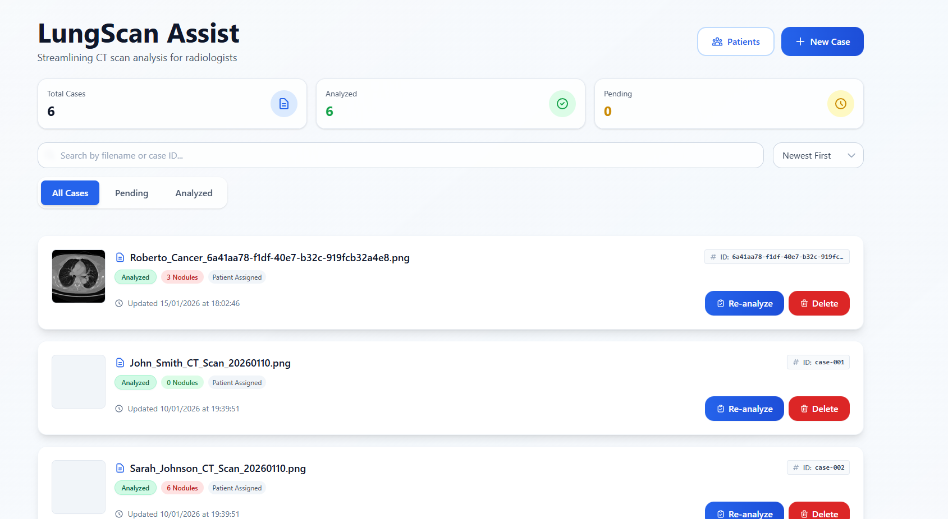
LungScan Assist: Application Overview
LungScan Assist is a web application that supports radiologists throughout the lung CT analysis workflow.
What the App Provides
Upload and manage lung CT scans
Organize scans into clinical cases
Link cases to patient records
Visualize analysis results directly on CT images
Document findings and export reports
Focus: usability, clinical workflow
and seamless AI integration

Slide 3
End-to-End Workflow
Typical Usage Flow
Create or select a patient
Upload a CT scan (JPEG / PNG / DICOM)
A case is created and analyzed
Results are attached to the case
Doctor reviews findings and adds notes
Report is generated and exported
Goal: mirror a real radiology process with minimal manual steps

Slide 4
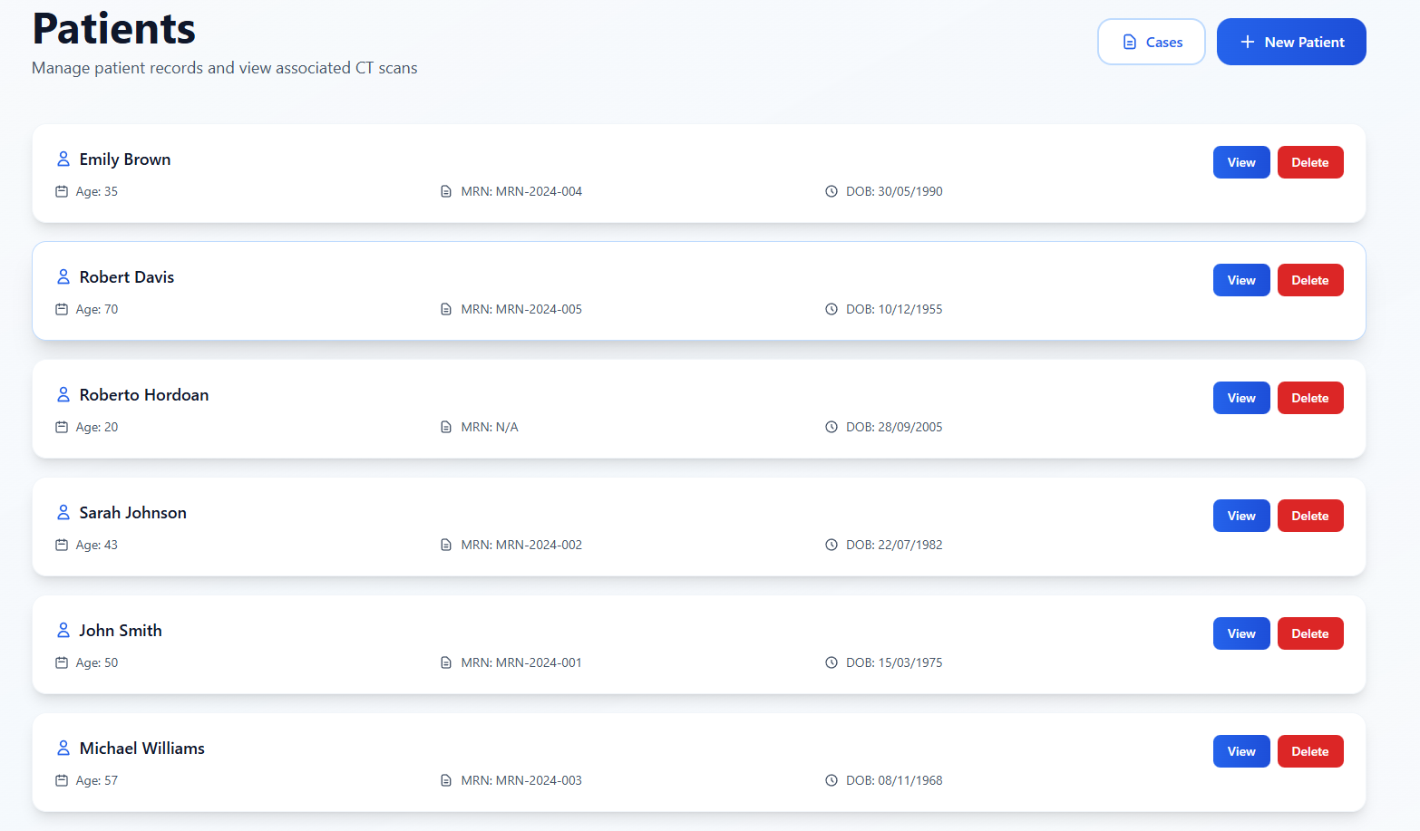
Case & Patient Management
Case Management
Central dashboard with all cases
Status tracking (Pending / Analyzed)
Search, filter, and sort functionality
Re-analyze or replace scans if needed
Patient Management
Dedicated patient records (name, DOB, MRN)
Multiple scans per patient
Full scan history per patient
Benefit: keeps medical data structured and traceable

Slide 5
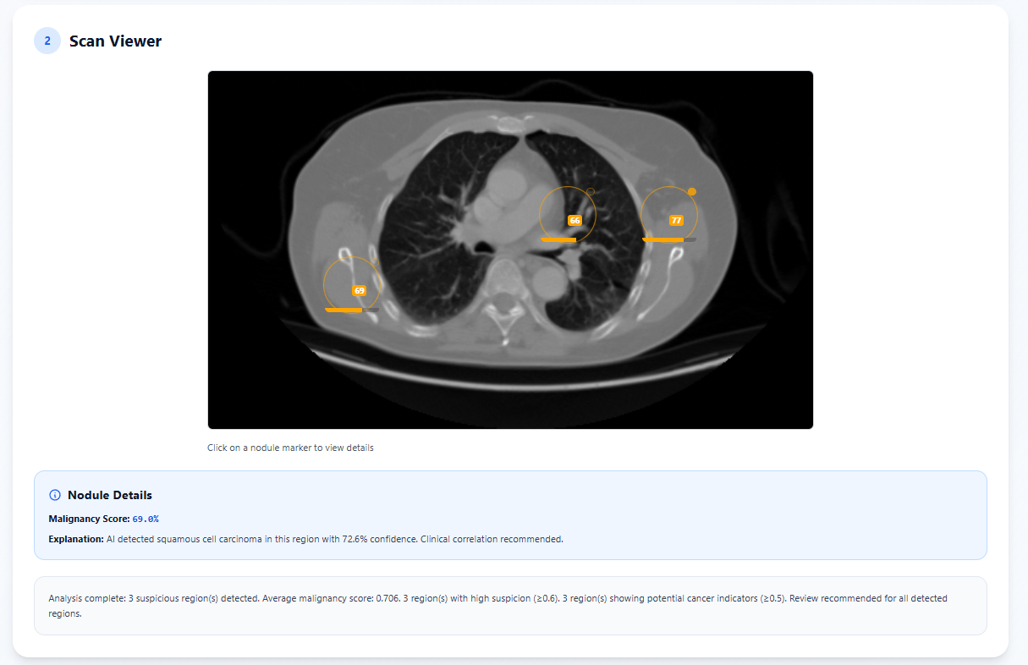
CT Scan Viewer & Visualization
Interactive Scan Viewer
High-resolution CT image display
Nodule overlays directly on the scan
Clickable markers with risk details
Color-coded risk visualization
Analytics
Nodule count and risk summaries
Risk distribution and size vs score charts
Outcome: fast visual interpretation for clinicians

Slide 6
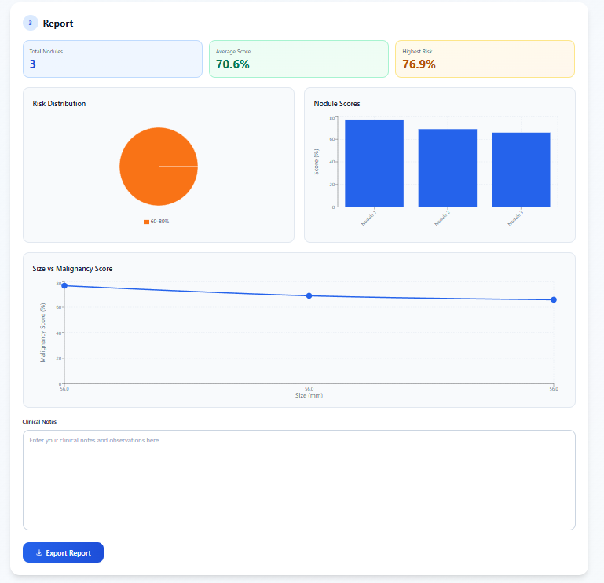
Clinical Notes, Reports & Extensibility
Clinical Documentation
Editable clinical notes per case
Persistent storage
Reporting
One-click report export
Includes patient info, findings, and notes
Designed for Extension
Modular architecture
Persistent data storage implemented

Slide 7
Thank you!
Next: Live demonstration of the application workflow

