Slide 1

MedTrain AI: Democratizing Medical Model Training
A universal, no-code environment for training and validating any diagnostic AI model.
Train. Deploy. | Powered by NVIDIA & Clinical Partners

Slide 2

The User & The Problem
„Dr. John Thome”
- The Archetype
Role: research scientist & Clinician
Frustration: manual, slow interpreation, limited software
Inertia: 42% of our target audience is 51+ years old. They have deep expertise, but little coding literacy
„Black box fear”: resistance to AI

Slide 3
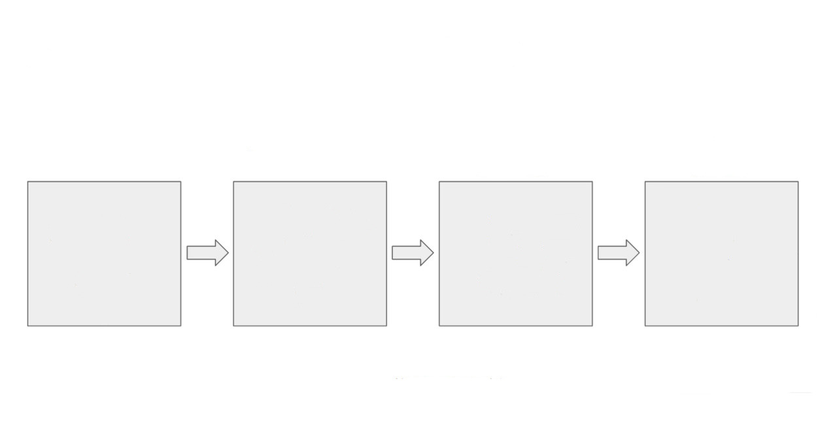




One Platform, Infinite Models
Import: Drag & Drop any Model Architecture
Train: Upload local patient datasets
Combine: merge new uploads with historical data
Validate: visual explainability and confidence scores

Slide 4

Market Entry: Cardiology
Why here:
High volume of image data & critical need for precision.
Target:
High-Income countries (where >90% of research funding exists)
Segments:
Hospitals, research centers, private cabinets

Slide 5

Why we win
Product
Versatility
Control
Transparency
Cost
Traditional diagnostic software
Rigid / Single disease
None („Black Box”)
Low
Expensive licensing
Outsourced AI teams
Low (dependent on devs)
High service fee
Flexible, Slow
Medium
MedTrain
AI
Universal, Multimodal
High (user trains)
High
Affordable subscription

Slide 6
Path to profitability
Year 1
Year 2
Costs ~€120k
Dev salaries ~€2.5k/month * 3
Infrastructure ~€11k
Marketing ~€23k
Revenue ~€40k
100 users @ ~€400/year
Net ~€-80k
Scale 100 -> 500 user
Costs ~€168
Dev salaries ~€130k
Infrastructure ~€15k
Marketing ~€23k
Revenue ~€210k
500 users @ ~€420/year
Net ~€42k

Slide 7

Infrastructure and validation
Nvidia: partners for high performance model training
Regina Maria: clinical partner for real world validation and acces to first users
European Union: funding programs and research incentives

Slide 8
The future of personalized medicine
Universal platform (Any model)
Secure & private
Financially sustainable
Let's build the standard for clinical AI training.

