Slide 1
Mitral Regurgitation Identification
MIRPR/PPI 2025-2026
Pângăleanu Cătălin
Smarandache Samuel
Steopei Cristian
Pășcuți Gloria
Moldovan-Ștefan Iustin

Slide 2
The Problem
• Mitral Regurgitation (MR) is a heart disorder where blood flows backwards
- 24 million people suffer from it worldwide
• Determining WHY MR occurs guides treatment selection
• Challenge: Multiple echocardiographic measurements are interdependent
• Goal: Characterize relationships between variables and their impact on MR severity
• More reproducible assessments → faster treatment decisions

Slide 3
The Data
• 1,003 frame-level observations from 26 patients
• Data collected by Dr. Dan Blendea’s based on echocardiograms
• 10 echocardiographic measurements analyzed: MR area (target), Systole/Diastole indicator, LA area/length/volume, MV tenting height, MV annulus, LV area/length/volume
• Preprocessing: median imputation, standardization, 80/20 train/validation split

Slide 4
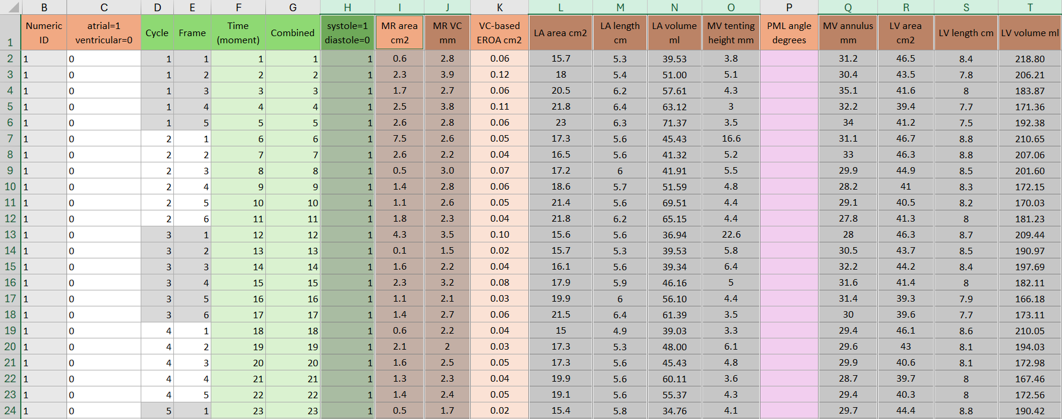

Slide 5
Approach 1: TabNet-based Partial Correlation
• Goal: Estimate pairwise partial correlations between all features
• Method: Use TabNet model to predict each variable from all others
• Residuals: Part of each variable unexplained by others
• Partial Correlation: Pearson correlation of residuals
• Advantage: Captures direct linear links

Slide 6
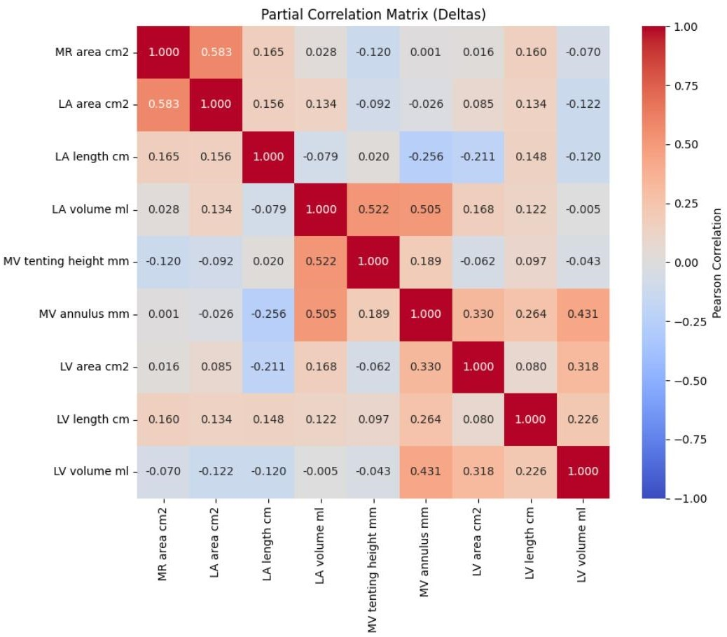
Partial correlation matrix showing direct linear associations between echocardiographic features

Slide 7
Approach 2: Graph Neural Network
• Limitations of Approach 1: Non-directional, MR area not explicit target, only linear associations
• Solutions: Treat MR area as explicit node in directed graph, add non-linearity
• Architecture: 9 nodes (8 features + MR area), learnable weight matrix G
• 2-layer GNN: Captures both direct and indirect relationships
• Loss: Mean Squared Error (MSE) on MR prediction (reached 0.00636 on validation subset) + structure preservation term
• Advantage: Directed edges, target-aware, more complex associations

Slide 8
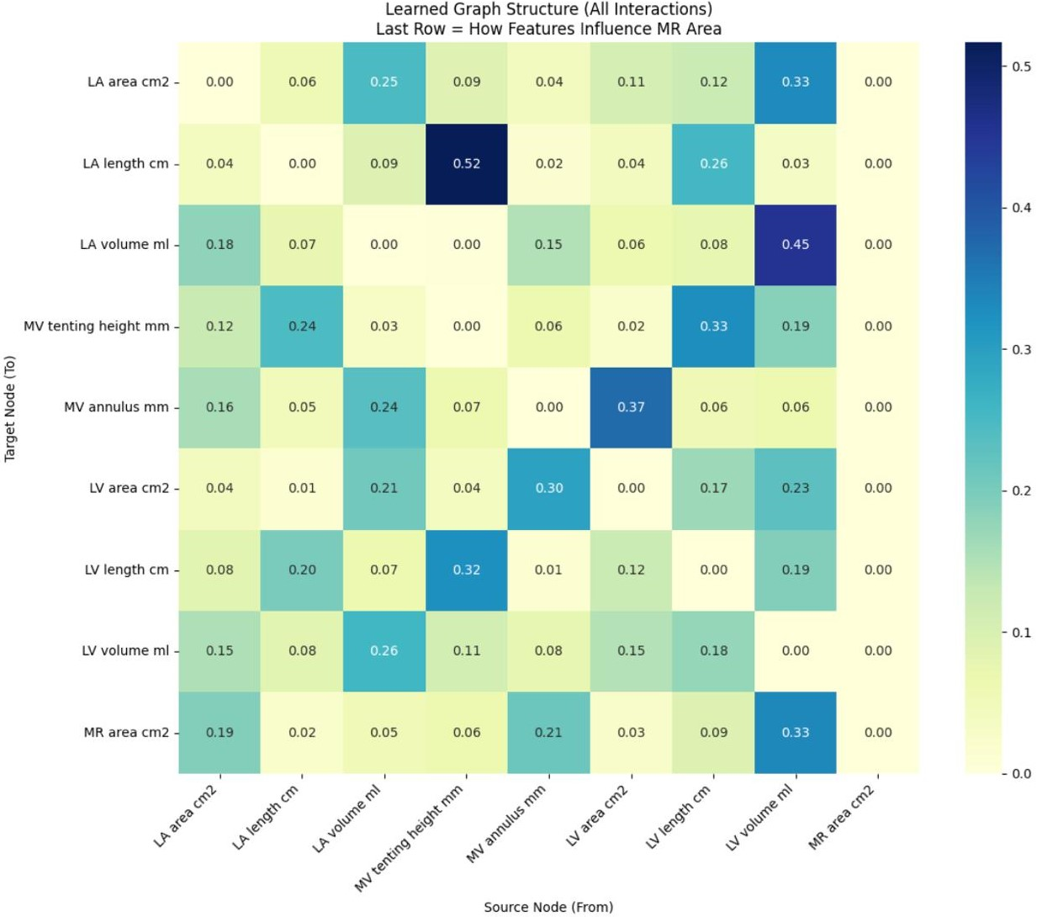
Row-normalized influence matrix from 2-layer GNN. Last row shows feature→MR contributions.

Slide 9
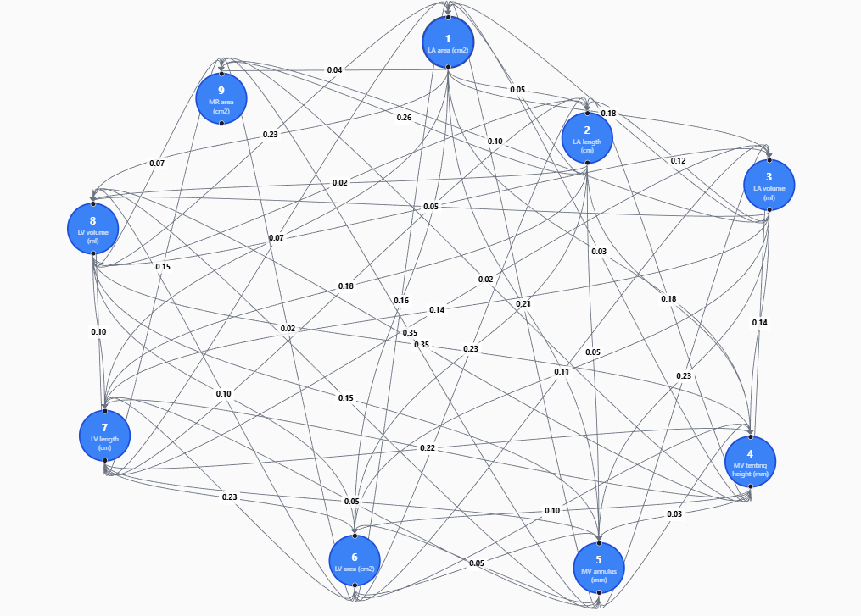
Graph representation of 2-layer GNN influence matrix

Slide 10
Market Analysis
Tool Category | Estimated Practitioner Usage | Description
Standard Echo Software | >95% | Standard tools on GE or Philips machines that calculate EF or VTI once the doctor picks the points. No "causality" analysis.
Automated Quantitation (AI) | ~10% – 15% | AI-driven "Auto-EF" or "Auto-Strain" that automatically identifies borders. Found mostly in private clinics and university hospitals.
Causal/Diagnostic AI | < 3% | Advanced tools (like EchoNet-Dynamic or PanEcho) that suggest a diagnosis or predict a "causal" outcome. Mostly used in research.

Slide 11
Why us?
Feature | Competitor AI Tools | Our App
Accuracy | High | High
Technical Requirement | Data Science / Python Knowledge | Zero (User-Friendly)
Integration | Complex Manual Setup | "Plug and Play"
User Focus | Researchers | Practicing Doctors

Slide 12
Level | Scope | Units (Patients / Facilities) | Value (Annual) | Why?
TAM | Worldwide | ~520M Patients ~165,000+ Hospitals | $250B+ | Global population with cardiovascular diseases and the total hospital infrastructure.
SAM | Romania | ~1.2M Patients ~4,500+ Clinics | €500M | Patients opting for private care and the network of private cabinets/clinics in Romania.
SOM | Cluj-Napoca | ~45,000 Patients 50+ Targeted Units | €15M - €20M | The specific patient flow through the ~50 private cardiology clinics/cabinets in Cluj.

Slide 13
Value Proposition:
A specialized AI app trained to analyze echocardiographic metrics, predict mitral regurgitation etiology, and identify causal relationships between cardiac parameters.
Business Model:
All plans include unlimited users per medical unit.
Basic – $300 / month
- Core AI analysis
- Document validation
- Basic medical insights
Pro – $450 / month
- Advanced statistics & predictions
- Full AI integration
- Extended analytics dashboard
Ultra – $600 / month
- Full access to all features
- Custom feature requests
- Direct contribution to platform evolution
Break-Even Projection
- 6 months with 10 subscribed medical units
- 12 months with 5 subscribed medical units

Slide 14
Conclusion & Future Work
• Successfully characterized echocardiographic feature interdependencies
• Two complementary approaches:
- TabNet partial correlation for symmetric, linear associations
- GNN for directed, nonlinear feature → MR relationships
• Clinical relevance: LV volume, MV annulus, LA area key contributors to MR
• Future work: Extend to more features and add temporal modeling

Slide 15
Thank You
Questions?

