Slide 1
AI Deployment
Tech Lab 5

Slide 2

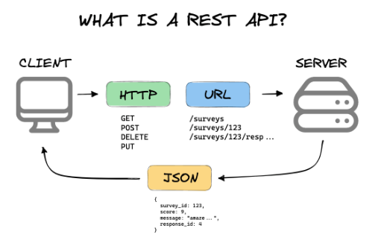
Flask
Python web framework
RESTful request dispatching
  Representational State Transfer
  rules that define how applications or devices can connect to and communicate with each other
Image: https://mannhowie.com/rest-api

Slide 3
Js Deploy – using tfjs
Example with yolo model in dir deploy_web from github project

Slide 4
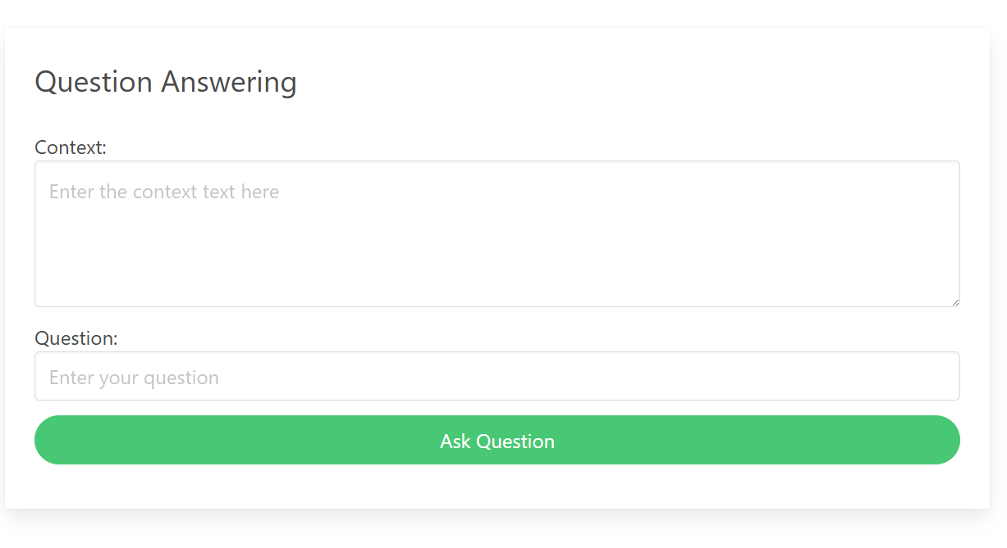
Flask Deploy LLM
Example with model T5 in dir flask_app_llm from github project

Slide 5
Flask Deploy DL (vision)
Example with model resnet in dir flask_app_dl from github project

Slide 6
Milestone 5 (due to week 11, 12)
Theme: To replace the mocked logic from Assignment 2 with your real, functioning backend, making the app "smart".
Tasks:
Core Logic Integration (Choose one path):
  For AI-driven apps: Integrate the AI model trained in Assignment 4. Deploy the model using Flask or FastAPI and call it from your app, or convert it to an on-device format (e.g., Core ML, TensorFlow Lite).
  For data-driven CRUD apps: Replace the mocked data from Assignment 2 with the real, cleaned dataset from Assignment 3.
End-to-End Functionality: Ensure the application is fully functional with the new, integrated logic. A user must be able to complete the core journey using real data or intelligence.
Deliverable: A video demo (1-2 minutes) showcasing the fully integrated, working MVP.

Slide 7
References
https://www.youtube.com/watch?v=pI0wQbJwIIs&t=1902s

Slide 8
Online deploy: render.com
Setup:
  Repository
  Branch
  Git Credentials
  Root Directory deploy/flask_app_DL
  Build Command pip install -r requirements.txt
  Start Command gunicorn app:app --bind 0.0.0.0:$PORT
requirements.txt​
Flask​
onnxruntime​
numpy​
Pillow​
Werkzeug​
gunicorn

