Slide 1
AI Cloud Deployment
Tech Lab 6

Slide 2
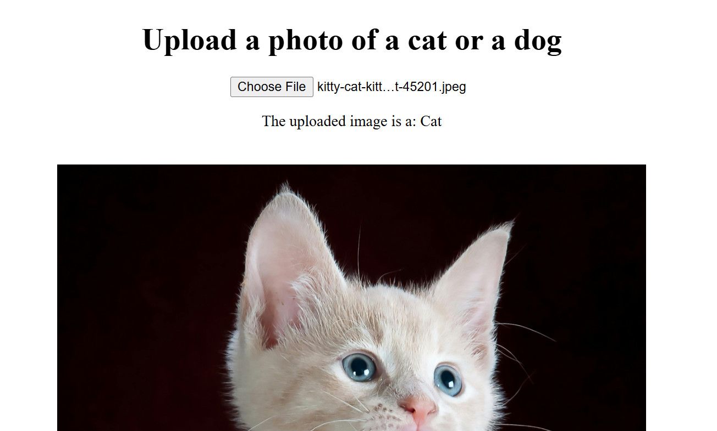
Cloud Flask Deploy DL (vision)
Render.com

Slide 3
Online deploy: render.com
Setup:
  Repository
  Branch
  Git Credentials
  Root Directory flask_app_DL
  Build Command pip install -r requirements.txt
  Start Command gunicorn app:app --bind 0.0.0.0:$PORT
requirements.txt​
Flask​
onnxruntime​
numpy​
Pillow​
Werkzeug​
gunicorn

Slide 4
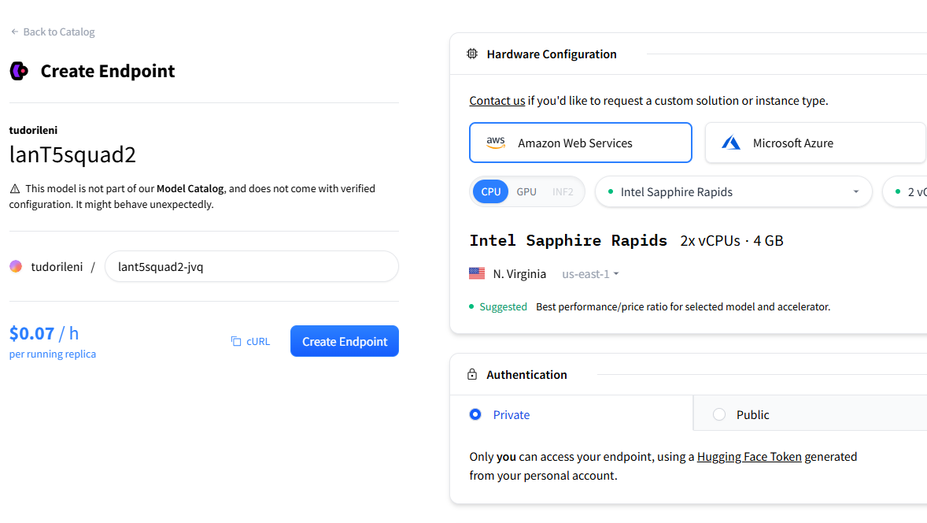
Inference Endpoints (HuggingFace) (LLM)
https://endpoints.huggingface.co/

Slide 5
Deploy on UBB MLhub (CPU)
Download WireGuard VPN config file from:
  https://www.cs.ubbcluj.ro/vpn/
Use MobaXterm or another terminal to connect via ssh to 172.30.249.193 (get user and pass on MSTeams)
Create a new dir for your own Flask/FastAPI server
Create a python environment inside the directory
  python3 -m venv env_name (put inside the server)
Start a background screen using the tmux command (necessary when closing the terminal the server will still run)
  tmux new -s [screen_name]
Activate the env (!! if not activated, you will use python from the machine, not recommended)
  source env_name/bin/activate
Install your own python packages
  pip install –r requirements.txt
Change port for your server to a unique port (given by me, because I have to configure the route ) 9002, 9003, …
Start server, and detach tmux screen
See all tmux screen: tmux ls
Attach tmux screen: tmux attach -t [screen_name]
Detach tmux screen: CTRL+B, release, then press D
Access your app on: scs.ubbcluj.ro/aiinference/[give_id]
Example: www.scs.ubbcluj.ro/aiinference/2

Slide 6
Other platflorm
https://modal.com/
Croq.com

