Slide 1

Predicting Alzheimer’s Diagnosis Using Lifestyle and Health Data
Christos Symeou & Leontios Ioannou Course: Data Mining on the Web

Slide 2
Dataset and Prediction Task
Dataset Origin:
Source: Healthcare surveys, clinical studies, and public health records from 20 countries.
Records: 74,283 samples.
Target Variable:
Alzheimer’s Diagnosis (Yes/No).
Features:
Includes demographic, lifestyle, medical, and genetic variables (e.g., age, BMI, smoking status, education, physical activity).
Objective:
Predict Alzheimer’s diagnosis based on various factors to support early detection and risk assessment.

Slide 3
Methodology
Exploratory Data Analysis (EDA): Investigated feature distributions and correlations with the target variable.
Feature Correlation: Analyzed the correlation of features with Alzheimer’s Diagnosis to understand relationships.
Data Splitting: Split the dataset into training and test sets (80%/20%) using stratified sampling.
Modeling: Used AdaBoostClassifier and CatBoostClassifier, with hyperparameter tuning through GridSearchCV

Slide 4
Exploratory Data Analysis (EDA)
Dataset features and types
Feature distributions and correlations
Key insights from visualizations

Slide 5
Dataset Features and Types
The dataset contains 24 features:
4 numerical
20 categorical
Grouped into four key domains:
Demographics — e.g., Age
Lifestyle — e.g., Smoking Status
Health & Medical History — e.g., Diabetes
Environment & Social Context — e.g., Urban vs Rural Living
✅ No missing values detected in any feature.

Slide 6
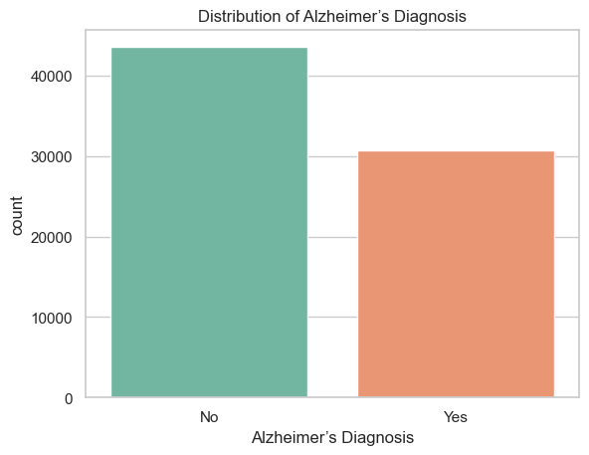
Target Variable distribution
Target Variable: Alzheimer’s Diagnosis
No: 58.7%
Yes: 41.3%
➡️ The classes are fairly balanced, so we did not apply any resampling techniques.

Slide 7
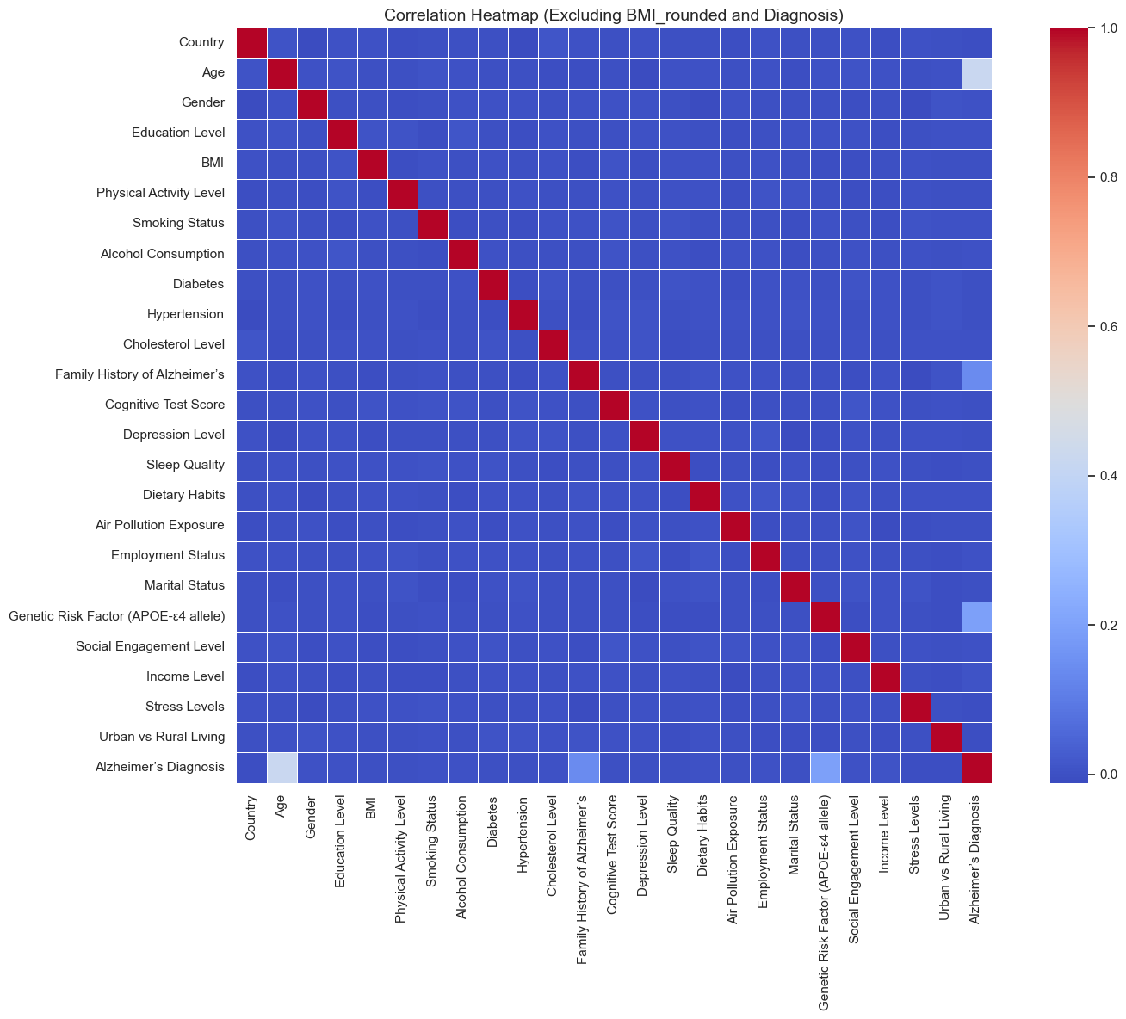
Feature Correlation Overview
Only three features show strong correlation with Alzheimer’s diagnosis:
Age (0.42)
Family History of Alzheimer’s (0.18)
Genetic Risk Factor (APOE-ε4) (0.17)
The rest of the features have low or negligible correlation with the target.

Slide 8
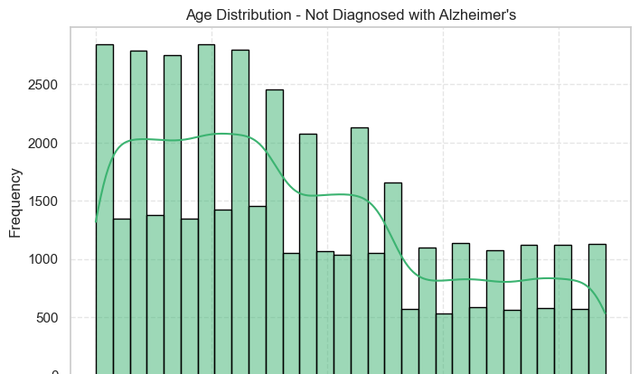
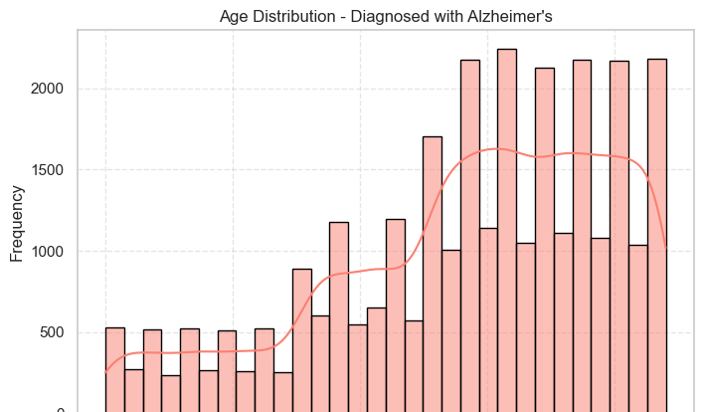
Key Feature Analysis: Age
Key Insights:
Age has a strong correlation with Alzheimer’s diagnosis, suggesting that age is a significant factor in the risk of Alzheimer’s disease.

Slide 9
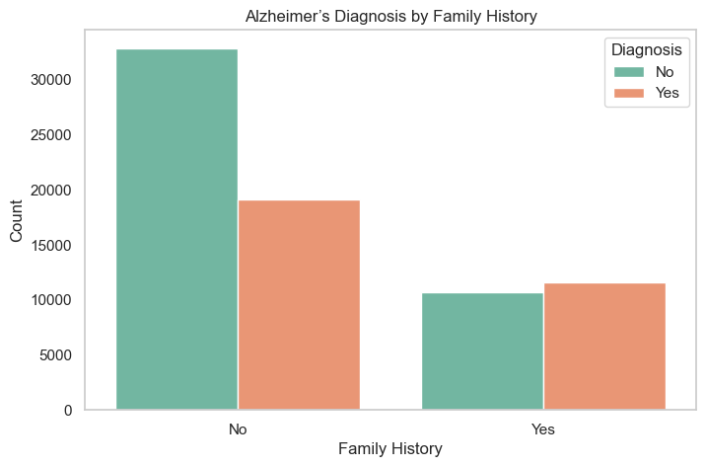
Key Feature Analysis: Family History of Alzheimer’s
Key Insights:
Having a family history of Alzheimer’s significantly increases the risk of developing the disease.

Slide 10
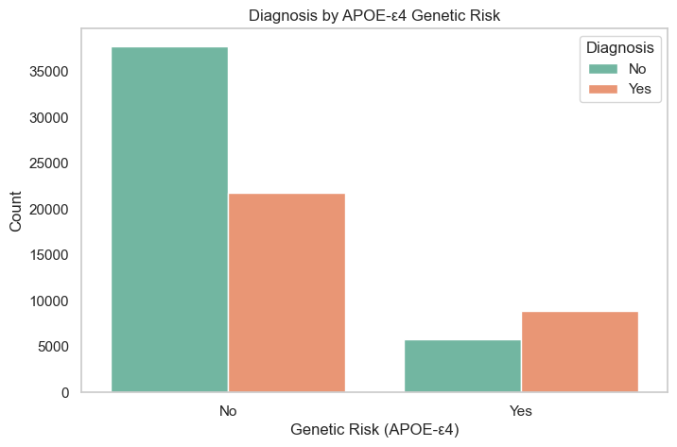
Key Feature Analysis: Genetic Risk Factor (APOE-ε4)
Key Insights:
The APOE-ε4 allele is a well-known genetic risk factor for Alzheimer's disease. Individuals carrying this allele have a higher risk of developing Alzheimer’s.

Slide 11
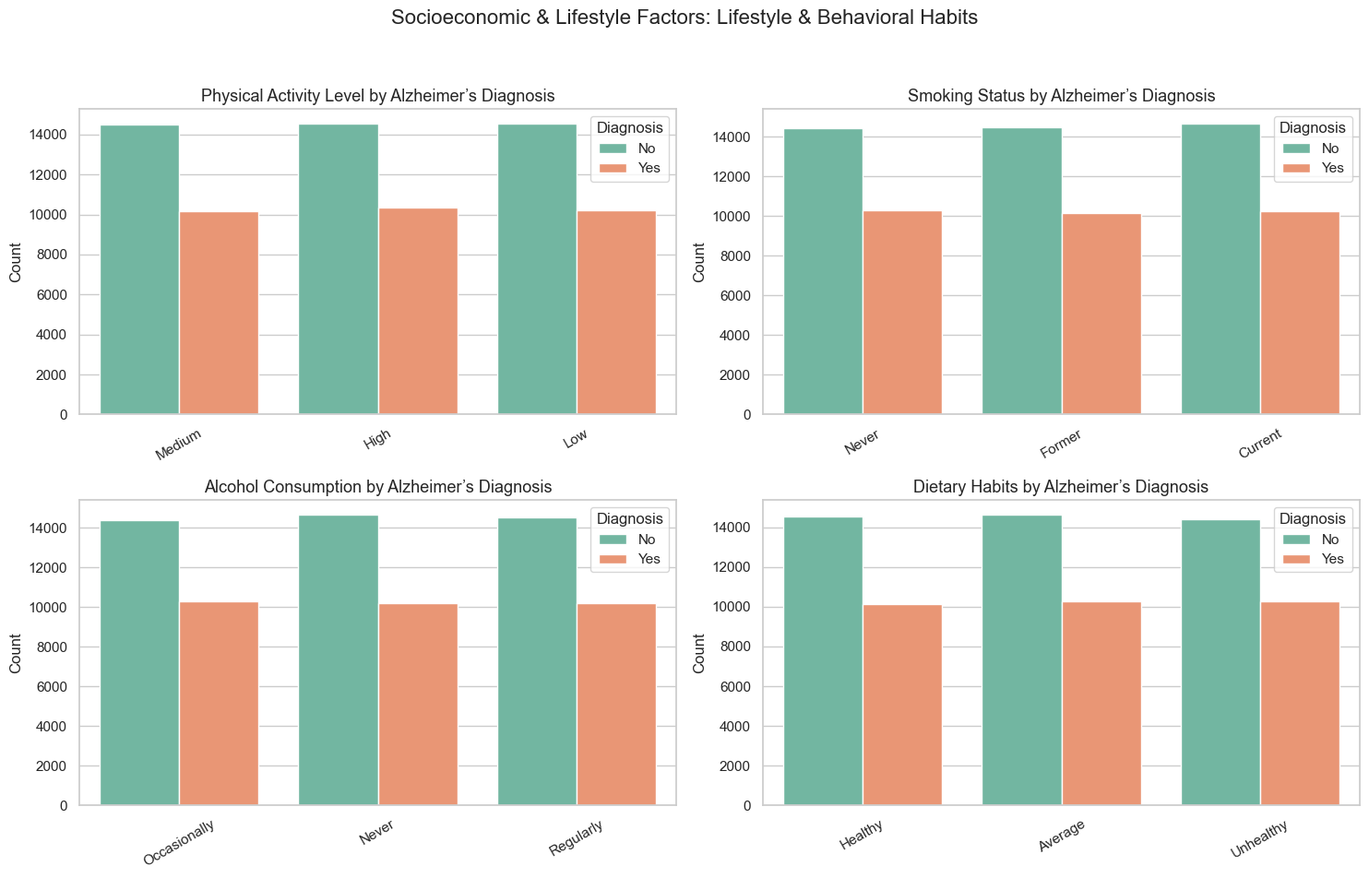
Secondary Features Overview
The remaining 21 features show low correlation with the target variable.
These features span across:
Lifestyle factors (e.g., Smoking, Alcohol Consumption, Physical Activity)
Medical conditions (e.g., Diabetes, Hypertension)
Environmental and social context (e.g., Air Pollution, Income, Marital Status)

