Slide 1

Predicting Alzheimer’s Diagnosis Using Lifestyle and Health Data
Christos Symeou & Leontios Ioannou Course: Data Mining on the Web
https://github.com/ileontios03/EPL448_Project.git

Slide 2
Dataset and Prediction Task
Dataset Origin:
Source: Healthcare surveys, clinical studies, and public health records from 20 countries.
Records: 74,283 samples.
Target Variable:
Alzheimer’s Diagnosis (Yes/No).
Features:
Includes demographic, lifestyle, medical, and genetic variables (e.g., age, BMI, smoking status, education, physical activity).
Objective:
Predict Alzheimer’s diagnosis based on various factors to support early detection and risk assessment.

Slide 3
Methodology
Exploratory Data Analysis (EDA)
Data Splitting
Modeling

Slide 4
Exploratory Data Analysis (EDA)
Dataset features and types
Feature distributions and correlations
Key insights from visualizations

Slide 5
Dataset Features and Types
The dataset contains 24 features:
4 numerical
20 categorical
Grouped into four key domains:
Demographics — e.g., Age
Lifestyle — e.g., Smoking Status
Health & Medical History — e.g., Diabetes
Environment & Social Context — e.g., Urban vs Rural Living
✅ No missing values detected in any feature.

Slide 6
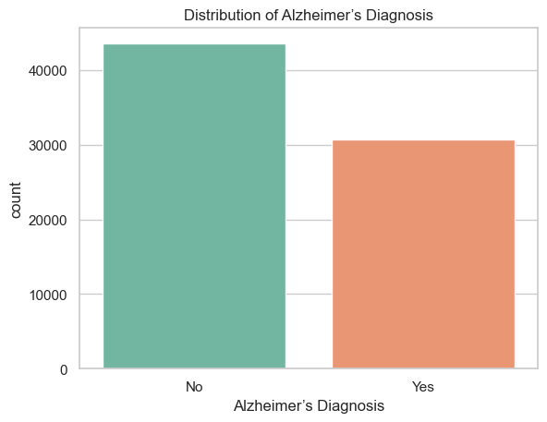
Target Variable distribution
Target Variable: Alzheimer’s Diagnosis
No: 58.7%
Yes: 41.3%
The classes are fairly balanced, so we did not apply any resampling techniques.

Slide 7
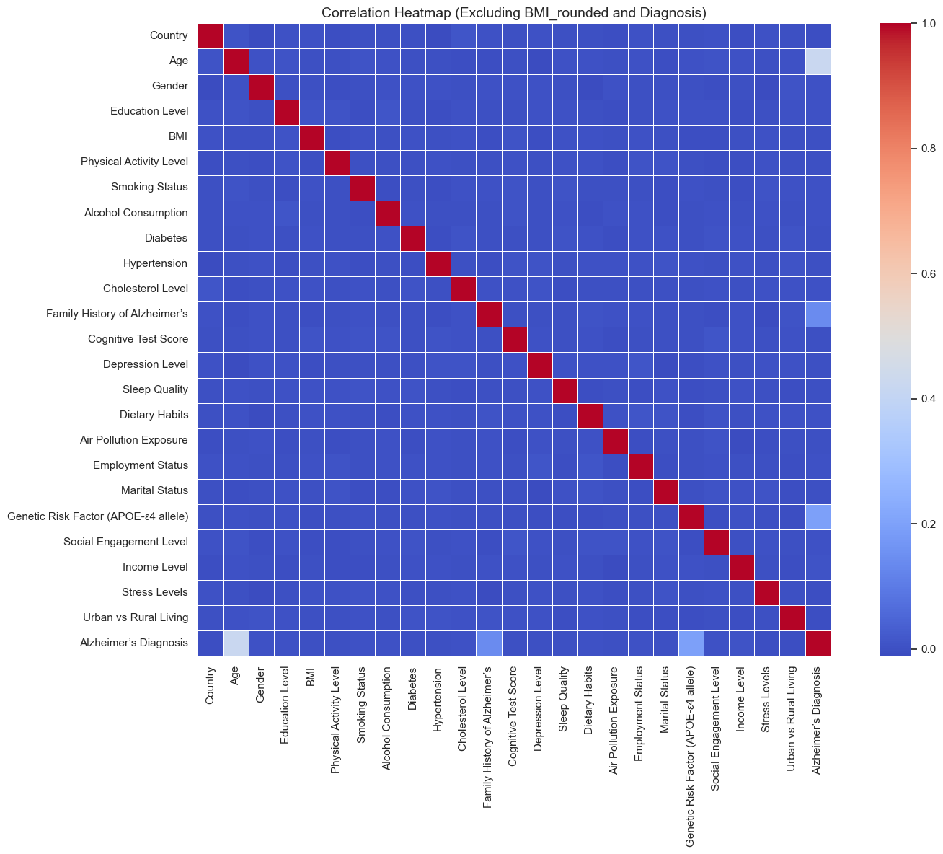
Feature Correlation Overview
Only three features show strong correlation with Alzheimer’s diagnosis:
Age (0.42)
Family History of Alzheimer’s (0.14)
Genetic Risk Factor (APOE-ε4) (0.19)
The rest of the features have low or negligible correlation with the target.

Slide 8
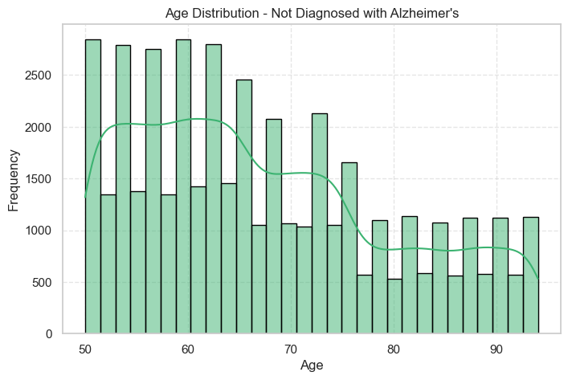
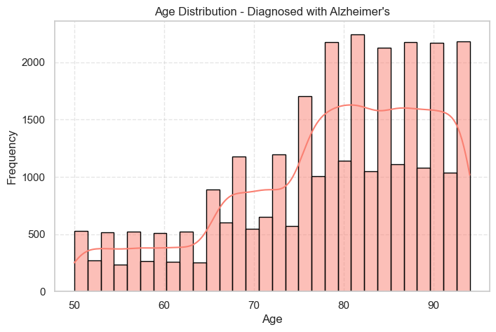
Key Feature Analysis: Age
Key Insights:
Age has a strong correlation with Alzheimer’s diagnosis, suggesting that age is a significant factor in the risk of Alzheimer’s disease.

Slide 9
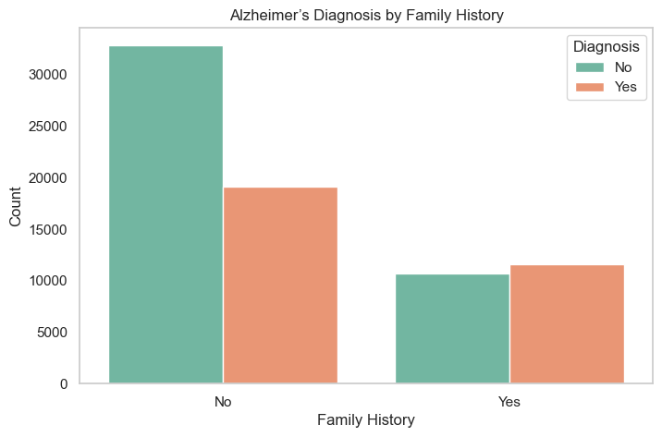
Key Feature Analysis: Family History of Alzheimer’s
Key Insights:
Having a family history of Alzheimer’s significantly increases the risk of developing the disease.

Slide 10
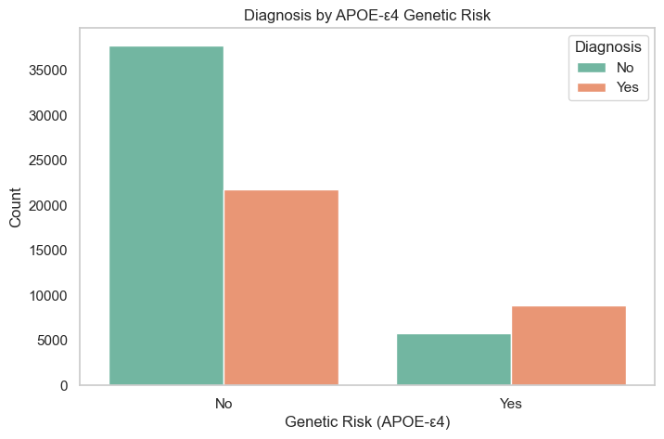
Key Feature Analysis: Genetic Risk Factor (APOE-ε4)
Key Insights:
The APOE-ε4 allele is a well-known genetic risk factor for Alzheimer's disease. Individuals carrying this allele have a higher risk of developing Alzheimer’s.

Slide 11
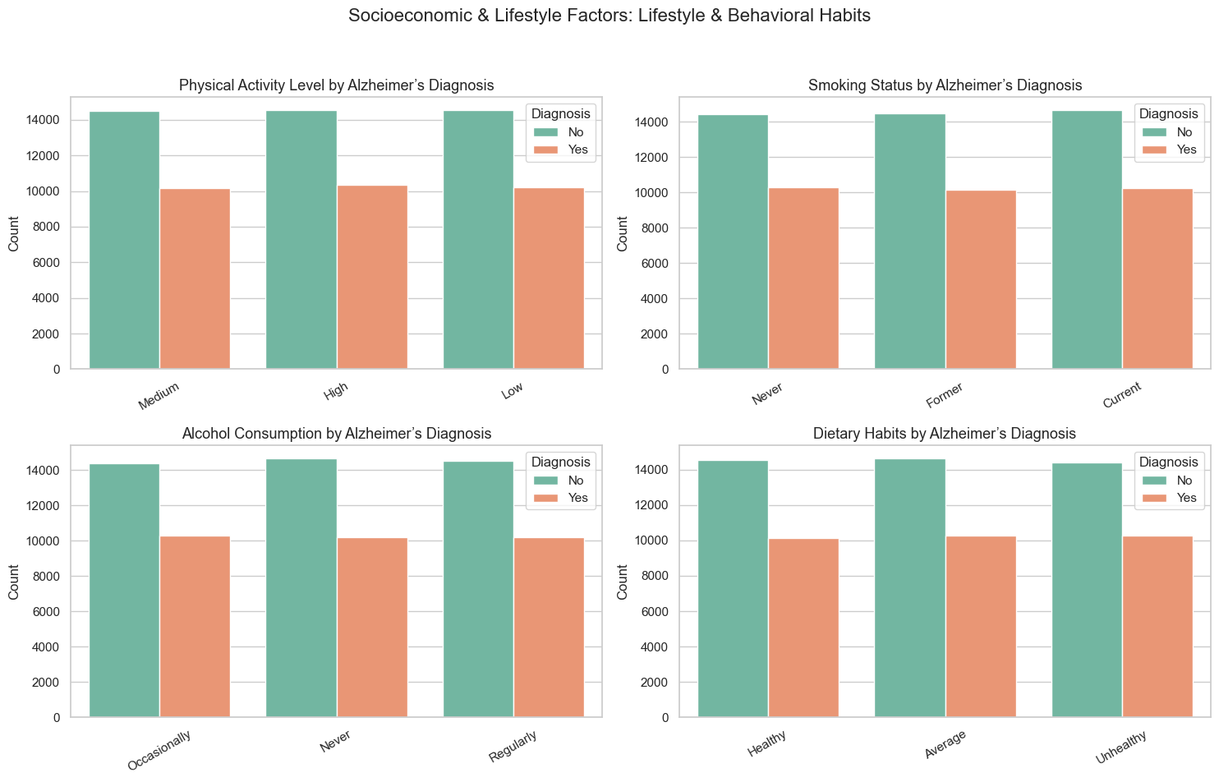
Secondary Features Overview
The remaining 21 features show low correlation with the target variable.
These features span across:
Lifestyle factors (e.g., Smoking, Alcohol Consumption, Physical Activity)
Medical conditions (e.g., Diabetes, Hypertension)
Environmental and social context (e.g., Air Pollution, Income, Marital Status)

Slide 12
Data Splitting
The dataset was split using an 80/20 ratio.
Stratified splitting was applied to preserve the balance of Alzheimer’s cases across both sets.
Resulting in:
Training set: 80% of the data
Test set: 20% of the data

Slide 13
Modeling using ML techniques

Slide 14
Modeling Strategy Overview
Phase 1: Initial Experimentation | Phase 2: Fine-Tuning
🔹 Created multiple dataset versions | 🔹 Focused on best models + preprocessing methods from Phase 1
🔹 Applied various classifiers with default settings | 🔹 Built pipelines combining preprocessing & model
🔹 Used cross-validation for evaluation | 🔹 Tuned hyperparameters using GridSearchCV
🔹 Identified top 2 models and dataset versions | 🔹 Evaluated using F1-score

Slide 15
Dataset versions – Part 1
Version 1
Numeric features scaled using RobustScaler (to reduce outlier impact).
Categorical features encoded using OrdinalEncoder.
Version 2
Yeo-Johnson transformation applied to numeric features (to handle skewness).
Categorical features encoded using OrdinalEncoder.

Slide 16
Dataset versions – Part 2
Version 3
Yeo-Johnson transformation on numeric features.
Categorical features encoded using OneHotEncoder (treat categories independently).
Version 4
Same preprocessing as V3.
PCA applied to reduce dimensionality (retain 95% variance).

Slide 17
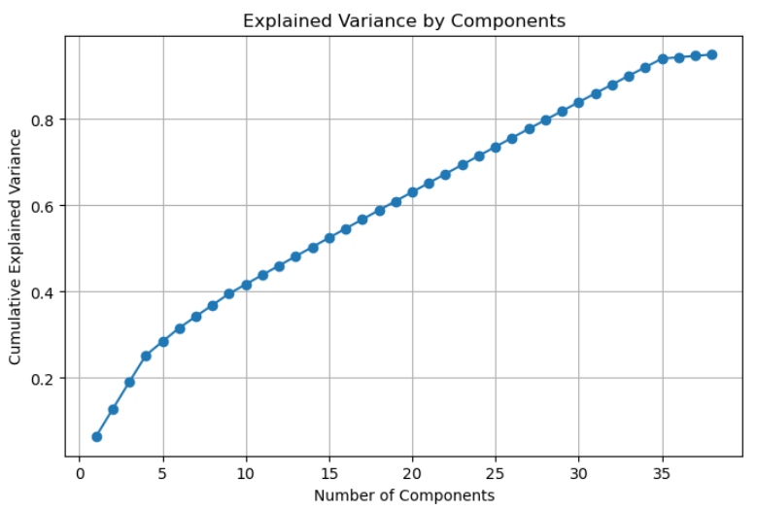
Dataset V4: PCA Analysis
Applied PCA to reduce dimensionality.
Retained ~95% of original variance.
Around 38 principal components selected.
Improved efficiency with minimal information loss.
PCA variance chart shows most variance captured early.

Slide 18
Evaluation Strategy
Random Forest Classifier | XGBoost Classifier
AdaBoost Classifier (SAMME) | CatBoost Classifier
Support Vector Classifier (SVC) | K-Nearest Neighbors (KNN)
Logistic Regression | Decision Tree Classifier
Gaussian Naive Bayes
Each classifier is trained on each version of the dataset.
Used 10-fold cross-validation
Evaluation metric: weighted F1-score
Goal: identify the top-performing models and dataset versions to carry forward into final testing

Slide 19
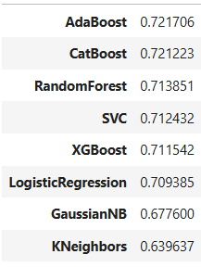
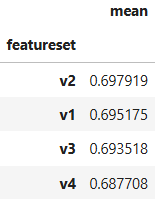
Phase 1 - Results
Top-performing classifiers:
AdaBoost
CatBoost
Best dataset versions:
V2
V1

Slide 20
Alternative Approach: Feature Reduction
Dropped all features except:
Age
Family History of Alzheimer’s
Genetic Risk Factor (APOE-ε4 allele)
Re-ran the same modeling process (pipelines + GridSearchCV)
Result:
Top 2 datasets and top 2 classifiers remained the same.
No change in F1-scores.
Conclusion: Other features had limited impact on final model performance.

Slide 21
Phase 2 – Hyperparameter Tuning
Feature Grouping: Numerical and categorical features
Preprocessing Pipelines: V1 (RobustScaler), V2 (PowerTransformer)
Classifiers: AdaBoost, CatBoost
Hyperparameter Tuning: GridSearchCV
Evaluation: Weighted F1 score, 5-fold cross-validation

Slide 22
Feature Grouping & Preprocessing Pipelines
Feature Grouping:
num_features: All numerical features
features_to_scale: Numerical features for scaling or unskewing
cat_features: All categorical features
Preprocessing Pipelines:
V1 (RobustScaler): Scaling of numerical features
V2 (PowerTransformer): Unskewing of numerical features
Categorical Encoding: OrdinalEncoder for categorical features

Slide 23
Classification Pipelines
AdaBoost Classifiers:
pipeline_ada_v1: Preprocessor1 (RobustScaler) + AdaBoostClassifier
pipeline_ada_v2: Preprocessor2 (PowerTransformer) + AdaBoostClassifier
CatBoost Classifiers:
pipeline_cat_v1: Preprocessor1 (RobustScaler) + CatBoostClassifier
pipeline_cat_v2: Preprocessor2 (PowerTransformer) + CatBoostClassifier

Slide 24
Hyperparameter Grids for GridSearchCV
AdaBoost Hyperparameters:
n_estimators: 50, 100, 200
learning_rate: 0.01, 0.1, 1.0
algorithm: 'SAMME’
CatBoost Hyperparameters:
depth: 4, 6
iterations: 100, 200
learning_rate: 0.01, 0.1

Slide 25
GridSearchCV for Hyperparameter Tuning
Steps:
5-fold cross-validation for model evaluation
Weighted F1 score to account for class imbalance
Output includes:
Best hyperparameters
Best cross-validation score
Test set performance

Slide 26
Results Discussion
AdaBoost (V1 & V2):
Best Parameters:
algorithm: SAMME
learning_rate: 1.0
n_estimators: 100
Cross-validation F1 score: 0.7291
Test F1 score: 0.7337
CatBoost (V1 & V2):
Best Parameters:
depth: 6
iterations: 100
learning_rate: 0.01
Cross-validation F1 score: 0.7275
Test F1 score: 0.7305
Final Model Chosen: AdaBoost V2 based on its superior performance.

Slide 27
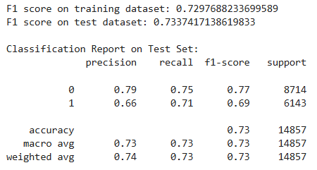
Final Model Evaluation: AdaBoost with Preprocessor V2
Selected based on strong performance in cross-validation and the test set.
Evaluation:
Weighted F1 Score on training and test sets.
Classification report to assess per-class performance (precision, recall, F1 score).

Slide 28
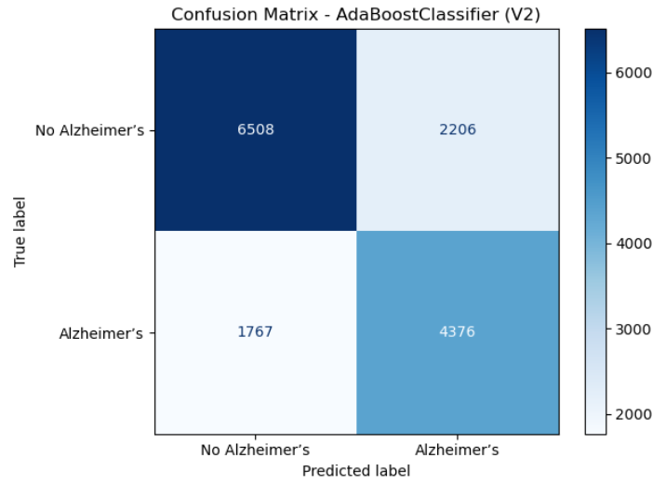
Confusion Matrix: Final Model (AdaBoost V2)
Key Insights:
Balanced sensitivity and specificity with a recall of 71% for Alzheimer’s cases.
Acceptable false positives for prioritizing early detection.
Strong and reliable classification performance across both classes.

Slide 29
Confusion Matrix: Final Model (AdaBoost V2)
Key Insights:
Balanced sensitivity and specificity with a recall of 71% for Alzheimer’s cases.
Acceptable false positives for prioritizing early detection.
Strong and reliable classification performance across both classes.

Slide 30
Conclusion
Final Model: CatBoost with Preprocessor V2.
Performance: Strong results with a weighted F1 score of 0.7305 on the test set.
Model Choice: AdaBoost also performed well, but CatBoost offered better generalization.
Key Insight: Our model offers a good balance between sensitivity and specificity, which is crucial for early Alzheimer’s detection.

Slide 31
Thank you for your attention! We are open to any questions.

