Slide 1

Predicting Alzheimer’s Diagnosis Using Lifestyle and Health Data
Christos Symeou & Leontios Ioannou Course: Data Mining on the Web

Slide 2
Dataset and Prediction Task
Dataset Origin:
Source: Healthcare surveys, clinical studies, and public health records from 20 countries.
Records: 74,283 samples.
Target Variable:
Alzheimer’s Diagnosis (Yes/No).
Features:
Includes demographic, lifestyle, medical, and genetic variables (e.g., age, BMI, smoking status, education, physical activity).
Objective:
Predict Alzheimer’s diagnosis based on various factors to support early detection and risk assessment.

Slide 3
Methodology
Exploratory Data Analysis (EDA)
Data Splitting
Modeling

Slide 4
Exploratory Data Analysis (EDA)
Dataset features and types
Feature distributions and correlations
Key insights from visualizations

Slide 5
Dataset Features and Types
The dataset contains 24 features:
4 numerical
20 categorical
Grouped into four key domains:
Demographics — e.g., Age
Lifestyle — e.g., Smoking Status
Health & Medical History — e.g., Diabetes
Environment & Social Context — e.g., Urban vs Rural Living
✅ No missing values detected in any feature.

Slide 6
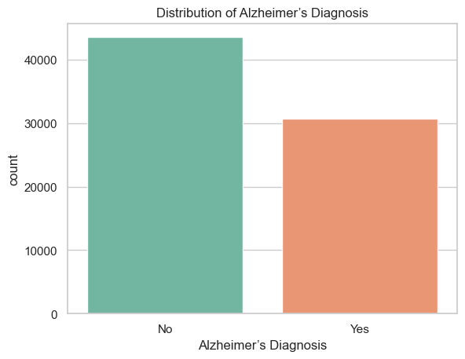
Target Variable distribution
Target Variable: Alzheimer’s Diagnosis
No: 58.7%
Yes: 41.3%
The classes are fairly balanced, so we did not apply any resampling techniques.

Slide 7
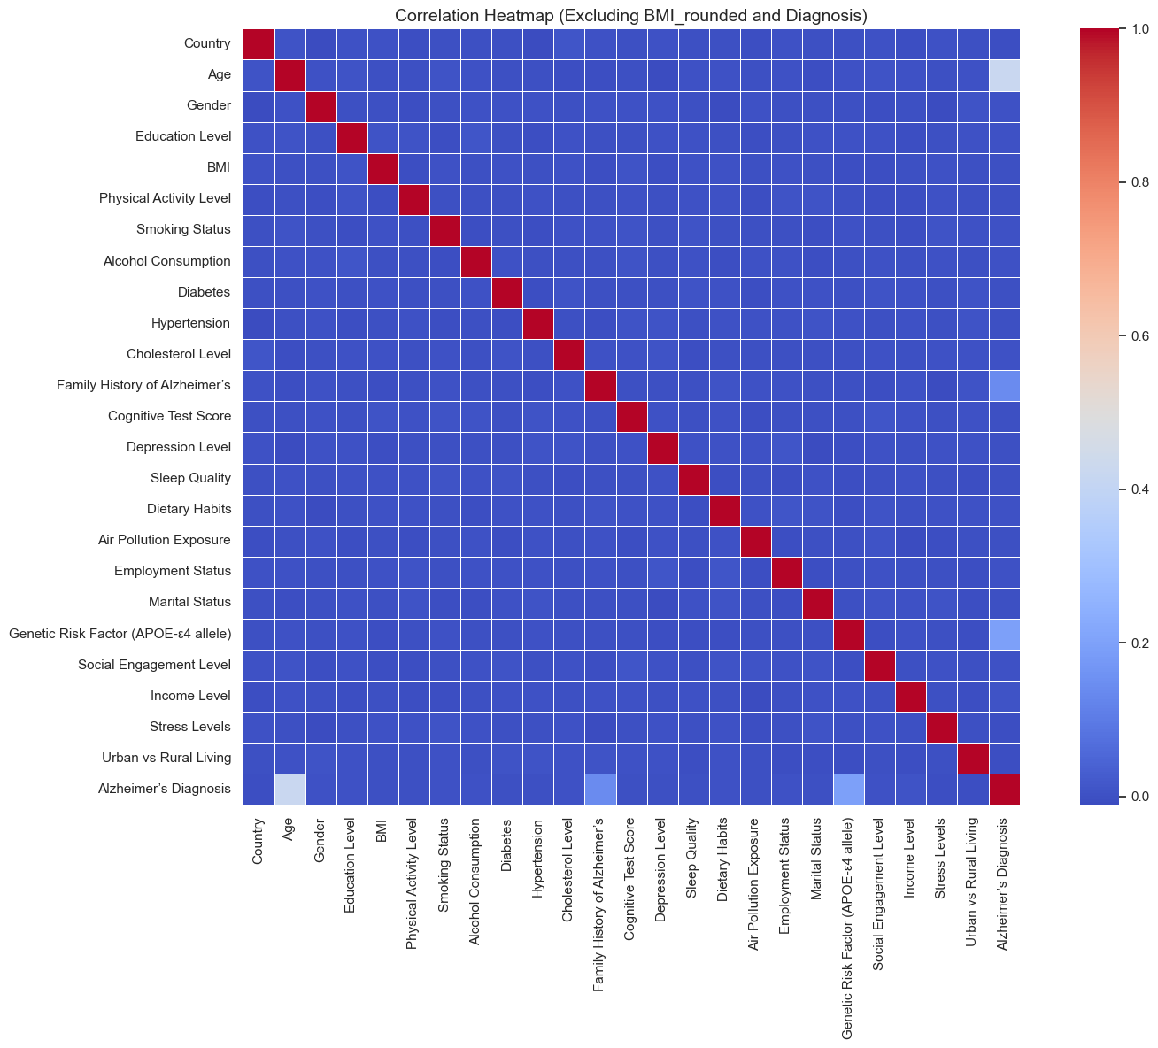
Feature Correlation Overview
Only three features show strong correlation with Alzheimer’s diagnosis:
Age (0.42)
Family History of Alzheimer’s (0.14)
Genetic Risk Factor (APOE-ε4) (0.19)
The rest of the features have low or negligible correlation with the target.

Slide 8
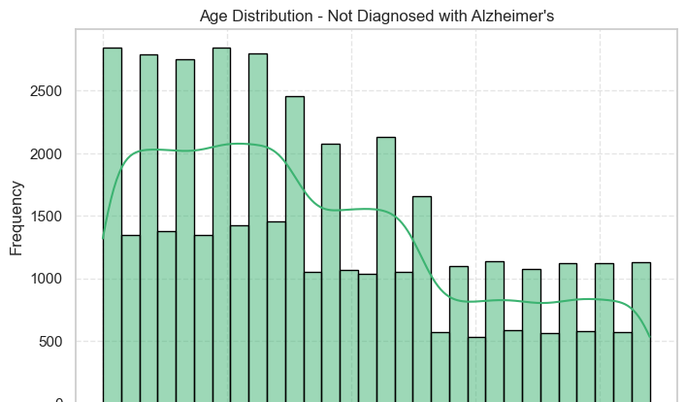
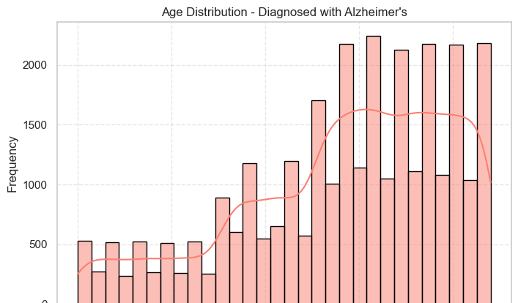
Key Feature Analysis: Age
Key Insights:
Age has a strong correlation with Alzheimer’s diagnosis, suggesting that age is a significant factor in the risk of Alzheimer’s disease.

Slide 9
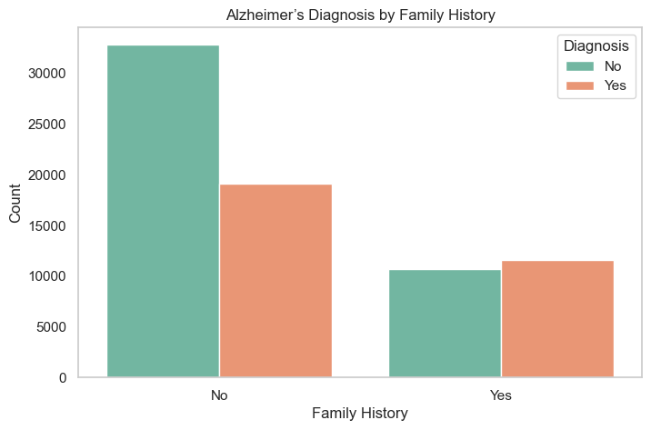
Key Feature Analysis: Family History of Alzheimer’s
Key Insights:
Having a family history of Alzheimer’s significantly increases the risk of developing the disease.

Slide 10
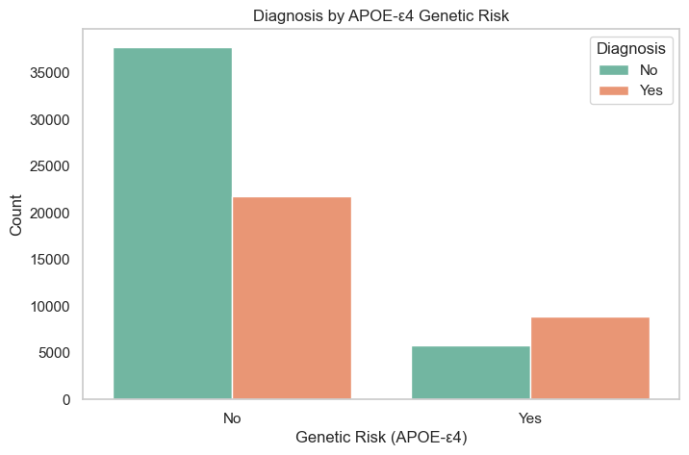
Key Feature Analysis: Genetic Risk Factor (APOE-ε4)
Key Insights:
The APOE-ε4 allele is a well-known genetic risk factor for Alzheimer's disease. Individuals carrying this allele have a higher risk of developing Alzheimer’s.

Slide 11
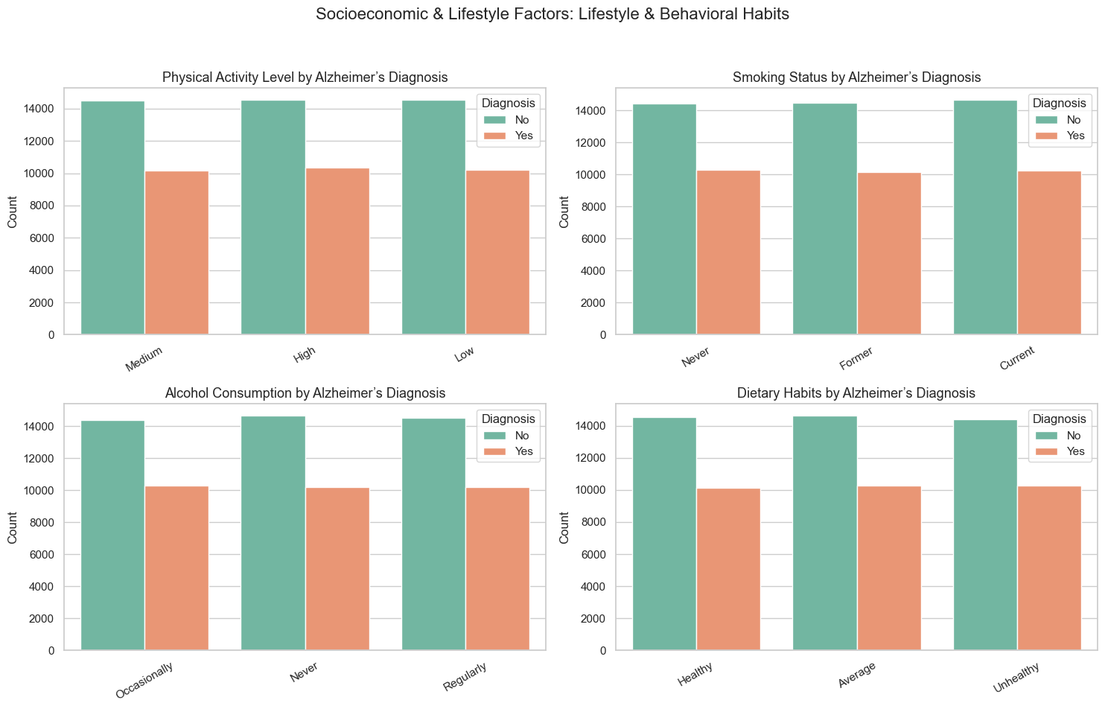
Secondary Features Overview
The remaining 21 features show low correlation with the target variable.
These features span across:
Lifestyle factors (e.g., Smoking, Alcohol Consumption, Physical Activity)
Medical conditions (e.g., Diabetes, Hypertension)
Environmental and social context (e.g., Air Pollution, Income, Marital Status)

Slide 12
Data Splitting
The dataset was split using an 80/20 ratio.
Stratified splitting was applied to preserve the balance of Alzheimer’s cases across both sets.
Resulting in:
Training set: 80% of the data
Test set: 20% of the data

Slide 13
Modeling using ML techniques

