Slide 1
SECP-5C1P
Railway Project

Slide 2
Team member
leader：
刘晓宇(Product Backlog and Sprint Backlog management)
Team member：
肖鹏飞(Front and back end design and coding)
孙林(Map implement and backend design)
周裕清(Cluster analysis)
杨歌(Configuration management)
沈在焕(Defect Management)

Slide 3
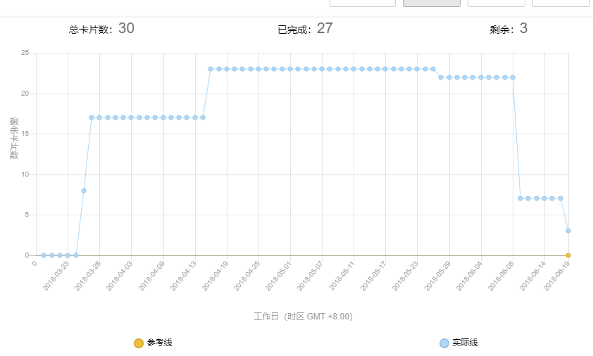
Product Backlog
Delivered user story: 14, Abandoned user story: 13

Slide 4
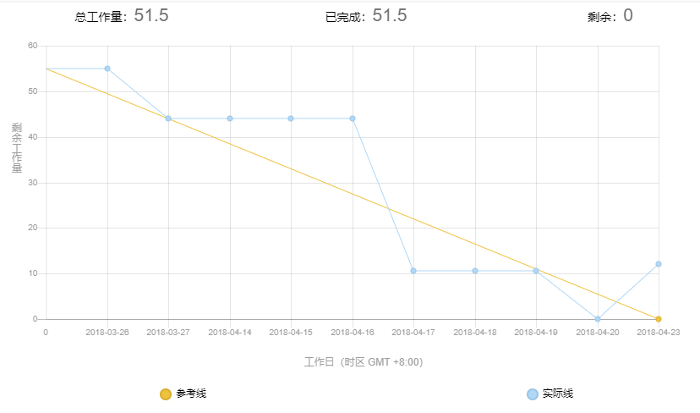
Sprint 1

Slide 5
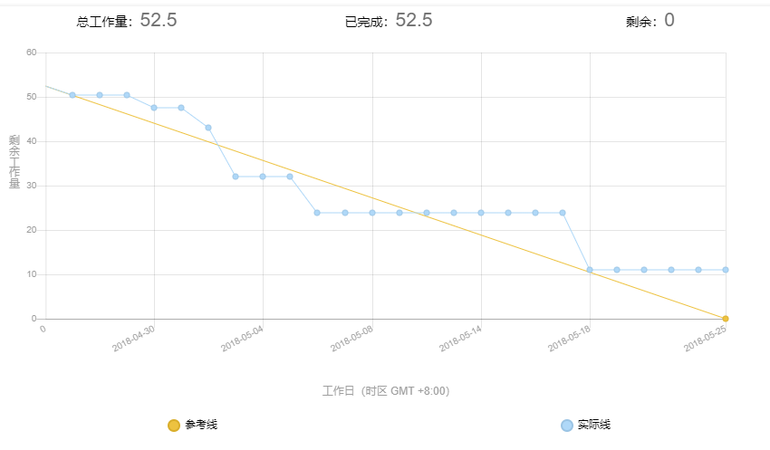
Sprint 2

Slide 6
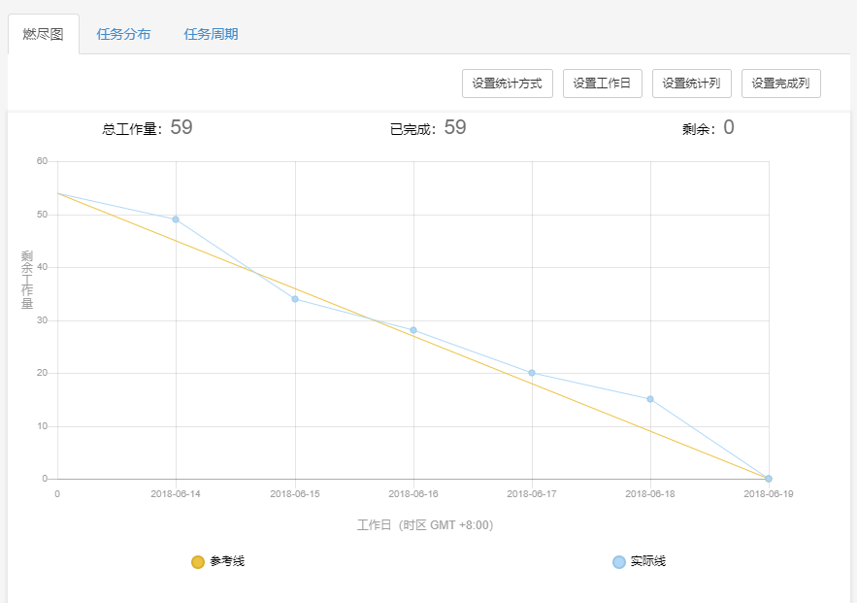
Sprint 3

Slide 7
Configuration Management
Branch: everyone has his/her own branch
File:
Doc-project related docs
Source-project sources, such as sql, csv
WebContent-Front end of the project
Src-Back end code source of the project

Slide 8
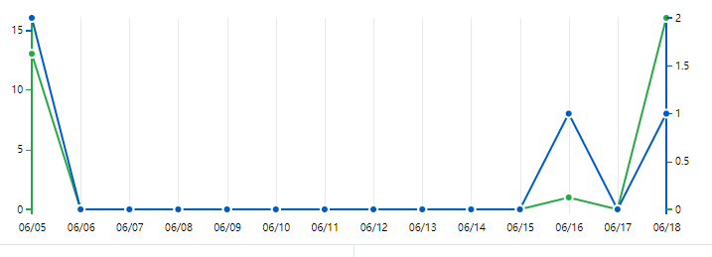
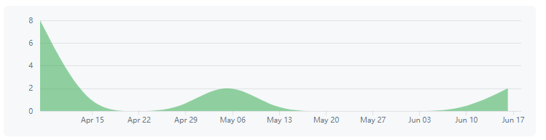
Git Frequency

Slide 9
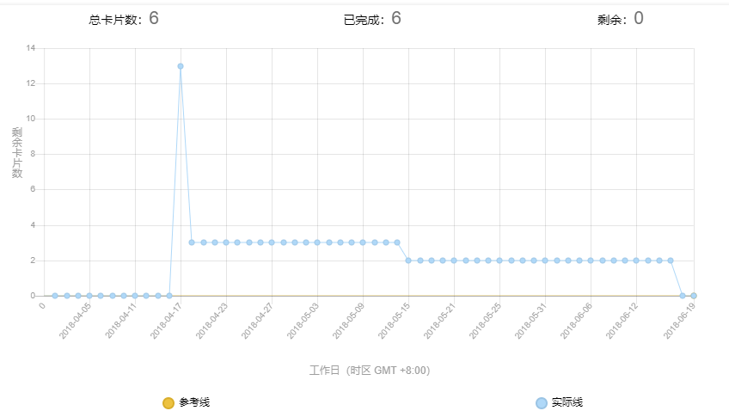
Defect Management

Slide 10
项目演示

Slide 11
Thanks!

