Slide 1
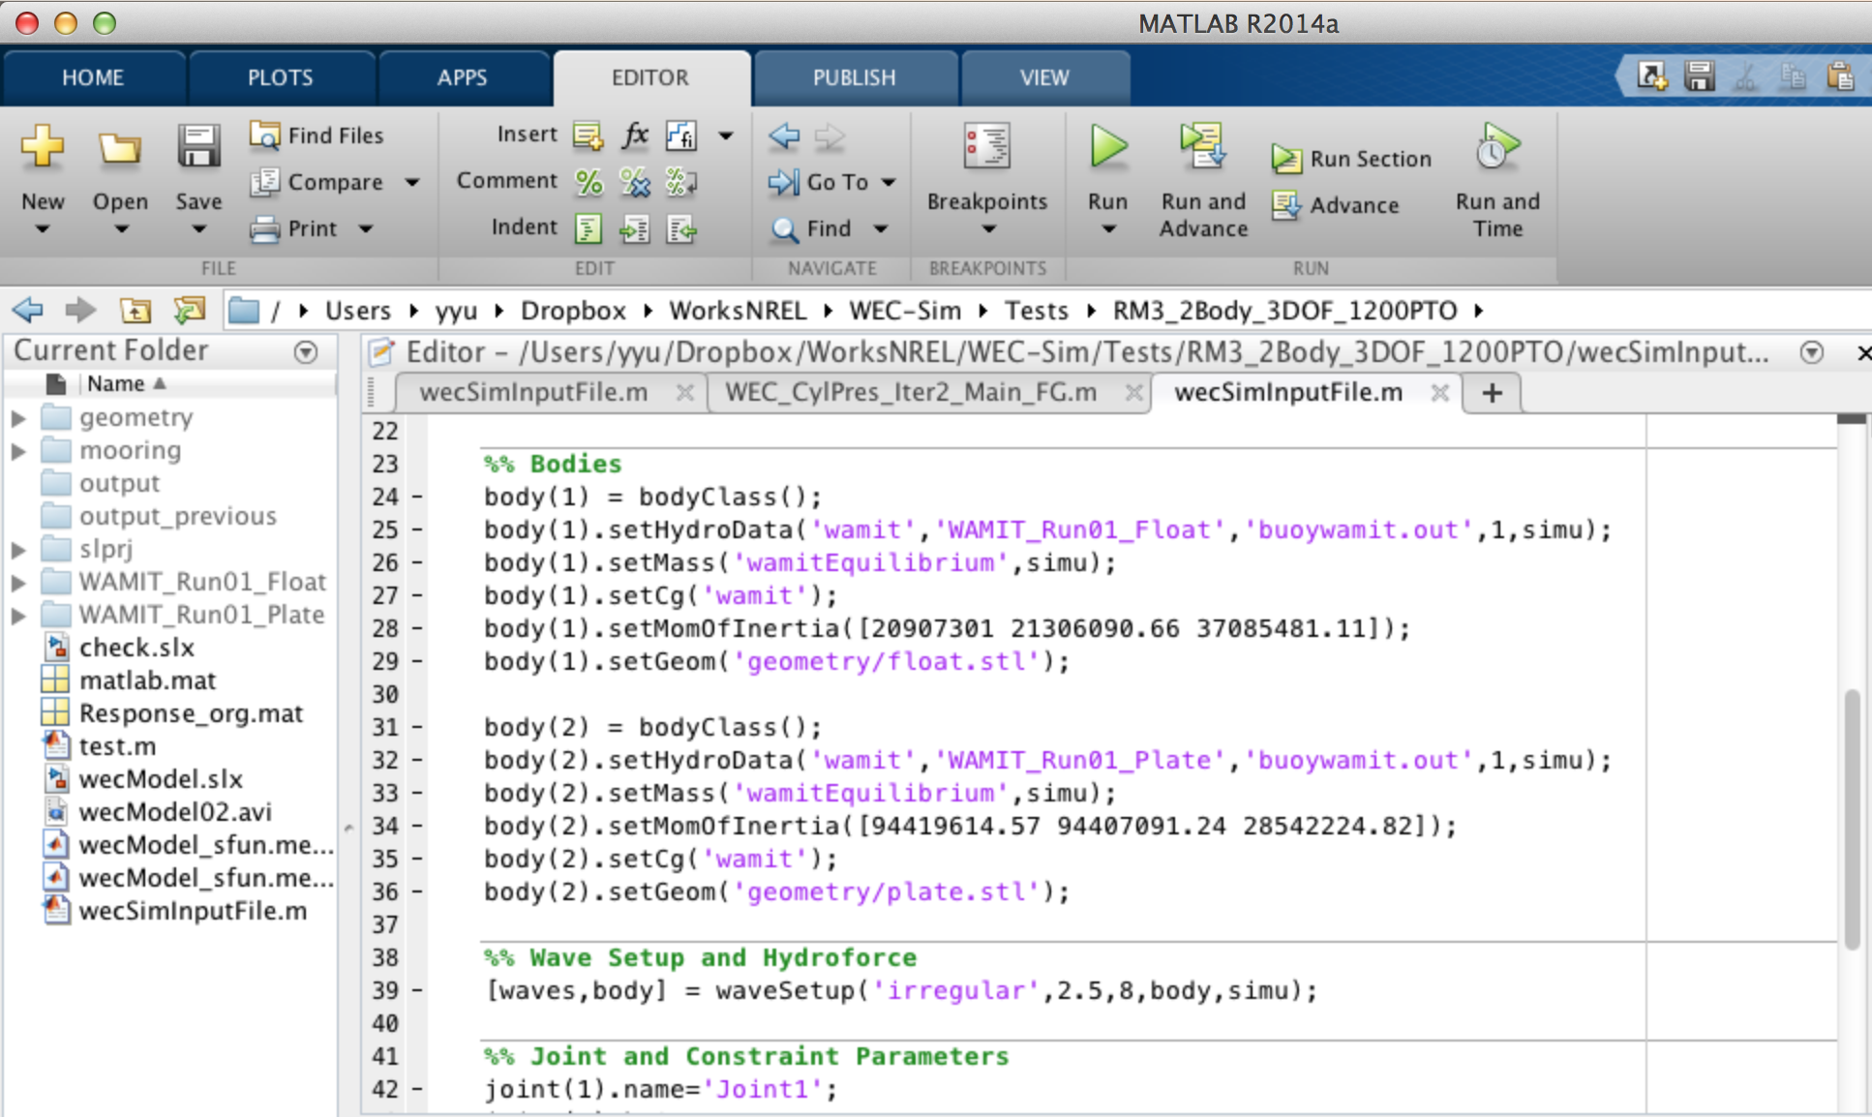
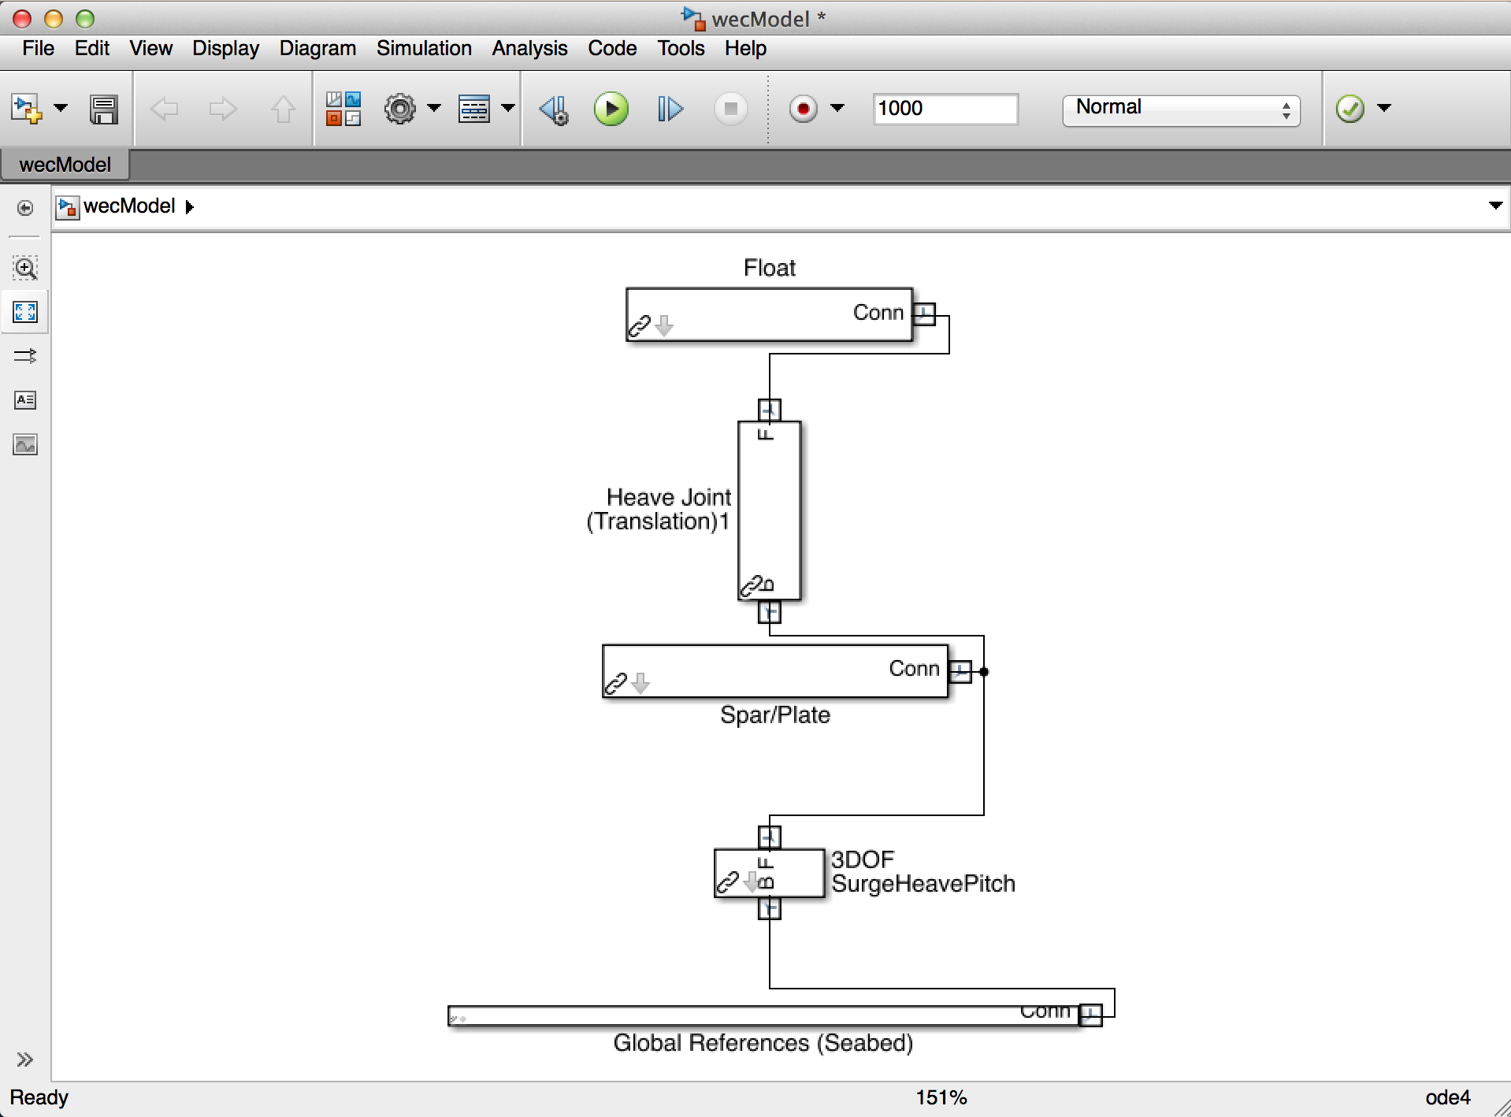
MATLAB Input Script
Simulink/SimMechanics Model
YES
No

Slide 4
Pre-Processing
Build the device CAD model
Run WAMIT
Build WEC Simulink/SimMechanics Model
Use WEC component library to build multi-body model of the device
User input setup
Wave conditions
Simulation settings
Define inertia properties and parameters
Execute WEC-Sim Simulations
From MATLAB input script
(NOT from WEC Simulink/SimMechanics Model)

Slide 5
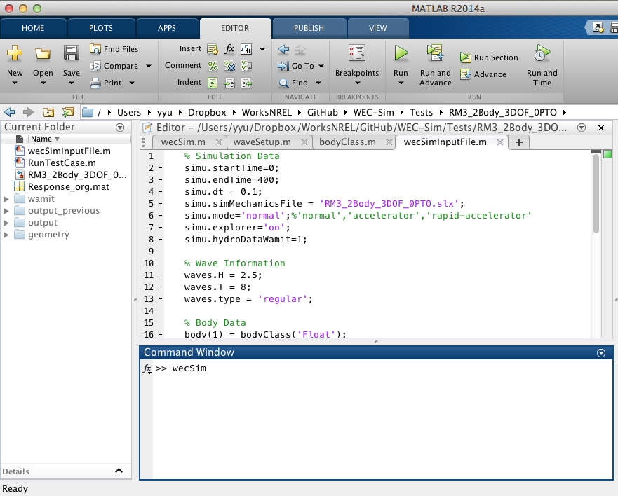
WEC-Sim Input File
Case
Directory
Command Line Window

