Slide 1
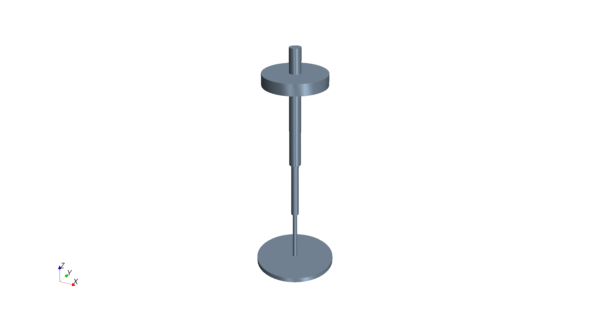
Heave
Z
Sway
Yaw
Y
Pitch
Incident wave
direction
Surge
Roll
X

