Slide 1

Mobile UX - Design
Notes:
Welcome

Slide 2
Recap
Decrease time for common tasks
Remove popups
Change the colour palette!!!
Remove premium from nav bar
Add a lock button
Increase reachability of common buttons
Notes:
These are the things that were needing to be changed in our prototype

Slide 3
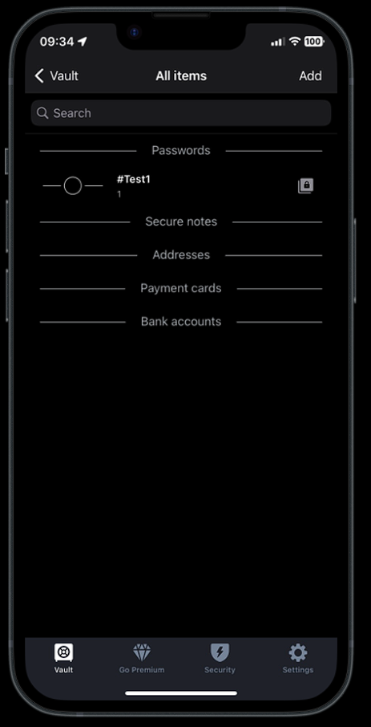
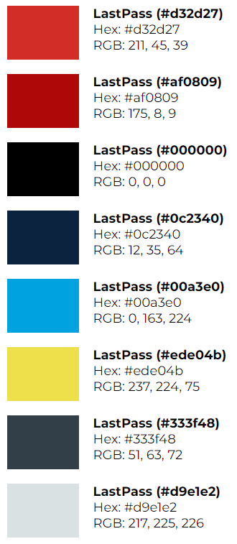
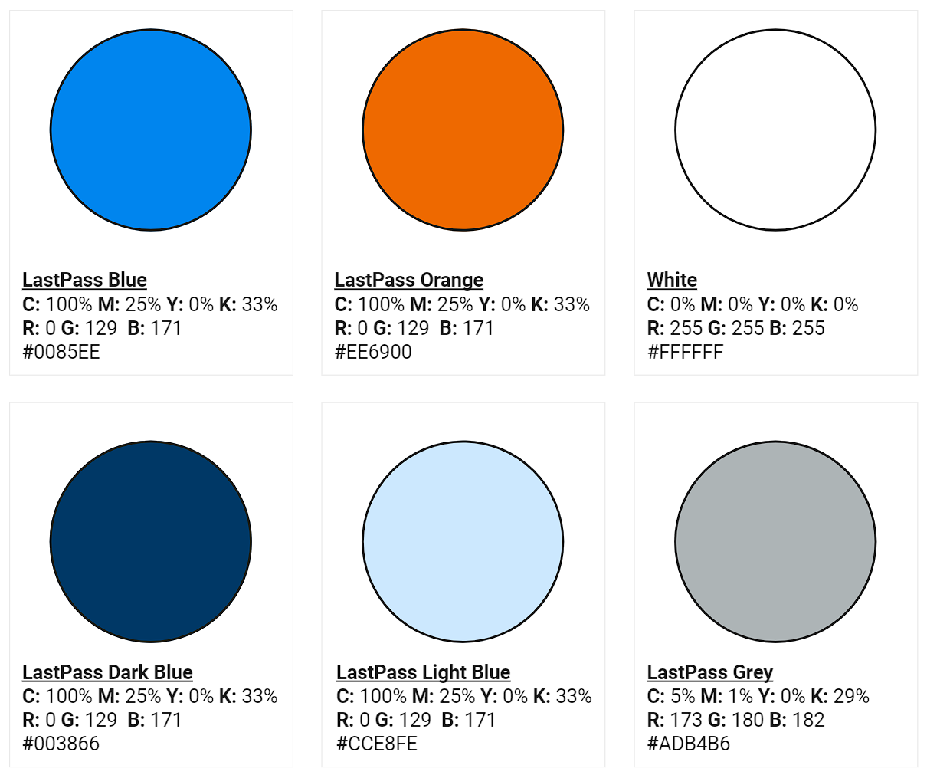
Colour Palette
Notes:
The first thing I did

Slide 4
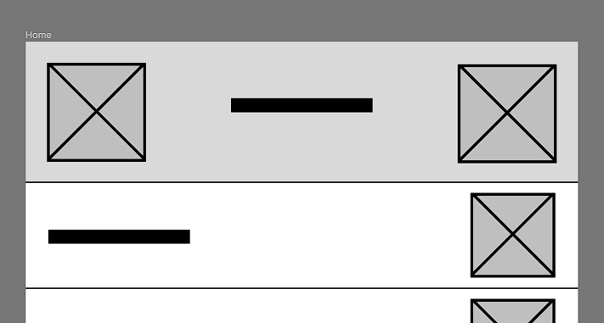

Lock Button
Notes:
Moved onto lofi – deciding on a lock button position
Example of current app with no such feature

Slide 5
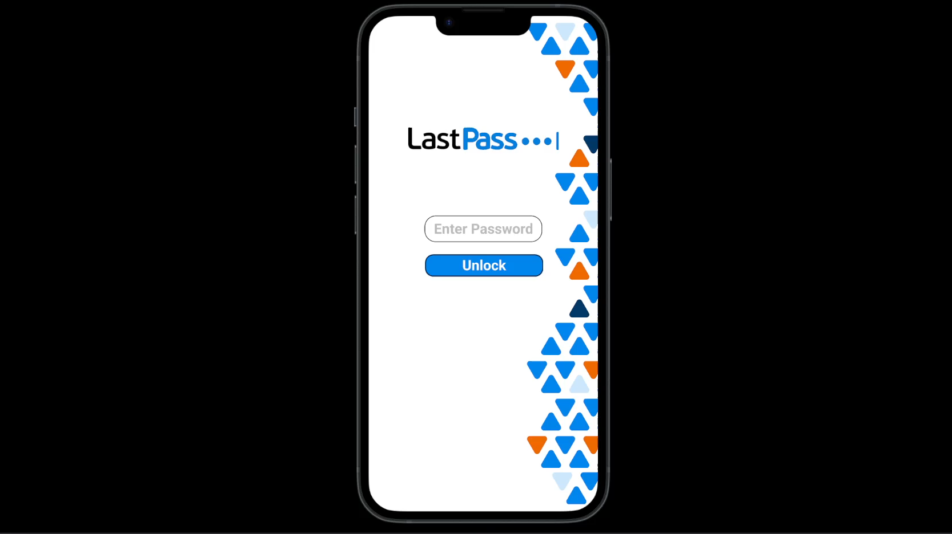
Notes:
Heres how the lock button looks and feels after feedback and development of the hifi

Slide 6
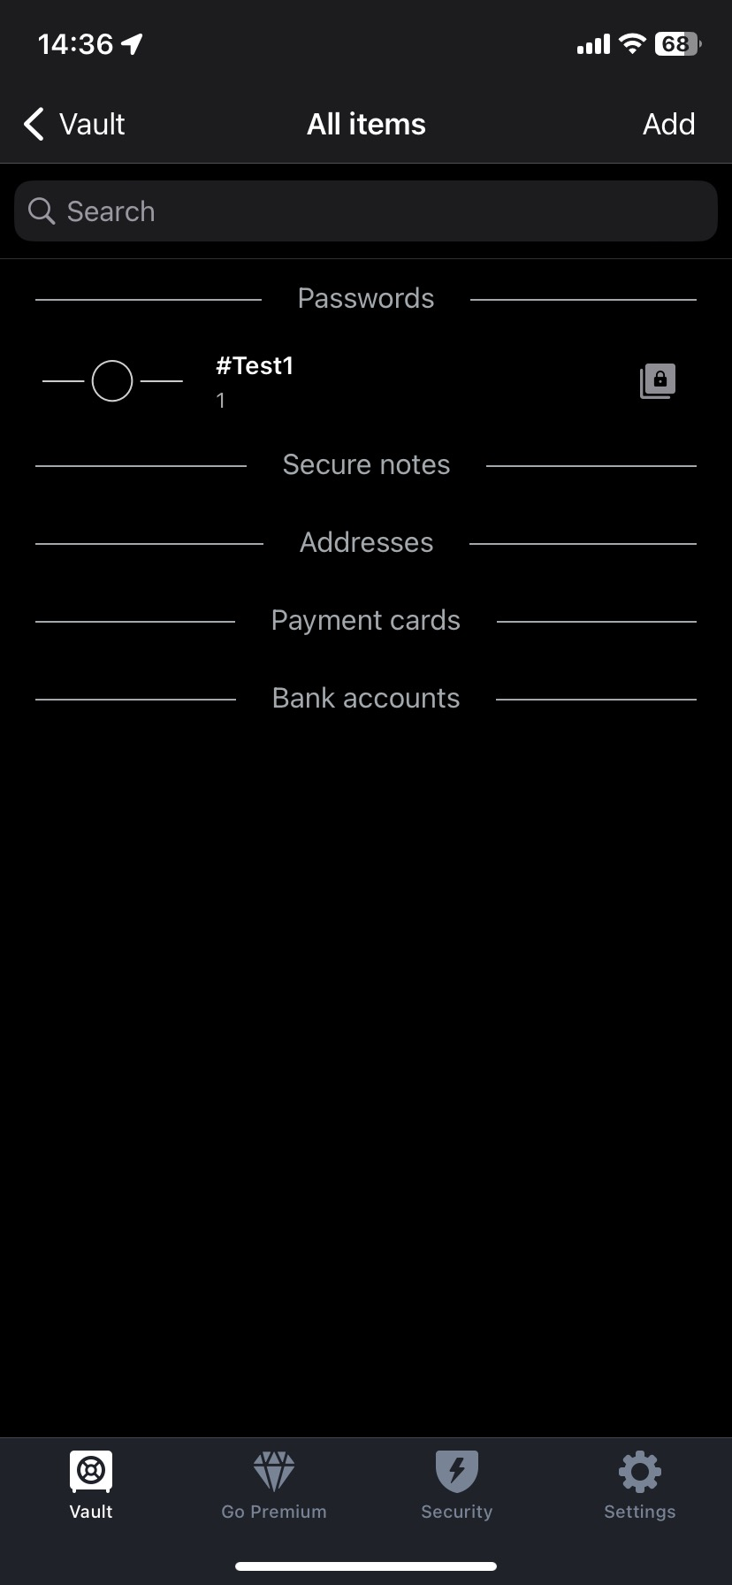
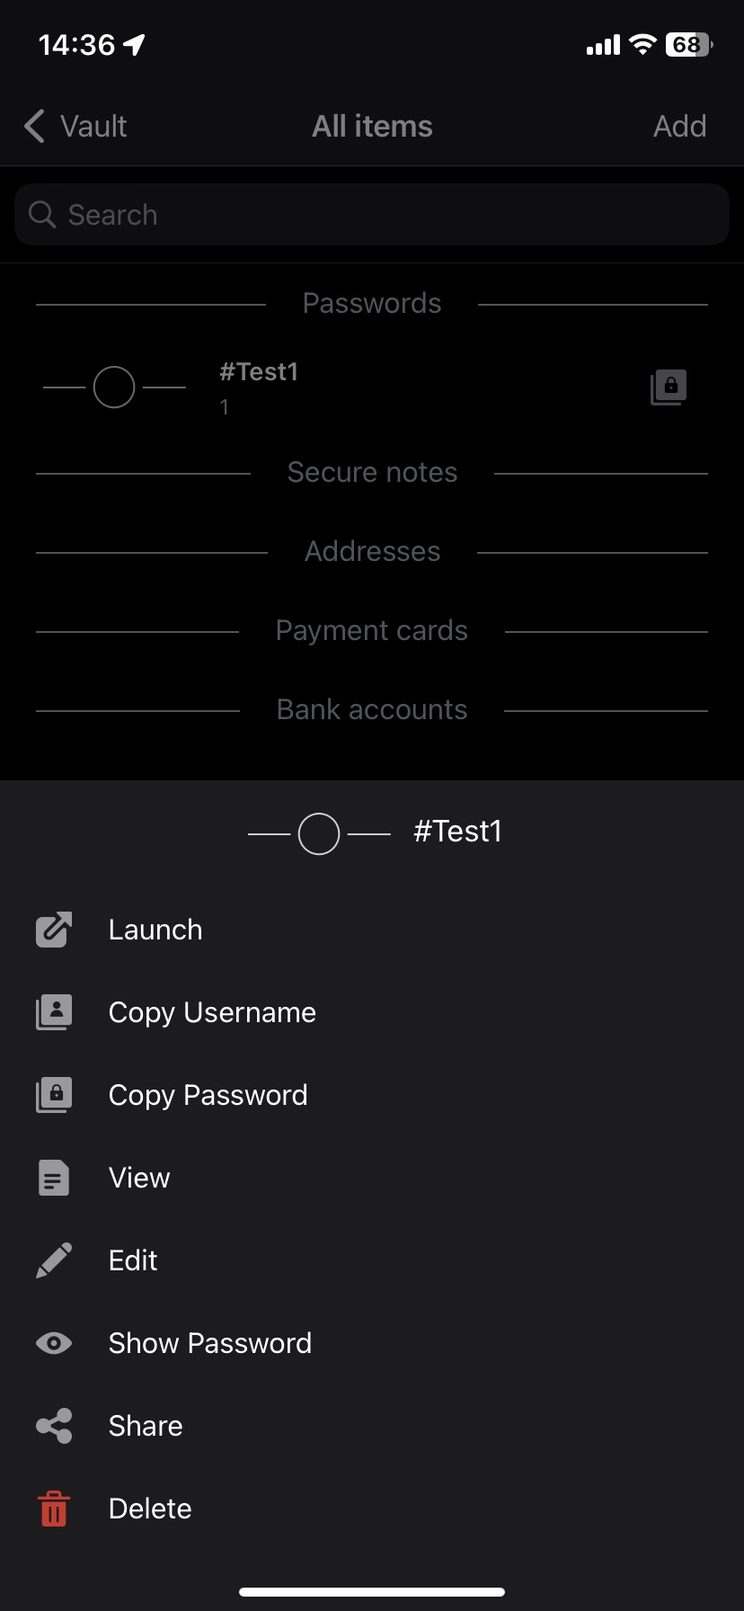
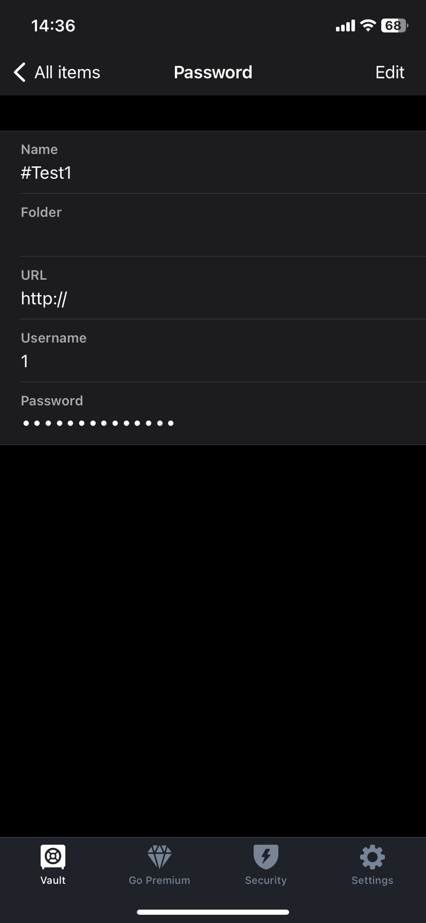
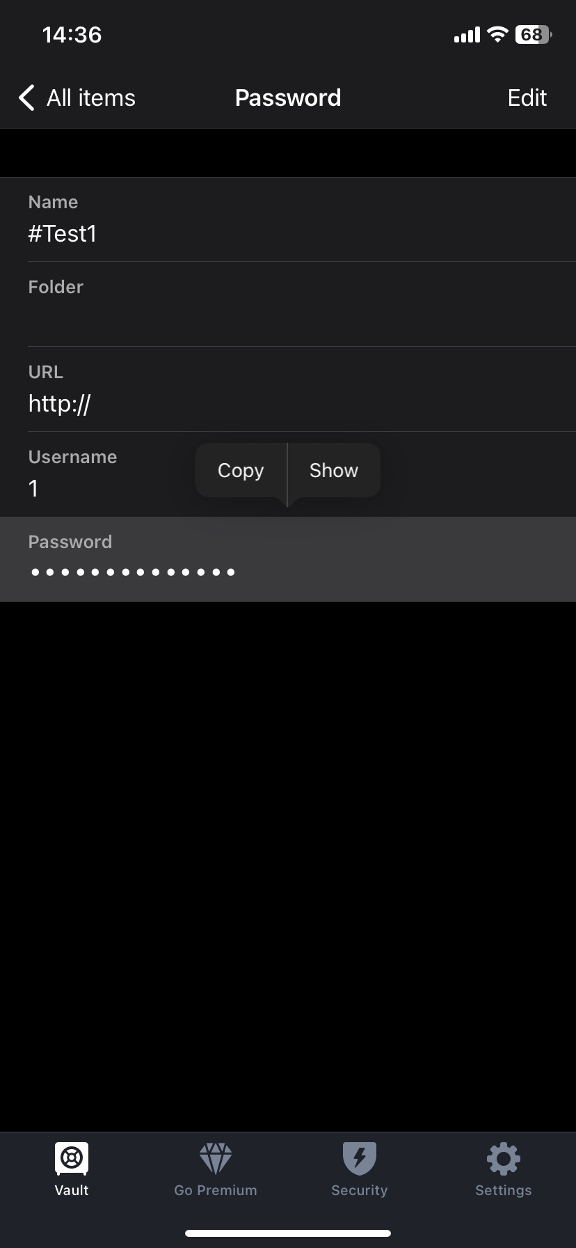
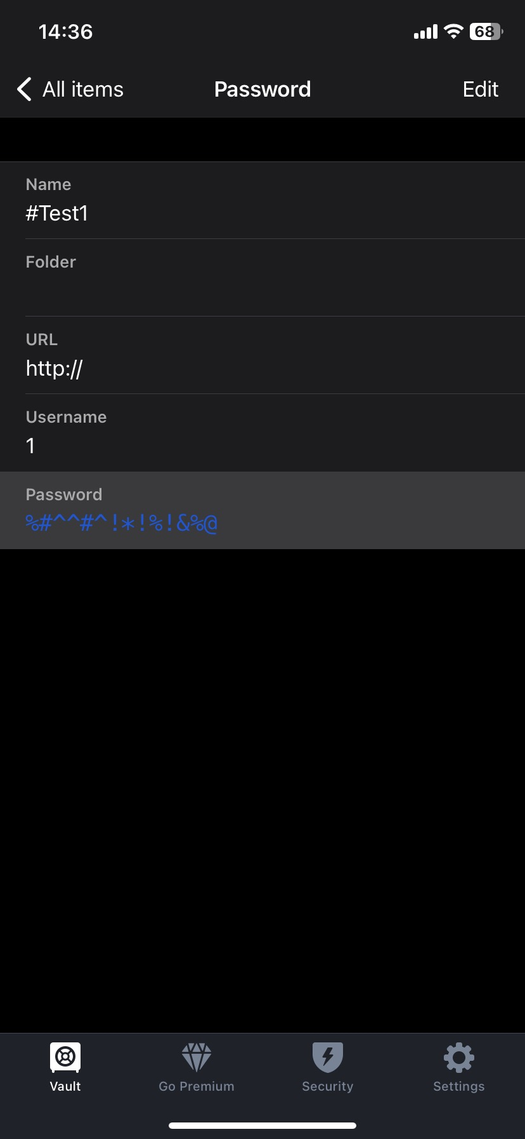
Remove Popups
Notes:
5 separate clicks to view a password….

Slide 7
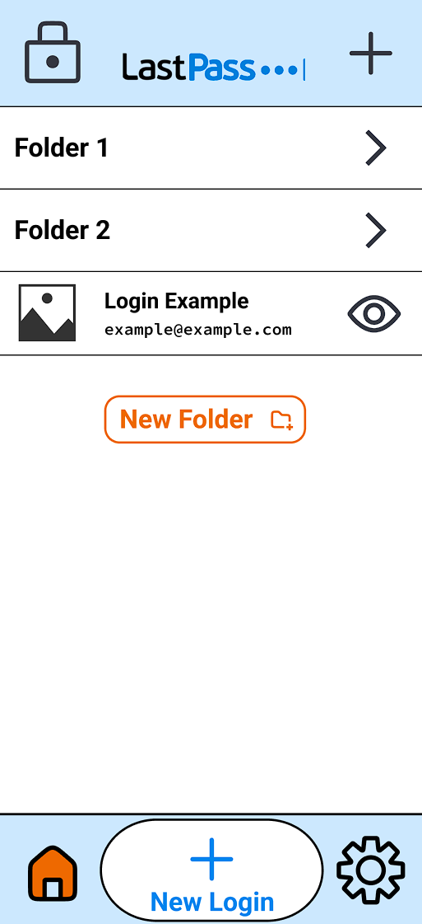
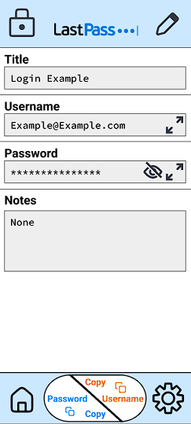

Remove Popups
Notes:
Two clicks now

Slide 8
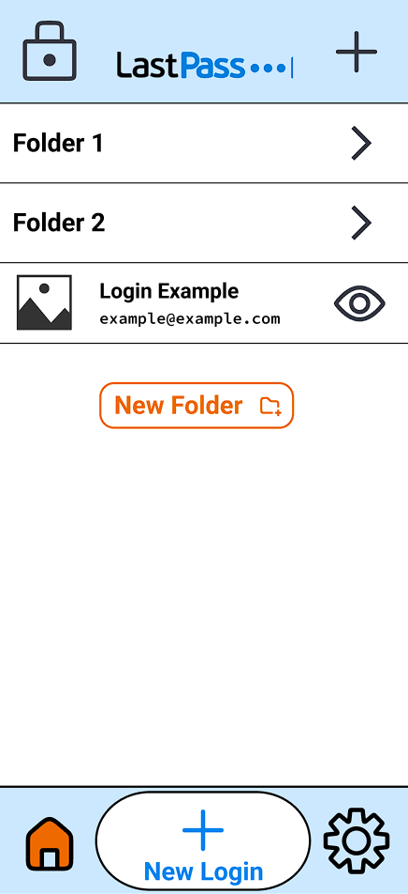
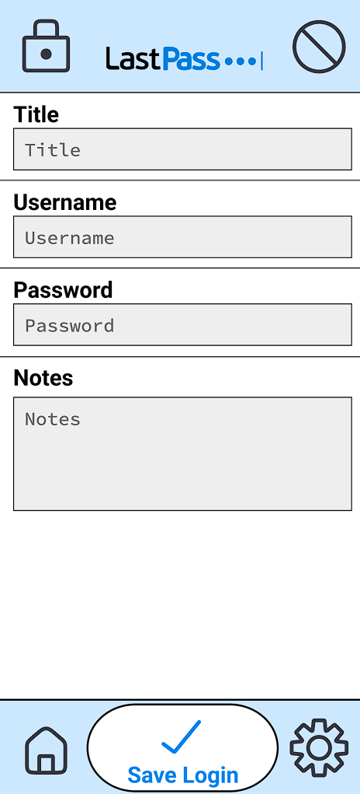



Reachability
**Removes “Premium” from main nav **
Notes:
Middle button

Slide 9
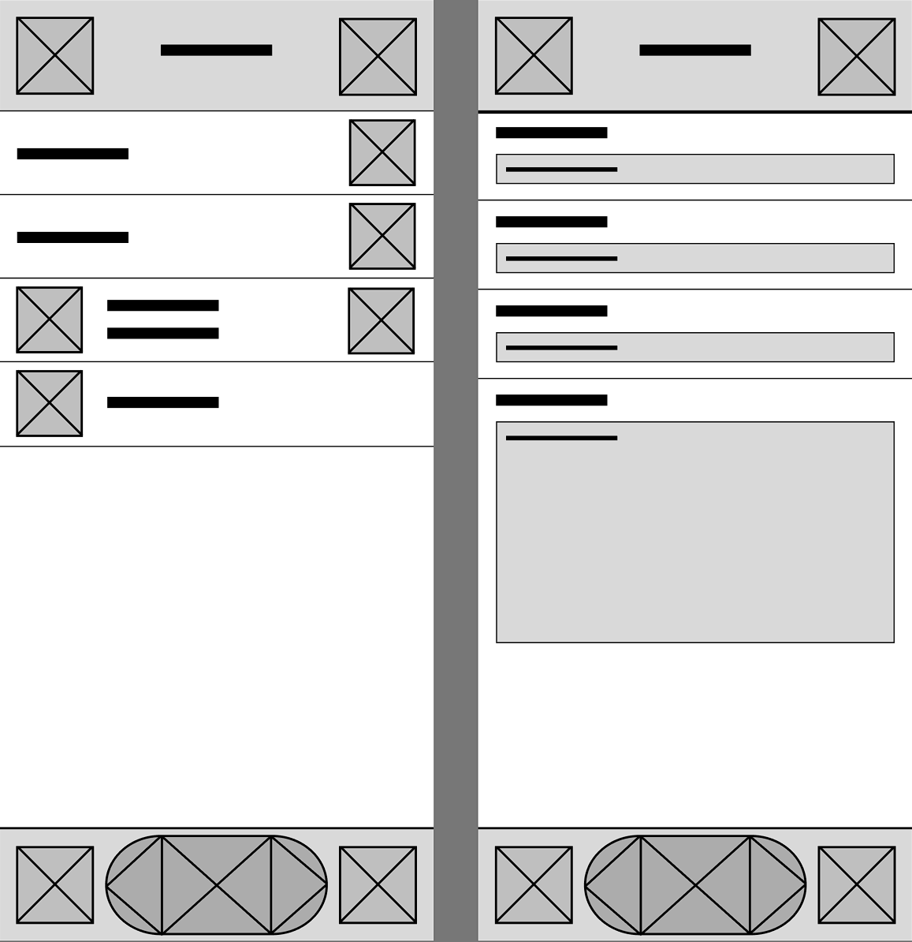
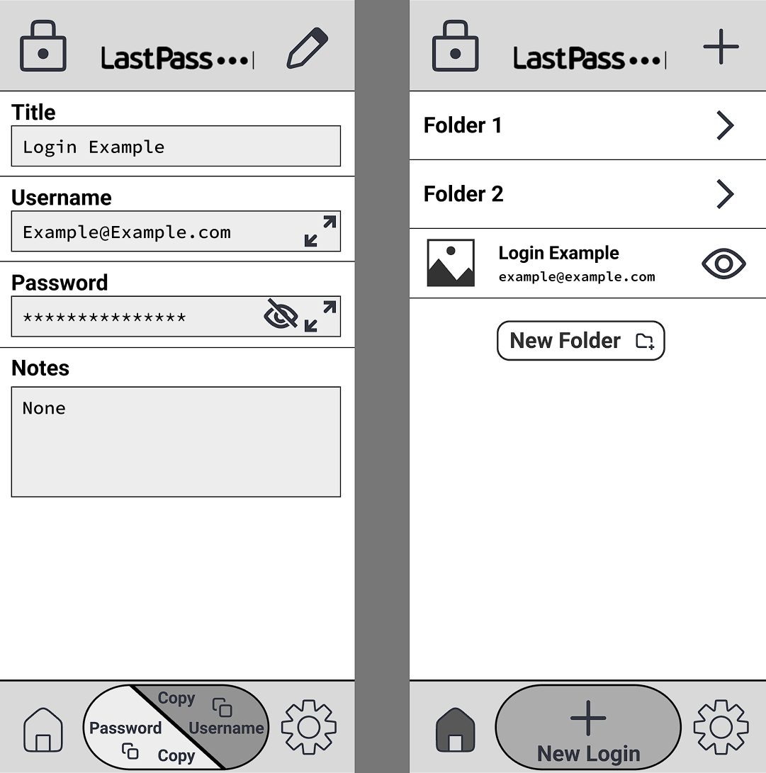
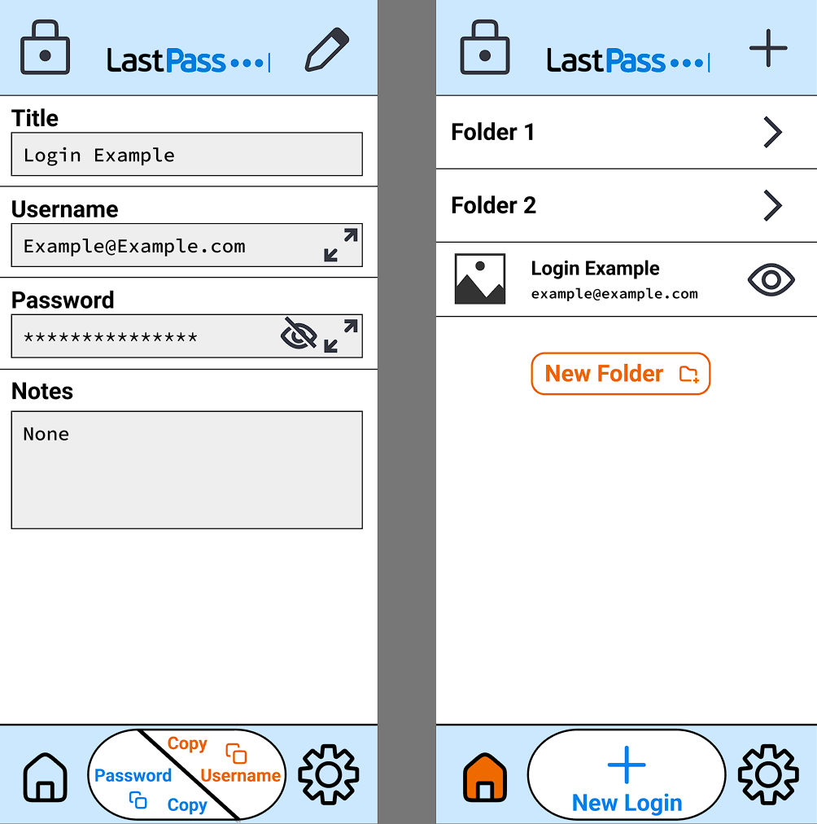


Process
Testing
Idea
Notes:
the process of how the lofi turned into the mefi and then the hifi

Slide 10
What’s Left?
Decrease time for common tasks
Remove popups
Change the colour palette!!!
Remove premium from nav bar
Add a lock button
Increase reachability of common buttons
Decrease time for common tasks
Remove popups
Change the colour palette!!!
Remove premium from nav bar
Add a lock button
Increase reachability of common buttons
Notes:
Decrease time isn’t as simple to fix – we have to test it

Slide 11
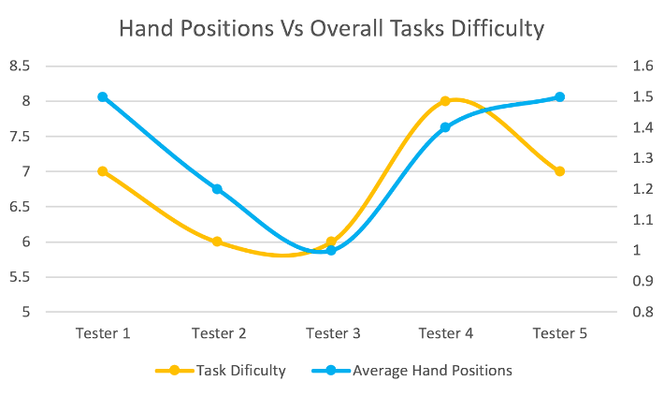
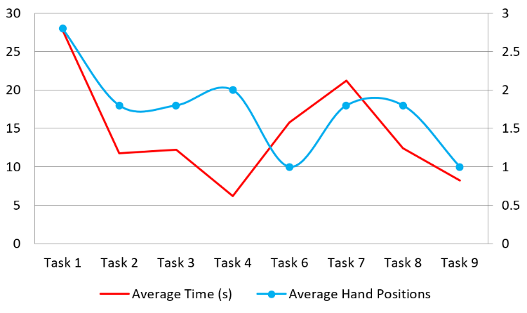
Results From RESEARCH
Notes:
Previous results from RESEARCH

Slide 12
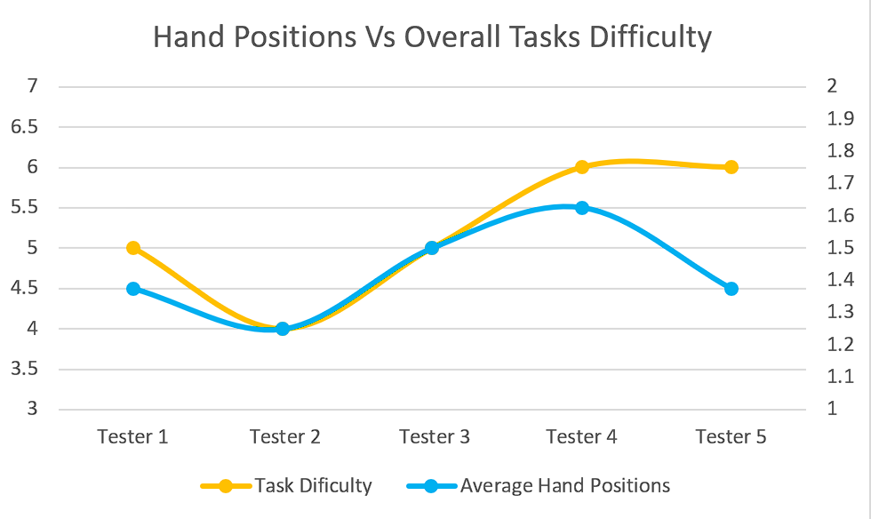




NEW Results From TESTING
Notes:
Same tests – same testers – same recording method

Slide 13
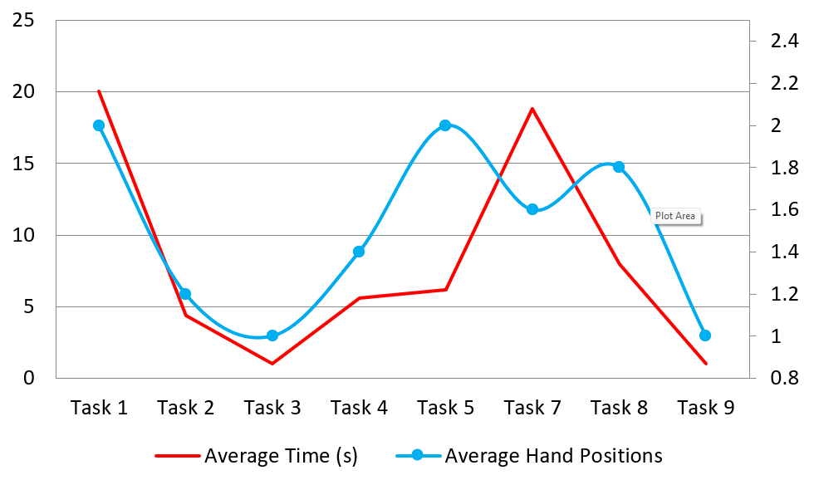
NEW Results From TESTING
Notes:
Same tests – same testers – same recording method

Slide 14
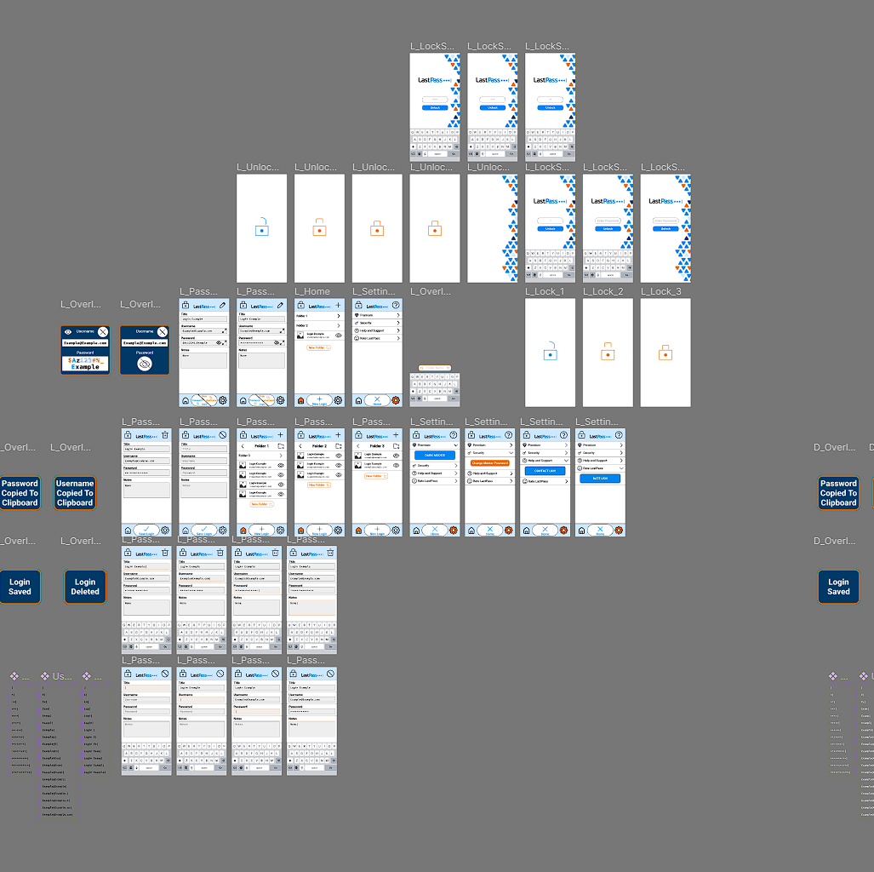
Figma Prototype (LoFi-Mefi-HiFi)
https://www.figma.com/file/cDpvMNjHZ7ehgAz22uOeea/LastPass?node-id=0%3A1&t=FfG8nEGVPc8Bug2a-1
Notes:
Finally I would like to show the prototype in action

Slide 15

Thank You!
Questions?

