Slide 1
Write Fight
Cs202.2
Alex.C Liam.K Alex.L Will.T

Slide 2

concept
“Write Fight” is a 2D word battler where 2 players face off against each other to gain points and overcome their opponent by placing words onto a grid.
Words can be placed horizontally and vertically. You can use letters already on the grid to affect your word. Players are given a set number of randomly selected letters each battle round which they are tasked with creating a word with. After each round the players are given points dependant on how long their words are or which letters, they use to create said word.

Slide 3
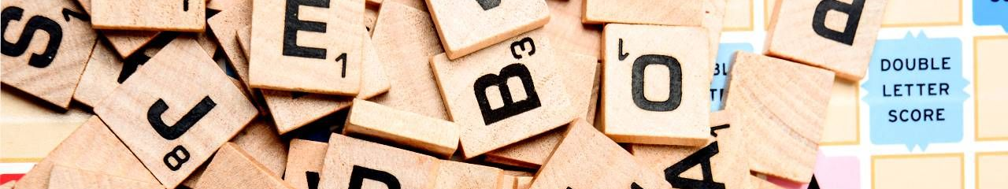
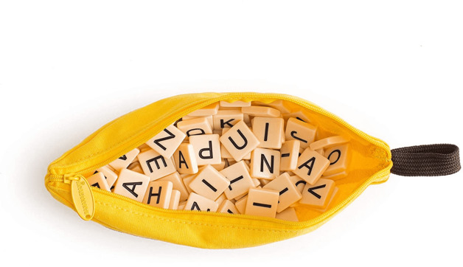
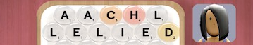
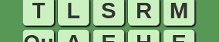
Insporations
SCRABBLE
Bananagrams
Words vs words
Serpentine

Slide 4











Tools used
Collaboration Tools
Trello
Microsoft Word
Microsoft Teams
Visual Studio Code
GitHub
GitHub Desktop
Figma
Miro
Python
Flask Framework

Slide 5

Target Audience
Write Fight caters to a wide selection of people due to its competitive nature, possible applications in education and the linguistics challenge it brings. The game is applicable to all ages due to its educational potential with its ability to tutor kids in grammar in a fun and interactive way or for adults wanting too mentally stimulate themselves with a gaming experience.

Slide 6
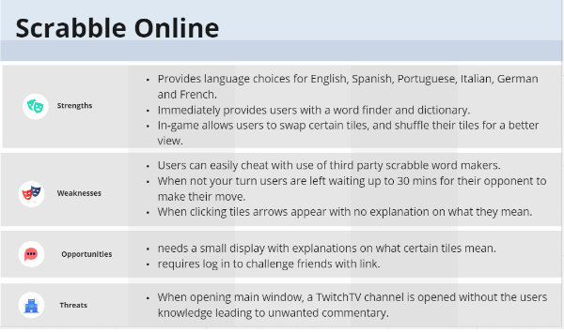
swot

Slide 7
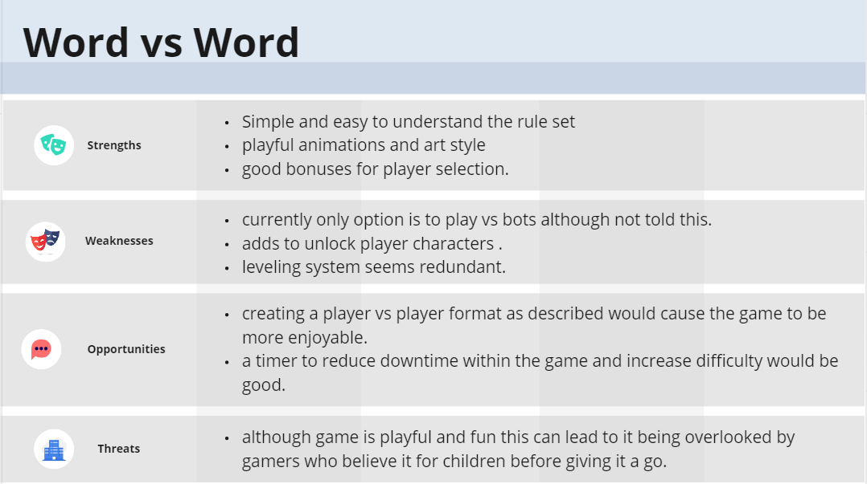
swot

Slide 8
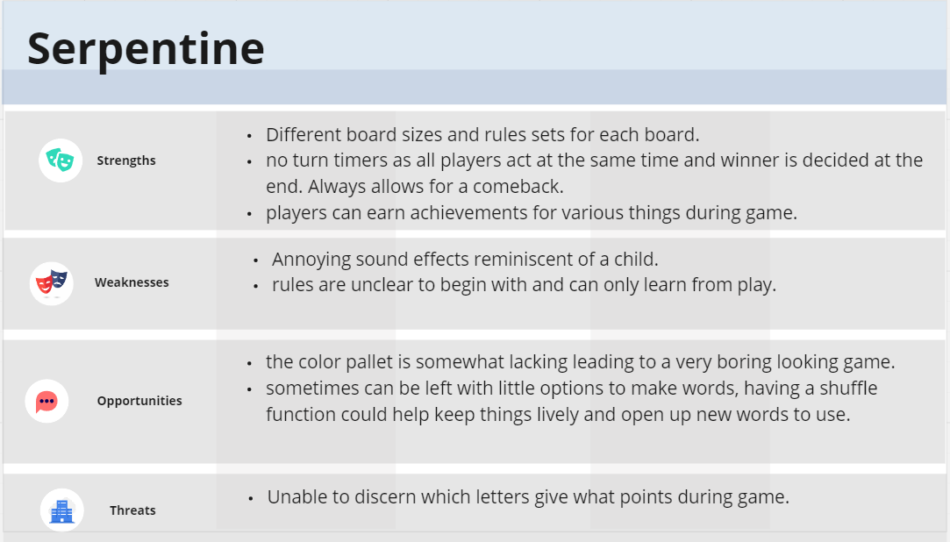
swot

Slide 9
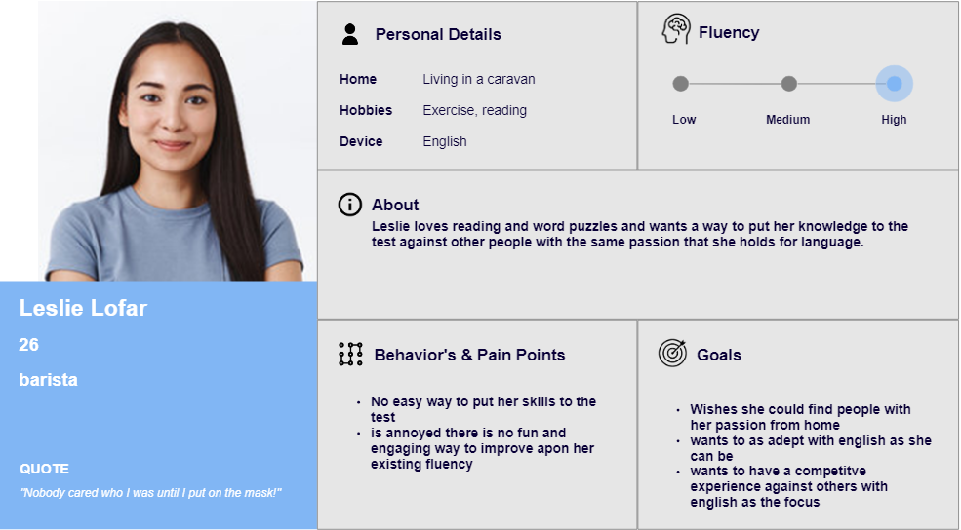
Persona

Slide 10
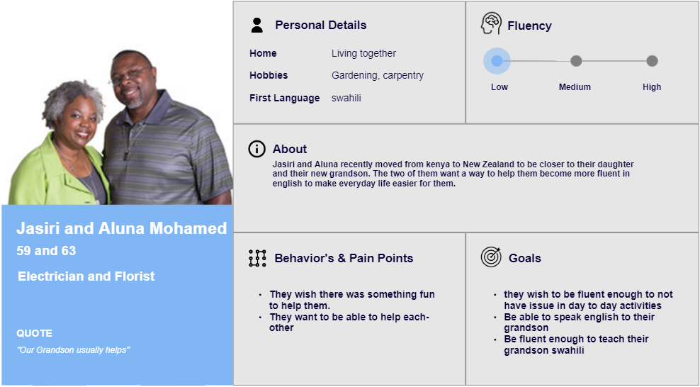
Persona

Slide 11
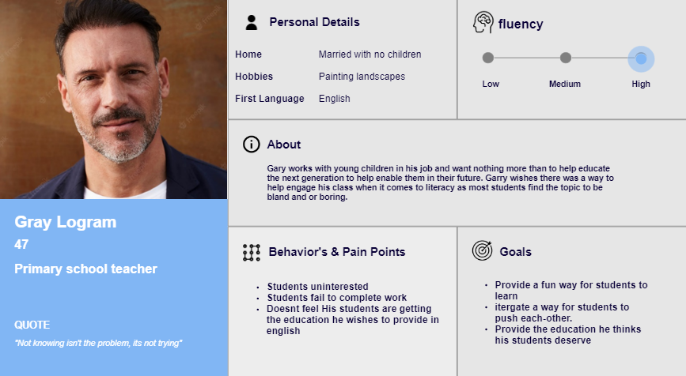
Persona

Slide 12
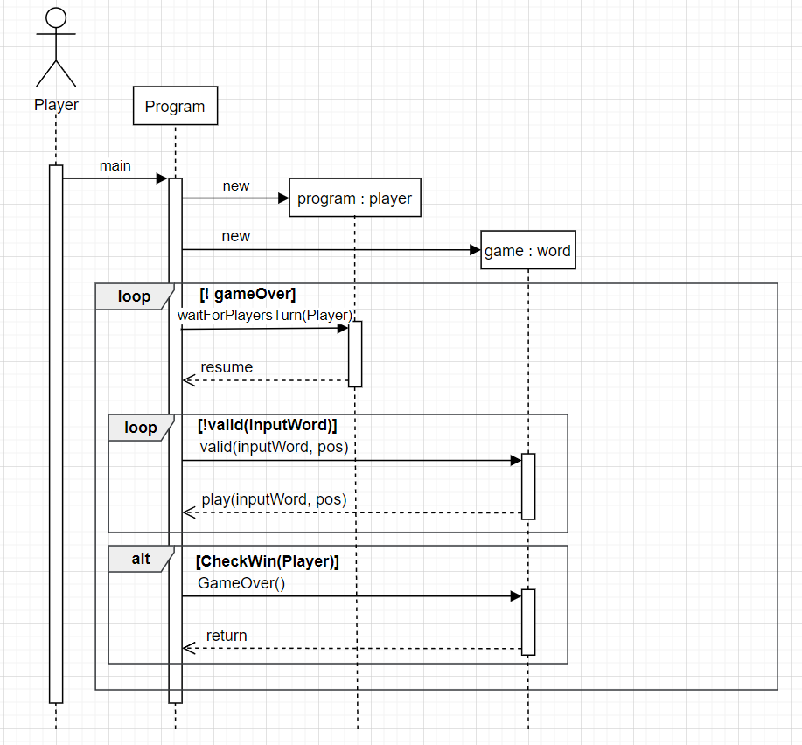
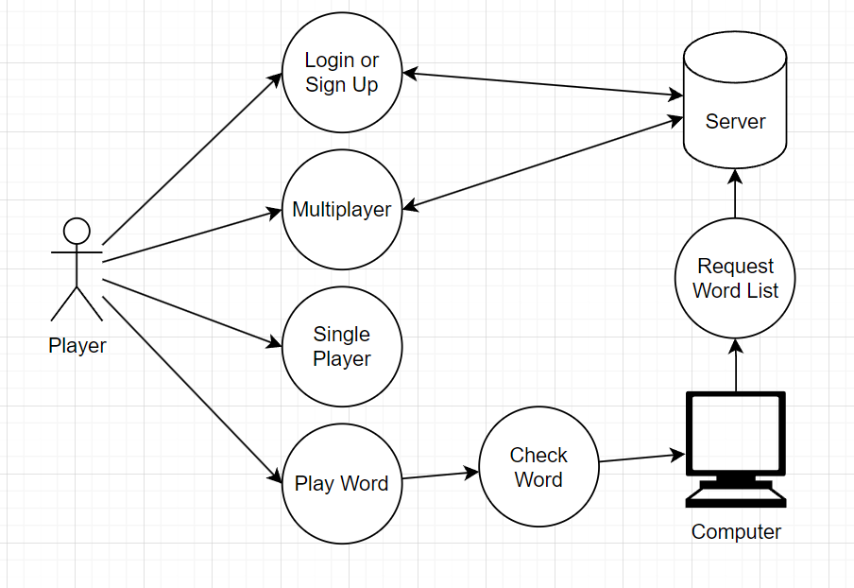
UML Diagrams

Slide 13
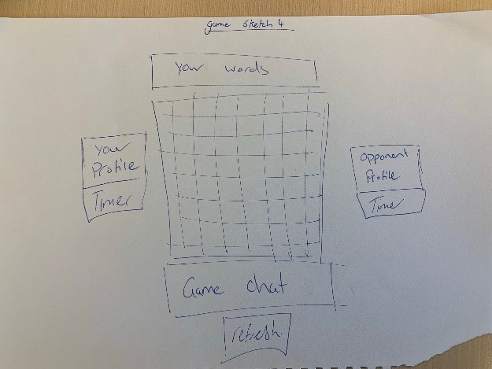
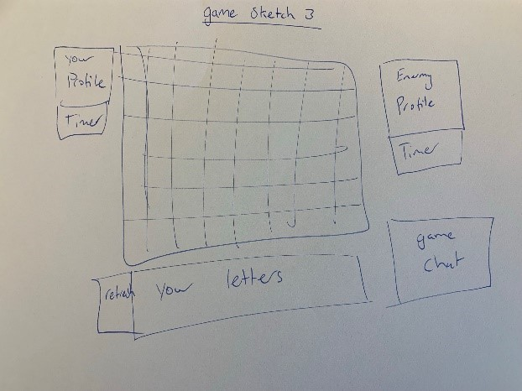
Early prototypes

Slide 14
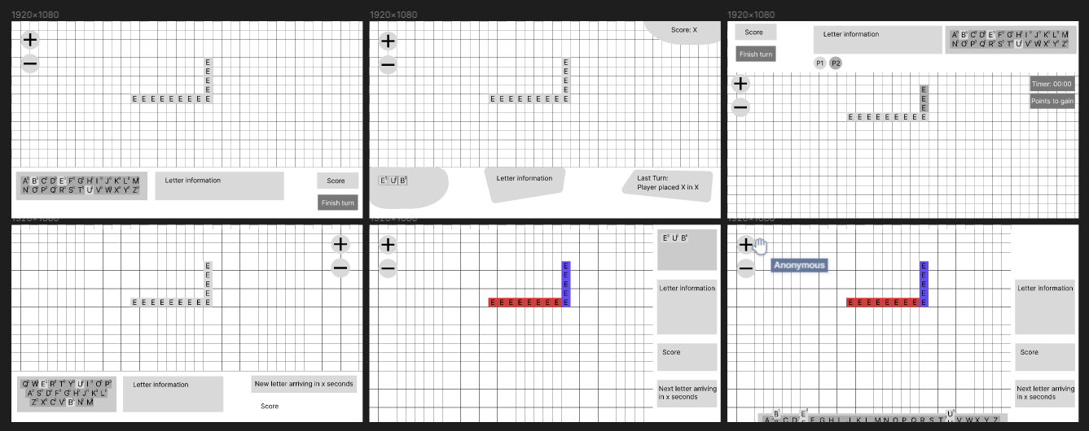
Lo-fi

Slide 15
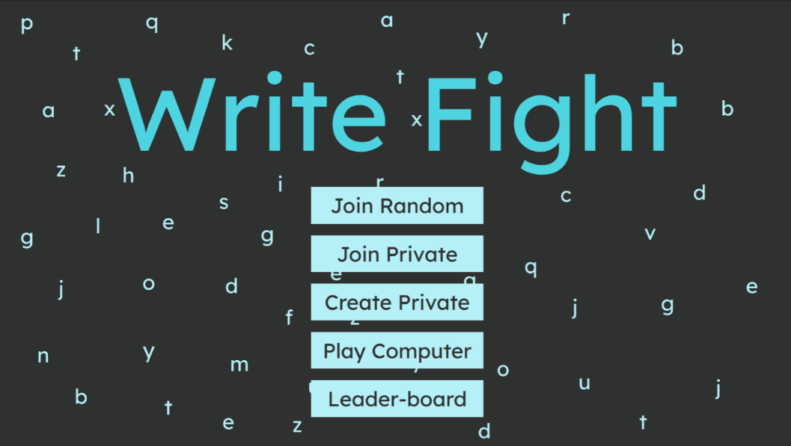

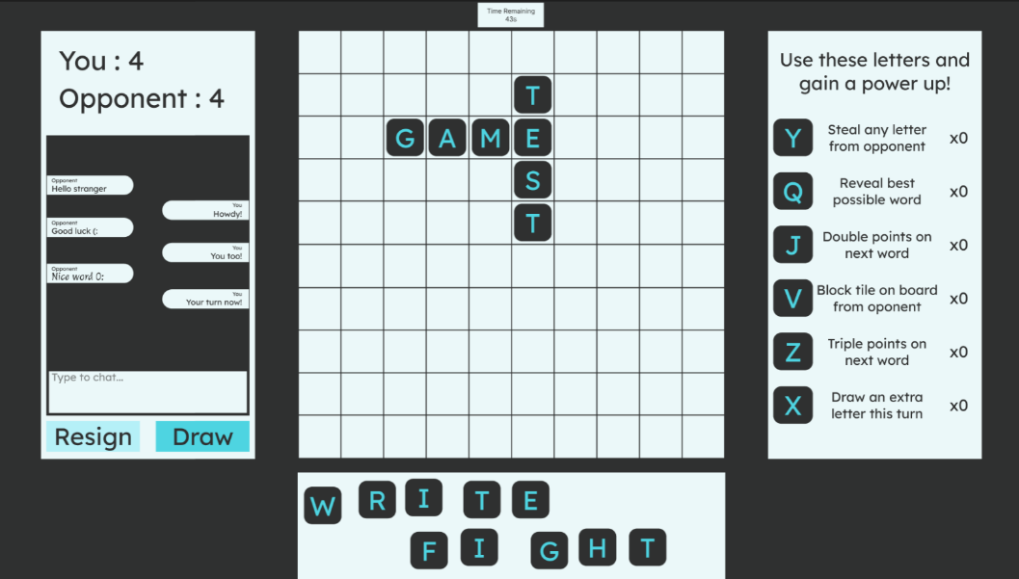
Hi-fi

Slide 16
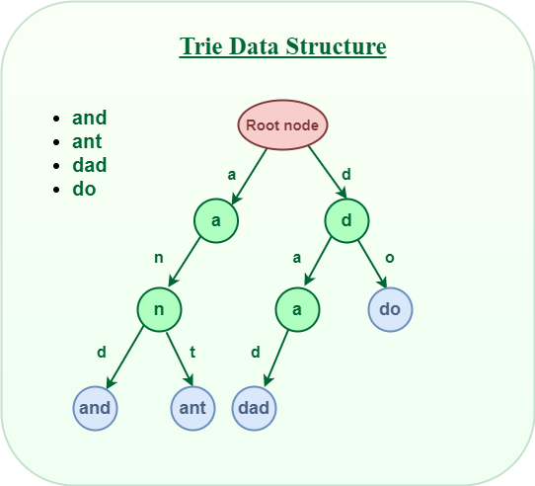
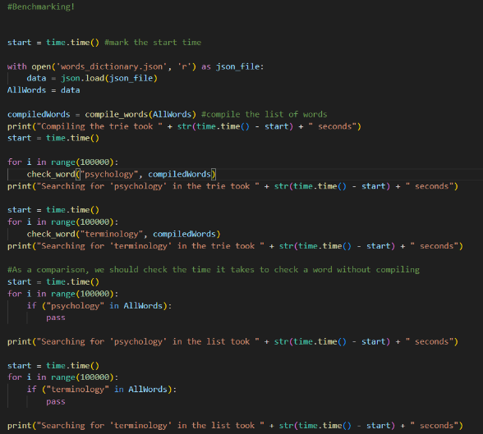
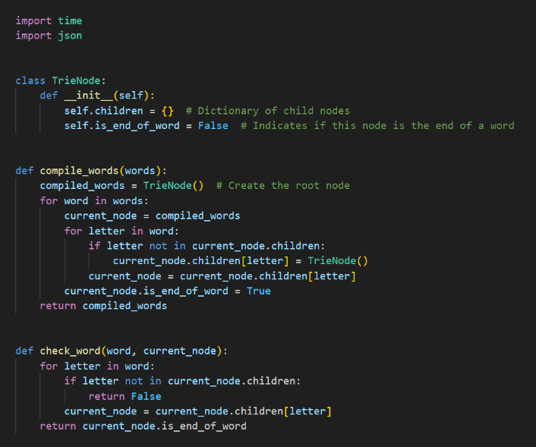
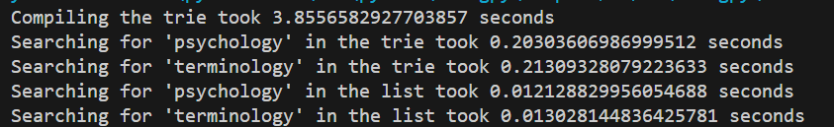
Concept Code – Trie vs List

Slide 17

The End

