Slide 1
Architects In Void
Alex Legner | Will Tetzlaff
CS301.2

Slide 2
About The Project
What is the project about?
What is the primary goal of the project?
What are the objectives of the project?

Slide 3
Timeline
Phase 1: Project Proposal
1
Week 1->3
Phase 2: IDD + SRS Research
2
Week 4->8
Phase 3: MVP Development
3
Week 9->16
Phase 4: R&D Report
4
Week 9->16

Slide 4
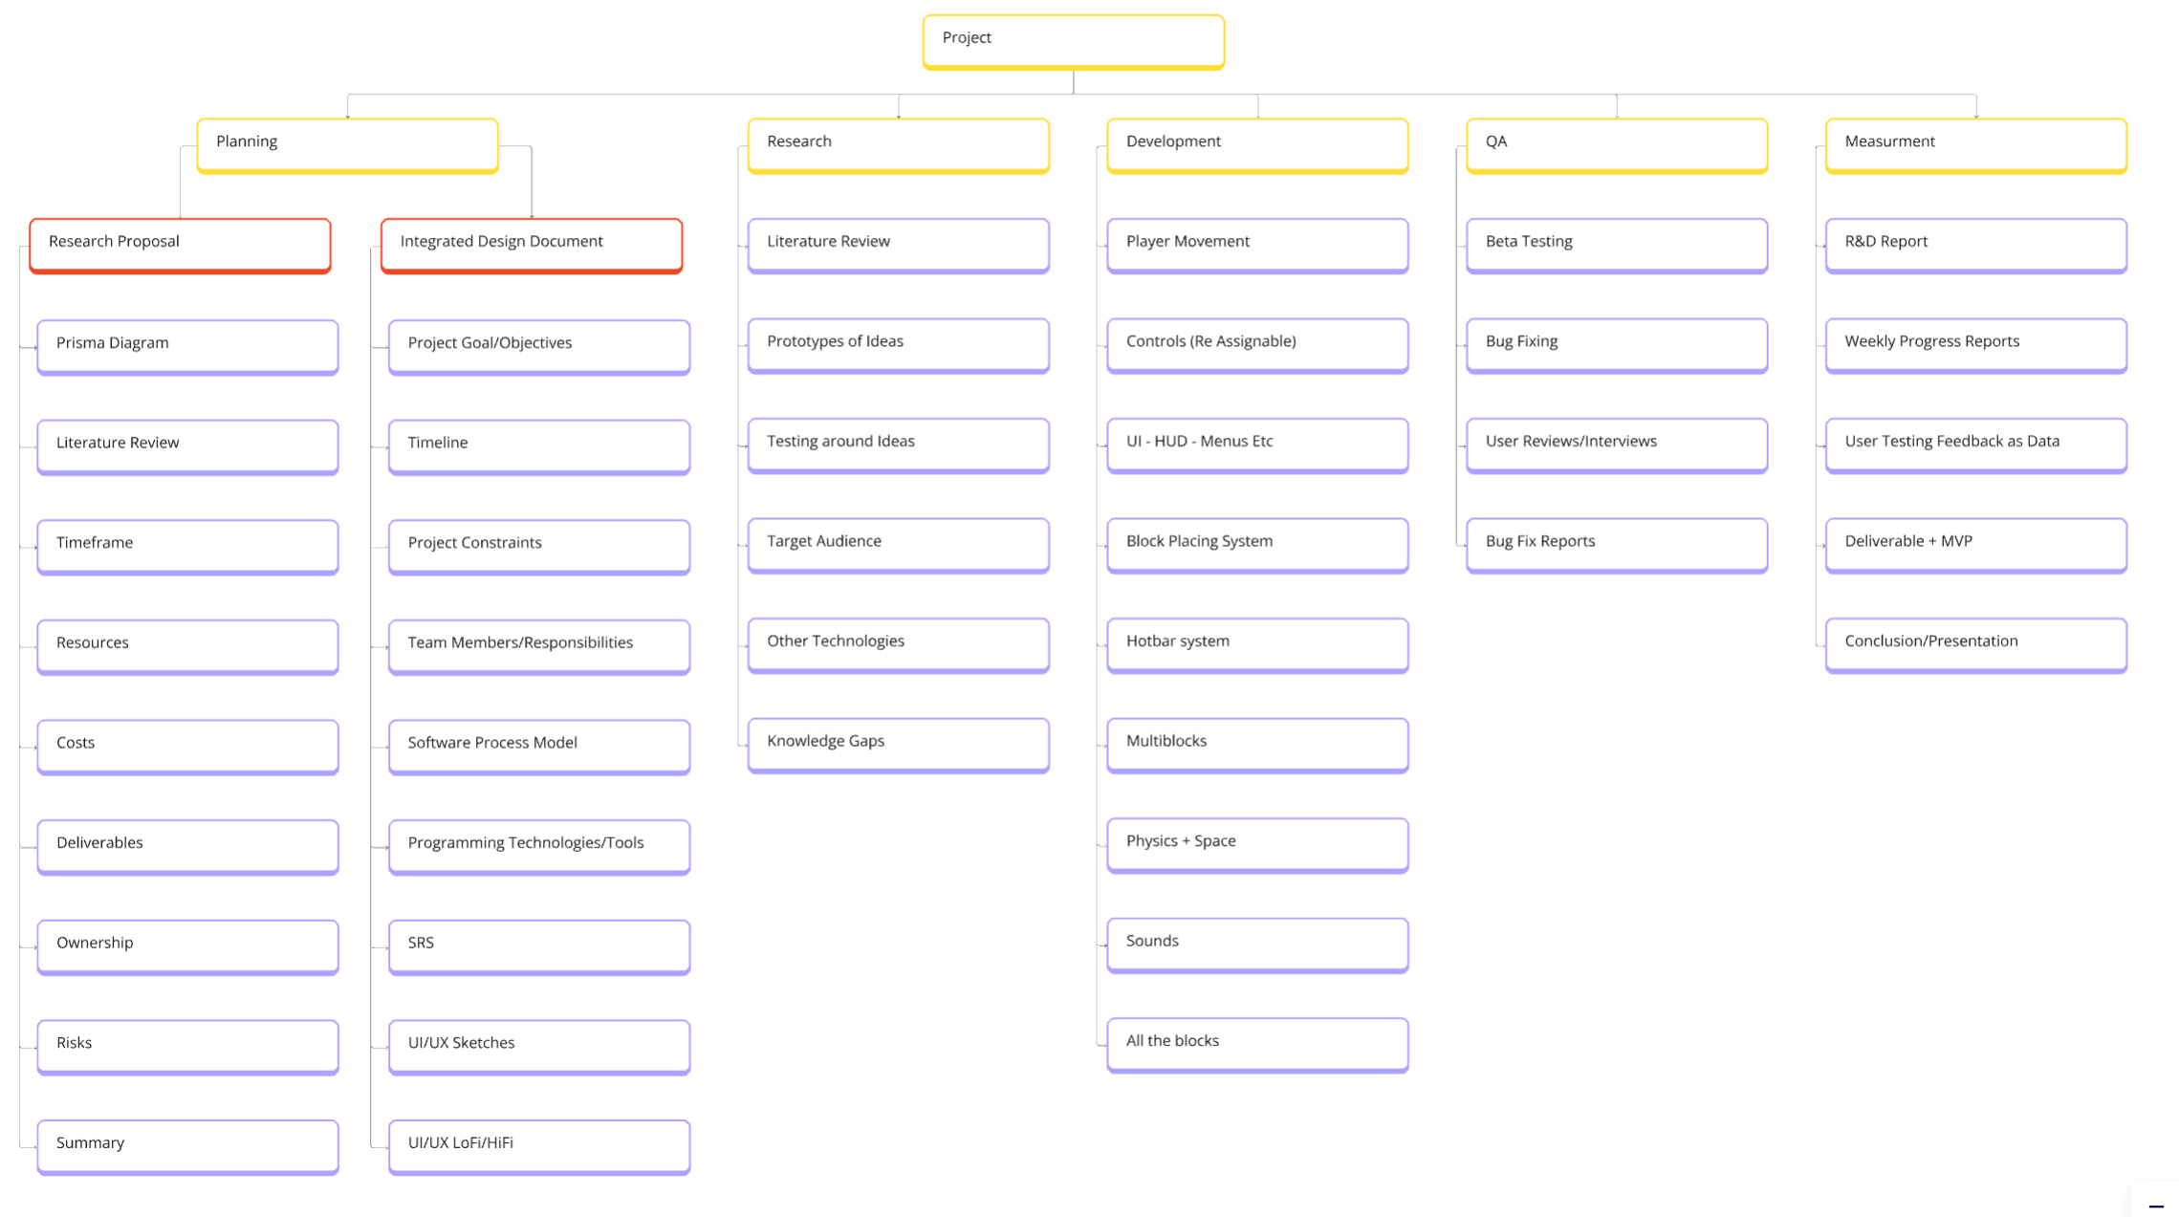
Work Breakdown Structure

Slide 5
Tools Used
Trello
Figma
Miro
MS – Word & PowerPoint & Teams
GitHub
Godot – C# & GDScript

Slide 6
Why Godot?
Open source
Easy to use
No fees ever
64bit/double floating points within transforms
Git integration
Learning Experience

Slide 7
SRS Outline
SRS Introduction
System Features and Requirements:
System Environment Overview
Users Requirements
Functional Requirements
Non-Functional Requirements
Prioritization and Negotiation
System Features
Interface Requirements
System Architecture
Use Cases and Supporting Diagrams:
Use cases for each type of user
Class diagram
Activity diagram

Slide 8
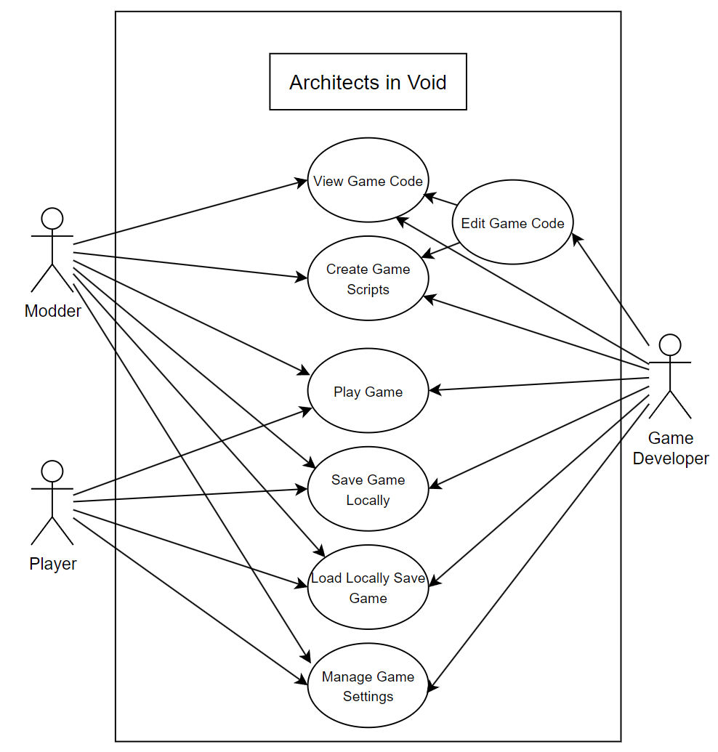
System Environment Overview

Slide 9
Functional Requirement
Create New Worlds
Load Existing Worlds
Delete Existing Worlds
Manage Game Settings
Save World
Exit Game
Manoeuvre Character
Manoeuvre Ship
Add New Blocks to Ship/Base
Complete or “Repair” Existing Blocks to Ship/Base
Interact with Objects
Interact with NPCs
Interact with Inventory
Mine Resources
Pause the Game
Manage Custom Scripts

Slide 10
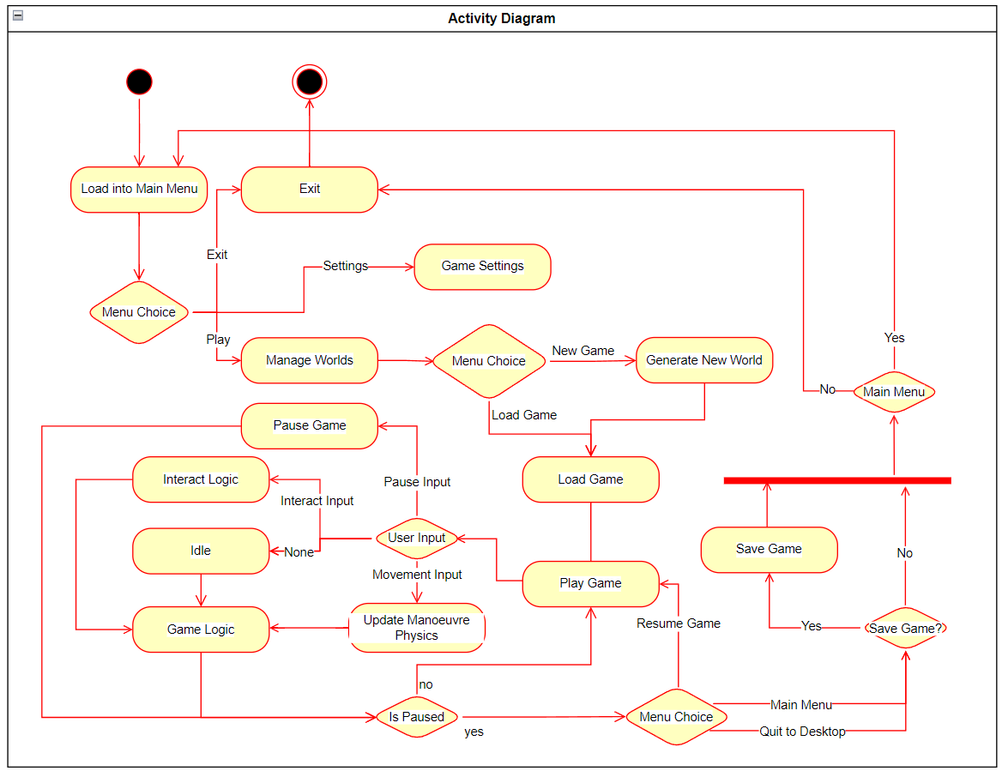
Activity Diagrams

Slide 11
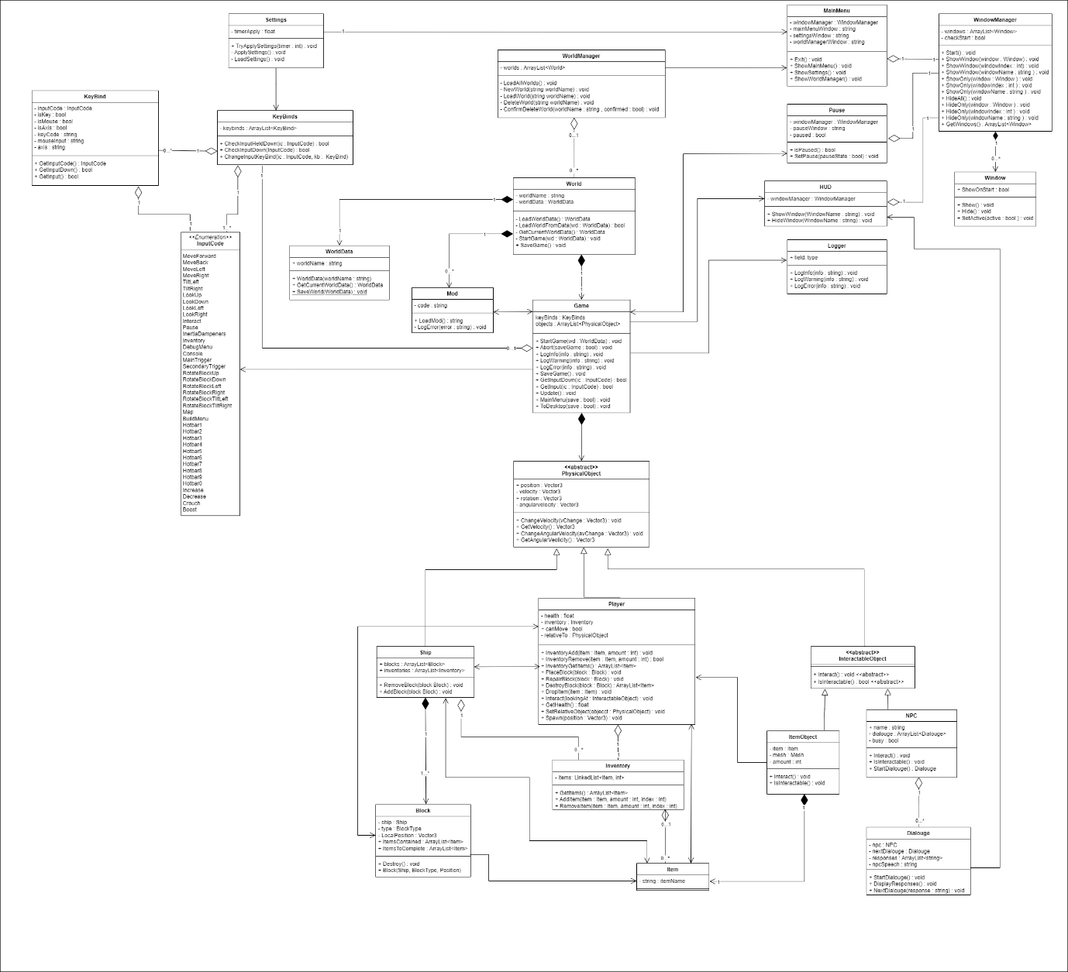
Class Diagram

Slide 12
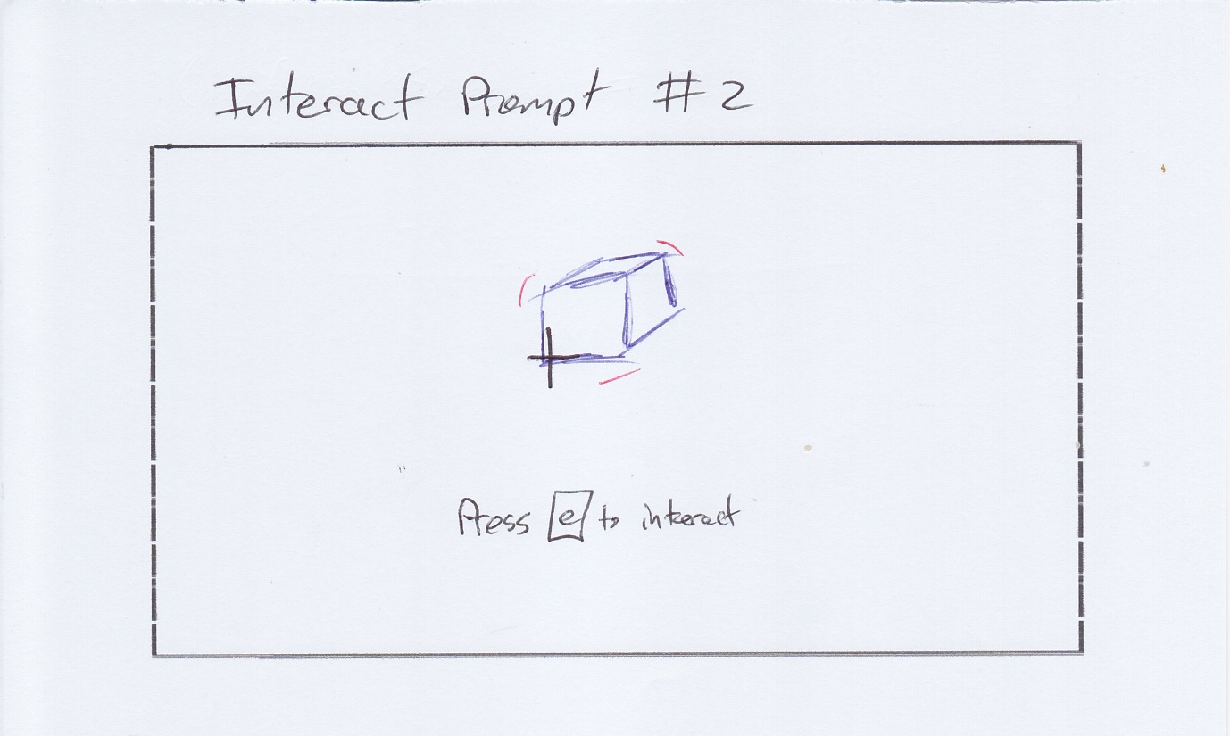
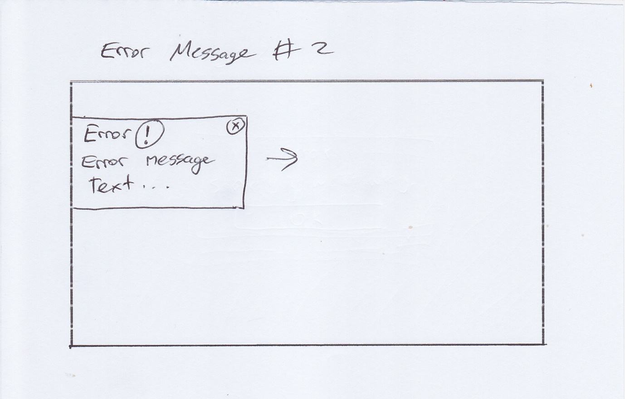
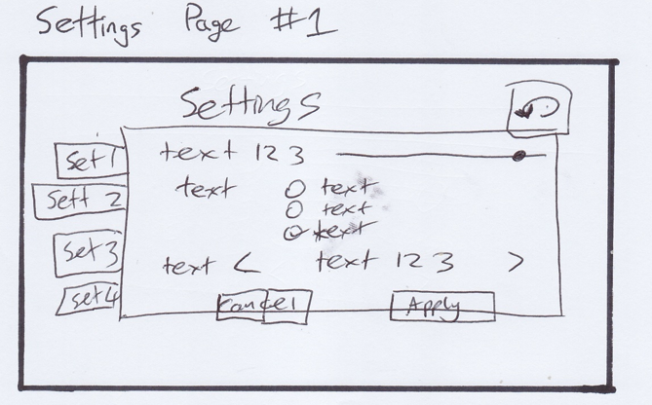
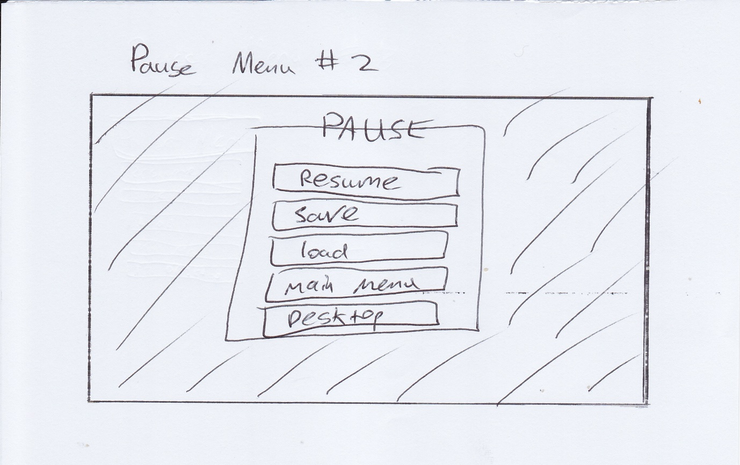
UI/UX Sketches

Slide 13
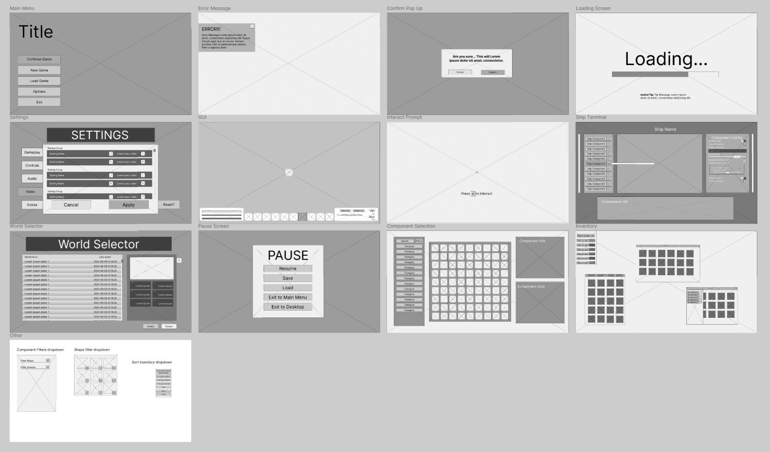
UI/UX LoFi

Slide 14
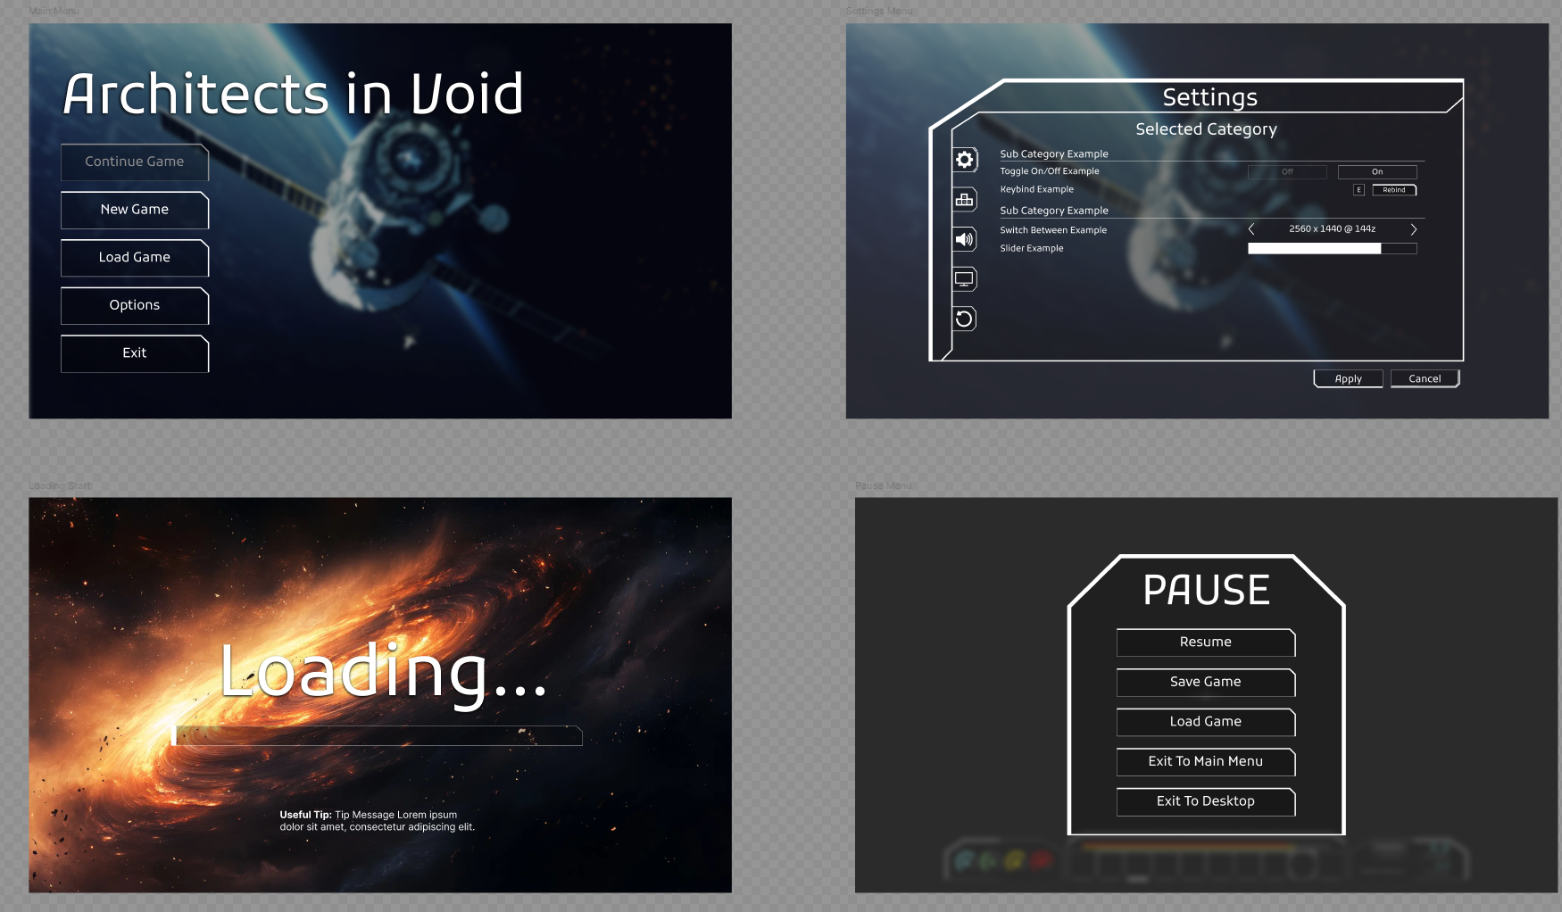
UI/UX HiFi

Slide 15
Questions?

Slide 16
The End

