Slide 1
Predicting US Accident Severity
A Machine Learning Comparison on 6.9M Real-World Records
6.9M records • 63 features • 4 models
DATS 6202 — Machine Learning I | Spring 2026 | Final Project
Notes:
Welcome everyone. Our project tackles accident severity prediction using the US Accidents dataset from Kaggle — 6.9 million real records spanning 2016 to 2023. The goal is to predict how severe an accident is on a 1 to 4 scale, so emergency services can prioritize their response. We compared four different machine learning models — Logistic Regression, Random Forest, LightGBM, and a neural network. Over the next ten minutes we'll walk you through the dataset, our exploratory analysis, the cleaning and feature engineering process, the four models we trained, and our final results. Let's get started.

Slide 2
01 / INTRODUCTION
Introduction & Problem
THE PROBLEM
SEVERITY SCALE
Traffic accidents cost the US $340 billion annually and cause over 40,000 deaths.
1
Minor — short delay, no injuries
0.97%
of dataset
OUR GOAL
2
Moderate — typical accident
77.6%
Predict accident severity (1=minor → 4=severe) from time, location, weather, and road features so emergency services can prioritize response.
of dataset
3
Significant — major delay, injuries
18.8%
of dataset
WHY IT'S HARD
4-class classification problem
Severe class imbalance (79.7% are Severity 2)
Non-linear relationships between features
4
Severe — long shutdown, fatal risk
2.6%
of dataset
US Accidents Severity Prediction • DATS 6202
Notes:
First, the problem and motivation. Traffic accidents cost the United States about 340 billion dollars every year and cause more than 40,000 deaths. Faster, smarter emergency response saves lives. Our goal is to predict the severity of an accident on a four-point scale using time, location, weather, and road features. If our model can flag severe accidents quickly, emergency services know where to send resources first. But this problem is hard for three reasons. First, it's a four-class classification, not just yes or no. Second, the data is severely imbalanced — almost 80 percent of accidents are Severity 2, which biases naive models toward always predicting 2. Third, the relationships between features and severity are highly non-linear. On the right you can see the severity breakdown — Severity 1 and 4 together are less than 4 percent of the data, which makes them especially hard to learn.

Slide 3
02 / DATA
Dataset Overview
7.7M
46
49
7.3 GB
Original records
Original columns
US states
Memory footprint
2016 → March 2023
before engineering
national coverage
before optimization
DATA SOURCE
FEATURE CATEGORIES
Sobhan Moosavi — US Accidents (March 2023)
Time
Start, End, duration
Public dataset hosted on Kaggle
Aggregated from MapQuest, Bing, and traffic APIs
Continuous coverage from Feb 2016 to Mar 2023
Each row is a single recorded traffic accident
Location
Lat, Lng, City, State, Zip
Weather
Temp, Humidity, Visibility, Wind, Precip
Road
Junction, Crossing, Stop, Traffic Signal...
Twilight
Day/Night, Civil/Nautical/Astro
Target
Severity (1–4)
US Accidents Severity Prediction • DATS 6202
Notes:
Now let's introduce the dataset. We used the US Accidents dataset by Sobhan Moosavi, hosted on Kaggle. It contains 7.7 million recorded accidents from February 2016 through March 2023 across all 49 mainland US states. Each row is a single accident. The raw data has 46 columns and takes up 7.3 gigabytes in memory — that's already a challenge on free Google Colab. The features fall into six categories: time information like start and end times, location data like latitude and longitude and state, weather conditions including temperature and precipitation, road characteristics like whether the accident was at a junction or near a traffic signal, twilight indicators that show whether it happened during day or night, and finally our target — Severity, on a scale from 1 to 4.

Slide 4
03 / CLEANING
Data Cleaning Pipeline
1
Drop useless columns
RESULT
Country (1 unique value), End_Lat/Lng (44% missing), Description (free text), Wind_Chill (correlated with Temperature)
Before
7,728,394 × 46
2
Fix impossible outliers
Temperature > 207°F → NaN, Wind Speed > 1087 mph → NaN, Pressure = 0 → NaN, Visibility > 140 mi → NaN
↓
After
3
Imputation
6,985,228 × 40
Precipitation NaN → 0 (no rain reported), other numeric NaN → median, categorical NaN → 'Unknown'
0 nulls remaining
4
Drop bad timestamps
Memory: 7.3 GB → 5.4 GB
743,166 rows with unparseable Start_Time or End_Time dropped — useless for time-based features
via dtype optimization
Loaded in chunks of 500k rows to stay within free Colab RAM
US Accidents Severity Prediction • DATS 6202
Notes:
Cleaning was a four-step pipeline. Step one: we dropped useless columns. Country had only one unique value — every row was US. End_Lat and End_Lng were missing 44 percent of the time. Wind Chill was 26 percent missing and highly correlated with Temperature, so it added little. Step two: we fixed obvious outliers. The raw data had a temperature reading of 207 degrees Fahrenheit and a wind speed of 1087 miles per hour — clearly data errors. We set those to NaN. Step three: imputation. We assumed that missing precipitation simply meant no rain was reported, so we filled it with zero. Other numeric nulls got the median, and categorical nulls got the label 'Unknown'. Step four: 743,166 rows had unparseable timestamps. Without valid start and end times we can't build any time features, so we dropped them. After all this we ended up with about 7 million clean rows across 40 columns and zero remaining nulls, dropping memory from 7.3 to 5.4 GB.

Slide 5
04 / FEATURE ENGINEERING
Feature Engineering — 23 New Features
Calendar features
Behavioral flags
start_year, start_month, start_day
start_hour, start_minute
start_dayofweek, start_quarter, weekofyear
is_weekend, is_business_hours
is_morning_rush (7–9 AM)
is_evening_rush (4–6 PM), is_rush_hour, is_night
Categorical buckets
Cyclical encoding
part_of_day (Morning/Afternoon/Evening/Night)
season (Winter/Spring/Summer/Fall)
Built with vectorized pd.cut()
hour_sin, hour_cos
dayofweek_sin, dayofweek_cos
month_sin, month_cos — preserves cycles
+ duration_min capped at 99th percentile (779.9 min ≈ 13 hrs) — data-driven, not arbitrary → Final shape: 6.9M × 63
US Accidents Severity Prediction • DATS 6202
Notes:
From the cleaned data we engineered 23 new features in four groups. First, calendar features — extracting year, month, day, hour, day of week, quarter and week of year from the timestamps. Second, behavioral flags — is it a weekend, is it morning rush hour, evening rush hour, business hours, or night-time? Third, categorical buckets — we used pandas cut to vectorize part of day and season, which is much faster than apply on 7 million rows. Fourth, and most importantly, cyclical encoding using sine and cosine. This is critical because hour 23 and hour 0 are one hour apart in real life, but a model would treat them as 23 hours apart numerically. Sine and cosine make the cycle continuous. We applied the same trick to day of week and month. We also computed accident duration in minutes and capped it at the 99th percentile — about 13 hours — which is a data-driven cutoff rather than a guess. Final shape going into modeling: 6.9 million rows by 63 columns.

Slide 6
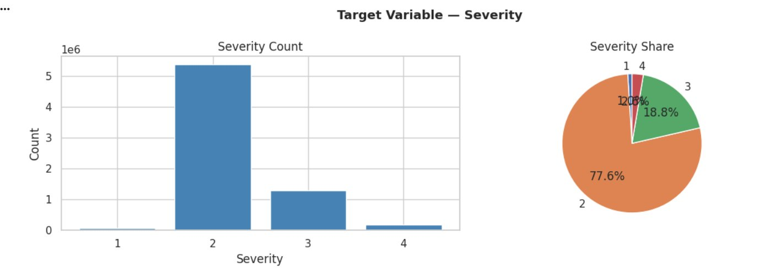
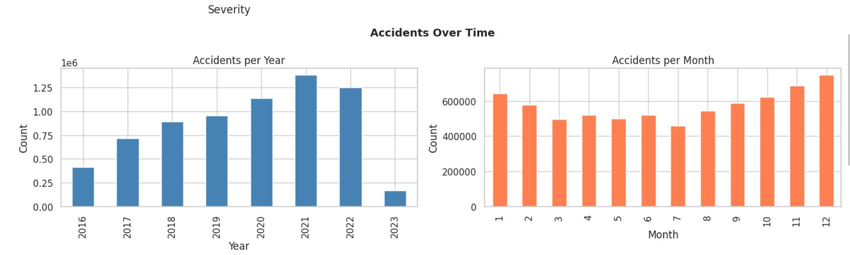
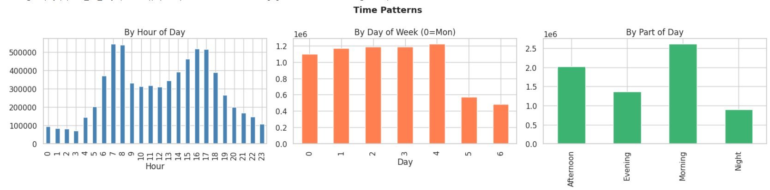
05 / EXPLORATORY ANALYSIS
EDA — Target & Time Trends
INSIGHT: Two clear rush-hour peaks (8 AM, 5 PM) • weekends quieter • rising trend 2016 → 2021 • 2023 partial year only
US Accidents Severity Prediction • DATS 6202
Notes:
Now let's look at exploratory data analysis. The top-left chart shows our target distribution. As we mentioned, Severity 2 is the dominant class at 77.6 percent. Severity 1 and 4 are extremely rare. This imbalance is the single biggest challenge of this project. The top-right chart shows accidents over time. There's a clear upward trend from 2016 to 2021, likely reflecting better data collection rather than more accidents. The drop in 2023 is just because the dataset ends in March. The bottom row shows time of day patterns. There are two clear peaks — around 8 in the morning and 5 in the evening, exactly the rush hours we engineered features for. Weekends, days 5 and 6, have noticeably fewer accidents than weekdays. Mornings are the busiest part of the day. These patterns confirmed that our time-based features should carry real predictive signal.

Slide 7
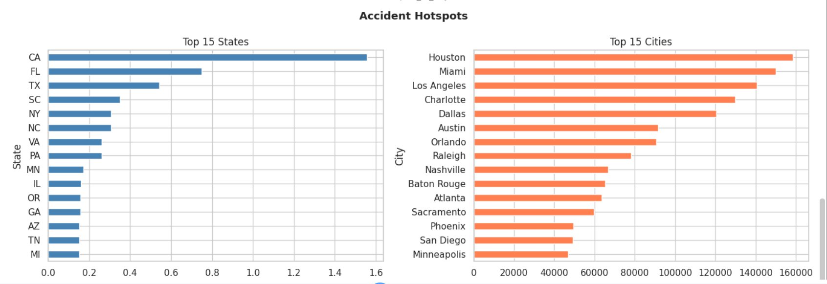
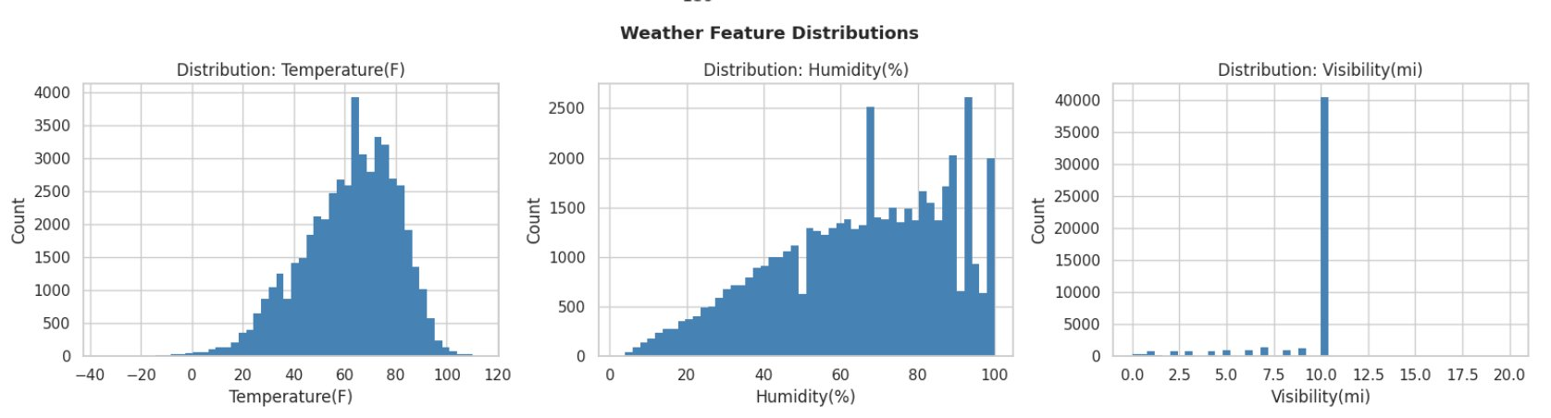
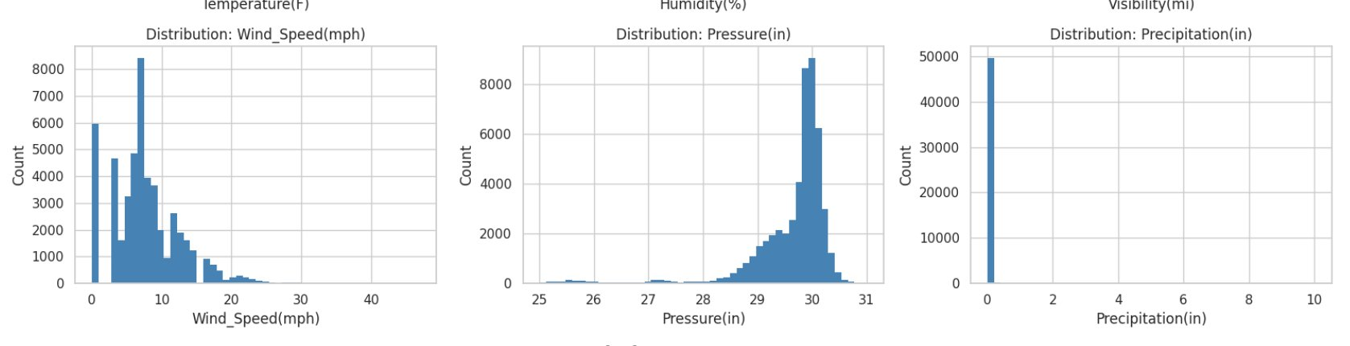
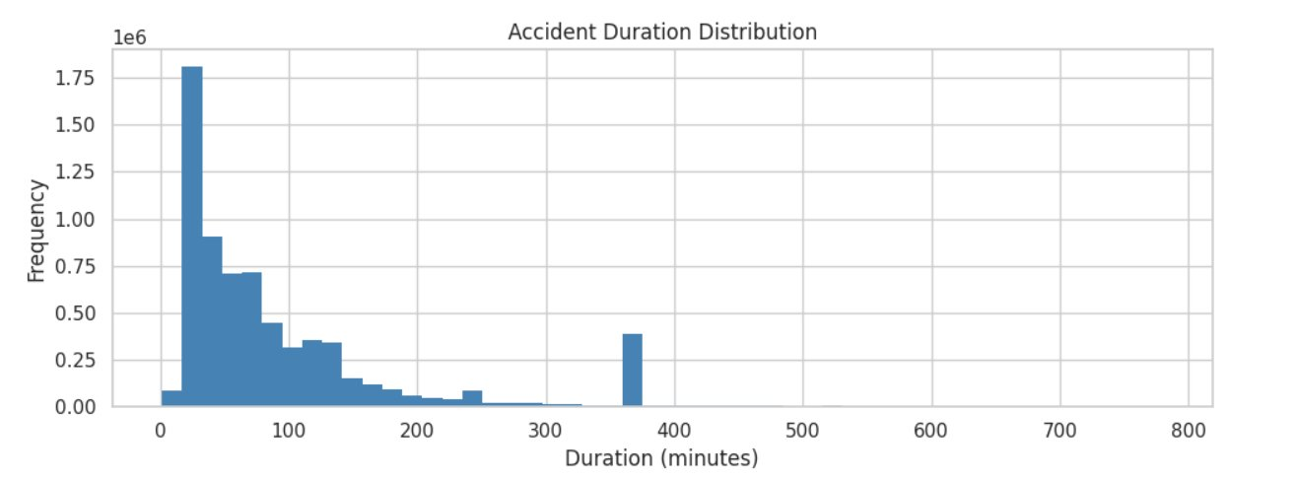
05 / EXPLORATORY ANALYSIS
EDA — Geography & Weather
INSIGHT: CA, FL, TX dominate • visibility spike at 10 mi (default value, treat with caution) • duration heavily right-skewed
US Accidents Severity Prediction • DATS 6202
Notes:
Geographic analysis shows that California, Florida, and Texas dominate the dataset — together they make up nearly half of all accidents. This partly reflects population but also reporting bias from the data sources. Houston, Miami, and Los Angeles top the city ranking. On the weather side, temperature follows a roughly normal distribution centered near 60 degrees Fahrenheit. We noticed a suspicious spike at exactly 10 miles for visibility — this is a default value used when visibility wasn't actually recorded, something we want any future iteration to be careful about. Pressure peaks tightly around 30 inches of mercury, which is normal atmospheric pressure. Precipitation is overwhelmingly zero — most accidents happen in dry conditions, not in storms. Duration is heavily right-skewed — most accidents resolve within an hour, but a long tail of multi-hour events exists, which is why we capped at the 99th percentile.

Slide 8
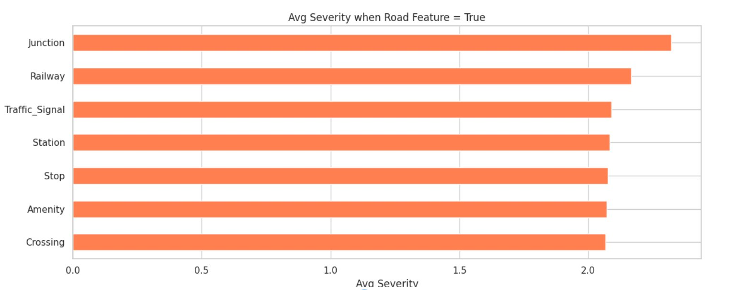
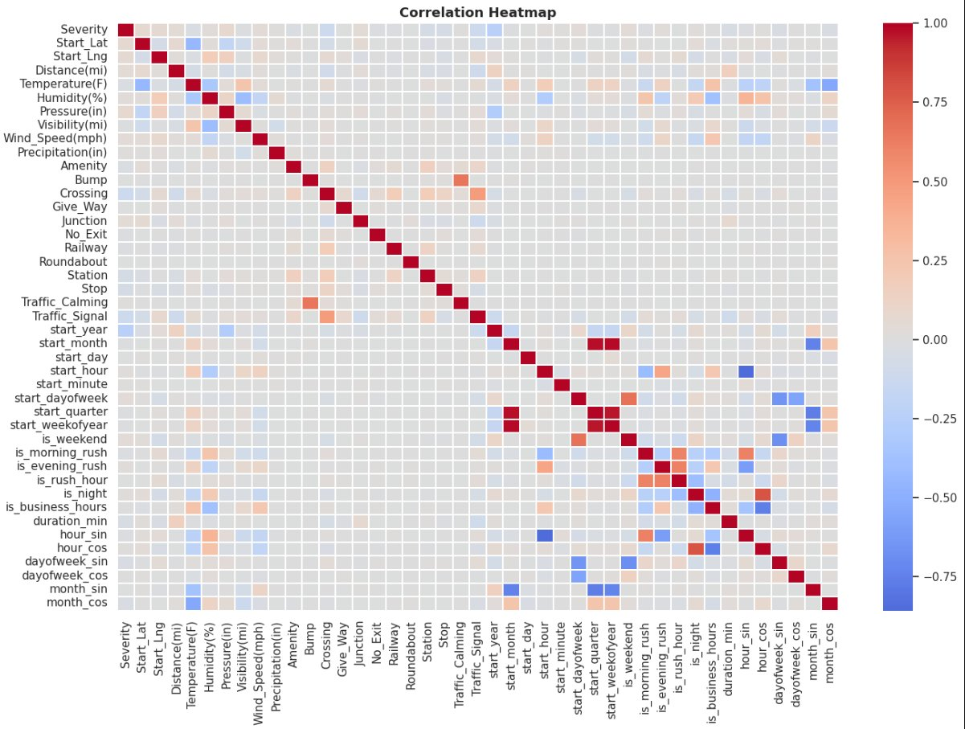
05 / EXPLORATORY ANALYSIS
EDA — Road Features & Correlations
INSIGHT: Junctions have the highest avg severity • weak feature-target correlations confirm this is a hard non-linear problem
US Accidents Severity Prediction • DATS 6202
Notes:
Road features matter. Junctions are the most dangerous — when an accident happens at an intersection, it's on average more severe. Railway crossings and traffic signals also correlate with higher severity. This makes intuitive sense: complex road geometry leads to worse outcomes. The correlation heatmap on the right tells an important story. Severity has very weak linear correlations with every individual feature — no single feature explains severity well. This is the single biggest takeaway from EDA: simple linear models will struggle, and we need non-linear models to capture the interactions. We can also see the cyclical features doing exactly what they should — hour_sin and hour_cos are uncorrelated with start_hour itself, providing genuinely new signal.

Slide 9
06 / METHODS
Experimental Methodology
Data
Load
→
Clean
+ Impute
→
Feature
Engineer
→
Sample
+ Encode
→
Train
+ GridSearch
→
Evaluate
+ Compare
CLASS-IMBALANCE STRATEGY
EVALUATION SETUP
class_weight = 'balanced'
Train / test split
80 / 20 • stratified
Why not undersampling?
GridSearch CV
3-fold cross validation
Would discard ~96% of data (5.3M+ rows)
Real Sev 2 patterns lost forever
Class weights solve it without data loss
Result: LightGBM Sev 1 recall = 0.95
Sample size
100k (LR, RF, MLP) • 500k (LightGBM)
Primary metric
Weighted F1 score
Secondary metrics
per-class recall (safety priority)
Why not accuracy
79.7% just by predicting Sev 2 — useless
US Accidents Severity Prediction • DATS 6202
Notes:
Now the methodology. Our pipeline follows six stages, shown across the top. After loading, cleaning, and feature engineering, we sampled and encoded the data, trained four models with grid-search hyperparameter tuning, and finally compared them. The key methodological choice was how to handle class imbalance. We deliberately chose class weights, set to 'balanced', over undersampling. Undersampling would have thrown away 96 percent of our data — over 5 million real Severity 2 patterns. Class weights tell the model that mistakes on rare classes cost more, without losing any data. The proof is in our final results — LightGBM achieves 95 percent recall on the rarest class, Severity 1. On the evaluation side, we used a stratified 80/20 train-test split with 3-fold cross validation during GridSearch. We trained on 100,000 rows for the lighter models and 500,000 for LightGBM. Our primary metric is weighted F1 score, not accuracy. Accuracy is misleading here — a naive model predicting Severity 2 every time would hit 79.7 percent accuracy and be completely useless. F1 balances precision and recall, and we also report per-class recall because in a safety system, missing a severe accident is much worse than a false alarm.

Slide 10
07 / MODELS
Model 1 — Logistic Regression
ROLE: BASELINE
WEIGHTED F1
Linear, interpretable, and fast — the model to beat.
0.5192
HYPERPARAMETERS (GridSearch)
C ∈ {0.1, 1}
solver = lbfgs
class_weight = balanced
Per-class F1
Sev 1
0.12
Sev 2
0.54
WHY THIS RESULT
Sev 3
0.52
Linear decision boundaries cannot capture the non-linear interactions between weather, location, and time. The 0.52 score is expected and validates moving to non-linear models.
Sev 4
0.15
Train time: 11.5s • Sample: 100,000 rows • Grid: 4 fits
US Accidents Severity Prediction • DATS 6202
Notes:
Our first model is Logistic Regression — the baseline. It's linear, fully interpretable, and trains in seconds. We tuned the regularization strength C and used class weights set to balanced. It scored 0.52 on weighted F1. That's not great, but it's exactly what we expected. The huge gap between Severity 2's F1 of 0.54 and Severity 1's F1 of just 0.12 shows that linear decision boundaries can't capture the relationships in this dataset. But this isn't a failure — it's the most important baseline. The 0.52 number is what the next three models need to beat, and all of them did. Logistic Regression proved that we needed non-linear models, which justifies everything that follows.

Slide 11
07 / MODELS
Model 2 — Random Forest
ROLE: NON-LINEAR ENSEMBLE
WEIGHTED F1
100 to 200 deep decision trees voting together — captures non-linear interactions naturally.
0.7589
HYPERPARAMETERS (GridSearch)
n_estimators ∈ {100, 200}
max_depth ∈ {10, 15}
class_weight = balanced
Per-class F1
Sev 1
0.48
Sev 2
0.82
KEY OBSERVATION
Sev 3
0.58
+0.24 jump over LR. Sev 1 recall hits 0.85 — the model genuinely finds rare events. Memory-heavy: this is why we capped RF at the 100k sample.
Sev 4
0.29
Train time: 237s • Sample: 100,000 rows • Grid: 12 fits
US Accidents Severity Prediction • DATS 6202
Notes:
Model two: Random Forest. We tuned the number of trees and maximum depth, ending up with 200 trees of depth 15. Random Forest jumped to 0.76 weighted F1 — a 0.24 improvement over Logistic Regression, which is a massive gain. The Severity 1 F1 went from 0.12 to 0.48, and Severity 2 hit 0.82. The interesting story is the precision-recall tradeoff. Random Forest is more conservative than Logistic Regression — its precision is much better, but it misses some Severity 4 cases that LR caught. That's normal behavior for ensemble methods. Important caveat: Random Forest is memory-heavy. Each tree stores the full structure, so we couldn't push it to 500,000 rows without crashing on free Colab. That's why our final winner — LightGBM — is even stronger because it could train on five times more data.

Slide 12
07 / MODELS
Model 3 — LightGBM 🏆
ROLE: WINNER
WEIGHTED F1 • BEST OVERALL
Gradient-boosted trees — the industry standard for tabular data and our project's best performer.
0.7595
BEST HYPERPARAMETERS
learning_rate = 0.1
num_leaves = 63
max_depth = 6
n_estimators = 200, balanced weights
Per-class F1
Sev 1
0.50
Sev 2
0.81
Sev 3
0.64
STANDOUT METRIC
Sev 1 recall = 0.95 → finds 95% of rare minor accidents
Sev 4
0.29
Sev 4 recall = 0.80 → finds 80% of severe accidents
Train time: 716s • Sample: 500,000 rows (5× more than RF) • Grid: 8 fits
US Accidents Severity Prediction • DATS 6202
Notes:
Model three is LightGBM — and it's our winner. LightGBM is gradient-boosted decision trees. It's specifically designed for tabular data and is the industry standard for problems like ours. Critically, it's much more memory-efficient than Random Forest, so we could train it on five hundred thousand rows — five times more data. After GridSearch the best configuration came back as learning rate 0.1, 63 leaves, max depth 6. The weighted F1 was 0.76 — slightly above Random Forest. But the real story isn't the headline F1 — it's the per-class recall. LightGBM finds 95 percent of Severity 1 accidents and 80 percent of Severity 4 accidents. In a real safety system this is what matters: you want to find the dangerous events, even if you have some false alarms. This is why LightGBM wins — not just on raw F1, but on the metrics that actually matter for emergency response.

Slide 13
07 / MODELS
Model 4 — Multi-Layer Perceptron
ROLE: NEURAL NETWORK
WEIGHTED F1
Feedforward neural net with 2 hidden layers — tests whether deep learning beats trees on tabular data.
0.7429
ARCHITECTURE
Hidden layers: (128, 64) ReLU
Learning rate = 0.001, max_iter = 30
Early stopping (validation_fraction=0.1)
Manual upsampling (no class_weight support)
Per-class F1
Sev 1
0.43
Sev 2
0.81
Sev 3
0.56
KEY FINDING
MLP loses to LightGBM on every minority-class metric. Confirms the well-established finding that gradient boosting outperforms neural nets on structured tabular data.
Sev 4
0.21
Train time: 113s • Sample: 100,000 rows (upsampled to 248k)
US Accidents Severity Prediction • DATS 6202
Notes:
Our fourth and final model is a Multi-Layer Perceptron — a neural network. We tested it specifically to see whether deep learning could beat the tree-based models on this structured tabular data. We used a small architecture, two hidden layers of 128 and 64 neurons, ReLU activation, with early stopping. Because scikit-learn's MLPClassifier doesn't support class weights directly, we upsampled the training data manually so each class had equal representation. The MLP scored 0.74 — competitive with Random Forest but below LightGBM. Most importantly, it underperforms LightGBM on every minority class metric: Severity 1 F1 of 0.43 versus LightGBM's 0.50, and Severity 4 F1 of 0.21 versus LightGBM's 0.29. This confirms a well-known finding in machine learning research: gradient boosting consistently beats neural networks on structured tabular data. Neural nets shine on images, text, and sequences — but for problems like ours, trees are the right tool.

Slide 14
08 / RESULTS
Final Model Comparison
METRICS BREAKDOWN
Model
F1
Sev1
Sev4
Time
LR
0.52
0.12
0.15
12s
MLP
0.74
0.43
0.21
113s
RF
0.76
0.48
0.29
237s
LGBM
0.76
0.50
0.29
716s
🏆 WINNER: LightGBM
Best F1 + best minority-class recall + most training data
TAKEAWAYS: (1) LR proves problem is non-linear (2) Tree models cluster around 0.76 (3) LightGBM trained on 5× more data than RF (4) Trees > Neural Nets on tabular data
US Accidents Severity Prediction • DATS 6202
Notes:
Here's the full comparison. The bar chart on the left shows weighted F1 — LightGBM at 0.7595 narrowly edging out Random Forest at 0.7589, with MLP at 0.7429 and Logistic Regression far behind at 0.5192. But the gold-highlighted column on the right tells the real story. LightGBM has the best F1 on rare class Severity 1 — 0.50 — and ties for best on Severity 4. It also trained on 500,000 rows, five times more data than Random Forest. Four key takeaways. First, the gap between Logistic Regression and the others proves this is fundamentally a non-linear problem. Second, the tree-based models all cluster tightly around 0.76 — they extract similar signal from the data. Third, LightGBM gets the win partly through algorithmic strength and partly through training on more data. And fourth, gradient boosting consistently outperforms neural networks on structured tabular problems — a finding that matches the broader machine learning literature.

Slide 15
09 / DISCUSSION
Limitations & Future Work
LIMITATIONS
FUTURE WORK
Free Colab RAM
Cloud compute (GCP / AWS)
Capped sample at 500k (7.2% of data)
Train on full 6.9M dataset
Limited GridSearch
Optuna 100+ trials
Time constraints → small parameter grids
Push F1 above 0.80 with proper tuning
SMOTE for Sev 1 / Sev 4
Severity 4 hard to predict
Synthetic samples for minority classes
Only 2.6% of data; F1 = 0.29 across models
Stacking ensemble
Visibility default values
Combine LightGBM + RF predictions
Spike at 10 mi suggests imputation noise
NLP on Description column
Extract crash narrative as features
No driver/vehicle data
Likely strong predictors are missing
Geographic clustering
Encode road segments by historical risk
US Accidents Severity Prediction • DATS 6202
Notes:
Every honest project should acknowledge its limits. First, free Google Colab RAM forced us to cap our biggest sample at 500,000 rows — about 7 percent of the full dataset. Second, our GridSearch was deliberately small to fit within session time limits. Third, Severity 4 remains hard to predict across all models because there are only 60,000 examples and the boundary between Severity 3 and 4 is inherently subjective. Fourth, we noticed a spike at 10 miles for visibility that suggests the data source uses 10 as a default when it doesn't really know. And fifth, we don't have driver or vehicle information — those are likely strong predictors that no model in this project can access. For future work — running on cloud compute would unlock the full 6.9 million rows. Optuna with 100 or more trials would likely push F1 above 0.80. SMOTE specifically targeted at Severity 1 and 4 could help minority class performance. A stacking ensemble combining LightGBM and Random Forest is a natural next step. Mining the free-text Description column with NLP could reveal crash characteristics we're currently throwing away. And encoding road segments by historical accident risk would add powerful geographic context.

Slide 16
CONCLUSIONS
What we learned
1
Problem complexity
2
Right metric matters
The 0.24 gap between LR (0.52) and LightGBM (0.76) confirms accident severity prediction is a genuinely non-linear problem.
Accuracy is misleading on imbalanced data. Weighted F1 + per-class recall reveals which model truly serves emergency response best.
3
LightGBM wins
4
Class weights > undersampling
Highest weighted F1 (0.76), best Sev 1 recall (0.95) and best Sev 4 recall (0.80). Trees beat neural nets on tabular data.
Weighted training preserved 6.9M rows of real signal and still achieved balanced minority-class performance.
Final answer: LightGBM, with class_weight='balanced', is our recommended model.
Notes:
To wrap up — four conclusions. One: the problem is non-linear. The gap between Logistic Regression and LightGBM proves this dataset has rich interactions that linear models cannot capture. Two: choosing the right metric matters. Accuracy alone would have made our work look much better than it really is. Weighted F1 combined with per-class recall is what tells us a model is actually useful for emergency response. Three: LightGBM wins. It has the highest weighted F1, the best recall on the safety-critical rare classes, and confirms the broader research finding that gradient boosting outperforms neural networks on tabular data. Four: class weights are better than undersampling for our problem. We kept all the real signal in our 6.9 million rows and still achieved balanced minority-class performance. Our final answer: LightGBM, with balanced class weights, is the model we'd put into production. Thank you — we'd be happy to take questions.

Slide 17
Thank you.
Questions?
DATS 6202 — Machine Learning I • Spring 2026 • Final Project
Notes:
Thank you for your attention. We're happy to take any questions about our methodology, the cleaning decisions, the choice of class weights over undersampling, or any of the model results.

