Slide 1


Mecidiyekoy survey inc. Project Report
Ilgın Tokalı
Intern
Date: Temmuz 22, 2025

Slide 2
Overview of project
From the home page, users can choose between two surveys: one about soccer team preferences and another about life satisfaction. Based on the results of each survey, several percentage bars are displayed. One represents the overall happiness level, while another shows the distribution of soccer team selections.
Users can also view all submitted survey entries, and if desired, they can edit or delete individual records.
2
2

Slide 3
USED technologies in this project
This web-based application is built using Java and powered by the Spring Boot framework. For the user interface, HTML is used to present survey forms and display dynamic data.
Persistent data management is handled through a MySQL database. All required tables, happiness_survey and football_survey, are stored within a database named mecidiyekoyanket.

Slide 4
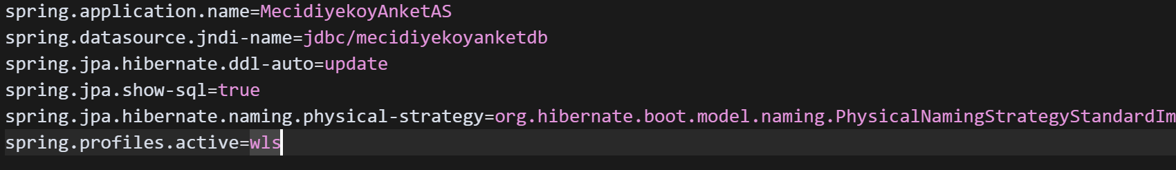
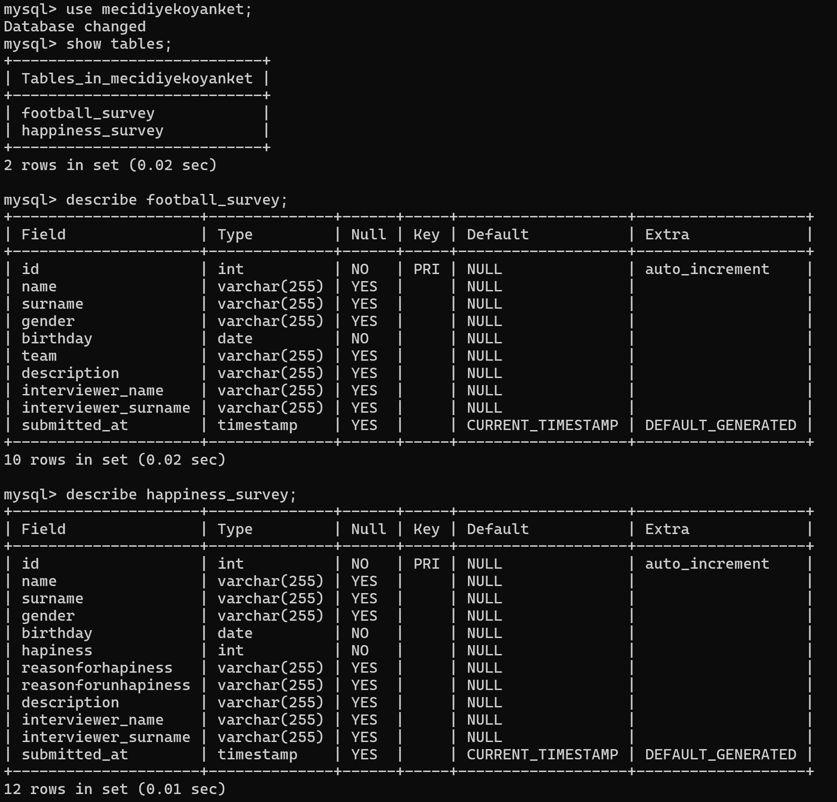
DATA MANAGEMENT
The MySQL database is integrated into Oracle WebLogic Server using a JDBC data source.
The project establishes its connection to the database through the WebLogic Server.

Slide 5
JAVA CLASSES
For each data table in the application, a corresponding Java entity class has been created. These entity classes represent the structure of records stored in the MySQL database.
In addition, for every entity class, a dedicated repository interface is defined. These repository interfaces extend Spring Data JPA’s JpaRepository, using the entity type and its primary key (ID) data type as parameters. This setup enables seamless CRUD operations and abstracts away the need for manual SQL queries or prepared statements..

Slide 6
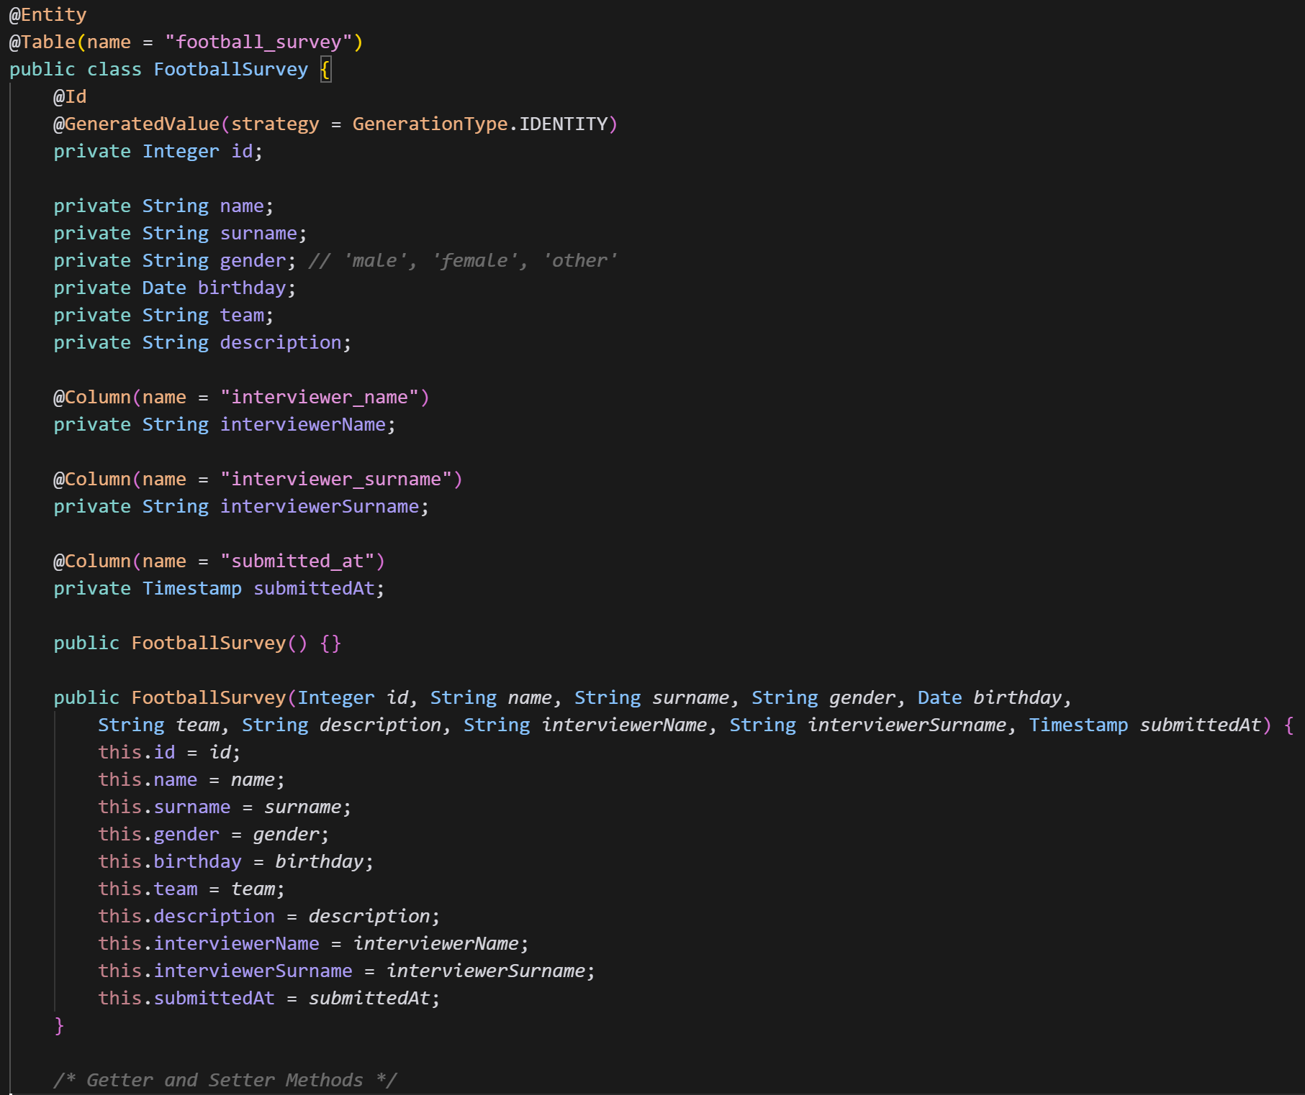
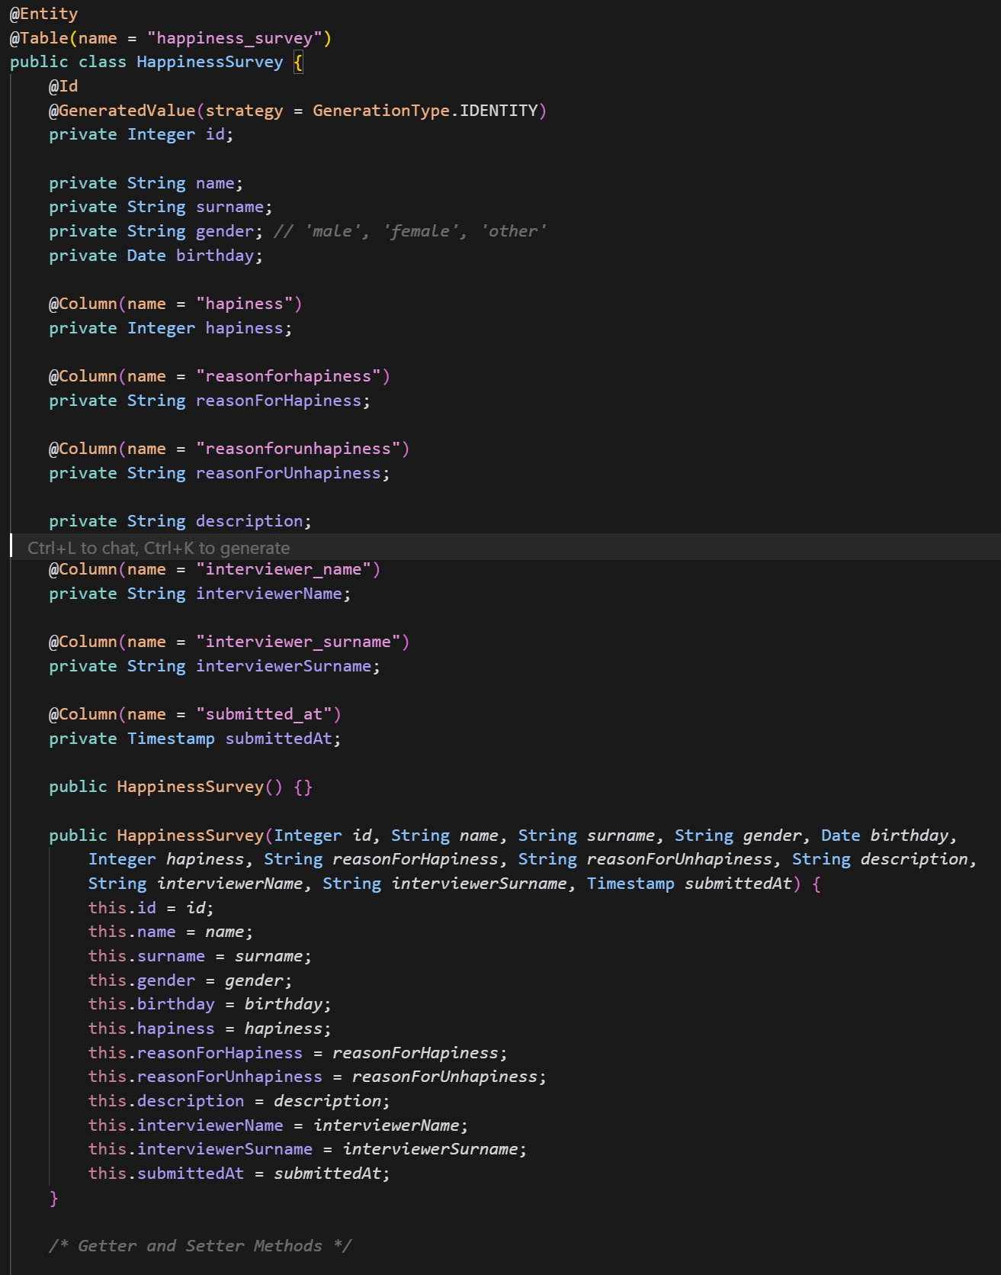

Slide 7
CONTROLLER CLASS
This java class is a web controller that uses Spring MVC framework to manage both surveys. It is annotated with @Controller enabling it to receive and respond to web requests.
Repositories:
footballRepo: Enables you to interact with football surveys (CRUD operations)
happinessRepo: Enables you to interact with happiness surveys
URL | Purpose | HTTP Method
/ | Home page: Navigation bar points to the collection of survey records. Percentages of happiness and teams. Selecting the survey | @RequestMapping
/completed-forms | Shows both survey’s results. | @GetMapping
/completed-forms/football/{id} | Shows details of certain football survey. | @RequestMapping
/completed-forms/happiness/{id} | Shows details of certain happiness survey. | @RequestMapping
…/edit and …/delete | In order to modify or delete a certain individual record. | …/edit: @GetMapping and @PostMapping …/delete: @GetMapping
/anket/football and /anket/happiness | In order to display and submit a new survey record. | @GetMapping and @PostMapping

Slide 8
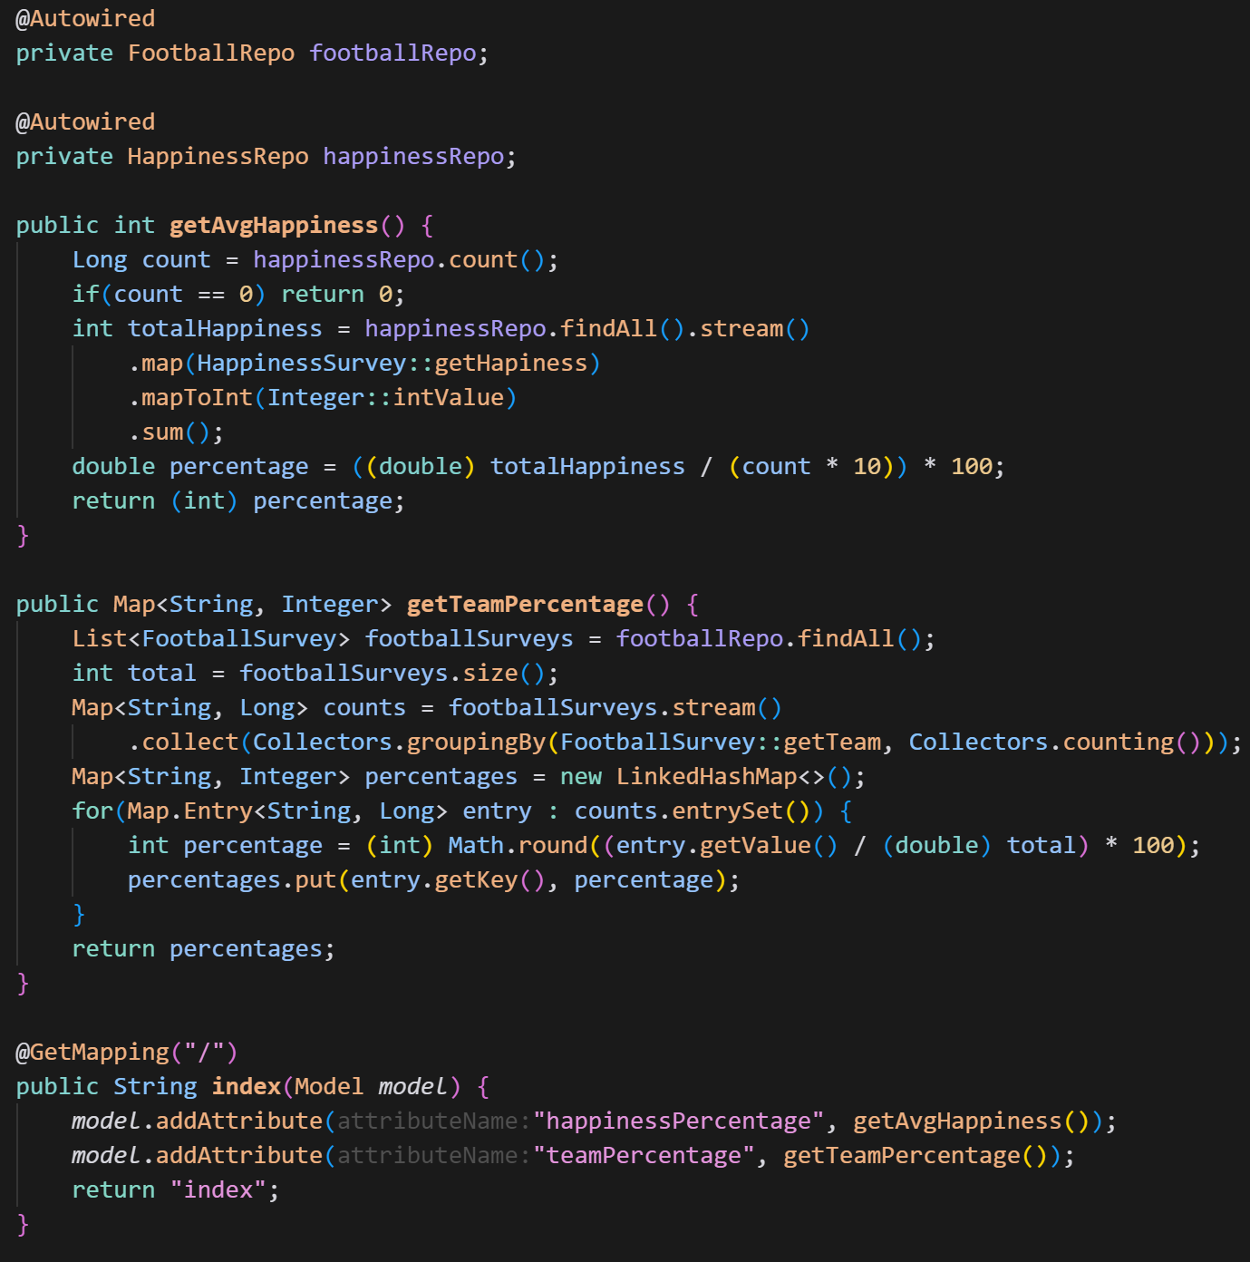

Functions of controller class
getAvgHappiness()
This function reads every surveyer’s amount of happiness in happiness_survey and converts to percentage.
getTeamPercentage()
This function creates groups of chosen teams and calculates each team’s selection percentage.

Slide 9
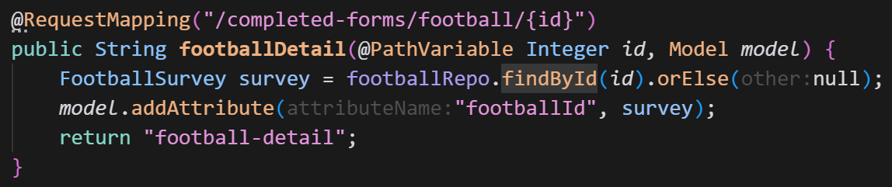
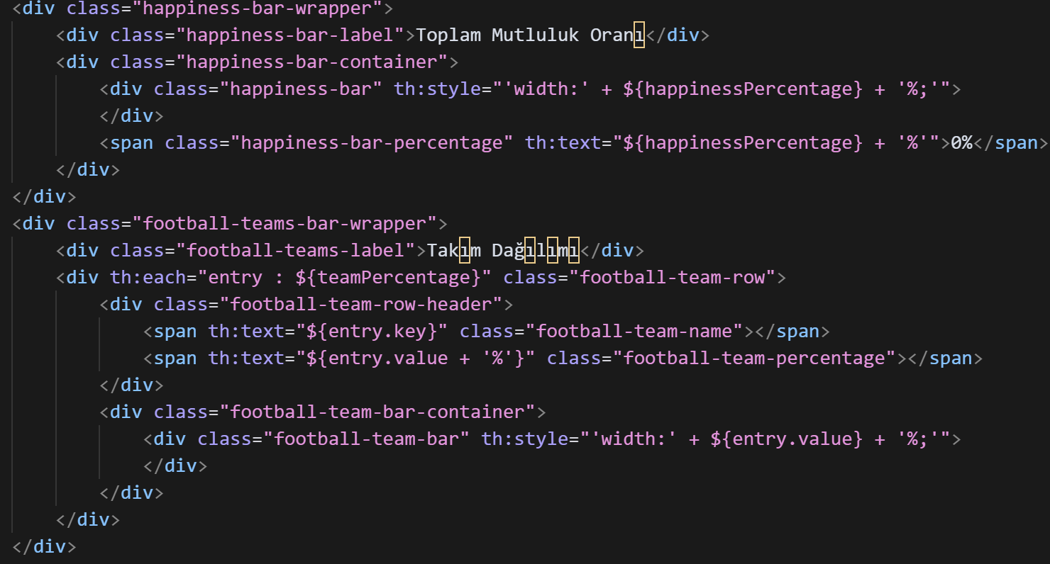
HTML & Thymeleaf integration
Thymeleaf is a server-side Java template engine used in Spring Boot to render dynamic data in HTML files. It is useful to bind model attributes directly to the user interface elements.
Source folder: src/main/resources/templates
The controller sends model attributes via Model objects.
Inside HTML, dynamic data is rendered using Thymeleaf syntax like ${} and th:*.

