Slide 1
Presentation App Agentic Ai
By Alexander Guarneri

Slide 2
Goals of the App
The goal is to provide technical users with a support tool that allows them to quickly understand how an application is built, what it does, and to identify potential dependencies without having to manually explore the source code.
Main features:
Automatic reading and parsing of repository source code files
Structural understanding of folder organization
Construction of a mini data warehouse containing code entities
Automatic generation of an application summary explaining its purpose and behavior
Creation of graphical visualizations to better understand the codebase
Interactive chat interface to answer technical questions about the repository

Slide 3

Overview of the Web App

Slide 4
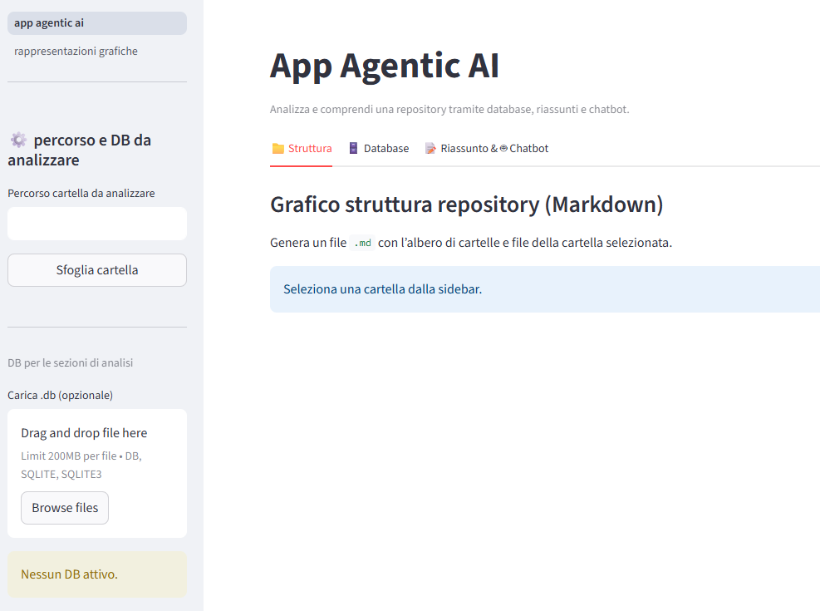
How the app looks in action
On the left sidebar, you can switch between the main sections:
App Agentic AI
Graphical Representations
Below that, in the section “Percorso e DB da analizzare”, you can select the folder of the repository to analyze, or load an existing database file (.db).
On the right side, in the main area, you can see the application’s key features — these will be explored in the next slides.

Slide 5
Page: app agentic ai

Slide 6
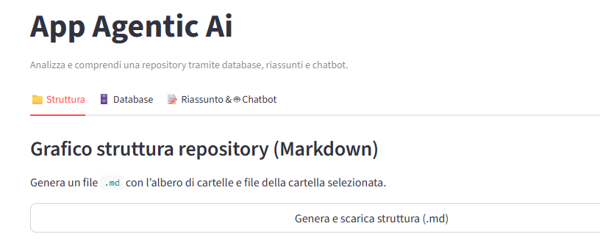
Tree graph of the repository structure
After selecting the repository to analyze, go to the Structure tab. By clicking on “Genera e scarica struttura (.md)”, the app generates a Markdown file that contains a tree graph of all folders and files in the repository.
This helps you visualize and understand the project’s structure more effectively.

Slide 7
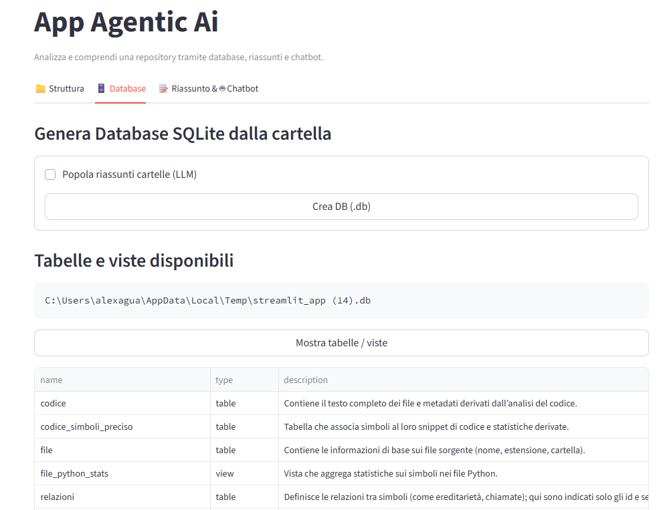
Database generation
In the Database tab, you can create a relational database that contains the main entities extracted from the repository’s code.
By enabling the option “Popola riassunti cartelle (LLM)”, the app also generates folder summaries produced by the LLM for each folder containing Python code.
In the section “Tabelle e viste disponibili”, you can view all the generated tables and views, along with a brief description of each.

Slide 8
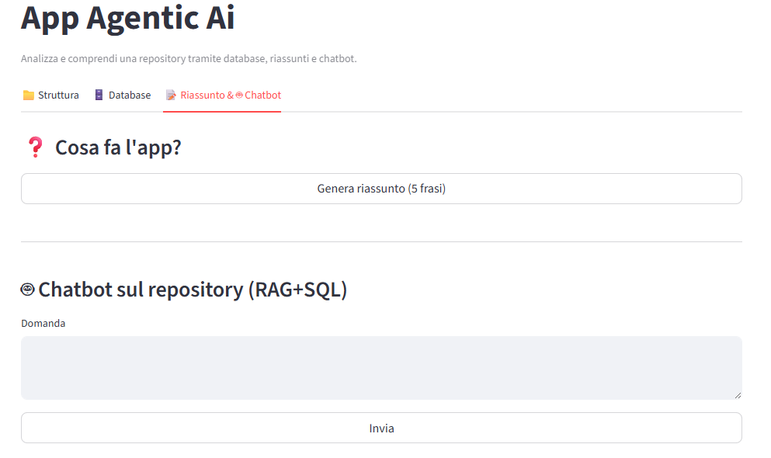
Summary and chatbot
In the Riassunto & Chatbot section, you can generate a summary that explains what the application does.
This section also includes an interactive chatbot that allows you to ask technical questions about the repository and get contextual answers generated by the LLM.

Slide 9
Page graphical rapresentation

Slide 10
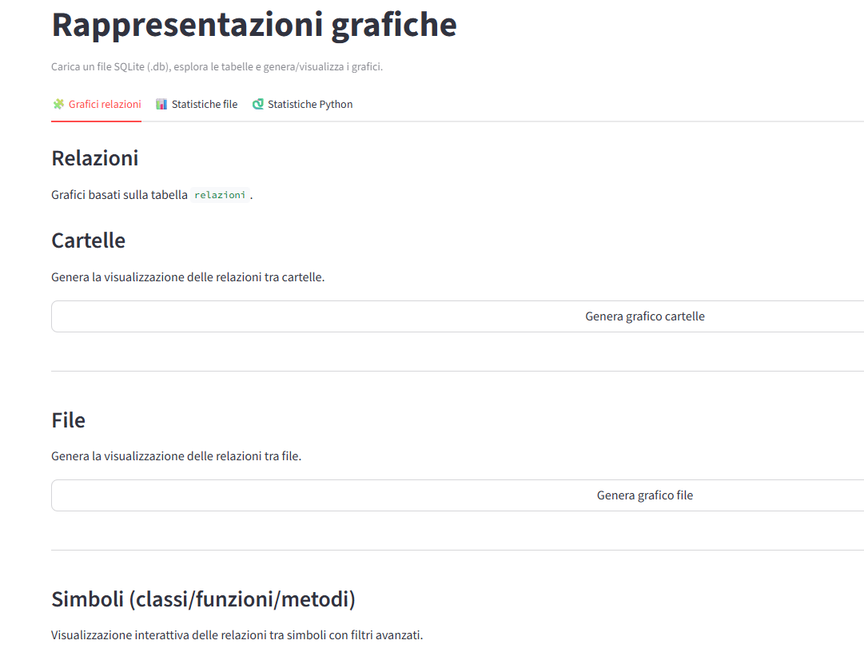
Relations graph
In the Grafici relazioni tab, you can generate interactive bubble graphs that visualize the relationships between entities.
The app can generate three types of graphs, depending on the level of analysis:
Folder relation graph – shows how folders are connected.
File relation graph – displays dependencies and links between files.
Symbol relation graph – illustrates relationships between classes, functions, methods, and variables.
These visualizations help you understand how entities interact with each other and how they are connected within the repository.

Slide 11
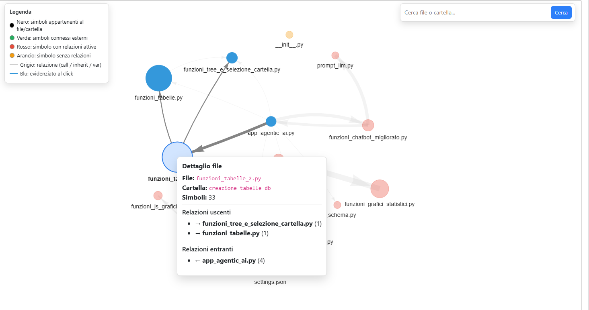
Example file relations graph
In the File Relations graph, each bubble represents a python file in the repository.
By clicking on a bubble, you can view detailed information about that file , including its relationships with other files and see how they communicate within the project structure.

Slide 12
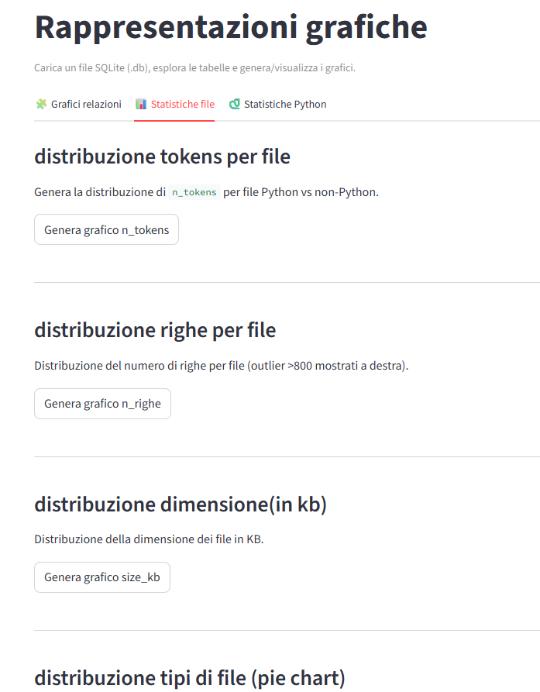
File statistics
In the File Statistics tab, you can generate several analytical charts that provide insights into the structure of the repository’s files.
The app allows you to create different types of graphs, including:
-Token distribution per file – compares Python and non-Python files based on token count.
-Line distribution per file
-File size distribution (in KB) – visualizes the relative size of the repository’s files.
File type distribution (pie chart) – displays the proportion of different file types in the project.
These charts help users analyze and compare the complexity, size, and composition of the project’s source files.

Slide 13
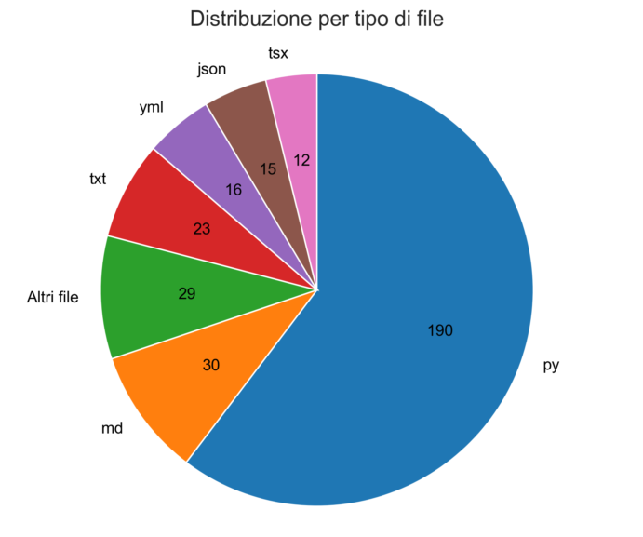
Example file statistics graph
Pie chart showing the proportion of file types

Slide 14
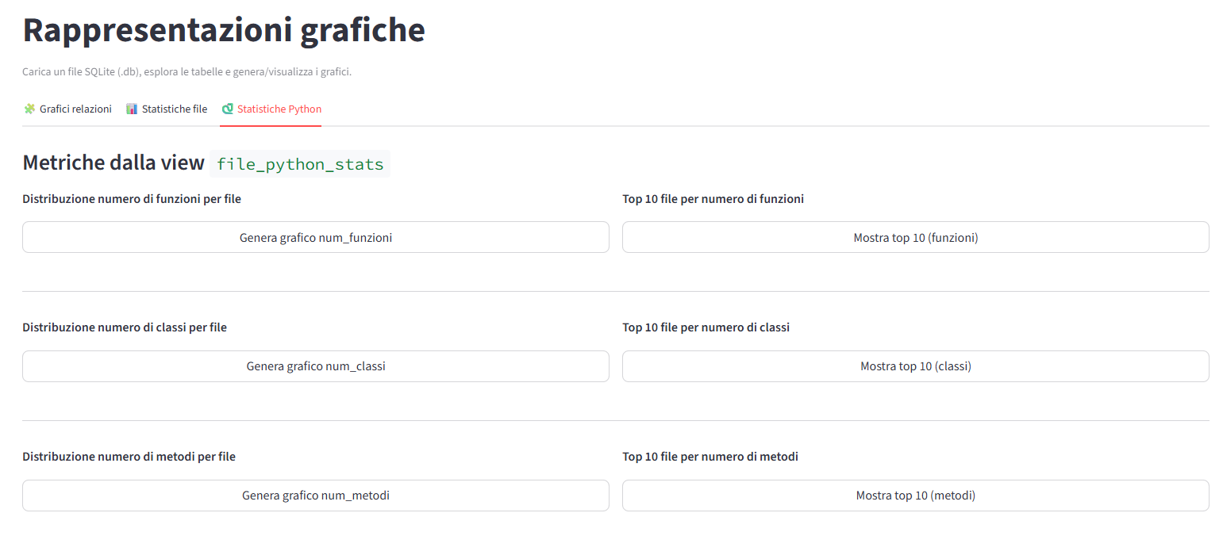
Statistics about python files

Slide 15
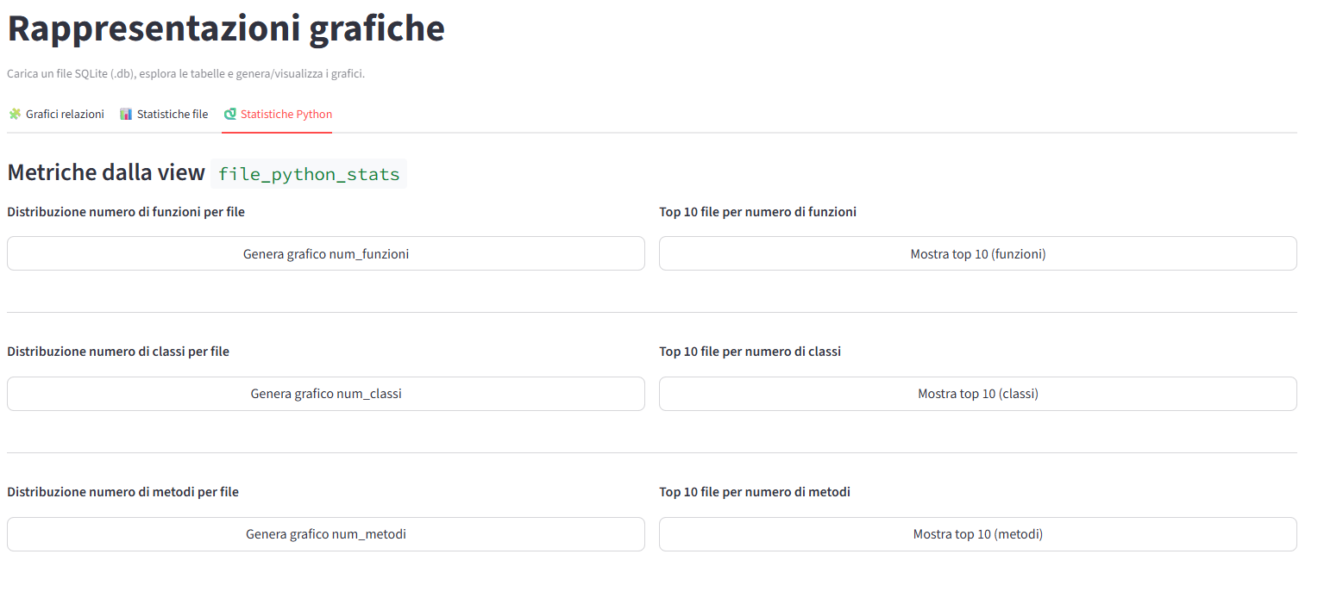
Python statistics
In the Python Statistics tab, you can generate graphs showing:
Number of functions per file and the Top 10 files with the highest function count.
Number of classes per file and the Top 10 files containing the most classes.
Number of methods per file and the Top 10 files with the largest number of methods.

Slide 16
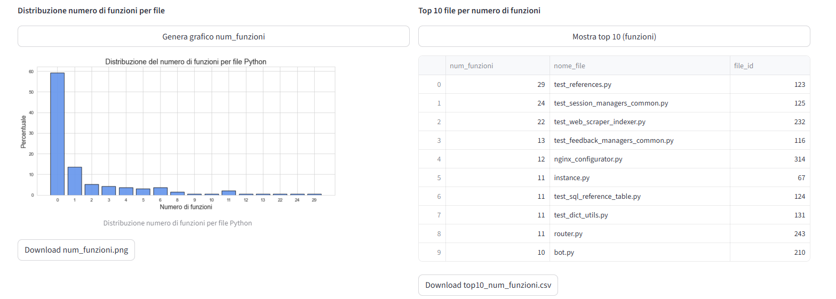
Example python statistics
This slide shows an example of the Python Statistics feature, where the app analyzes the number of functions per file across the repository.
On the left, a histogram displays the distribution of functions among all Python files. On the right, a table lists the Top 10 files with the highest number of functions.

