Slide 1
Hexadecimal Calculator
Il-gwon Park
Date : June 2015 6-18

Slide 2
Contents
01 / Language
02 / Practice
002

Slide 3

DB
01
Language
003
Notes:
The Microsoft Access Security Notice Dailog Box

Slide 4
DB
02
Practice
004

Slide 5

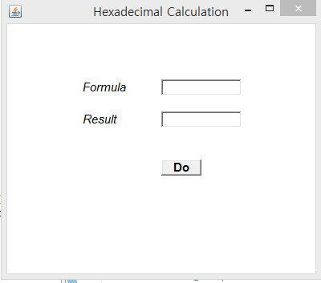
02 Practice
Simple
UI
005
Notes:
A Potential Security concern has been identified.

Slide 6
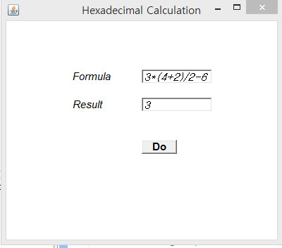
02 Practice
Calculation with Parenthesis
006
Notes:
A Potential Security concern has been identified.

Slide 7
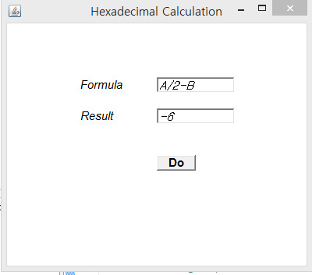
02 Practice
Negative Number
Answer
007
Notes:
A Potential Security concern has been identified.

Slide 8
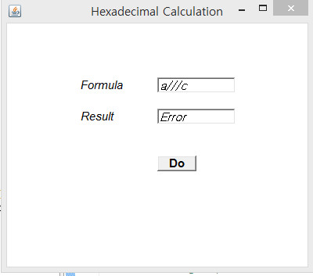
02 Practice
Calculation with
Wrong Operation
008
Notes:
A Potential Security concern has been identified.

Slide 9

02 Practice
Calculation with Wrong Number
009
Notes:
A Potential Security concern has been identified.

Slide 10

02 Practice
Calculation with
Maximum Boundary
(FFFFFFFF+FFFFFFFF)
010
Notes:
A Potential Security concern has been identified.

Slide 11
The End

