Slide 1

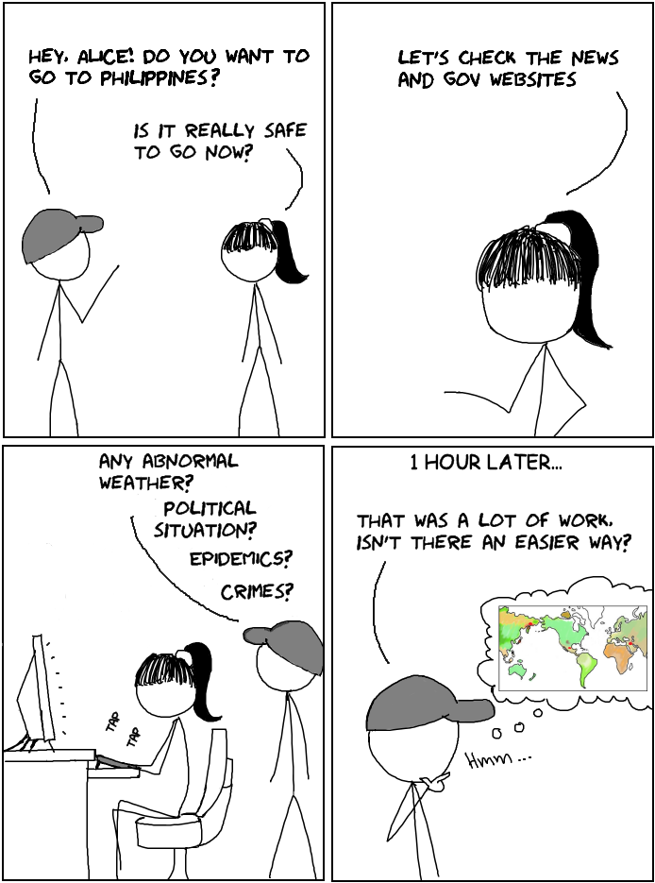
Where do you want to go today?*
*©Microsoft

Slide 2





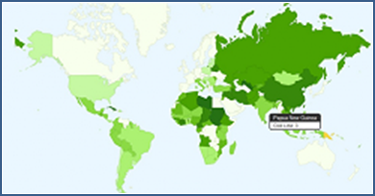
MAPSTER
Natural Disaster
Politics & Religion
Epidemics
Crime & Terrorism
Nuclear
Other
=
Term Frequency
Document Frequency
Source Weighting
Keyword Weighting
“Safety”Score
Lauren Dunn
Irma Lam
Clarissa Soon

