Slide 1

Virtual Classroom
Group 2
Mohammed Hasib Junayed Ilham
H.M. Ahnaf Akif Siam
Tahsin Hassan

Slide 2

AGENDA
INTRODUCTION
Motivation
Key Features
System Architecture
Live Demonstration
Conclusion

Slide 3
Introduction
The Virtual Classroom is a Java-based desktop application designed to manage online education.
It supports instructors in creating courses and managing assignments and students in accessing materials and submitting assignments.

Slide 4
Motivation
To provide a user-friendly, standalone platform for virtual education.
Focus on simplicity, functionality, and a modern dark theme interface.

Slide 5
KEY features
Instructor Features:
Create, edit, delete courses
Upload PDF materials for courses
View and grade assignments
Student Features:
Enroll in courses
Access and download materials
Submit assignments and track grades

Slide 6
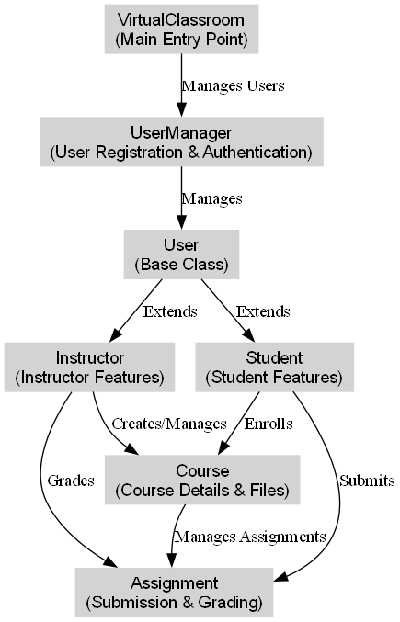
System architecture

Slide 7
Live demonstration

Slide 8
Conclusion
The Virtual Classroom project achieves its goal of providing an intuitive, standalone platform for virtual education.
It supports both instructors and students with robust features and an aesthetically pleasing design.
This project lays the foundation for further improvements to meet evolving educational needs.

Slide 9

THANK YOU

