Slide 1


FRAMEWORK-BASED MOBILE APPLICATION DEVELOPMENT - CSM3114 -K1
PROJECT 1:
TO-DO LIST APP
ILHAM HANINA MADIHA BINTI OTHMAN (S63762)

Slide 2



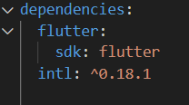


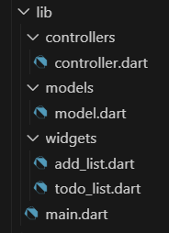
TO-DO LIST APP
Using Dart and Flutter Frameworks.
using MVC(Model-View-Controller)

Slide 3


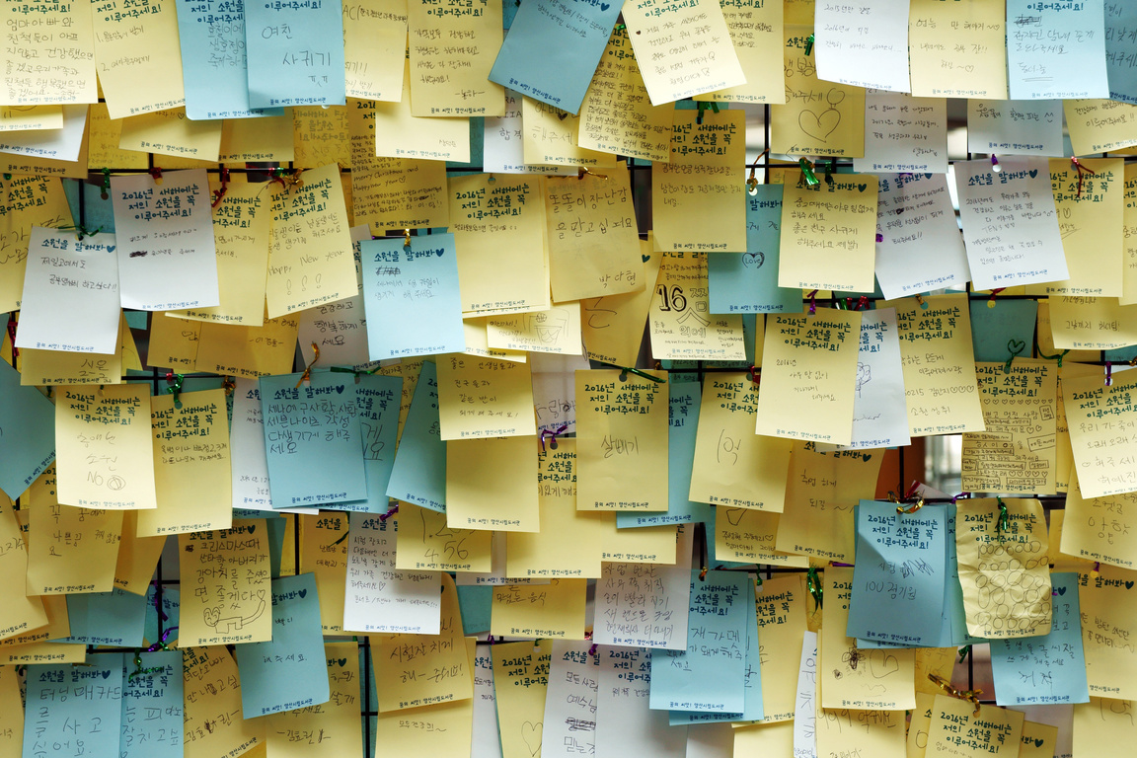
REFERENCES
Class Activity for shopping_list, expenses_app, and the labs’ answers.
https://docs.flutter.dev/tools/pubspec#:~:text=The%20pubspec%20file%20specifies%20dependencies,version%20of%20the%20 Flutter%20 SDK
https://www.fluttercampus.com/guide/169/how-to-sort-list-by-date-in-dart-flutter/
https://api.flutter.dev/flutter
https://pub.dev/packages/intl
https://youtu.be/SmTCmDMi4BY

Slide 4

THANK'S FOR WATCHING
ILHAM HANINA

