Slide 1
Git and GitHub for Beginners
@ilhamsuaib

Slide 2
Overview
What is git?
Why git?
What is Github?
Git commands
Quick example using git and Github
Install and create a Github account
Git flow

Slide 3
What is git?
Git is a version control system
Started in 2005
Created by Linus Torvald

Slide 4
What is version control?
A system that keeps records of your changes
Allows for collaborative development
Allows you to know who made that changes and when
Allows you to revert any changes and go back to a previous state/version

Slide 5
Why use git?
Skripsi
Skripsi final
Skripsi final fix
Skripsi final fix bener
Skripsi final fix bener ya Allah
Skripsi final fix bener ya Allah cobaan apa ini

Slide 6
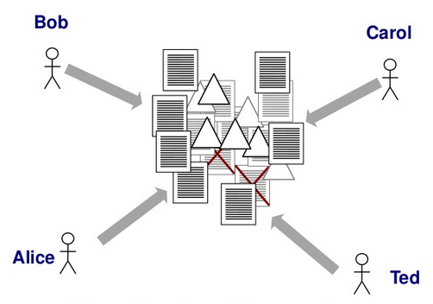
Why use git?

Slide 7



Git repositories?

Slide 8
What is github?
www.github.com
Largest web based git repository hosting service
Allows for code colaboration with anyone online
Adds extra functionality on top of git (UI, documentation, bug tracking, pull request and more)
Founded in 2008
Also has an Enterprice edition for businesses

Slide 9
Git commands?
clone
init
add
commit
push
status
branch
…etc.

Slide 10
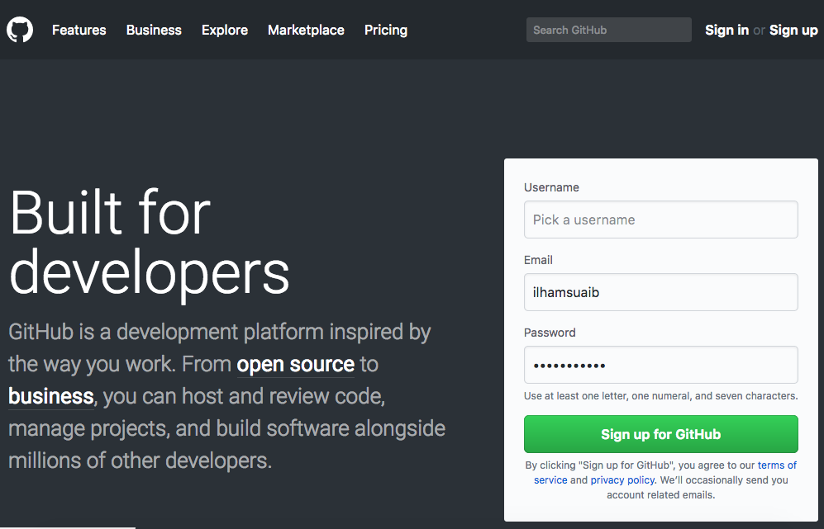
Install and Create Github Account
Download git at https://git-scm.com/downloads
Create account https://github.com/
Free for public repositories

Slide 11
Example using git and github
Lest do this

