Slide 1
Codex Online Test Case Data Scientist
Ilham Zulfikri Firdaus
ilham.Zulfikri.f@mail.ugm.ac.id

Slide 2
Agenda
Talent Profile Insight
Terminate prediction

Slide 3
Talent Profile Insight

Slide 4
Problem definition
Company X hired a Data Scientist to do the cost reduction analysis for recruitment process and maintain the existing talent.
Find the next action item and recommendation for management level

Slide 5
Target Definition
I defined reducing cost and maintened existing talent as longer employment length. If the employees stay longer than before, the company need no recruitment cost at all, make sense right?.
The problem is, how to achieve longer employment length? we should answer the following questions.
Does marriage affects the employment length?
Does seniority level affects the employment length?
Does performance score affects the employment length?
Does engagement survey affects the employment length?
Does employee satisfaction affects the employment length?
Does Special project count affets the employment length?
Does absences affects the employment length?

Slide 6
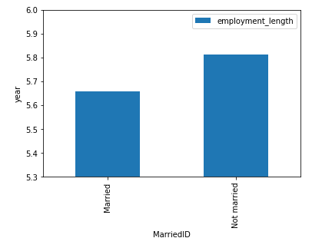
Marriage
The not marriage employee tend to have longer employment length. With this,
The company could do following action item to keep the employee not marry,
Offer competitive benefit for employee who is not married
Make an agreement to not marry within the employment

Slide 7
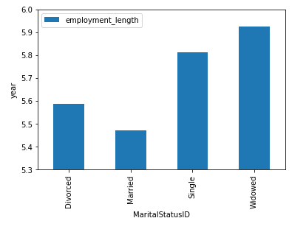
Marital Status
The not married employee tend to have longer employment length. With this,
The company could do following action item to keep the employee not marry,
Offer competitive benefit for employee who is single, widowed and divorced
Offer new facilities to support married employees

Slide 8
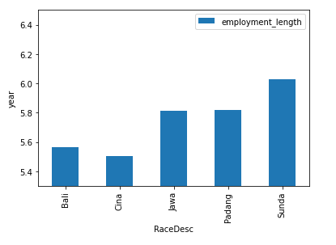
Race discrimination
Chinese tend to stay lesser compared to another race in this company. To increase the average employment length, this is the action item for management-level,
Reducre the discrimination for Chinese
Promote Chinese to the higher position (as an movement act, so that other Chinese feel motivated)

Slide 9
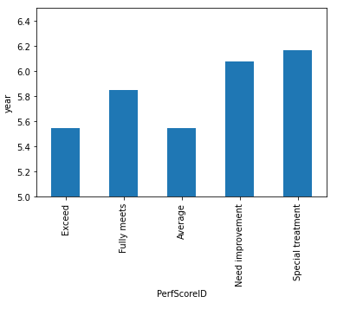
Performance
The high performer has lower employment length. It signs that the company might not give enough compensation for this high performer.
Please give them more reward and compensation
Appreciate their achievements

Slide 10
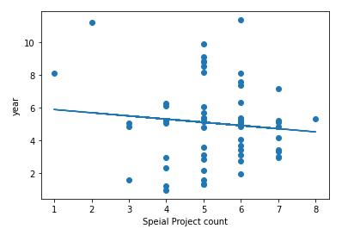
Special Project
The more special project taken by the employee, the higher the probability the employee will leave the company.
Consider Work and life balance
Considers the company outing
Consider the benefit for each special project

Slide 11
Terminate Prediction

Slide 12
Problem definition
The talent management department wants to know on what condition an employee will terminate their position (voluntarily, underperformance, or another cause). This prediction system might get huge impact for talent management department, because they could prepare for talent replacement or further strategy.

Slide 13
Target definition
the target defined by this assumption,
if an employee still active, then 0
if an employee terminate his position on whatever the cause, then 1

Slide 14
Work Framework
Data
Feature Engineering
Oversampling
Modelling
(Random Forest)
Evaluation
Insight
Note:
On hot encoding is the only thing that applied in feature engineering (only applicable for categorical feature)
SMOTE is implemented in oversampling. This method is pretty effective for increasing the recall or sensitivity score
I will use random forest. Since the majority feature is categorical. For hypertuning, I use Grid Search method
In the evaluation, I only use AUC and Recall metric. Since both metrics are powerful for binary classification, imbalance dataset, and thresholding calibration
After that, we will see what parameters has high contributing factor to the termination

Slide 15
Model Performance
Performance :
recall: 0.695
auc: 0.807
Our rule of thumb is,
AUC > 0.65
Recall > 0.4
Then our model is acceptable

Slide 16
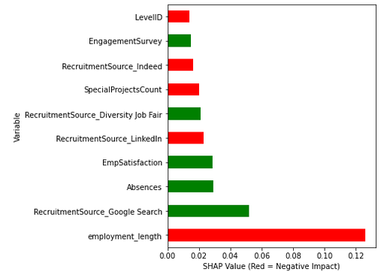
Termination sign characteristics
From that figure, we conclude that our model will predict the employee will get terminated if,
the employee length got longer
the employee is recruited from google search
the employee do more absences during the work period
The employee has higher employee satisfaction
The employee is recruited from Job Fair
The employee do more special project within the work period
The employee has higher Engagement survey

