Slide 1


Slide 2
TheIrish Dummy Banks
a peer to peer lending bank based in the Ireland

Slide 3
How Lending Club Works
Borrower : Request for loan
Lender : Register for account
Borrower : get funded
Lender : build portfolio
Borrower : pay the installment
Lender : earn the interest

Slide 4
Company Growth

Slide 5
Community
208k
Ulster
204k
Northern Ireland
155k
Connaught
214k
Leinster
104k
Munster

Slide 6
Investment Health

Slide 7
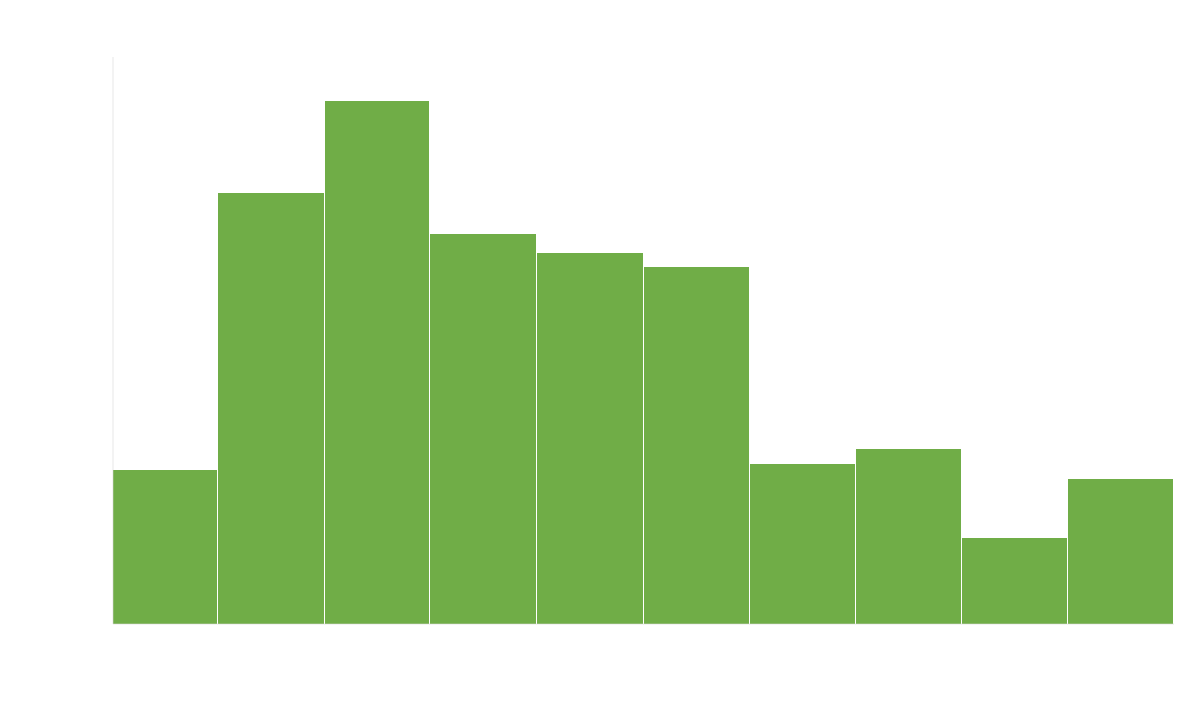
Loan Requested

Slide 8
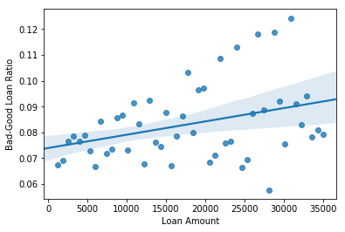
Loan Amount | Bad – Good Loan Ratio

Slide 9
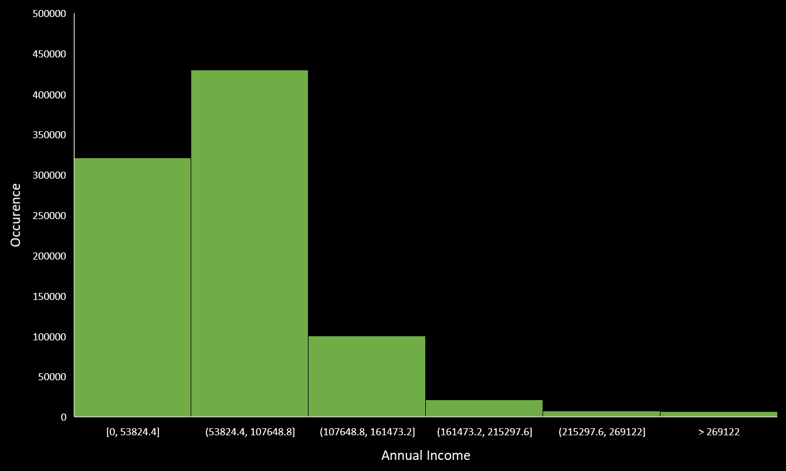

Annual Income

Slide 10
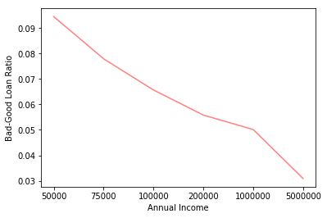
Annual Income| Bad – Good Loan Ratio

Slide 11
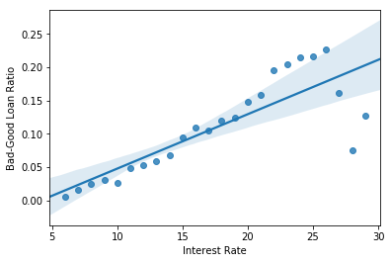
Interest Rate | Bad – Good Loan Ratio

Slide 12
Grade
A – G
In Categorical form.
A means the highest score
G means the lowest score

Slide 13
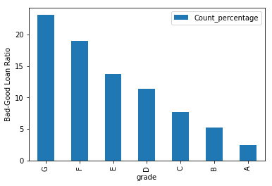
Grade | Bad – Good Loan Ratio

Slide 14
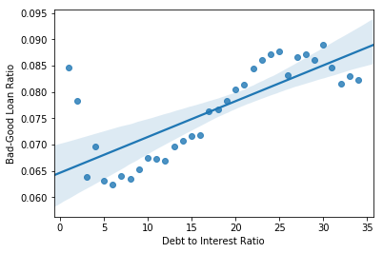
Debt to Interest Ratio | Bad – Good Loan Ratio

Slide 15
Application Type
Individual
Joint

Slide 16
Application Type
7.6%
1%
Individual
Joint

Slide 17
Employement Length
0 – 10 Year
In Categorical form
0 means less than 1 year
10 means more than 10 year

Slide 18
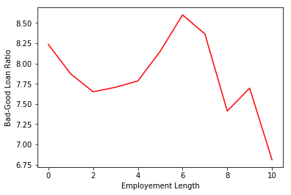
Employement Length | Bad – Good Loan Ratio

Slide 19
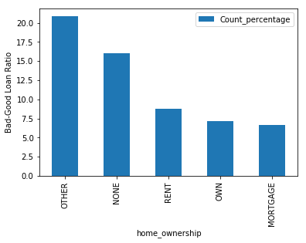
Home Ownership | Bad – Good Loan Ratio

Slide 20
Home Ownership

Slide 21
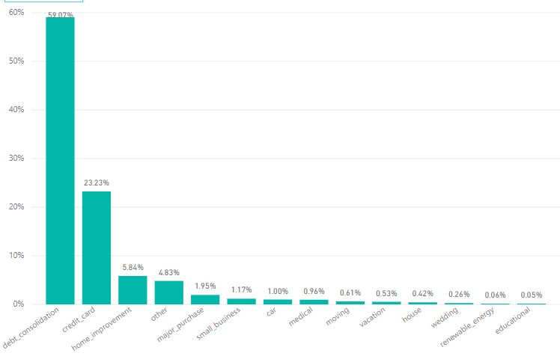
Purpose

Slide 22
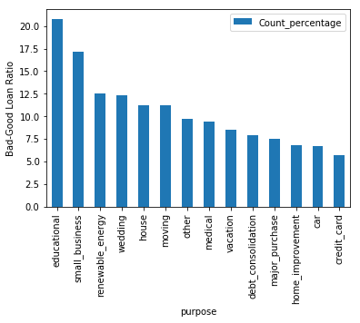
Purpose | Bad – Good Loan Ratio

Slide 23
Is that enough?

Slide 24
Even though educational purpose has more than 20% bad loan, it equals to 88 contract.
Meanwhile, 17% bad loan in small business equals to 1781 contracts.
It is more Significant.

Slide 25
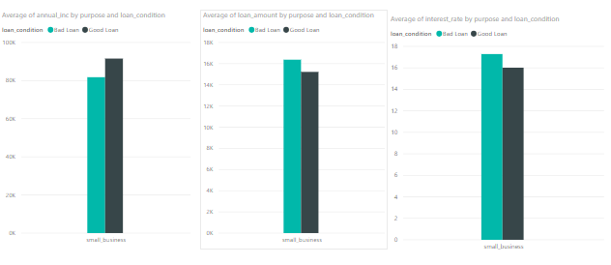
Lower Annual Income
Higher Loan Amount
Higher Interest Rate

Slide 26
Give a recommendation to borrower that they should adjust their loan request
or
The system should recommend them new loan amount.

Slide 27
Let’s play
With prediction

Slide 28
Drop Feature
Total Payment
Total Received Principle
Recoveries
Installment

Slide 29
Method
One-Hot Encoding

Slide 30
OOTB
MainData
OOTA
Timeline
Making Dataset

Slide 31
Training-Validation-Test Split
Remove Outlier from Training Data
Oversampling for Training Data
Data Preprocessing

Slide 32
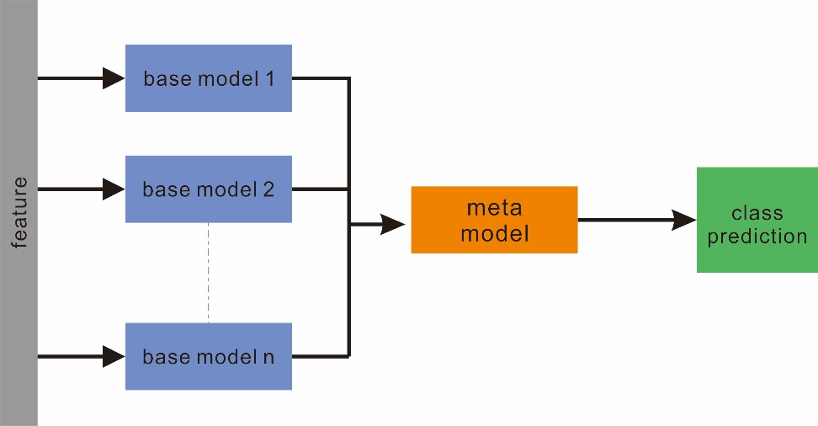
Making Model

Slide 33
Model Stability
Threshold Calibration
Evaluation

