Slide 1
Towards a Secure DevOps Pipeline
Security Measures for a Secure CI/CD Delivery Chain

Slide 2
Seven Key Security Domains in DevSecOp
01
02
03
04
Source Code Security
Dependency Security
CI/CD Pipeline Security
Artifact and Container Image Security
05
06
07
Infrastructure Security
Runtime Security
Monitoring and Incident Response

Slide 3

Snyk
Snyk – Security Built for DevOps
Identifies vulnerabilities
Fully integrates into CI/CD pipelines
Prioritizes risks based on severity
Key Business Benefits
Reduces security exposure
Strengthens collaboration between development
Continuous monitoring
Technical Approach
Static and dynamic code analysis
Detects vulnerabilities in open-source components and containerized environments
Provides automated fix suggestions and integrates directly

Slide 4
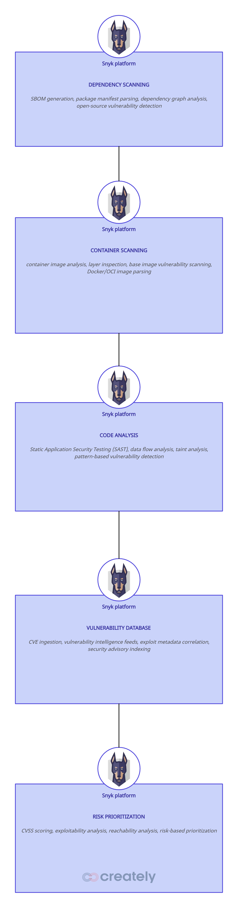
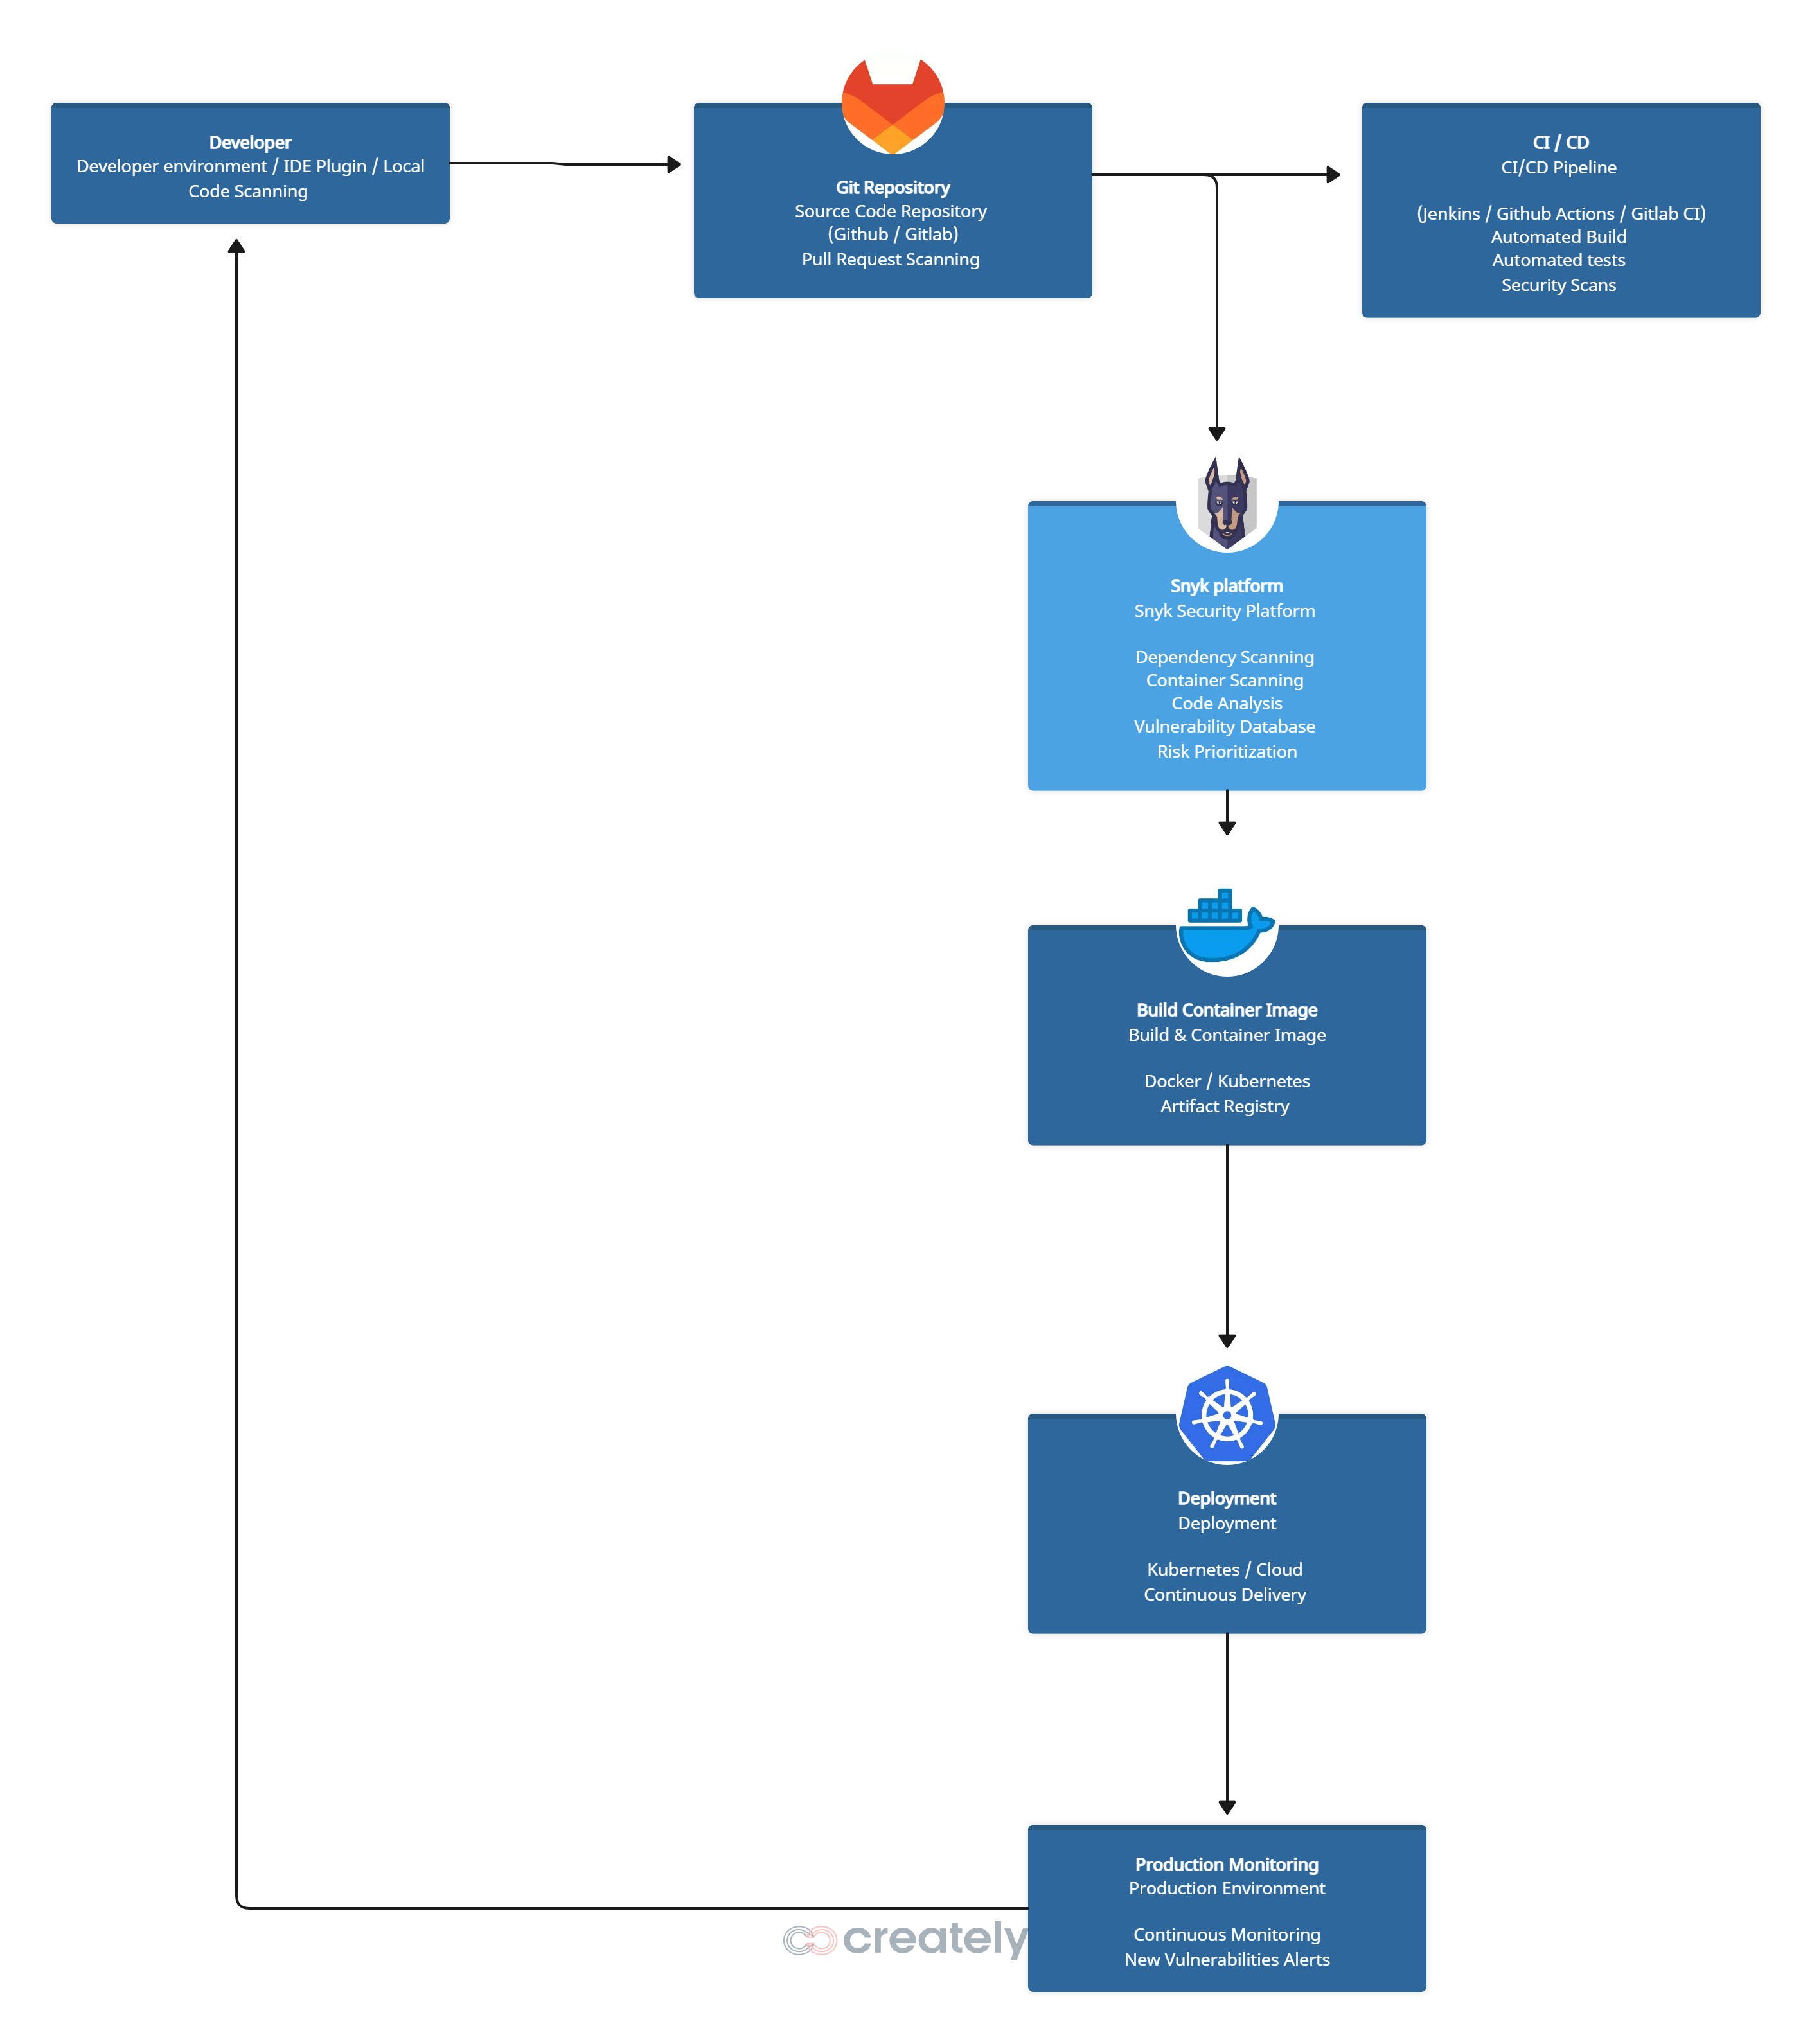
Application architecture
SBOM,
Manifest parsing
Dependency graph
CI/CD CHAIN
Image scanning
Layer analysis
Base image CVEs
SAST
Data flow
Taint analysis
CVE feeds
Security advisories
Vuln intelligence
CVSS scoring
Exploitability
Reachability

Slide 5
Comparing Security Tools: Snyk in Your DevSecOps Stack
Capability | Trivy | GitLab SAST | SonarQube | Snyk | Dependency-Track
SAST (Security) | ❌ | ✅ | ✅ | ✅ | ❌
Code Quality / Maintainability | ❌ | ⚠️ | ✅ | ❌ | ❌
Open Source Dependency Security (SCA) | ⚠️ | ⚠️ | ⚠️ | ✅ | ✅
Transitive Dependency Analysis | ⚠️ | ⚠️ | ❌ | ✅ | ✅
Container Image Scanning | ✅ | ⚠️ | ❌ | ✅ | ❌
Infrastructure as Code Scanning (IaC) | ✅ | ⚠️ | ❌ | ✅ | ❌
OS Package Vulnerability Detection | ✅ | ❌ | ❌ | ⚠️ | ❌
Automated Fix Suggestions | ❌ | ❌ | ⚠️ | ✅ | ❌
Automatic Pull Requests for Fixes | ❌ | ❌ | ❌ | ✅ | ❌
Vulnerability Path / Exploitability Info | ⚠️ | ❌ | ❌ | ✅ | ✅
IDE Security Scanning | ❌ | ⚠️ | ⚠️ | ✅ | ❌
CLI Local Scanning | ✅ | ⚠️ | ⚠️ | ✅ | ❌
CI/CD Integration | ✅ | ✅ | ✅ | ✅ | ✅
Shift-Left Security | ⚠️ | ⚠️ | ⚠️ | ✅ | ⚠️
Developer-Focused UX / Dashboard | ⚠️ | ⚠️ | ⚠️ | ✅ | ⚠️
Dedicated Open Source Vulnerability DB | ⚠️ | ⚠️ | ❌ | ✅ | ✅
Snyk → Best for Open Source Security + automated remediation + developer integration
Dependency-Track → Best for enterprise-wide SCA inventory & reporting
Trivy / GitLab SAST / SonarQube → Cover containers, code security, and code quality

Slide 6
DEMO
Snyk

Slide 7
Security Impact
Impact ;
➡️ Faster vulnerability remediation
➡️ Reduced security risks in applications
➡️ Stronger DevSecOps security posture
➡️ Early vulnerability detection in the CI/CD pipeline
➡️ Improved application reliability
➡️ Continuous security monitoring
➡️ Replacement of multiple security tools through a unified platform

