Slide 1
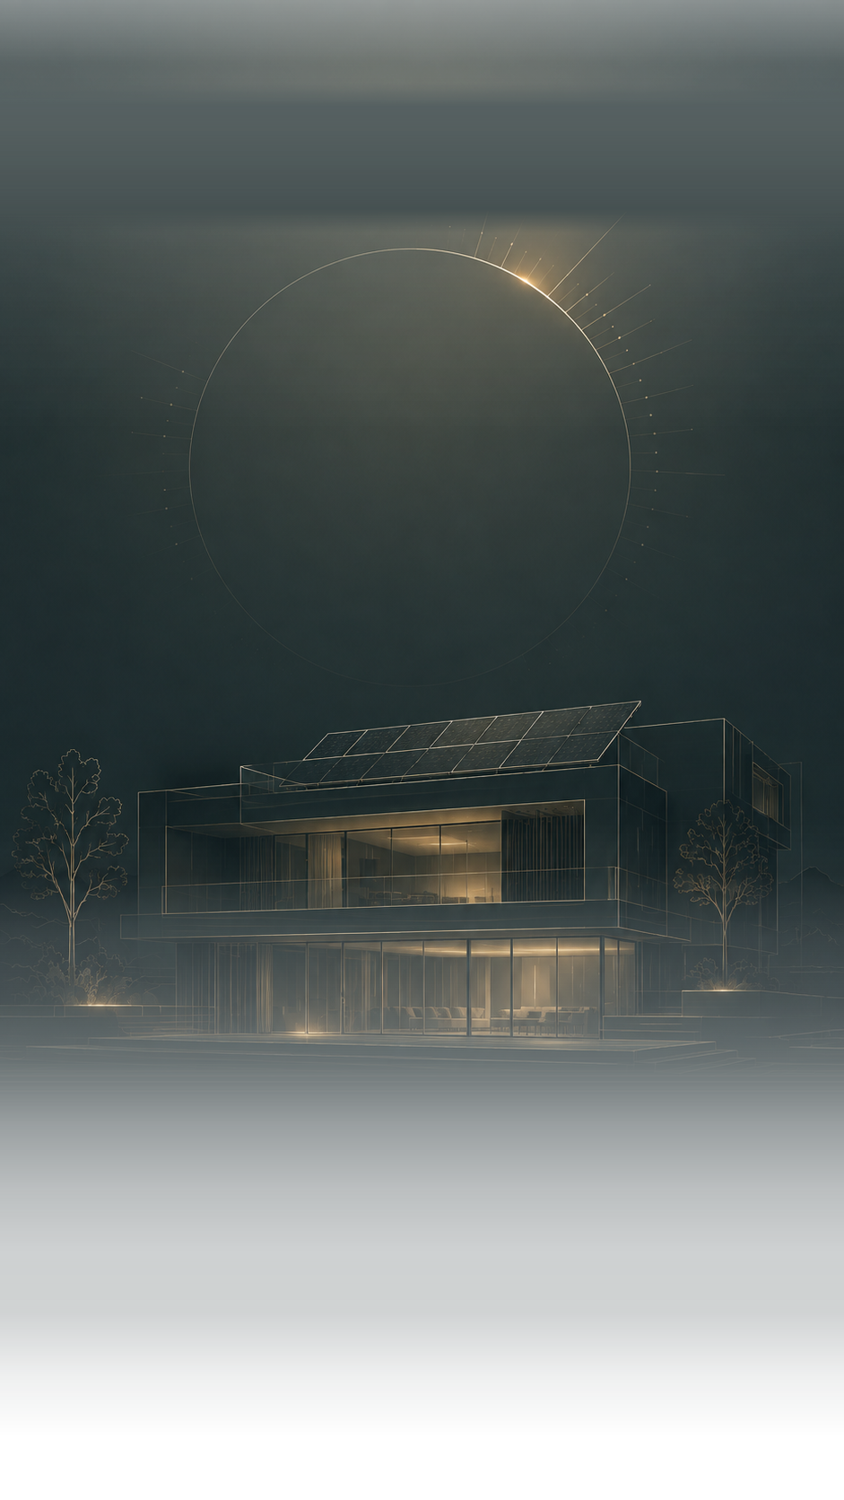

01
SOLAR PROPOSAL · NFX-[0000-0000]
Power your villa
with solar
PREPARED FOR
SYSTEM SIZE
Mr Ahmed
12 kW system ·
covers 84% of your
home
Jumeirah Golf Estates
Aug 19, 2026

Slide 2




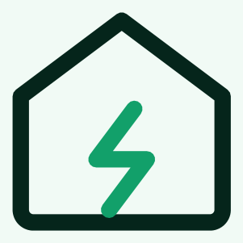
SAVINGS
Your estimated savings
Monthly savings
02
6000 AED
Roof array detail
or browse files
Annual savings
70,100 AED
84%
of your home covered
Current bill
2,300 AED
−1,100 AED
New bill
1,200 AED
Current consumption
Solar generation
83.930 kWh
35.00 kWh
No more bills
25-year
warranty
Built for the
UAE
Always
powered

Slide 3
COST STRUCTURE
What you're paying for
Six lines, proportional to spend · AED, VAT included
Solar panels
18,711
33 × 700 W bifacial
03
Hybrid inverter
12,548
Deye 30 kW, on & off-grid
Battery storage
19,560
4 × 20 kWh LFP
Installation
34,650
Mounting, wiring, commissioning
Cables and components
21,384
DC/AC cabling, breakers, connectors
Approvals and logistics
6,353
Drawings, permits, transport, equipment
Total project cost, including VAT
AED 113,206

Slide 4
PAYMENT
Chose your payment option
Total project value
AED 85,000
OPTION 1 · PAY AS WE BUILD
5 stages
04
10%
On signing — community approvals,
documents and detailed drawings
30%
Once permits and drawings are approved —
solar panels purchased
30%
Panel installation, batteries and inverters
purchased
20%
System connection and electrical works
10%
Final inspection, commissioning, monitoring
app, handover
Save 15%
OPTION 2 · FAST TRACK
60%
On signing — approvals, drawings and full
equipment purchase
30%
Installation complete — panels mounted,
system connected
10%
Final inspection, commissioning and
handover
Offer validity — 14 days · until Aug 20, 2026.

Slide 5



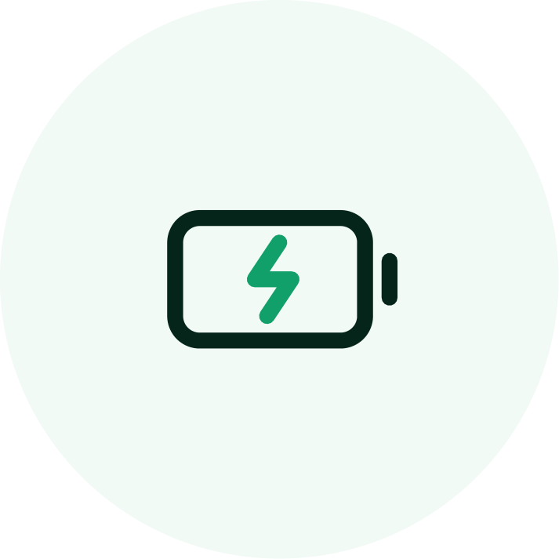
WHAT'S INCLUDED · 1/2
What's included
Permits and approvals
DEWA, ADDC, SEWA or Etihad WE, whichever
applies
Community and master developer approvals
Drawings, applications and final inspection
05
Solar panels
Jinko, JA Solar or JCL, 700 W bifacial N-type
25-year performance warranty
Rated for salt mist and abrasive dust
Inverter
Deye on-grid or hybrid inverter
10-year warranty
Active cooling, holds output through peak heat
Battery storage
LFP high-voltage cells
10-year warranty
Aerosol fire suppression inside the cabinet

Slide 6






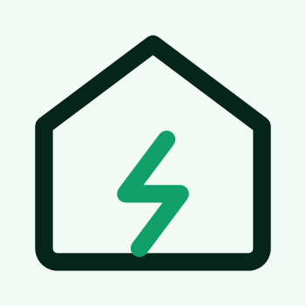
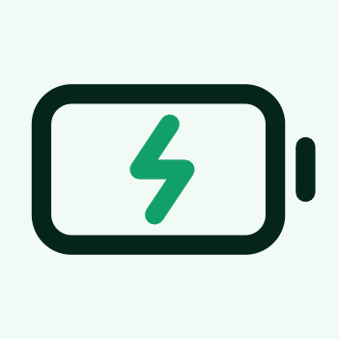
WHAT'S INCLUDED · 2/2
What's included
Mounting structures
Aluminium 6063 T6, anodized
10-year product warranty
Flat roof, tile roof or carport frames
Switchgear and connection
ABB, Schneider or Eaton components
Fully compliant with utility regulations
Smart bidirectional meter installed
06
Installation and workmanship
Our own in-house mechanical and electrical teams
Crane lifting and scaffolding included
Testing, commissioning and handover
ENERGY PATH
DC
AC
Sun
Array
Inverter
Villa
stored DC
Battery

Slide 7
NUMBERS
Financial analysis
5.5
25
25%
years to
payback
years of
service life
return on
investment
12 kW
84%
113,206
system size
of your home
covered
AED total
project cost
Cumulative savings
over 25 years
AED 584,415 by year 25
payback
07
5
10
15
20
25
Cost not yet returned
Savings after payback
Cashflow accounts for 0.55% annual panel degradation and 3%
annual inflation.

Slide 8

TRACK RECORD
100+
projects in Emirates
The primary communities where we easily
secure permits.
Emaar · Nakheel · Meraas · Damac · Dubai Holding · Sobha
08
IMG-03
IMG-04
IMG-05
or browse files
or browse files
or browse files
IMG-06
IMG-07
IMG-08
or browse files
or browse files
or browse files
IMG-09
IMG-10
IMG-11
or browse files
or browse files
or browse files

Slide 9




THE TEAM
Who builds your system
Engineers, not installers
[paragraph · from source]
We speak your language
[paragraph · from source]
Nothing rushed, nothing left to
chance
09
[paragraph · from source]
Five years on our workmanship
[paragraph · from source]

Slide 10

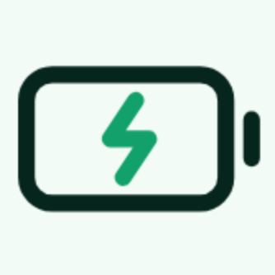

POSITIONING
First high-
capacity hibrid
energy system
provider for
luxury villas in
the UAE.
Industrial-grade engineering, applied to private
villas. Conventional residential installers can't
build systems of this scale — large energy
companies won't.
10
High-power
generation
Large-scale
storage
Smart load
control

Slide 11
DELIVERED SYSTEMS
OFF-GRID FARM
Customer Energy System: Remote Farm / Off-
Grid Solar System
IMG-12
38 panels, 50 kW inverter
or browse files
System
70 kWh
Storage
100% generator power → 0
AED/day
Bill before →
after
Full overnight autonomy
Backup
autonomy
HYBRID SYSTEM FOR
VILLA
IMG-13
Customer Energy System: 5-Bedroom Villa on
Jubail Island
or browse files
38 panels, 50 kW inverter
System
121 kWh
Storage
3,000 AED/mo → 1,500
AED (18,000 AED/yr
savings)
Bill before →
after
Seamless full-home
backup during outages
Backup
autonomy
What your system gives back
11
41,235
28,000
10,375
717
kWh of clean
electricity
kg of CO₂
avoided
litres of fuel not
burned
trees planted,
equivalent
Every year your villa runs on sunlight instead of the grid.

Slide 12
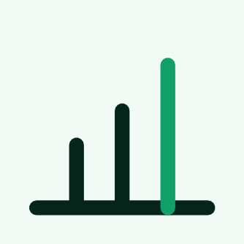



MONITORING
Your system, in your pocket.
Smart control with built-in automation — see
generation, consumption and system health
from anywhere.
Energy consumption
statistics
Smart management
IMG-14
Generation forecast
or browse files
Live online
monitoring
Ready to catch the sun?
Download the app and follow your villa's energy from
day one.
App Store QR
Google Play QR
or browse files
or browse files
12
App Store
Google Play
Deye logo
or browse files

Slide 13

Closing photo — villa at night, lit
or browse files
YOUR OWN
POWER DAY
AND NIGHT
13
Message us on WhatsApp
+971 58 583 7425
OFFICE 101-34, GAL BUSINESS CENTER, DUBAI
PRODUCTION CITY, DUBAI, UAE

