Slide 1
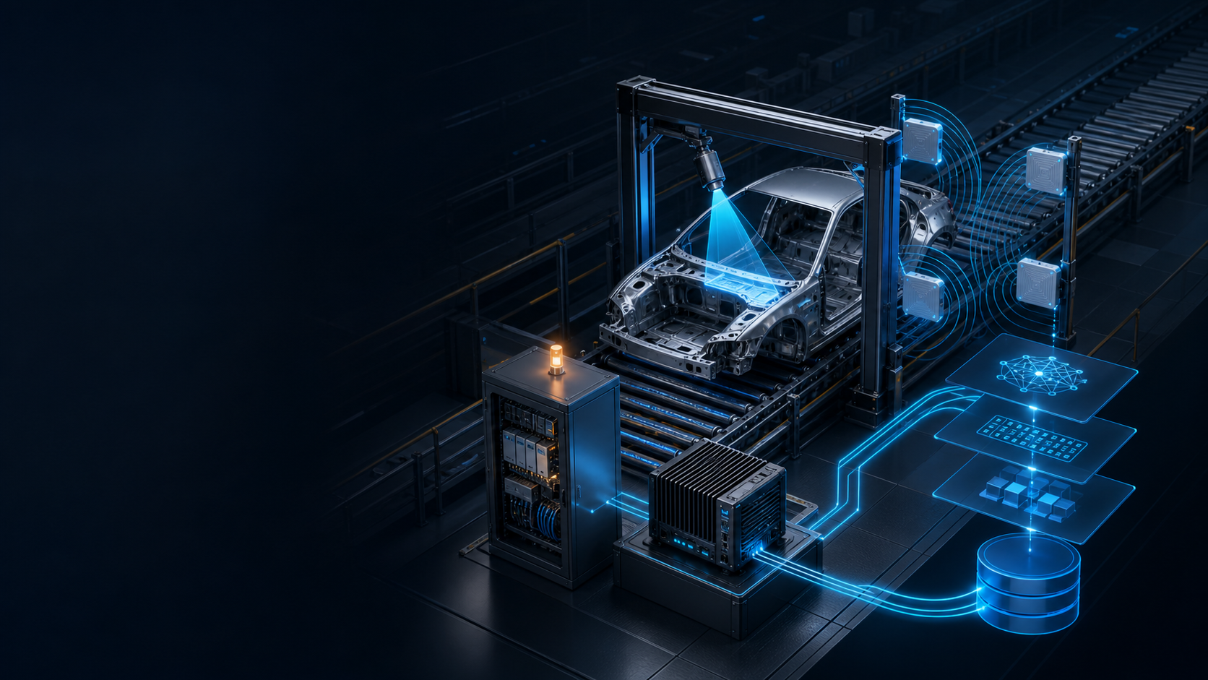
STATION 509 · ENGINEERING REVIEW
AI_CAM v1.2.1
Production
Stabilization
Industrial AI VIN Reading & Traceability System
One trigger. One body-cycle. One auditable result.
DOCUMENTATION PACKAGE · 29 JULY 2026
Notes:
[Sources]
- Repository: README.md; VERSION; config/settings.yaml
- Generated visual: reports/assets/ai_cam_isometric_hero.png (OpenAI ImageGen; no external asset)
[/Sources]

Slide 2
02
WHY AI_CAM EXISTS
A single body produces multiple identity signals
The production risk is not missing data—it is losing the relationship between signals.
PLC
arrival pulse
defines the cycle
AI_CAM OPERATING CONTRACT
1
One body-cycle
owns every result.
accepted trigger
VISION
engraved VIN
1
reads physical identity
The session binds trigger, camera frames, YOLO crops, OCR evidence, RFID events, final status, and stored evidence before anything is persisted.
body-cycle
RFID
electronic EPC
1
reads tag identity
final row
Notes:
[Sources]
- Repository: README.md
- Repository: backend/pipeline.py
- Repository: backend/database/db.py
[/Sources]

Slide 3
03
END-TO-END WORKFLOW
Every body follows one deterministic evidence path
Camera and RFID start in parallel; the session closes only once.
CAMERA → YOLO
3 OCR VIEWS
stable VIN crop
validate / preserve
SESSION
FINALIZE ONCE
D2222
open owner
start 30 s deadline
SQLite row
Dashboard
Logs + evidence
ARRIVAL
RFID INVENTORY
SESSION BINDING
session EPC
VIN + EPC + evidence
Notes:
[Sources]
- Repository: README.md
- Repository: backend/pipeline.py
- Repository: backend/rfid/rfid_service.py
- Repository: backend/database/db.py
[/Sources]

Slide 4
04
BODY-CYCLE CONTROL
The PLC pulse is a boundary—not just a signal
Debounce and suppression protect the one-body / one-record invariant.
ARMED
DEBOUNCE
ACTIVE
FINALIZE
CLOSED
zero observed
stable high ≥ 200 ms
session owns capture
result or deadline
one row updated
90 s
DUPLICATE IGNORED
EARLY TRIGGER AUDITED
Triggers received while ACTIVE
minimum body interval
Production queueing is disabled. The next body must rearm through zero and satisfy the minimum interval.
Notes:
[Sources]
- Repository: config/settings.yaml (plc and session sections)
- Repository: backend/plc/plc_service.py
- Repository: backend/pipeline.py
- Repository: backend/plc/edge_audit.py
[/Sources]

Slide 5
05
HARDWARE STACK
Four hardware layers anchor the system in the cell
Exact ordering variants and the installed GPU SKU still require commissioning evidence.
SICK
INDUSTRIAL VISION
MELS
LINE CONTROLLER
IMPI
RAIN RFID
NVID
EDGE INFERENCE
SICK Lector 652
MELSEC-Q
Impinj R700
NVIDIA target
2.1 MP · 2048×1088 · up to 70 Hz
MC protocol · D register · 3E frame
4 ports · ISO 18000-63 · up to 1100 reads/s
cuda:0 target · safe CPU fallback
GigE / IP65 family
CoLa 2111 + project BLOB 2113
D2222 bit 0
100 ms polling / 200 ms debounce
REST + HTTP stream
session-window RSSI selection
Installed model unresolved
Torch + Paddle probes required
FAMILY-LEVEL CAPABILITIES · LIVE SKU / FIRMWARE / OPTICS / ANTENNAS / GPU TO BE CAPTURED ON SITE
Notes:
[Sources]
- Repository: reports/HARDWARE_CAPABILITY_REPORT.md
- SICK official operating instructions: https://cdn.sick.com/media/docs/3/53/453/operating_instructions_lector64x_65x_flex_lector65x_dynamic_focus_fr_im0071453.pdf
- Mitsubishi official MC Protocol manual: https://www.mitsubishielectric.com/dl/fa/document/manual/plc/sh080008/sh080008ab.pdf
- Impinj R700 official datasheet: https://support.impinj.com/hc/article_attachments/31243539924371
- NVIDIA model is not asserted; README.md uses GTX 1650 only as an example
[/Sources]

Slide 6
06
VISION PIPELINE
Vision starts by finding the right metal region
A high-quality crop cannot bypass low detector confidence.
01
SICK frame
DECODED FRAME
CoLa control + BLOB payload
STRICT GATE
02
YOLO box
0.90
VIN REGION
local models/yolo/best.pt
03
Stable evidence
minimum peak YOLO
confidence before OCR
multi-frame / IoU / quality
Illustrative schematic — no runtime images are packaged in this release
04
OCR submit
peak YOLO ≥ 0.90
Notes:
[Sources]
- Repository: backend/camera/camera_client.py
- Repository: backend/ai/detector.py
- Repository: backend/pipeline.py (_submit_ocr_frames)
- Repository: backend/config.py (ocr_submit_min_yolo_conf default)
[/Sources]

Slide 7
07
AI STACK
Parallel OCR views expose single-model blind spots
The production VIN comes from Paddle variant fusion; the three-engine stage preserves additional evidence.
EVIDENCE CANDIDATE
ENGRAVED_V121
SHARED INPUT
ONNX/PT engraved-character classifier
adaptive segmentation · per-character gates
VIN CROP
EVIDENCE VALIDATOR
PADDLE_ENHANCED
one session · one source
contrast-enhanced crop
separate inference and stored payload
EVIDENCE VALIDATOR
PADDLE_RAW
raw / minimally normalized crop
preserves an independent OCR payload
CURRENT LIVE AUTHORITY: process-isolated multi-crop Paddle variants + position-level VIN fusion
Notes:
[Sources]
- Repository: docs/OCR_FUSION.md
- Repository: backend/ai/ocr_orchestrator.py
- Repository: backend/ai/engines/engraved_v121.py
- Repository: backend/ai/engines/paddle_profiles.py
- Repository: backend/database/ocr_v121_db.py
[/Sources]

Slide 8
08
OCR DECISION LOGIC
The production VIN is a guarded Paddle fusion result
Parallel Engraved/RAW/Enhanced output explains disagreement but does not currently write the session VIN.
1
2
3
4
5
READ
FUSE
APPLY
GATE
LOCK
multi-crop Paddle preprocessing variants
weighted character votes by position
known-model rules + auditable corrections
score · margins · support · conflicts
accepted VIN becomes immutable
Configuration / implementation reconciliation required
YAML: GUARDED_PRIMARY
Call graph: write_final = false
The evidence-stage candidate is stored for audit/collection; OCRWorker remains the body-cycle authority.
Notes:
[Sources]
- Repository: config/settings.yaml (ocr_release.release_mode)
- Repository: RELEASE_NOTES_v1.2.1.md
- Repository: README.md
- Repository: backend/config.py
- Repository: backend/ai/ocr_orchestrator.py
[/Sources]

Slide 9
09
REAL OCR CHALLENGE
Weak characters expose the next validation gap
Engraved metal, glare, perspective, and narrow strokes make some glyphs systematically confusable.
SCHEMATIC EVIDENCE STRIP
Implemented helper proposes:
··· U / V ··· F / E ··· 0 / 6 / 8 ···
≥ 2 independent frames
OR ≥ 2 engines agree
OR high engraved character confidence
No runtime crops or production VINs are included in this release tree.
SOURCE HASH
DISAGREEMENT
LIVE STATUS
preprocessing variants can count once
utilities compare raw / final / engines
helpers are tested but not wired to acceptance
Notes:
[Sources]
- Repository: backend/ai/ocr_disagreement.py
- Repository: docs/OCR_FUSION.md
- Repository asset boundary: runtime/crops contains only .gitkeep in this release
[/Sources]

Slide 10
10
MODEL IMPROVEMENT LOOP
Every hard case can improve the next model
The current live loop generates review candidates—not automatic ground truth.
AMBIGUOUS
CAPTURE
ALIGN
REVIEW
TRAIN
no-read / disagreement / weak char
source frame + line + engine evidence
engine boxes or projection valleys
authoritative or human approval
versioned dataset and evaluation
Why equal-width splitting is blocked
EQUAL SPLIT = PENDING REVIEW
Perspective + uneven engraving + padding + narrow/wide glyphs can cut through strokes.
Collector metadata blocks equal-split training; SQLite eligibility fields still need schema parity
Notes:
[Sources]
- Repository: docs/DATASET_CHARACTER_ALIGNMENT.md
- Repository: backend/ai/ocr_collector.py
- Repository: backend/ai/dataset_collector.py
- Repository: tests/test_dataset_alignment_v13.py
[/Sources]

Slide 11
11
SOFTWARE ARCHITECTURE
Session ownership keeps parallel results attached
Device I/O, AI inference, persistence, and UI share one explicit session identity.
PLC SERVICE
YOLO + OCR
STATE OWNER
FASTAPI
CAMERA CLIENT
PIPELINE
REST
MJPEG
Dashboard
History
SQLITE
session map
capture owner
deadlines · retries
finalization
RFID SERVICE
LOGS / AUDIT
Notes:
[Sources]
- Repository: backend/pipeline.py
- Repository: backend/server.py
- Repository: backend/ai/detector.py and backend/ai/ocr_worker.py
- Repository: backend/database/db.py
- Repository: frontend/templates and frontend/static
[/Sources]

Slide 12
12
PERSISTENCE AND TRACEABILITY
One session becomes one auditable database row
Three OCR engine rows explain the decision without multiplying production records.
ocr_engine_results
vin_records
one row per engine / session
text · boxes · confidence · model · latency · errors
SESSION START
UNIQUE session_id
INSERT pending row
VIN · raw OCR · model · confidence
RFID EPC + raw EPC · status · image
failure reason · latency · timestamps
ocr_collection_items
alignment · label status · review metadata
FINALIZATION UPDATES THE SAME ROW
Notes:
[Sources]
- Repository: backend/database/db.py
- Repository: backend/database/ocr_v121_db.py
- Repository: migrations/v1_2_1_ocr_evidence.sql
[/Sources]

Slide 13
13
OPERATOR EXPERIENCE
Operators see live evidence and history
The schematic is reconstructed from the actual templates and API—not presented as a screenshot.
AI_CAM / DASHBOARD
DASHBOARD
device state · live stream · counters
CAMERA
PLC
RFID
AI
LAST VIN
HISTORY
READY
READY
READY
READY
—
VIN/RFID filter · status · image · export
LOGS
LIVE MJPEG / YOLO OVERLAY
PLC CONTROL
search · stream · stats · download
ON / OFF
SYSTEM
camera frame area
health · services · architecture
COUNTERS
FPS · DET · VIN
SETTINGS
masked secrets · controlled updates
Notes:
[Sources]
- Repository: frontend/templates/dashboard.html
- Repository: frontend/templates/history.html
- Repository: frontend/templates/logs.html, system.html, settings.html
- Repository: backend/server.py
- Repository: frontend/static/js/dashboard.js and history.js
[/Sources]

Slide 14
14
PRODUCTION STABILIZATION
Stabilization closes the failure loops
The release adds bounded behavior and evidence at the exact points where production ambiguity occurs.
TRIGGER
CAPTURE
DETECTION
edge debounce
suppression audit
watchdog
reconnect / ownership
stable frames
strict 0.90 OCR gate
OCR
FAILURE
OBSERVE
new-evidence retry
VIN_LOCKED
best crop / last frame
reasoned status
24 h real artifacts
honesty gate
DECODED FRAMES + NO VIN ⇒ EVIDENCE IMAGE · PARTIAL OBSERVATION ⇒ NOT COMPLETED
Notes:
[Sources]
- Repository: CHANGELOG.md
- Repository: docs/FAILURE_EVIDENCE.md
- Repository: docs/PRODUCTION_OBSERVATION.md
- Repository: backend/ai/ocr_retry_guard.py
- Repository: backend/plc/edge_audit.py
[/Sources]

Slide 15
15
CODEBASE STRUCTURE
Devices, AI, data, and operations stay separated
The pipeline integrates adapters; tests keep subsystem behavior explicit.
backend/plc
backend/rfid
trigger + audit
backend/pipeline.py
R700 + EPC
Session state
Device coordination
Capture + inference ownership
Finalization
backend/camera
backend/ai
CoLa + BLOB
YOLO + OCR + collection
backend/database
backend/server + frontend
SQLite + migration
API + operator UI
run.py · config/settings.yaml · models/ · tests/ · tools/ · docs/ · reports/
Notes:
[Sources]
- Repository: run.py
- Repository: backend/ and frontend/
- Repository: reports/SYSTEM_DISCOVERY_REPORT.md
- Repository: reports/CODE_ARCHITECTURE_ANALYSIS.md
[/Sources]

Slide 16
16
ENGINEERING ASSESSMENT
Current strengths are clear; remaining gates are operational
The architecture is evidence-rich, but live cell proof still determines production confidence.
CURRENT STRENGTHS
OPEN GATES
✓
Explicit session ownership
!
Reconcile GUARDED_PRIMARY config vs evidence-only hook
✓
One-record idempotency
!
Verify camera optics and real VIN image quality
✓
Per-engine evidence beside production Paddle fusion
!
Confirm PLC module, port, and ladder pulse
✓
Bounded retries + VIN lock
!
Validate R700 region / antennas / RF field
✓
Failure image preservation
!
Capture exact GPU and CUDA framework readiness
✓
Portable local models and runtime
!
Integrate weak-character guards and complete 24 h observation
Notes:
[Sources]
- Repository: reports/CODE_ARCHITECTURE_ANALYSIS.md
- Repository: reports/HARDWARE_CAPABILITY_REPORT.md
- Repository: reports/FINAL_RELEASE_CONSOLIDATION_REPORT.md
- Repository: docs/PRODUCTION_OBSERVATION.md
[/Sources]

Slide 17
17
READINESS GATE
Commissioning evidence determines readiness
Offline coverage supports deployment; it does not replace proof from Station 509.
01
02
03
04
05
PLC
CAMERA
RFID
GPU
24 H
one pulse → one session
no replay / no duplicate
nameplate + optics
capture / reconnect / exposure
region + firmware + antennas
adjacent-body / stale-tag test
exact SKU + driver
Torch and Paddle CUDA probes
real window completed
zero duplicate records
Documentation package: READY
Live production validation: PENDING SITE EVIDENCE
Notes:
[Sources]
- Repository: reports/HARDWARE_CAPABILITY_REPORT.md (live validation checklist)
- Repository: reports/FINAL_RELEASE_CONSOLIDATION_REPORT.md
- Repository: docs/HIL_PRODUCTION_VALIDATION_PLAN.md
- Repository: docs/PRODUCTION_OBSERVATION.md
[/Sources]

Slide 18
AI_CAM V1.2.1
One trigger.
One body.
One traceable result.
PLC
VISION
RFID
RECORD
AI_CAM turns a PLC event, engraved identity, and RFID evidence into a single session-owned production record—with the data needed to explain success and failure.
NEXT: CAPTURE SITE EVIDENCE · ALIGN OCR AUTHORITY · COMPLETE 24-HOUR OBSERVATION
Notes:
[Sources]
- Repository: README.md
- Repository: reports/CODE_ARCHITECTURE_ANALYSIS.md
- Repository: reports/HARDWARE_CAPABILITY_REPORT.md
[/Sources]

