Slide 1

Principal Image Component Analysis & Simple Object Hypersampling

Slide 2
Principle Image Component Analysis
Use Haar Cascades or deep learning techniques of similar caliber to identify all relevant objects in image
Extract relevant objects and reduce to minimal keywords
Encode compressed vector

Slide 3
Simple Object Hypersampling
Decode compressed vector
Upsample minimal keywords through hypersampling of Simple Object database

Slide 4
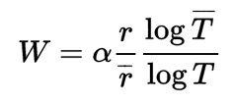
Result on Feline Test Subjects
Compression Ratio:
801.393728
Weissman Score:
V
W = ~400

