Slide 1
Πρακτική Άσκηση Genekor
Bioinformatics Department
July – August 2025
Ηλιάνα
Αγγελική
Χριστόφορος

Slide 2
Introduction
The ACMG 2015 criteria refer to the standards and guidelines established by the American College of Medical Genetics and Genomics (ACMG) and the Association for Molecular Pathology (AMP) in 2015 for the interpretation of sequence variants.
These guidelines provide a structured framework to classify genetic variants based on evidence into 5 tiers:
Pathogenic,
Likely pathogenic,
Uncertain significance,
Likely benign and
Benign
16 pathogenic criteria and 12 benign criteria (28 criteria in total)
Richards, S., Aziz, N., Bale, S., Bick, D., Das, S., Gastier-Foster, J., Grody, W. W., Hegde, M., Lyon, E., Spector, E., Voelkerding, K., Rehm, H. L., & ACMG Laboratory Quality Assurance Committee (2015). Standards and guidelines for the interpretation of sequence variants: a joint consensus recommendation of the American College of Medical Genetics and Genomics and the Association for Molecular Pathology. Genetics in medicine : official journal of the American College of Medical Genetics, 17(5), 405–424. https://doi.org/10.1038/gim.2015.30

Slide 3
ACMG 2015 criteria used
PS1: Same amino acid change as a previously established pathogenic variant regardless of nucleotide change
PM5: Novel missense change at an amino acid residue where a different missense change determined to be pathogenic has been seen before
PP5: Reputable source recently reports variant as pathogenic, but the evidence is not available to the laboratory to perform an independent evaluation
BP6: Reputable source recently reports variant as benign, but the evidence is not available to the laboratory to perform an independent evaluation
Richards, S., Aziz, N., Bale, S., Bick, D., Das, S., Gastier-Foster, J., Grody, W. W., Hegde, M., Lyon, E., Spector, E., Voelkerding, K., Rehm, H. L., & ACMG Laboratory Quality Assurance Committee (2015). Standards and guidelines for the interpretation of sequence variants: a joint consensus recommendation of the American College of Medical Genetics and Genomics and the Association for Molecular Pathology. Genetics in medicine : official journal of the American College of Medical Genetics, 17(5), 405–424. https://doi.org/10.1038/gim.2015.30

Slide 4
Purpose
The script:
Downloads the ClinVar variant_summary.txt file from NCBI
Filters it for TP53 variants (GRCh38)
Process it to extract relevant genomic/protein change information
Applies ACMG classification support rules (PS1, PM5, PP5 and BP6)
Stores the results into a PostgreSQL database (clinvar_db)
This script automatically retrieves TP53 ClinVar data, processes and classifies variants with ACMG support criteria and loads the results into a structured PostgreSQL database for downstream analysis.

Slide 5
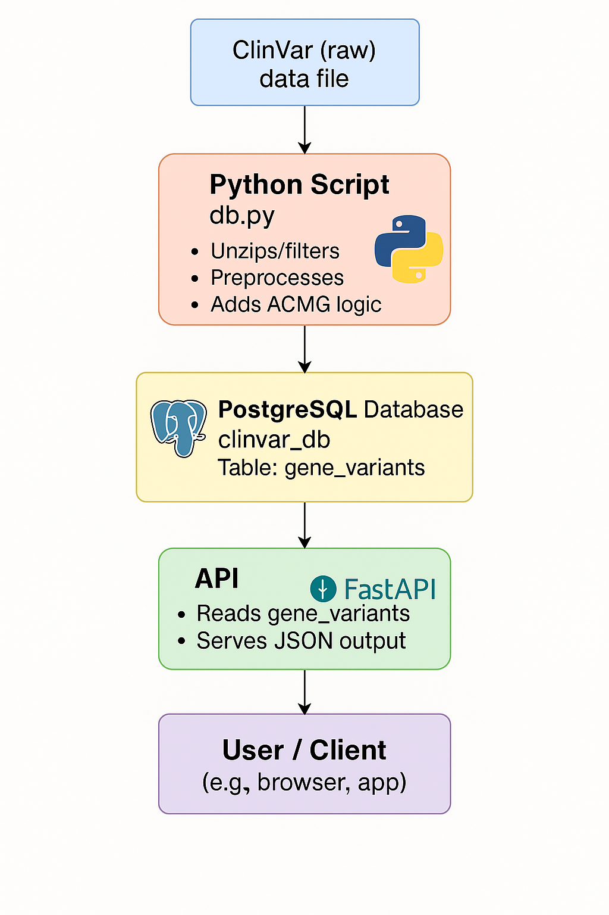
Workflow
Step-by-step database workflow:
Database Setup
Data Download & Filtering
Data Cleaning & Parsing
Clinical Significance Simplification
Variant Consequences
ACMG Support Criteria
Filtering for Reliable Variants
Database Insertion
Clean up

Slide 6
Main function workflow
Σύνδεση στη βάση & δημιουργία πίνακα
Κατέβασμα του ClinVar αρχείου
Επεξεργασία με process_clinvar_data
Απλοποίηση της κλινικής σημασίας και υπολογισμός conflicts
Υπολογισμός consequences (protein/ DNA/ molecular)
Υπολογισμός ACMG criteria (group-based + direct)
Συνδυασμός όλων των ACMG κριτηρίων σε μία στήλη (acmg_combined_criteria)
Μετατροπή πεδίων λίστας (π.χ. rcvaccession)
Φιλτράρισμα αξιόπιστων IDs
Εισαγωγή όλων των δεδομένων στη βάση
Καθαρισμός προσωρινών αρχείων

Slide 7

Python libraries
psycopg2
pandas
urllib
re
traceback
os
typing
subprocess
collections

Slide 8
API Purpose
This FastAPI app provides an API interface to query and analyze ClinVar variant data stored in your PostgreSQL gene_variants table.
It allows users to:
Check API health
Retrieve specific variant details by gene and HGVS notation
Perform ACMG rule classification (PS1, PM5, PP5, BP6) on database variants
Search for variants by protein position or consequence type
Aggregate and summarize variant classifications

Slide 9
API Queries
1. Health check
2. Variant Lookup by Gene + HGVS
3. Apply ACMG Rules to All Variants
4. Search Variants by Protein Position
5. Search Variants by Molecular Consequence
6. Summarizes Classification Counts

Slide 10
API Workflow
Ο χρήστης καλεί ένα endpoint
Δημιουργείται σύνδεση με PostgreSQL μέσω psycopg2
Εκτέλεση SQL query ανάλογα με τα φίλτρα εισόδου
Αν δε βρεθεί η παραλλαγή
Δημιουργείται DataFrame και grouping με pandas
Σε βοηθητικά endpoints
count
Group by summary
Αν βρεθεί η παραλλαγή
JSON summary με όλα τα βασικά πεδία
Φορτώνονται όλες οι παραλλαγές του γονιδίου
Υπολογίζονται ACMG κριτήρια μέσω apply_ps1_pm5_pp5_bp6
Κλείνει η σύνδεση με τη βάση στο finally block

Slide 11
API characteristics
Ανθεκτικότητα: όλα τα endpoints έχουν try/except/finally blocks
Δυνατότητα επέκτασης: Τα ACMG κριτήρια υλοποιούνται modular (apply_ps1_pm5_pp5_bp6), άρα μπορούν να προστεθούν νέα
Ευκολία παρουσίασης: Τα αποτελέσματα είναι σε JSON format

Slide 12
Results

Slide 13
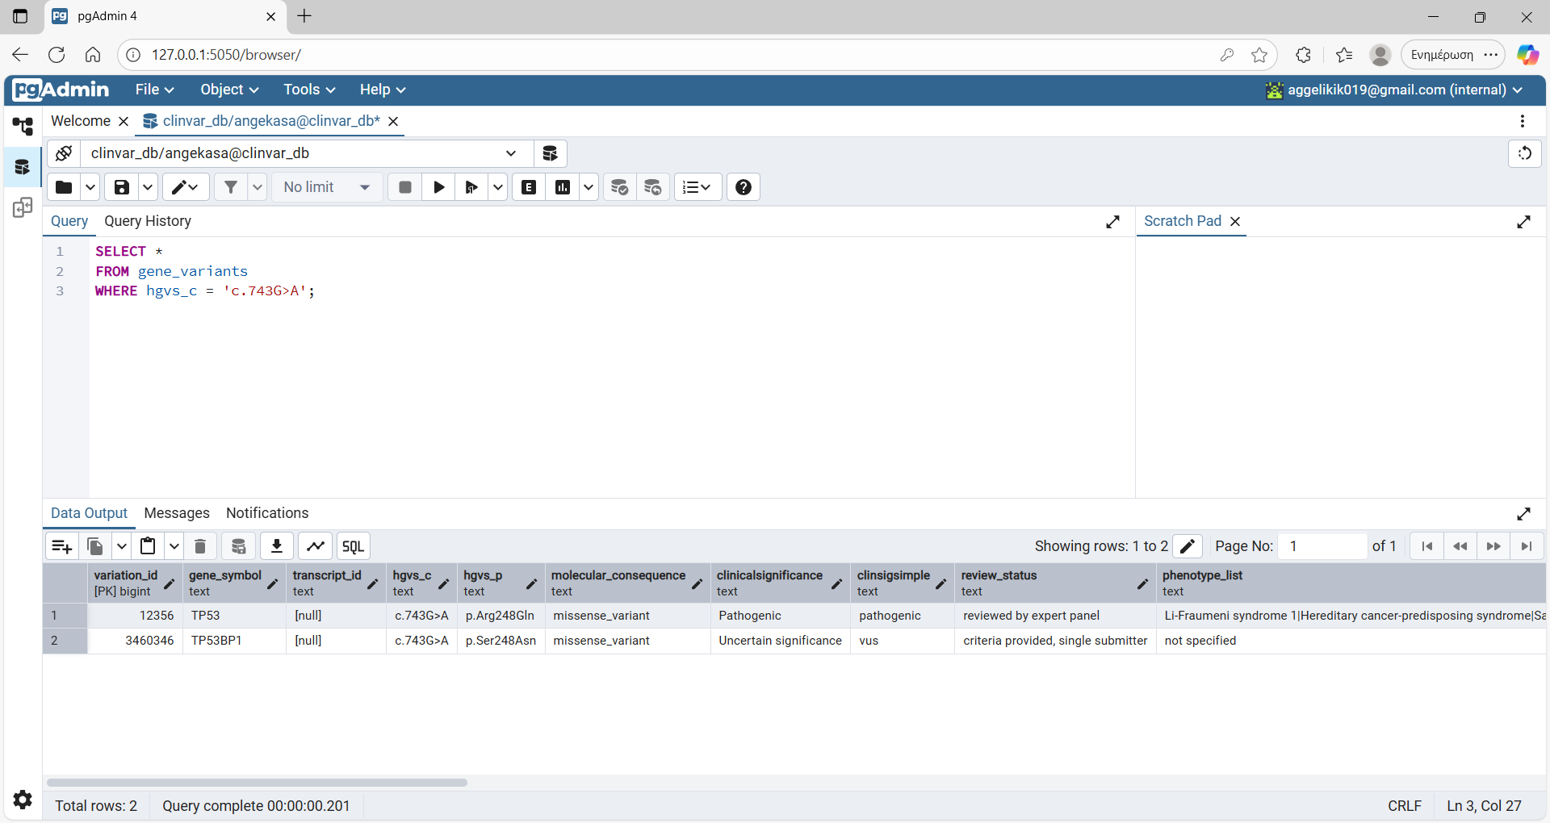
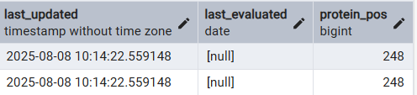
Results

Slide 14
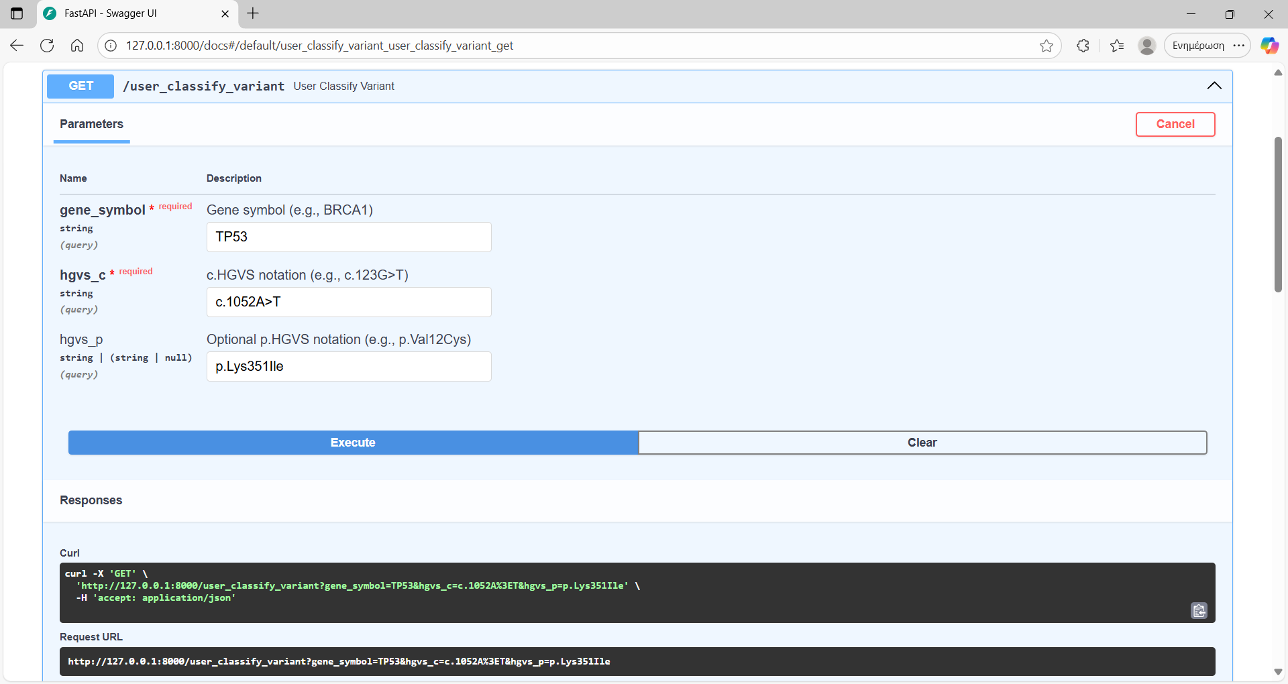
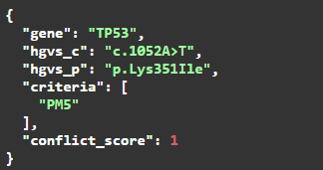

Slide 15
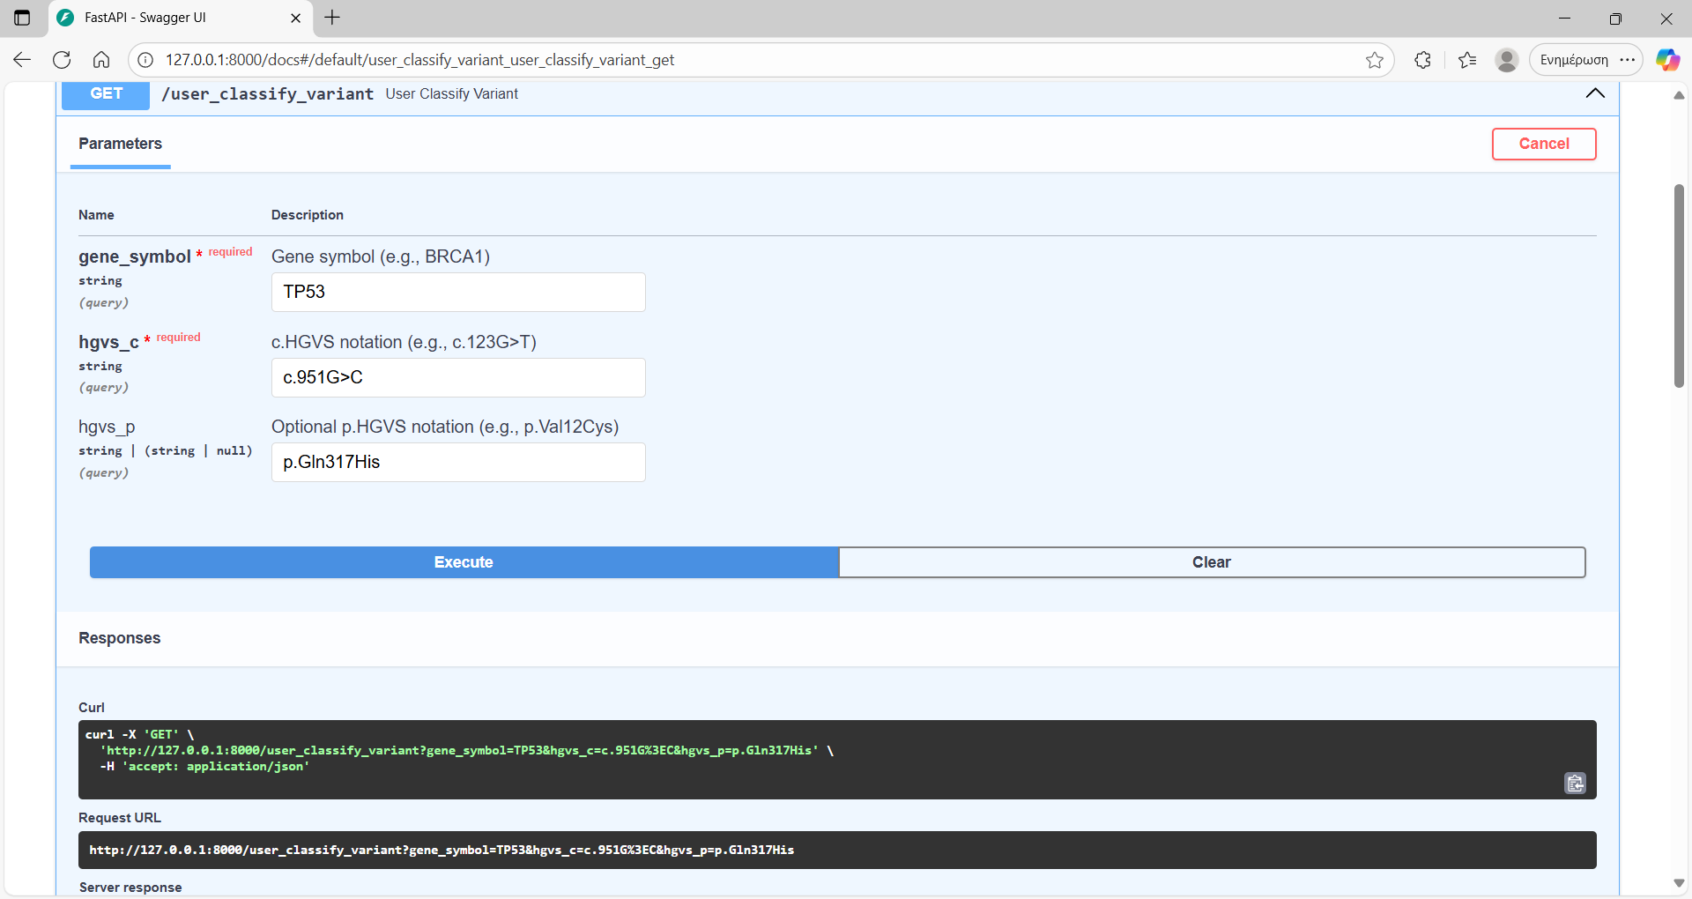
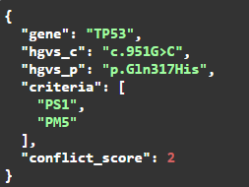

Slide 16
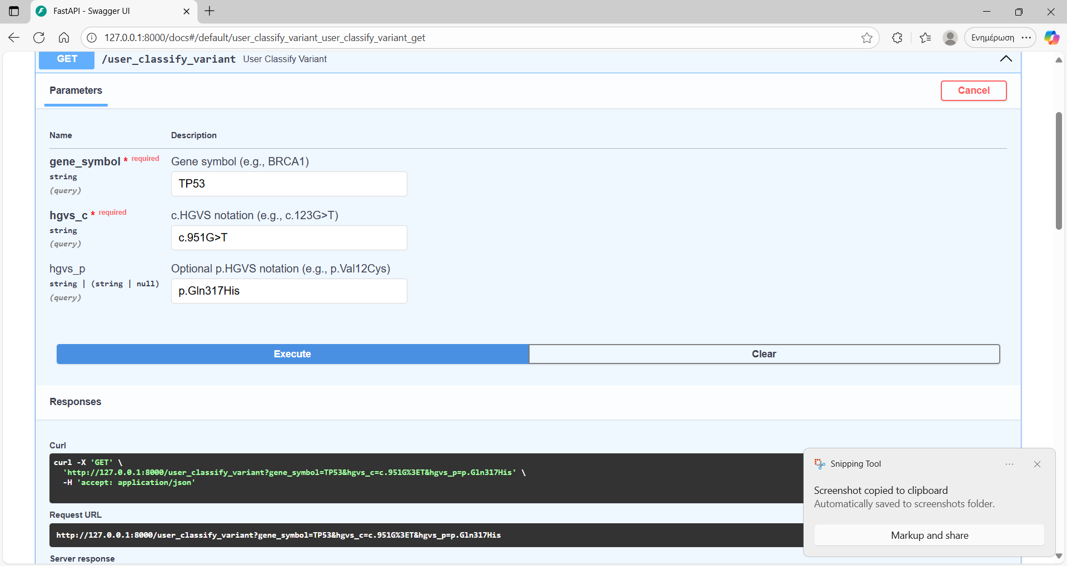
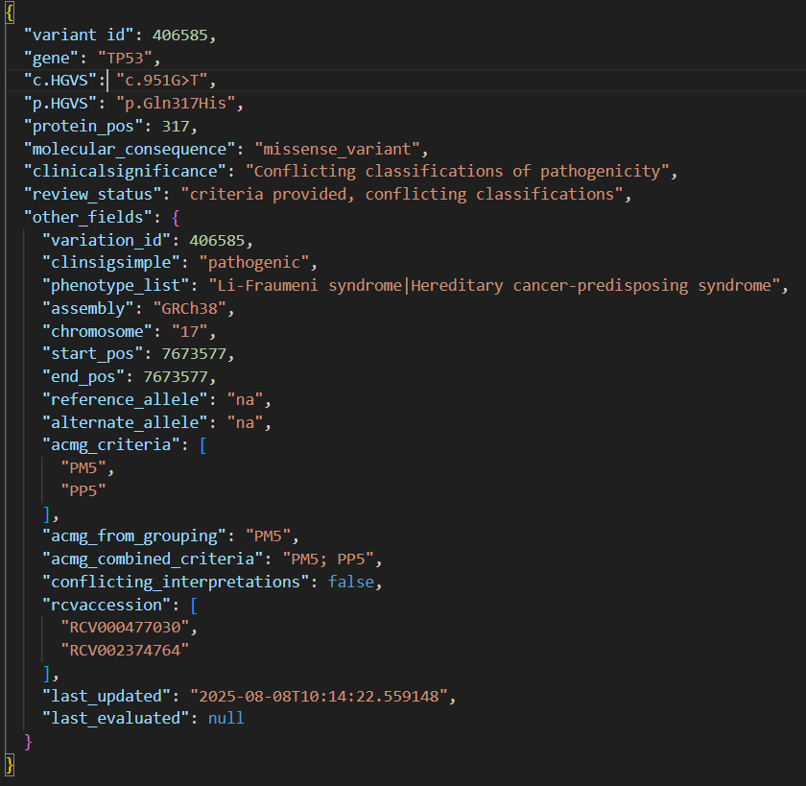

Slide 17
Conclusions - προεκτάσεις
Συμπεράσματα:
Ο κώδικας δημιουργεί ένα πλήρες API για έρευνα παραλλαγών που υπάρχουν στην ClinVar με:
Υποστήριξη αναζητήσεων σε βάθος (gene, cDNA, protein, genomic regions)
Βοηθητικά εργαλεία (counts, summaries)
Υλοποίηση ACMG κριτηρίων για υποβοήθηση ερμηνείας παραλλαγών
Προεκτάσεις:
Προέκταση για περισσότερα γονίδια ή φιλτράρισμα
Σύνδεση με άλλες βάσεις δεδομένων για επιπλέον επιβεβαίωση
Προσθήκη επιπλέον πινάκων για προσθήκη επιπλέον ερωτημάτων
Προσθήκη PM1 κριτηρίου
Δυνατότητα προέκτασης για επιπλέον κριτήρια ή filtering

Slide 18

Thank you!!

Slide 19
REFERENCES
Richards, S., Aziz, N., Bale, S., Bick, D., Das, S., Gastier-Foster, J., Grody, W. W., Hegde, M., Lyon, E., Spector, E., Voelkerding, K., Rehm, H. L., & ACMG Laboratory Quality Assurance Committee (2015). Standards and guidelines for the interpretation of sequence variants: a joint consensus recommendation of the American College of Medical Genetics and Genomics and the Association for Molecular Pathology. Genetics in medicine : official journal of the American College of Medical Genetics, 17(5), 405–424. https://doi.org/10.1038/gim.2015.30
Tornesello M. L. (2025). TP53 mutations in cancer: Molecular features and therapeutic opportunities (Review). International journal of molecular medicine, 55(1), 7. https://doi.org/10.3892/ijmm.2024.5448
Marei, H.E., Althani, A., Afifi, N. et al. p53 signaling in cancer progression and therapy. Cancer Cell Int 21, 703 (2021). https://doi.org/10.1186/s12935-021-02396-8
Chen, X., Zhang, T., Su, W. et al. Mutant p53 in cancer: from molecular mechanism to therapeutic modulation. Cell Death Dis 13, 974 (2022). https://doi.org/10.1038/s41419-022-05408-1
Li, Marilyn M. et al. Standards and Guidelines for the Interpretation and Reporting of Sequence Variants in Cancer. The Journal of Molecular Diagnostics, Volume 19, Issue 1, 4 – 23
Cortés-Ciriano, I., Gulhan, D.C., Lee, J.JK. et al. Computational analysis of cancer genome sequencing data. Nat Rev Genet 23, 298–314 (2022). https://doi.org/10.1038/s41576-021-00431-y

