Slide 1


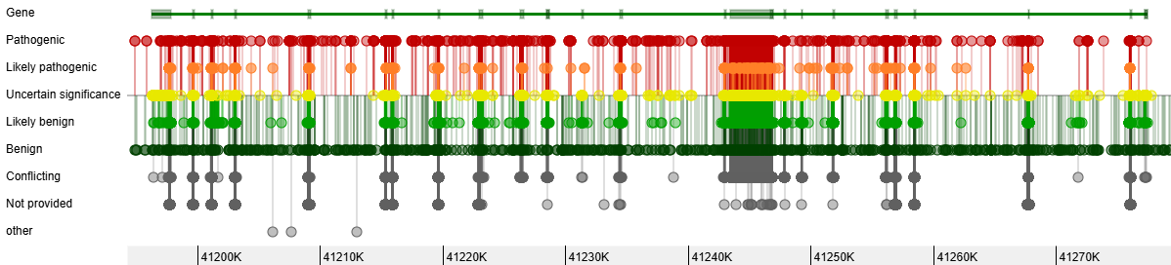
INTRODUCTION
Στόχος:
Αξιολόγηση μεταλλάξεων BRCA1 από ClinVar με βάση ACMG κριτήρια

Slide 2
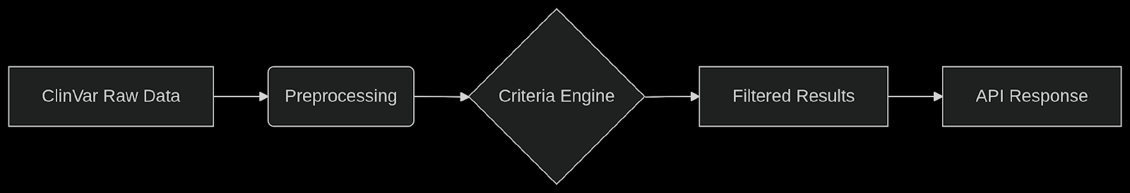
METHODS
Εργαλεία:
Python
Pandas library
FastAPI/ Java
PostgreSQL/ SQLite
Πηγές δεδομένων:
ClinVar (XML/TSV αρχεία)
ENIGMA για επιπλέον επιβεβαίωση

Slide 3
ACMG CRITERIA
BP6 (Benign Supporting Evidence) | Reputable source recently reports variant as benign, but the evidence is not available to the laboratory to perform an independent evaluation
PP5 (Pathogenic Supporting Evidence) | Reputable source recently reports variant as pathogenic, but the evidence is not available to the laboratory to perform an independent evaluation
PM5 (Pathogenic Moderate Evidence) | Novel missense change at an amino acid residue where a different missense change determined to be pathogenic has been seen before
PS1 (Pathogenic Strong Evidence) | Same amino acid change as a previously established pathogenic variant regardless of nucleotide change
Richards, S., Aziz, N., Bale, S. et al. Standards and guidelines for the interpretation of sequence variants: a joint consensus recommendation of the American College of Medical Genetics and Genomics and the Association for Molecular Pathology. Genet Med 17, 405–423 (2015). https://doi.org/10.1038/gim.2015.30

Slide 4
JSON Schema (Για API Responses)
{ "metadata": {
"query_parameters": {
"gene": "BRCA1",
"criterion": "PS1",
"date_queried": "2023-11-20" },
"pagination": {
"total_variants": 15,
"current_page": 1 } },
"data": [
{ "variant_id": 12345,
"gene": "BRCA1",
"protein_change": "p.Arg504Gly",
"dna_change": "c.1510A>G",
"clinical_significance": "Pathogenic",
"review_status": "Expert panel",
"acmg_criteria": ["PS1", "PM5"],
"conflicting_interpretations": [
{ "submitter": "LabA",
"classification": "Pathogenic" },
{ "submitter": "LabB",
"classification": "Benign" } ],
"last_updated": "2023-10-15" } ],
"actions": {
"next_step": "Reanalyze_with_ACMG_guidelines",
"api_endpoint_for_reanalysis": "/api/reanalyze/12345" } }
API DEVELOPMENT
API RESPONSE:
Δομή API:
Endpoint: GET /variant_info/{mutation}
variant_info: όνομα endpoint
{mutation}: δυναμική παράμετρος του path
get_variant_info(): η συνάρτηση που εκτελείται όταν γίνεται αίτημα
Π.χ.
http://localhost:8000/variant_info/p.Cys61Gly
Απάντηση: JSON με κλινική σημασία, κριτήρια ACMG, conflicts

Slide 5
EXAMPLE OF USE
#Αίτημα 2 (Protein Change):
curl -X POST "http://localhost:8000/get_variant_info/" \
-H "Content-Type: application/json" \
-d '{"gene": "BRCA1", "variant": "p.Val12Cys"}'
#Απάντηση:
{
"gene": "BRCA1",
"variant": "p.Val12Cys",
"clinical_significance": "Likely pathogenic",
"review_status": "Conflicting interpretations",
"acmg_criteria": [
{
"criterion": "PM5",
"explanation": "Different amino acid change at the same position as a known pathogenic variant."
}
],
"conflicting_interpretations": [
{
"submitter": "LabA",
"classification": "Pathogenic"
},
{
"submitter": "LabB",
"classification": "Benign"
}
]
}
#Αίτημα 1 (DNA Change):
curl -X POST "http://localhost:8000/get_variant_info/" \
-H "Content-Type: application/json" \
-d '{"gene": "BRCA1", "variant": "c.123G>T"}'
#Απάντηση:
{
"gene": "BRCA1",
"variant": "c.123G>T",
"clinical_significance": "Pathogenic",
"review_status": "Expert panel",
"acmg_criteria": [
{
"criterion": "PS1",
"explanation": "Same amino acid change as a known pathogenic variant (different nucleotide change)."
},
{
"criterion": "PP5",
"explanation": "Pathogenic classification from reputable source without published evidence."
}
],
"conflicting_interpretations": null
}

Slide 6
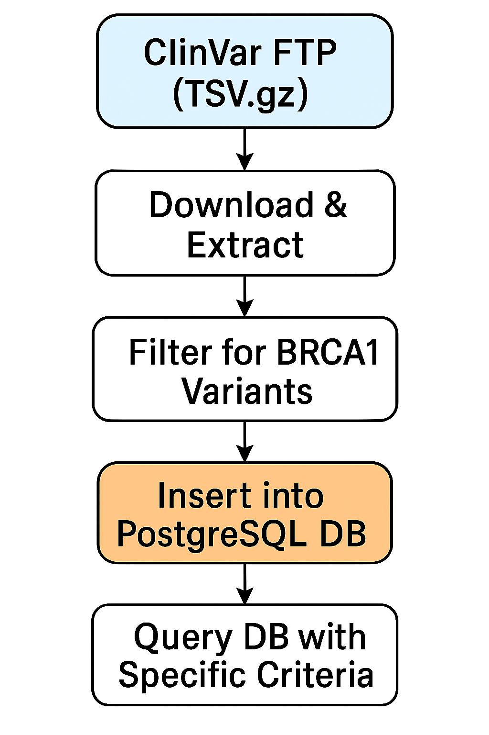
SCRIPTS
Βάση Δεδομένων
Βήμα 1 – Λήψη δεδομένων
Download ClinVar variant_summary.txt.gz from FTP
Extract .gz to .tsv
Automatically check if a new ClinVar release exists.
Βήμα 2 – Επεξεργασία δεδομένων
Filter rows for GeneSymbol == "BRCA1".
Extract columns: VariationID, c.HGVS, p.HGVS, ClinicalSignificance…
Deduplicate entries (if needed).
Βήμα 3 – Εισαγωγή στη Βάση
Drop previous data if needed.
Insert processed BRCA1 variants into variants table.
Track ClinVar release in clinvar_release_info table.
Αυτόματη Ενημέρωση
Check ClinVar release every month.
Skip update if DB is up-to-date.
Use --force option to refresh manually.
Query Layer
Enable search for:
Exact Variant Match
Same p.HGVS but different c.HGVS
Same p.HGVS position
Example SQL Queries

Slide 7
SCRIPTS
`-- Table for variants CREATE TABLE IF NOT EXISTS variants ( accession TEXT PRIMARY KEY, -- ClinVar Accession ID (RCV...) variation_id INTEGER, -- Numeric ClinVar ID gene_symbol TEXT, -- Gene name (e.g., BRCA1) name TEXT, -- Full HGVS description (e.g., NM_007294.3(BRCA1):c.123G>T) c_hgvs TEXT, -- c.HGVS (e.g., c.123G>T) p_hgvs TEXT, -- p.HGVS (e.g., p.Val12Cys) p_position INTEGER, -- Parsed amino acid position (e.g., 12) phenotype_list TEXT, -- Associated diseases clinical_significance TEXT, -- Pathogenicity (Pathogenic, Benign, etc.) review_status TEXT, -- Level of review duplicate_count INTEGER DEFAULT 1 -- Count of duplicates if any release_version TEXT );
-- Indexes for fast queries CREATE INDEX IF NOT EXISTS idx_gene ON variants (gene_symbol); CREATE INDEX IF NOT EXISTS idx_p_hgvs ON variants (p_hgvs); CREATE INDEX IF NOT EXISTS idx_p_position ON variants (p_position); `
INSERT INTO acmg_criteria (name, description, type) VALUES
('PS1', 'Same amino acid change as known pathogenic variant', 'Pathogenic'),
('PM5', 'Different amino acid change at known pathogenic position', 'Pathogenic'),
('PP5', 'Pathogenic classification from trusted source', 'Pathogenic'),
('BP6', 'Benign classification from trusted source', 'Benign');
Δομή βάσης δεδομένων

Slide 8
SCRIPTS
Download and parse data
Σύνδεση στη βάση δεδομένων
Κατέβασμα δεδομένων
Εξαγωγή και μετασχηματισμός
Αποθήκευση σε CSV
Εισαγωγή στη βάση δεδομένων
Κλείσιμο σύνδεσης
Καθαρισμός προσωρινών στοιχείων
Ρυθμίσεις
Ρυθμίσεις βάσης δεδομένων
Σύνδεση στη βάση
Δημιουργία πινάκων
Κύριος πίνακας μεταλλάξεων
Λήψη έκδοσης ClinVar
Κατέβασμα και αποσυμπίεση δεδομένων
Εξαγωγή και μετασχηματισμός δεδομένων BRCA1
1. Φιλτράρισμα για BRCA1
2. Μετασχηματισμός στη ζητούμενη μορφή
3. Προσθήκη των ACMG κριτηρίων
Υπολογισμός των ACMG κριτηρίων
Λεξικό με γνωστές παθογόνες μεταλλάξεις
1. Έλεγχος για PS1
2. Προσθήκη άλλων κριτηρίων (PM5, PP5, BP6)
3. Αποθήκευση των κριτηρίων
9. Αποθήκευση σε CSV
Μετατροπή των λιστών/λεξικών σε JSON strings για το CSV
10. Εισαγωγή στη βάση δεδομένων

Slide 9
# Μετασχηματισμός στη ζητούμενη μορφή
df = df[[
'VariationID', 'GeneSymbol', 'HGVS_c', 'HGVS_p',
'ClinicalSignificance', 'ReviewStatus', 'Name', 'Type',
'PhenotypeIDS', 'Submitter'
]].rename(columns={
'VariationID': 'variant_id',
'GeneSymbol': 'gene_symbol',
'HGVS_c': 'dna_change',
'HGVS_p': 'protein_change',
'ClinicalSignificance': 'clinical_significance',
'ReviewStatus': 'review_status',
'Name': 'condition',
'Type': 'variant_type',
'PhenotypeIDS': 'phenotypes',
'Submitter': 'submitter’
})
SCRIPTS
Download and parse data
#--- Ρυθμίσεις ---
CLINVAR_URL = "https://ftp.ncbi.nlm.nih.gov/pub/clinvar/tab_delimited/variant_summary.txt.gz"
GZ_FILE = "variant_summary.txt.gz"
TSV_FILE = "variant_summary.txt"
GENE_FILTER = "BRCA1"
OUTPUT_CSV = "brca_variants.csv"
#--- Ρυθμίσεις Βάσης Δεδομένων ---
DB_NAME = "clinvar_db"
DB_USER = "postgres"
DB_PASS = "your_password"
DB_HOST = "localhost"
DB_PORT = 5432
#--- Σύνδεση στη Βάση ---
def connect_db():
return psycopg2.connect(
dbname=DB_NAME,
user=DB_USER,
password=DB_PASS,
host=DB_HOST,
port=DB_PORT
)
#--- Λήψη έκδοσης ClinVar ---
def get_remote_release_version():
try:
with urllib.request.urlopen("https://ftp.ncbi.nlm.nih.gov/pub/clinvar/tab_delimited/README.txt") as response:
for line in response.read().decode().splitlines():
if "Release" in line and "ClinVar" in line:
return line.strip()
return None
except Exception as e:
print(f"Σφάλμα κατά τη λήψη έκδοσης: {e}")
return None
# Μετατροπή των λιστών/λεξικών σε JSON strings για το CSV
df_csv = df.copy()
df_csv['acmg_criteria'] = df_csv['acmg_criteria'].apply(lambda x: json.loads(x) if x else [])
df_csv.to_csv(filename, index=False, encoding='utf-8')
#--- Αποθήκευση σε CSV ---
def save_to_csv(df, filename=OUTPUT_CSV):
print(f"Αποθήκευση σε {filename}...")

Slide 10
SCRIPTS
Criteria
# Λεξικά γνωστών pathogenic variants και θέσεων
known_pathogenic = {
'p.Arg504Gly': 'c.1510A>T', # PS1: Ίδιο protein change, διαφορετικό DNA
'p.Trp41*': 'c.123G>A' # PM5: Θέση 41 είναι hotspot
}
pathogenic_positions = [504, 41] # PM5: Γνωστές pathogenic θέσεις
trusted_submitters = ['ENIGMA', 'ClinVar'] # PP5/BP6: Αξιόπιστες πηγές
# Συνάρτηση ελέγχου ACMG κριτηρίων
def apply_acmg_criteria(row):
criteria = []
# PS1
if row['ProteinChange'] in known_pathogenic and row['DNAChange'] != known_pathogenic[row['ProteinChange']]:
criteria.append('PS1')
# PM5
protein_pos = int(''.join(filter(str.isdigit, row['ProteinChange']))) if pd.notna(row['ProteinChange']) else None
if protein_pos in pathogenic_positions and row['ProteinChange'] not in known_pathogenic:
criteria.append('PM5')
# PP5/BP6
if row['Submitter'] in trusted_submitters:
if row['ClinicalSignificance'] == 'Pathogenic':
criteria.append('PP5')
elif row['ClinicalSignificance'] == 'Benign':
criteria.append('BP6')
return criteria
# Εφαρμογή στη στήλη 'acmg_criteria'
df_brca['acmg_criteria'] = df_brca.apply(apply_acmg_criteria, axis=1)

Slide 11
SCRIPTS
API Endpoint for Criteria
# Δημιουργία λίστας με κριτήρια και εξηγήσεις
criteria_details = [
{"criterion": criterion, "explanation": acmg_explanations.get(criterion, "No description available.")}
for criterion in acmg_criteria
]
app = FastAPI()
df = pd.read_csv('brca_acmg_classified.csv') # Προϋπόθεση: Το CSV έχει στήλη 'acmg_criteria' ως λίστα
class VariantQuery(BaseModel):
gene: str # Π.χ., "BRCA1"
variant: str # Π.χ., "c.123G>T" ή "p.Val12Cys"
@app.post("/get_variant_info/")
async def get_variant_info(query: VariantQuery):
# Αναγνώριση τύπου μετάλλαξης (DNA ή protein)
if query.variant.startswith("c."):
filtered = df[(df['gene'] == query.gene) & (df['dna_change'] == query.variant)]
elif query.variant.startswith("p."):
filtered = df[(df['gene'] == query.gene) & (df['protein_change'] == query.variant)]
else:
raise HTTPException(status_code=400, detail="Invalid variant format. Use 'c.' for DNA or 'p.' for protein changes.")
if filtered.empty:
raise HTTPException(status_code=404, detail=f"Variant {query.variant} not found for gene {query.gene}")
variant_data = filtered.iloc[0].to_dict()
return {
"gene": query.gene,
"variant": query.variant,
"clinical_significance": variant_data.get("clinical_significance"),
"review_status": variant_data.get("review_status"),
"acmg_criteria": criteria_details,
"conflicting_interpretations": variant_data.get("conflicting_interpretations")
}
# Ανάλυση κριτηρίων ACMG
acmg_criteria = variant_data.get("acmg_criteria", [])
acmg_explanations = {
"PS1": "Same amino acid change as a known pathogenic variant (different nucleotide change).",
"PM5": "Different amino acid change at the same position as a known pathogenic variant.",
"PP5": "Pathogenic classification from reputable source without published evidence.",
"BP6": "Benign classification from reputable source without published evidence."
}

Slide 12
SCRIPTS
API Response
app = FastAPI()
# Φόρτωμα του CSV
df = pd.read_csv('brca_acmg_variants.csv')
# Αν η στήλη acmg_criteria περιέχει λίστες ως string, τις μετατρέπουμε σε Python λίστες
df['acmg_criteria'] = df['acmg_criteria'].apply(
lambda x: ast.literal_eval(x) if isinstance(x, str) else []
)
# endpoint: Παίρνει μια μετάλλαξη και επιστρέφει τύπο και κριτήρια
@app.get("/variant_info/{mutation}")
def get_variant_info(mutation: str):
# Φιλτράρει με βάση την στήλη 'ProteinChange'
match = df[df['ProteinChange'] == mutation]
if match.empty:
return {
"mutation": mutation,
"message": "Η μετάλλαξη δεν βρέθηκε στη βάση δεδομένων."
}
# Παίρνει την πρώτη καταχώρηση
row = match.iloc[0]
return {
"mutation": mutation,
"variant_type": row['variant_type'],
"acmg_criteria": row['acmg_criteria'],
}

Slide 13
Ευχαριστούμε!

