Slide 1
S3GE Design Layers
Module
Application/Game
Application
Image
Entity
Effects
Audio
User
Bots
Network
MAUI Browser
Gizmo
Canvas
Input
Device
Logic
Repository
Database
Binary
Decision
Path Finding
Trigger
MAUI v2
Persistent Data
User Interface
Entity
MEChs
Trixie
Illudium
ParticleSys
BlitzTerrain
Interior
Octree
Actor
Environment
Core System
DarkGDK
Fulcrum
DarkBox
virtual
QuantumPath
S3GE XML
HTTP
I₂P
DarkLUA
Core Libraries
Wii
XBOX
OAW
DX9
Physx
Box2D
Recast/Detour
irrXML
DarkNet
LUA
S3GE Engine
Input
Audio
Graphics
Physics
Solvers
Data
Network
Bindings

Slide 2
S3GE Content Loading
and Workflow
S3GE
Initialize
Scripting
Networking
DarkLUA
DarkNet
Load
Registry
Configuration
Registry
S3GE XML
.maui/.s3ge
Initialize
Sub Systems
Trixie
Fulcrum
QuantumPath
DarkLUA
Script
Load
MAUI
Main & Core
MAUI
Illudium
Media/Data
Load
S3GE
Applications
Load
Game Level
Content

Slide 3

Trixie / Trixster
Trixie is a dynamic 2D/3D image drawing and mapping system for S3GE.
Trixel - a Pixel: 4 Byte Component within a Memblock representing 1 pixel in which drawing operations at the lowest level are performed.
Components
Image – Entity contain a group of Layers in which drawing operations can be performed.
Bitmap – Represents the visual drawing surface.
Layer(2D) – Memblock that represents a drawing a 2D image/texture (referred to as image) area used for dynamic and static trixel drawing operations. Multiple Layers can be created and stacked to create a single complex image. Layers can also be manipulated during Engine Run-time to support various visual effects.
Single Object
Dynamic Rendering System
Image/Texture
Channel Map - Specialty Layer that uses different color pixels to represent areas on image in which operations can be performed independently. Channel Maps can be used to create a variety of Image-based Maps and can be applied one or more Layers.
Trixie Image
Direct Apply
OR
Object Group
Channel – Layer that represents a individual area of a Channel Map
Texture Flipping
aka
Double Buffering
Layer(3D) – Memblock that represents a 3D Objects Vertices and UV Coords.
Similar to Layer(2D), Multple Layers can be used to apply multiple Images to a 3D Object.
Stamp – Image used that can be applied by a Brush.
Cluster – Group of Stamps that can be applied by a Brush as a single stamp.
Stamp FX – FX for applying a Stamp or Cluster.
Tool - A Entity used for selecting parts of an image, image transformation, applying drawing operations and effects,
Brush – Tool Object that user controls with the pointer to draw on a Layers using stamp / cluster, effects
PaintBot – Tool Object that automates drawing with Brush to fill Channels
PaintBot FX – FX for applying a Bucket Fills.
Selector – Tool Object that is used to select parts of a image, UVs, etc. This is achieved by creating a channel map and draws using a brush. Once the channel is defined , it can be applied to another Layer and Edit Operations (copy, paste, delete, etc) performed.
Effect – Scriptable Drawing Operation than be applied by various Tool Objects. Multiple Effects
can be stacked together in a FX.
FX – A group of Effects.

Slide 4
Multi-Application User Interface
Input Device
Collision
Object
Gizmo
Widget
Doodad
Jigger
Wizmo
Gadgets
Physics
Controller
Pointer
Network
Procedural
Collision/Contact
Detection
N
Composite
Gizmo
Coupler
TIMING
Visual
Object
HUD
Event
States
Reticle
Canvas
Interactive
Entities
Trigger
Behaviors
Down
Enter
Transitions
Exit
Hover
Actor
Composite
Up
ACTIONS
Event-Driven
Scripting
Style/Theme/Scheme
Interactive-centric
Engine Model
Notes:
MAUI Interactive Primitives
Canvas (aka Observer/Camera/Screen)
InputDevice
Gizmo

Slide 5
Illudium Particle System
Reactor
(Composite Fuzz)
Variable
Map
Emitter
Vertice
(Fragment Generation Controller)
Fragment
Vertice
FUZZY
Particle Group
Object
Composite
Fuzz
Collision/Contact
Detection
Collision
Object
Visual
Object
Coupler
Reactors:
Clouds
Flocks
Foilage
Pyro
Fluids
LensFlare
Breakable: Glass Window
Dyna-Skin: Hair/Fur
Dyna-Light/Shadow
TIMING
Domain
Event
States
Behaviors & Transitions
Dying
Idle
Die
Move
Action: Fragment/Visual Object Manipulator
EFFECT (Action List)
Event-Driven
Scripting
Style/Theme/Scheme
Visual Object Factories
Notes:
Illudium
Particle base primitive that contains vertex & variable map (Attributes).
Emitter is the core particle of a Fuzz Object. Its used a the prototype to generate Fragments and is usually parented to another object for control and event generation.
Fragment is a individual Particle Vertex generated by a Emitter coupled to a Collsion Object and Visual Object.
Collision Object is a 2D 3D collision object used provide collision detection/response and physics simulation.
Domain is a Speciality Collision Object used o provide Collsion Volume,
Visual Object is a 2D/3D Object that visually represents a Particle.
Fuzzy Object is a group of Fragments control as a singluar object.
Reactor is a Composite Of Fuzz Objects
Reactor Systems: Static & Dynamic
Event State enumated value that represents a Finite State based Collision/Timing and other Event States.
Behavior controls a Particle Event State Operation based on Current and Next Event States.
Transition executes an Effect based on Previous Event State
Style/Theme are Procedural Generation Factories for 2D/3D visual objects. (Trixie)
Action is a Script that manipulates a Particle's Attributes, Collision and Visual Object Properties.
Effect is a List of Actions applied to a Particle.

Slide 6


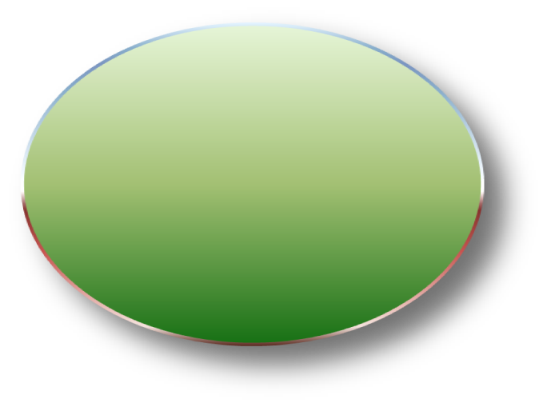
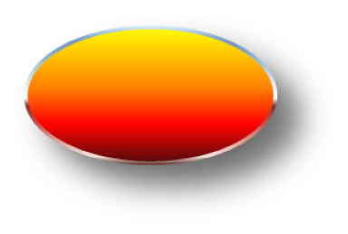
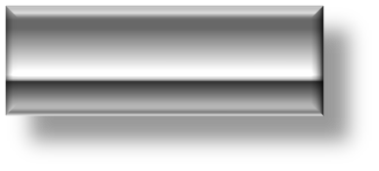


Network Topology
Moderated
Open
Repository
(Development)
Asset
3rd Party
Editor
www.HPQuest.com
Host Server
HTTP/FTP/SMTP/PHP/MySQL
Media/Data
Database
WebApps
TournamentBlitz
S3GE
Client Applications
Entities & Quest
The Internet
HTTP
Quality Assurance
Mods/Devs
I₂P (RTP/RTSP)
Closed
Repository
(Production)
HTTP
S3GW
Game Server
Session Initiation Protocol (SIP)
SIMPLE
I₂P Immediate Input Protocol
(RTP/RTSP)
Notes:
Moderated Open Repository
DarkMORG is designed with a heavy dependence on Player-Created Media and Content. To facilitate a quick and user-friendly means for Players to get their Art into the game (and of course protect the game from damage), a Moderated Open Repository is established.
Players can simply upload their Media Files to MOR for review and approval via HTTP. Moderators inspect files for damage, compromise, obscenities, etc. Upon approval the files are moved to the Closed Repository (Host Server) for use in game.
Simplified Directory Structure
DarkMORG Host Server, MOR, and Client utilize a simple and identical Directory Structure to maintain files. All files are required to have a unique name. All files retain their native format and extension without cosolidation or additional compression.
Root:
-- 2D: Stores all Image and Movie Media Files
-- 3D: Stores all 3D Geometry and Animation Media Files
-- Audio: Stores Audio Media Files
----Sound
----Music
-- Data: Stores all Logic and Aux Data Files
---- UI: Stores User Interface and Dialog Files
---- Logic: Stores all logic Script Files for transfer between Host and Clients.
DarkMORG Client Makes use of popular media formats and a few specialty formats. The compressed formats are used where possible. All files are distributed independently (No Archives).
Data Formats:
---- 3D Geometry *.x
---- MAUI Font *.png
---- Texture *.jpg
---- TextureMAX *.tmx All visible 3D entities use a TextureMAX texture
---- Terrain Height Map *.bmp
---- Music *.mp3
---- 3D/2D Sound *.wav
A Game with MORe Content / MORe Games with The Content
One of my goals for MOR is not only to supply my MMO with lots of content, but, also supply lots of other games with the content.
For example, one game concept thats on burner is the development of two distinct genres that interact together to create a MMO with complex Political Factions. 1) Kings: A Real-time Strategy Game in which Player's battle for control over Terriorities on a Slower Turn-based `Macro` Scale. 2) Knights: Multiplayer FPS in which Players select a faction and battle over Bases on a Faster Twitch-based `Micro` scale. The actions of Kings generates quest for the Knights - Knight's success/failure effect Kings ability to control a territory. Although the genres play from different perspectives and game mechanics, they can share the same Assets and Lore.

Slide 7
PALM: Programmable Application Layer Model for Transactions: Request-Response
SIP
HTTP
Request Message
Message
Header
Multi-Transaction
Single Transaction
Transaction
Response Message
Body
Direct
Transaction
HTTP Client
HTTP Server
Programmable (Scripted) Areas:
1. Transaction State Behavior?
2. Header Manipulation Rules
3. Message Body - Parsing & Format
4. Action on Data
Relayed
Transaction
I2P Client
I2P Server
I2P Client
I2P: Immediate Input Protocol
Relayed
Transaction
I2P Client
I2P Server
VOIP
I2P Client
Client Input
Notes:
I2P Packet Format
* Offset 0: 1 byte denoting the command transmitted.
* Offset 1: 2 bytes, the length of the data transmitted.
* Offset 3: variable length, the body of the message.
References:
http://wow.stratics.com/content/features/editorials/mech/

Slide 8
Network: Client Update
Automated Update Management
User Selective Update Management
When the client is launched, the user must provide a user name and password to access to the Remote Web & Database Host Server (RPG Server). Once U/P is received and validated the Client queries a list of available Quests from the RPG Server.
S3GE is designed with emphasis on the smoothest and fastest possible Massive FPS Combat and Mini-games and desires minimum loading before or during combat. Due to the unpredictable nature of real-time Editng System (in which new content can be added, modified, or removed during game play) and constant new content additions I’m implementing creative techniques to update the client.
To cope with the ever changing content, two strategies are employed: 'Dummy' Replacements and Streamed Updates.
The Dummy Replacement Class feature uses media files already downloaded to the client as fill-ins. The Player is given a option to download the needed files prior to engaging combat.
Changes can occur anytime the player may have to face new mobs without possessing needed files. In this scenario, the player will be given a choice of options based on whether the attacking mob is AI or Human controlled at the time of the encounter.
If Mob is AI controlled the player can elect to download files, in which the files are downloaded on-the-spot, and combat engagement is put in a pending status until download completion. If the players elects to skip download, they are offered to Flee or Engage (a replacement). If the player flees the needed files are queued for streaming download and engagement with such mob will be put in pending status automatically until download is completed.
If Mob is Human controlled the player is only offered to Flee or Engage (a replacement) in which if the player flees the needed files are queued for streaming download and engagement with such mob will be put in pending status automatically until download is completed.
Both situations can influence a Party Combat formation, thus all party members must be notified if a players has to ‘Sit Out’ (download) upon combat engagement.
Download Options
Install on Start: Pre-loads remote Assets by checking local assets against new/updated on remote, installs on local machine prior to game launch.
Install in Play: Checks local assets against new/updates streams Updates during play. If Asset not available will use Sub , Queue, and Install on Exit .
Install On Demand : Installs Remote as needed, if not local available.
  Optional Prompt, to instlall immediately or Install on Exit
Install on Exit: Uses local Asset Replacements/Subs and queue remote asset for download when exiting the client.
Create Asset
Cannot use Asset until Resource is Cached
If Resource Cached
Else If Resource Stored Locally
Start Load
Else If Resource Store Remotely
Start Download
EndIf
Notes:
Server World Load
Query MMO_Quest {
Query MMO_World: Terrain Collision Objects
Query MEC Low LOD Collision Objects derived from MMO_MECEntity: Character, Structure, Vehicle, Weapons , Trees{}
Set up Dark AI
Set up Fulcrum
Query Motors
Query Logic Triggers
Query GTR
}
Client World Load
Query MMO_Quest{
Query MMO_World: Terrain, Sky, Starfield, Celestial
Query MMO_MECEntity: Character, Structure, Vehicle, Weapons , Trees {
Query MMO_MECBlock{
Query MMO_Asset: Mesh,Texture
Query MMO_MECConnector{}
}
Query MMO_MECAccessory{
Query *Applicable_Accessory Table (ie Reactors, Lensflare,etc){
If Applicable Accessory = Motor {
Query MMO_MECLinkage{}
}
}
Select MMO_MECEntity.Type
Case Character
Weld Character
Query Animation Data
EndCase
Case Structure
Octree Culling
LightMap
EndCase
EndSelect
}
Query Effects: Particles, LensFlare
Query Audio: Music, SoundFX
Query Motors
}

Slide 9




Server Client Sim Entities
RPG Entities 3D + Physics + AI + Skin + Map
Static Entities
Terrain 3D + Physics + Skin + Map
Water Body 3D + Map
Tree [Client-side Billboarding] 3D+ AI + Skin + Map
Building [Client-side Octree Culling] | 3D + Physics (Static Rigid Body) + AI (Obstacle) + Skin + Map
Structure 3D + AI (Obstacle) + Skin + Map
Dynamic Entities
Hit Object Physics (Dynamic Rigid Body)
Player 3D + AI (Player) + Physics (Chr Controller)+ Skin + Map
NPC 3D + AI (Enemy | Friendly | Neutral) + Physics + Skin + Map
Prop 3D
Machine
Vehicle
Platform 3D + Physics (Dynamic Rigid Body) Skin + Map
Door {3D + Physics + Skin + Map & Trigger: AI (View Blocking) }
Fire Arm 3D + Physics + Skin + Map
Melee 3D + Physics + Skin + Map
FX Entities
Ammo aka Projectile 3D + Physics + Skin + Map
Particles
Decals
Flocks 3D + Physics + Skin + Map
Foliage Sprite + Skin + Shader
Cloud Sprite + Skin + Shader
Lens Flares Sprite + Skin + Shader
GUI
3D
Sprite, Single Mesh & Composite (MEC)
Animation, 3D Light, and 3D Sound.
Physics
Physics Object used for Physics and general Collision Detection
AI
BRAINS Agent
Skin
2D Asset Trixie Image
General Texture Map.
Map
2D Asset TrixieTexture Map
Game Server Sim Entities
Client Sim Entities
Trees, Structures, Static Props
Fulcrum Static Rigid Body
DarkAI Obstacles
Static Entities
Static Entities
Players & Bots
Fulcrum Character Controller
BRAIN Player
Terrain, Buildings
Fulcrum Static Rigid Body
Trixie Skin
Trees, Structures, Static Props
Fulcrum Static Rigid Body
Skinner
Texture Maps
Players & Bots
Fulcrum Character Controller
Terrain, Buildings
Fulcrum Static Rigid Body
BRAINS Container & Zones
Entity
MEC
Assembly
Dynamic Entities
Dynamic Entities
HitObjects
Fulcrum Dynamic Rigid Body
DarkAI Trigger
Parts
HitObjects
Fulcrum Dynamic Rigid Body
Notes:
Server & Client Sim Entities
Server manages a Physics / Logic representation of all interactive game Entities. The Client maintains a replica of the Server’s Physics representation and also provides a Graphical representation of the game entity. AI for inteactive entities is managed on the Server meanwhile, AI for non-interactive entities (ie Flocks, etc) is managed on the Client. No Graphical representation (MEC) for entity is applied on the server.
Special consideration is given
Type MMO_ServerSimEntity
NetworkID
Type
ID
Physics
AI
EndType
Type MMO_ClientSimEntity
NetworkID
Type
EntityID `MEC
Physics
EndType

Slide 10
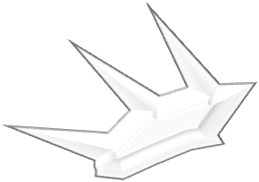



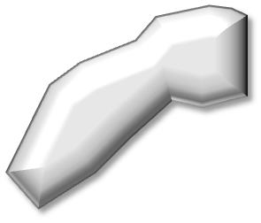
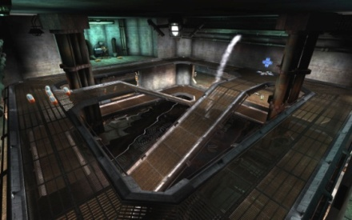
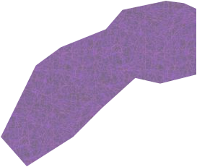



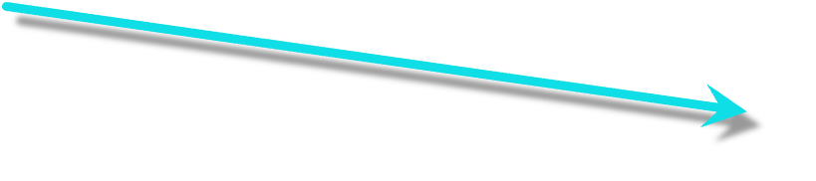


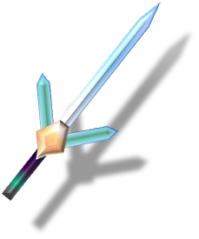

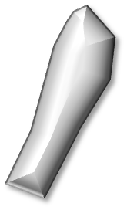

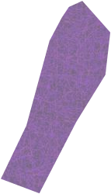
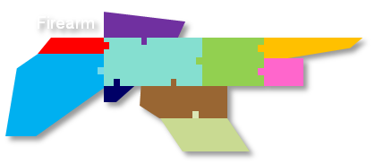
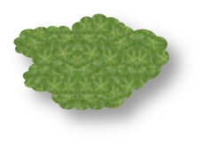
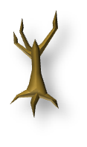
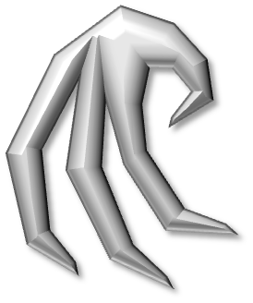

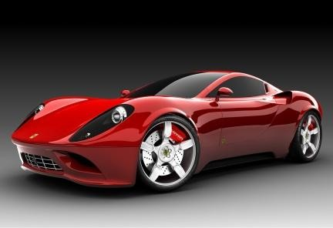
Model Entity Construction Sets
Construct
Block
Connector
Block
Armor
Part
Item
Bone
(Slot)
(Peg)
Mount
Slot
Accessory
(Motor)
Mount
Peg
Building and Structures
Bone
`UL1.1.`
Link
Skin
Entity Categories
Character
Bone
`UL1.2.`
UpperArm
Part
Melee
Bone
`UL1.2.`
Prop
LowerArm
Part
Bone
`UL1.3.`
Weld(s)
Bone
`UL1.3.`
Hand
Part
Tree
Vehicle
& Machine
Mount
Slot
Mount
Any
Claw
Part
HitObject Accessory
Notes:
Modular Entity Construction Sets (MECS)
Inspired by Toy Construction Sets (Meccano, Tinker Toys, KNEX, Legos) I played with as a child, I’m implementing Modular Entity Construction (MEC) Sets based on the Methodology of interconnecting Blocks, Connectors, and Accessories. DARKMORG takes this methodology further by allowing the user to create the blocks no matter the shape to become connectable. The motivation behind the implementation of MECS is to 1) Support countless variations of High Level Game Entities by mixing/matching smaller components that are assembled in the engine at runtime using Database Queries; 2) Promote rapid production of user created content, placing emphasis on the creation of smaller 3D/2D assets that can be interchanged in various entities vs. creation of larger single entities such as a single mesh Character.
The MECS Toy Construction Set Methodology of interconnecting Blocks, Connectors, and Accessories.
The MECS Construct – Defines a Block/Accessory and its Connectors.
Block: 3D Mesh Asset in which one more Connectors are added. Note: Geometry, Animation, Textures, and Shaders are created with 3rd party tools.
Skin
Accessory - Audio/Visual or Virtual Object used to control or produce an effect.
FX Objects
Reactors: Particle Emitter
LensFlares
3D Objects
Lights
Camera
Sound
Physics Objects
Hit Object: Fulcrum Static|Dynamic Rigid Body that’s sole purpose is to execute a action when a [i]collision event[/i] occurs between itself and other Hit Objects. Hit Objects are `glued` to other objects such as Players/NPCs, Weapons, Projectiles, etc to create a means of interaction. Hit Objects are used for all 3D interactions and are what make Interactive Entities…interactive.
Cloth – Fulcrum Cloth Object.
Connector: A geometry or virtual connection point in which a Blocks and Accessories are connected or linked.
Mount – A external connector added to mesh or internal point defined within the mesh used to connect Parts & Accessories at runtime. Gender determines Parent/Child Relation between block and connector. Mounts have 3 types of Genders: Slot/Peg/Any.
Slots are Parented by Blocks, Blocks are Parented by Pegs, Only Slot to Peg relationship allowed between specified Mounts of either gender. If the connection gender is any is used as standard mount
Bone: two connecting points defined within a mesh used for bone animation. The two points maintain a Parent/Child relationship defined by the animation data. Two Bones connect to each other, at the points of the same name. Bones can be assigned a gender to connect to Mounts and Joints.
Joint: Fulcrum Rigid Body Joint often used in Machines: 6DOF, Clyindrical, Distance, Fixed, Point in Plane, Point on Line, Prismatic,Pully, Revolute, Sphere.
Weld: A vertex point defined within a mesh and assigned to be used for (magnetic threshold) welding of two meshes together to create a single seamless mesh. Welds have two genders: Positive|Negative.
Link: A virtual link connector between a Motor (Impulse Source) Accessory and one or more Blocks and Accessories
Entity → Class → ClassType (aka SubClass) → Class Parts
Entity Intance → Part → Construct {Block/Accessory + Connectors}
The MECS Entity – Defines Parts and Accessories used to assemble a Game Entity
Part - Single Construct or Construct Composite
Core: Base Part in which Limb Parts connect. Mandatory for Entity Assembly.
Limb: Extension Component that
The Game Entity Classes
Engine handles each Game Entity Class of Parts in a specific way.
Terra-Form (Terrain + Sky + Celetstrial Body + Fluidbody + Cloud)
Building / Structure
Tree
Character/NPC
Firearm (Gunvertor)
Projectile (Missile)
Melee Weapon
Prop (animated & static)
Vehicle
Machine
Items (Single Mesh/Textures with Connectors)
Client → Save: Insert into Database Tables
Database → MECS XML → Client

Slide 11
Model Entity Construction Sets: FireArm Entity Class / GunVertor Weapon System
Travel Control: Line Of Sight, Straight, trajectory, remote triggered, man-piloted, ai-piloted (heat-seeker), patterned
Travel Path:
Travel Range
HitObject Shape
HitObject Size
Destruct on Impact
Inflict on Impact
Explosion
Explosion Range
Explosion Rate of Growth
Sight & Cursor
00
Scope
AmmoMeter
Firing Unit
Bayonet
Chamber
Barrel
Distorter
Ammunition
Stock-Grip
Loader
Trigger
Bullet
ShotGun
Lazer
Death Ray
Pulse
Missle
Rocket
Grenade
Bomb
Mine
Magazine
Notes:
Gunvertor Components
Chamber: The Weapon Core Component in which other components connect into. It is the mechanism loads ammunitions from the ammunition storage into the weapon, applies motivational force, directs ammunition through the barrel, and ejects ammunition byproducts. Chambers effect the amount, type and speed of loading ammunitions.
Barrel: Projects the ammunition. Barrels effect ammunition range and dispersion. Long Barrels produce long range/ narrow dispersion; Shorter Barrel produces short range/wide dispersion. Barrels also provide a ‘heat sinking’ for the weapon.
Loader: Can be attached to the barrel or magazine. Loads ammunition with Hand2.
Trigger: Control mechanism that is linked to the Firing Unit. The Trigger determines how the user can fire the weapon and select ammunition. A weapon can posses multiple triggers.
Firing Unit: This component provides motivational force to a ammunition. High Quality Firing Units can project ammunition a great speeds long distances.
Stock-Grip: Absorbs Recoil. Recoil can effect weapon handling and accuracy. High Quality Stocks can absorbs greater amounts of recoil. Handgrip attaches to player. Stock can also be used to Butt an opponent. The damage inflicted by such an attack is dependent on the Quality of the butt.
Magazine: Magazine – PowerCell - Canisters are storage components. These components effect Ammunition Refill/Recharge speed and Storage Quantity.
Scope: A HUD accessory component that assist in visibility of the target (ie: Zoom, Infrared, Thermovision)
Sight + Cursor: A HUD accessory component that assists in targeting object. Displays Targeting Cursor.
AmmoMeter: A HUD Display for Ammo Count associated with the magazine.
Distorter: This accessory attaches to the Barrel of the weapon to muffle sound of Solid Ammunitions or change the visual characteristics of Energy Ammunitions.
Bayonet: This Blade Weapon accessory attaches to the barrel of the weapon and used as melee weapon
Ammunition: Inflicts Damage Effect to target upon impact
Projectile
Flash
Waste
Decal
Weapon Animation States
Loading
Charging
Firing
Discharging
Targeting
Bayonet Slash
Bayonet Stab
Stock Butt

Slide 12




B.R.A.I.N.S: Behavioral Rules Artificial Intelligence Node System
Interactive Entities
Collision & RayCasting
Sensory
(Input)
Collision Objects
Triggers
Collision Objects
Players/NPCs, Weapons
Status
Give||Take Registry
Name
Type
Value
Operator
Name
Type
Value
Operators
Strength
25
>
And
Strength
99
>
Q & A Dialog
Keys
Or
GoldKey
1
>
Or
GoldKey
0
>
Or
LockPick
8
>
Or
LockPick
10
>
Or
Binary Decision Tree
If Give.Registry(“GoldKey”) > Take.Registry(“GoldKey”)
Return TRUE Else Return FALSE
TRUE
Nodes
Nodes
If Give.Registry(“LockPick”) > Take.Registry(“LockPick”)
Return TRUE Else Return FALSE
FALSE
Event
States
A2B
PathFinding
Behaviors & Transitions
B
Idle
Dying
Action: Fragment/Visual Object Manipulator
Attack
Motor
(Output)
Event-Driven
Scripting
EFFECT (Action List)
A
Notes:
BRAIN Agent
Input Sensor – inputdevice contact collision(MAUI), bound collision check (MEChs)
Decision Processor - Conditional Check (GTR)
Output
State change, Activation
Variable Reassignment
Motor → Pathfinding
Motivations:
1) How do I resolve player actions, or have a good system of restricting/allowing player action without writing hundreds of functions?
2) How can I make the avatar "smart" so that it will interact with different objects in the world in different ways.
One way you can solve NPC these issues is through the use of what is called a "Give/Take System." The phrase "Give/Take" here does not refer to inventory system or other types of in-game exchanges (although a Give/Take System is normally used to resolve these transactions as well). Instead, this phrase refers to a systematic approach to resolving actions players attempt to do, with a way of allowing the avatar to intelligently and logically respond.
[/quote]
Hi Darrel,
I too use `Give/Take` to describe a concept of Logic implementation in my Interactivity Model, The Give||Take Registry (formerly Give/Take Inventory). The driver behind GTR was to answer the questions proposed above from the perspective of different interactions between the Player, Environment, and NPC/Bots.
I wasn't sure if you were refering to my concept in your statement: `The phrase Give/Take here does not refer to inventory system or other types of in-game exchanges`, but, I believe that we are taking very similar approaches to answer the questions above. I've revamp'd my system and a small overview may reveal the similarities between our approaches.
[quote]The first thing we need to implement this system is way of encapsulating a LOT of if-endif conditions down into a much smaller "package" in terms of lines of code. One way this can be accomplished is by reducing all conditions into simple Yes/No questions.[quote]
This is exactly what GTR accomplishes. In fact, that is all it does. Basically, the Registry is a list (queue, stack, or any other data structure) of Node Keys. A Node Key contains a: name/value(VariableMap), compare operator, and logical operator. Node Keys can represent any kind of property. The data in the Node Key is used to perform a simple IF condition and return a TRUE/FALSE result. [i]I find it easier to visualize each IF Condition as a `node` in a decision tree, hince the label Node Key.[/i] All the Node results are tallied to produce a final TRUE/FALSE result.
All Interactive Entities have their own Registry and the Give||Take role is based on the entity that initiates the interaction (collision check). Entities who initiate the interaction are [i]Giving[/i], the receiving Entities are [i]Taking[/i]. When Giving, each Node Key can represents something the Entity possesses. When Taking, each Node Key can represents something [i]required by[/i] the Giving Entity for positive interaction.
From a coding perspective, we iterate through each Node Key in the Take Registry. Each Node Key is matched-by-name to a Node Key in the Give Registry. The Operators from Take Registry Node Key are used to perform the comparison. If the result is TRUE we continue to the next Node Key, otherwise we exit checking returning a FALSE result. If we’re able to iterate through all the nodes we return a TRUE. Thats it! The final result can used to execute a scripted action.
In my MMORPG, GTR is a simple and high performance solution for dealing with Interactions that require many conditional checks against a Player Character abilities, skills, accessories, items etc. GTR solves Question #1. GTR is only a part of a larger Interactivity Model I lovenly call the Behavioral Rule Artificial Intellegence Nodes System (BRAINS). BRAINS also includes Binary Decision Trees, Collision Objects (Triggers), Tasks (LUA Script), Dark AI (Pathfinding), and Q & A Diaglog.
Triggers address Question#2. A Trigger is a type of [i]Collision Object[/i] placed in the environment to trigger events (ie: Door Switch). A Collision Object is a 2D/3D Object (Fulcrum) that executes one or more scripted actions when a [i]collision event[/i] occurs between itself and other Collision Objects. Collision Objects are `glued` to other objects such as Players/NPCs, Weapons, Projectiles, etc to create a means of interaction. Collision Objects are used for all 3D interactions and are what make Interactive Entities…interactive.
A Quest Map can contain hundreds of Triggers. Thus, instead of a requiring a slew of actions for a Interactive Entity to `intelligently and logically` respond to a Triggered Event, the Trigger executes a action that acts upon the Interactive Entity.

Slide 14





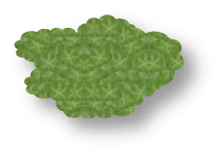







Hieararchal Interaction Mechanics using Give||Take Registry
Take
Process
Give
Timer
Farming
Mini-Game
12
9
3
6
Seedling
Earth-Aligned
Output
Quantity
WaterBodies
Water-Aligned
Input
Rate
Output
Rate
Seeder
Earth-Aligned
InputRadius
Collision Object

Slide 15
Rumble Tone Generation
The idea behind RTG is use a variety of low frequency tones to simulate forcefeed back and rumble effect such as eDimensional’s Audio FX Force Feedback PC Gaming Headset.
Notes:
Rumble Tone Generation
Modular Melody Construction

Slide 16
Camera System: LOD, VIS/Culling, Blur Effect
Dot
LOD
Mesh
Collision
Texture
Out of Stereoscopic
Depth of View
Sprite 2D
Low Poly 3D
Med Poly 3D
High Poly 3D
Notes:
DarkMORG Client
Supports First Person Perspective and Third Person Perspective
First Person Mode A `Full Bodied\Self View + Cursor`
First Person Mode B `Weapon & Cursor on Screen` + Cursor Unlock
First Person Mode C `Cursor Only` (dScribe)
First Person Mode D (Over The Shoulder (w/ Weapon))
Automated Cinematic Camera Control for multiple users. This can by performing a perimeter check for all party members. If players are within the specific parameter of a player that activates an cinematic event and are 1) not engaged in combat or loading state, their characters are put in Ghost mode and the party cinematic is loaded and played when the cinematic completed for all players in the perimeter, the characters are restored.
Octree Culling is achieved with Diggsey’s Octree Culling V1.0 Plugin. The culling maps are generated on the fly upon level load.

Slide 17

Drawing Board
[Host Server] PHP Script → [Client] XML (MAUI) » DarkLUA Script → LUA Script
Theme Border Images
1
First Child
Gizmo 1
Last Child
0
1
2
0,0: Top Left
0,1: Top Center
0,2: Top Right
1,0: Middle Left
1,1: Middle Center
1,2: Middle Right
2,0: Bottom Left
2,1: Bottom Center
2,2: Bottom Right
3,0: Top Frame
0,3: Left Frame
2,3: Right Frame
3,2: Bottom Frame
0
3
3
Parent
Parent
Parent
Gizmo 2
Next
Previous
Gizmo 3
Next
Previous
Gizmo 4
1
3
Sibling
Sibling
Input & Text Box Behavior
2
H
e
l
l
o
0,0
15,0
1,1
14,1
0,0
2,2
13,2
15,0
1,1
2,2
13,2
14,1
2,13
13,13
1,14
14,14
0,15
2,13
13,13
15,15
1,14
14,14
0,15
15,15
Notes:
2D Input Behavior
On initial DOWN Eventstate calculate `Cursor` Gizmo position based on Pointer Coords and Character Width
Highligter
a. On HOLD Eventstate position Highlight Gizmo
Widgets
`Left` moves Cursor Left based on Character Width + Kern
`Right` moves Cursor Right based on Character Width + Kern
`Home`
`End` moves character to last character on line
`Delete` cursor maintains position , deletes character to right, shifting character to the right - leftward
`Insert` inserts new character, moves Cursor moves to end of new character, shifts characters to the right - rightward
`Backspace` deletes character to left, Cursor moves to end of character to the left, shifting character to the right - leftward
If `Input/Text` Gizmo is moved and Cursor assigned as child with Parental Control
Textbox
HighLighter
a.
Widgets
Left/Right/Up/Down moves Cursor Direction between Characters
`Carriage Return` creates new line if none exists, shifts text to right to next line and all line below down
`Backspace` (Extras) moves text lines below up, line of above is empty, if not append to last character line, shift all text chars/lines
`Delete` (Extra)
`Insert` (Extra)

