Slide 1

Trixie
Trixie is a dynamic 2D/3D image drawing and mapping system for S3GE.
Trixel - a Pixel: 4 Byte Component within a Memblock representing 1 pixel in which drawing operations at the lowest level are performed.
Components
Image – Entity contain a group of Layers in which drawing operations can be performed.
Bitmap – Represents the visual drawing surface.
Layer(2D) – Memblock that represents a drawing a 2D image/texture (referred to as image) area used for dynamic and static trixel drawing operations. Multiple Layers can be created and stacked to create a single complex image. Layers can also be manipulated during Engine Run-time to support various visual effects.
Single Object
Dynamic Rendering System
Image/Texture
Channel Map - Specialty Layer that uses different color pixels to represent areas on image in which operations can be performed independently. Channel Maps can be used to create a variety of Image-based Maps and can be applied one or more Layers.
Trixie Image
Direct Apply
OR
Object Group
Channel – Layer that represents a individual area of a Channel Map
Texture Flipping
aka
Double Buffering
Layer(3D) – Memblock that represents a 3D Objects Vertices and UV Coords.
Similar to Layer(2D), Multple Layers can be used to apply multiple Images to a 3D Object.
Stamp – Image used that can be applied by a Brush.
Cluster – Group of Stamps that can be applied by a Brush as a single stamp.
Stamp FX – FX for applying a Stamp or Cluster.
Tool - A Entity used for selecting parts of an image, image transformation, applying drawing operations and effects,
Brush – Tool Object that user controls with the pointer to draw on a Layers using stamp / cluster, effects
PaintBot – Tool Object that automates drawing with Brush to fill Channels
PaintBot FX – FX for applying a Bucket Fills.
Selector – Tool Object that is used to select parts of a image, UVs, etc. This is achieved by creating a channel map and draws using a brush. Once the channel is defined , it can be applied to another Layer and Edit Operations (copy, paste, delete, etc) performed.
Effect – Scriptable Drawing Operation than be applied by various Tool Objects. Multiple Effects
can be stacked together in a FX.
FX – A group of Effects.
Notes:
References:
Road Kill UV (Open Source) UV Unwrapping Source
http://www.pullin-shapes.co.uk/page8.htm

Slide 2
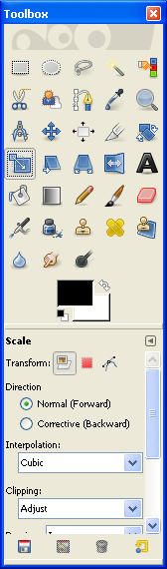
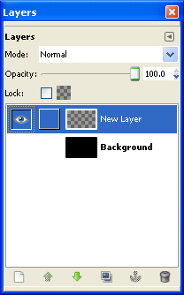
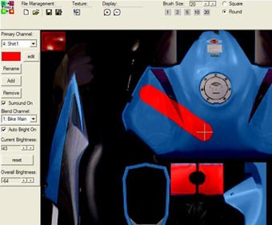
Trixster (Trixie Editor Application)
Image Objects
Dialogs
Image, Layers2D/3D, Channel Map, Channels,
Pixel Shader
S3GEdit Main Menu
Selection
Trixter Main
S3GE Canvas – viewport for 2D Images/3D World
Layer Stack
Stamp, Cluster
Tool Box
Information/Help Context Bar
Tool Objects
Brush, PaintBot, Selector , Transformers, Color Picker
Script Objects
Effect FX, Stamp/Cluster FX, Paintbot FX
Properties
Image
Stamp/Brush
Channel 1{255,0,0}
Notes:
References:
Road Kill UV (Open Source) UV Unwrapping Source
http://www.pullin-shapes.co.uk/page8.htm

Slide 3
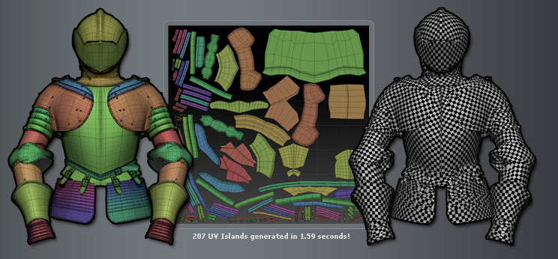
Layer(3D) – Memblock that represents a 3D Objects Vertices and UV Coords.
Similar to Layer(2D), Multple Layers can be used to apply multiple Images to a 3D Object.
Notes:
References:
Road Kill UV (Open Source) UV Unwrapping Source
http://www.pullin-shapes.co.uk/page8.htm

Slide 4
Trixie
Work Flow Diagrams
New Image
Auto Generate
Base Layer O
Auto Generate
Base
Channel Map
New Stamp
Auto Generate
Base Image
Auto Generate
Base Effect
New Brush
Use Current
Stamp
Notes:
References:
Road Kill UV (Open Source) UV Unwrapping Source
http://www.pullin-shapes.co.uk/page8.htm

