Slide 1
CEBD- 1250-BigDataStorage Team Snowstorm
Ilia Kassianenko, Pawel Kaluski, Fritz Gyger
24th March 2019
Instructor: Daniel Paes

Slide 2
Agenda
Scope
Data Flow
Decision Chart Database system
Entity Relationship Diagram
Decision chart storage
Solution Choice
Q&A

Slide 3

Scope (Ilia)
https://youtu.be/DGysE5mrjwk
Notes:
https://www.youtube.com/watch?v=DGysE5mrjwk

Slide 4
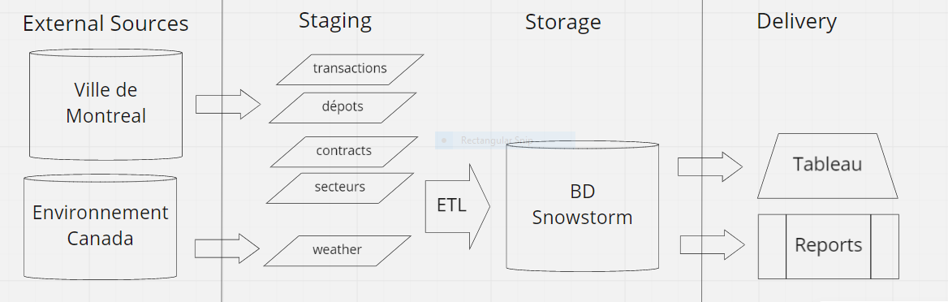
Data Flow
Notes:
https://realtimeboard.com/app/board/o9J_kyQw7mY=/?moveToWidget=3074457346472753162
All are csv files sourced from
City of Montréal for the snow removal information : (Licence: Attribution 4.0 international CC BY 4.0)
- Snow removal transactions
Snow Depots
Contracts
Sectors (incl. Burroughs)
Environment Canada
for the weather data, such as total precipitation and snow on the ground from the station at Dorval airport
All source data is open data readily available on the respective websites.
Weekly extractions as the files are updated by the city every Monday at 1am EST between November 1st – April 1st.
We’re extracting the weather data at the same time.
Extract source files in UTF-8 format in order to have French accents.
We plan to use Python to develop the ETL process and the data cleansing. There are a few rules to be applied. We’ll get to them later.

Slide 5
Decision chart database system
Data model | Performance | Scalability | Flexibility | Complexity | Functionality
Key–value store | high | high | high | none | variable (none)
Column-oriented store | high | high | moderate | low | minimal
Document-oriented store | high | variable (high) | high | low | variable (low)
Graph database | variable | variable | high | high | graph theory
Relational database | variable | variable | low | moderate | relational algebra
Notes:
*Consistency and availability
Key-value stores are capable of providing much higher performances than RDBMS
>> In our case data organization and management is more important than the performance.
Column family databases are designed for large volumes of data, read and write performance, and high availability
>> We don’t have large volumes and don’t need great performance nor high availability.
Document databases have ability to store varying attributes along with large amounts of data
>> We don’t have large volumes and the data is static (format doesn’t change much).
Graph database is designed to treat the relationships between data as equally important to the data itself. It is intended to hold data without constricting it to a pre-defined model.
>> The relationships between the data is static and the pre-defined model does not change.

Slide 6
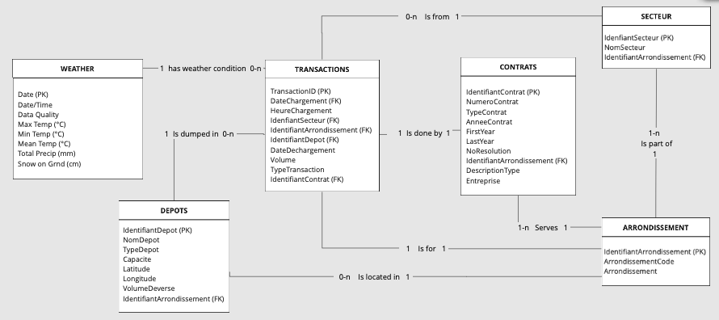
Entity Relationship Diagram (ERD)
Notes:
https://realtimeboard.com/app/board/o9J_kyQw7mY=/?moveToWidget=3074457346471590609
Present the entities and their relationships.
Volume :
Initial : about 35 MB
Weekly growth: about 10MB for transaction & weather data.
Design decisions :
We removed all source attributes that were not useful or always null.
Validation rules:
DATES : Need to be valid dates in the right sequence
(ex. 2106-02-07 found in source data)
Transformation rules:
TRANSACTIONS
Split DateChargement (format Timestamp YYYY-MM-DD hh:mm:ss) into DateChargement (YYYY-MM-DD) and HeureChargement (hh:mm:ss) to allow easy join with DATE (YYYY-MM-DD) in WEATHER table.
CONTRATS
Split AnneeContrat (format YYYY-YYYY) in FirstYear & LastYear in order to allow easier filtering.

Slide 7
Decision Chart Storage
 | Solutions
Features | Zoho | Ninox | Caspio | Digital Ocean
Backup & Recovery |  |  |  | 
Data Migration |  |  |  | 
Data Replication |  |  |  | 
Data Security |  |  |  | 
Database Conversion |  |  | 
Mobile Access |  | 
Performance Analysis |  |  | 
Queries |  |  |  | 
Relational |  |  |  | 
Virtualization |  |  | 
Price/Month for 10 users | $150.00 | $83.30 | $59.00 | $25 .00
Notes:
Pawel : Based on pricing and features shown on Capterra, Digital Ocean, and Cloudways. (100$ credit with Digital Ocean)
The proposed solution, Digital Ocean, is considered to offer the needed functionality at the lowest price. Should there be a change of magnitude to the price or any other issue with Digital Ocean, the proposed alternative is Caspio.
[PK1]$5 Compute + $15 Database + $5 storage
Number of users is unclear. As for the features, someare more obvious than others. Sinceigital Ocean was not part

Slide 8
Solution Choice: Digital Ocean (www.do.co)
Fully managed PostgreSQL databases
Access through UI or API
Free daily backups with point-in-time recovery
Standby nodes with auto-failover
End-to-end security
Scalable performance
24/7 support
Notes:
Pawel
Data temperature Warm, SSD storage, weekly update,

Slide 9
Wrap up (Ilia)
Milestones approach
SLA
Risks
Notes:
Milestones (the way we worked)
Risk
SLA:
Operations 8 AM to 8 PM EST for nationwide coverage
Office hours 9 AM to 5 PM EST
Public link:
https://realtimeboard.com/app/board/o9J_kyQw7mY=/

Slide 10
Questions?

Slide 11
Thank you from Team Snowstorm
https://realtimeboard.com/app/board/o9J_kyQw7mY=/
https://github.com/iliakass/CEB1250_repo/tree/master/Project/Submitted/220319

