Slide 1
CEBD 1260 - BIG DATA ANALYTICS SPRING 2019 Project Swarm: Web App for determining the quarantine period due to a Bed bug infestation
Ilia Kassianenko & Luigi Clerici

Slide 2
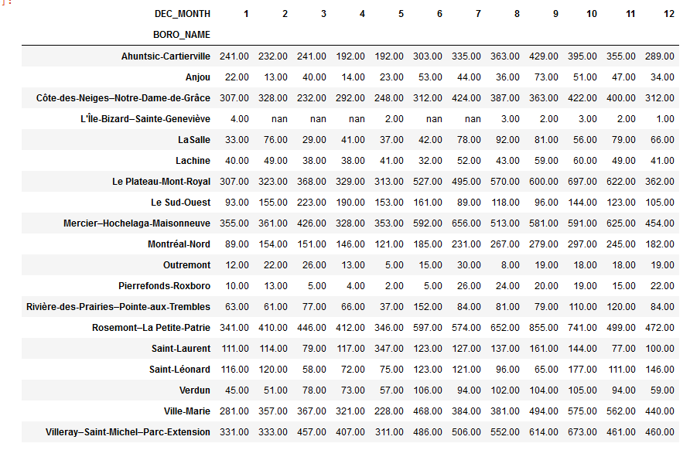
Problem Definition
Our analysis centers around the bedbug infestation issue affecting the boroughs of the island of Montreal. Some boroughs and neighborhoods have been impacted considerably more than others. While some escape this nightmare, others have to live through the chaotic turmoil of an extermination procedure. An infestation can turn a relatively tranquil existence upside down and impact one’s life temporarily through the tedious and time consuming process required to eradicate these bugs from your home and the costs associated to it. The tracking of the dataset declarations to the city began in 2011.
Dataset view by Month and Borough since 2011.

Slide 3
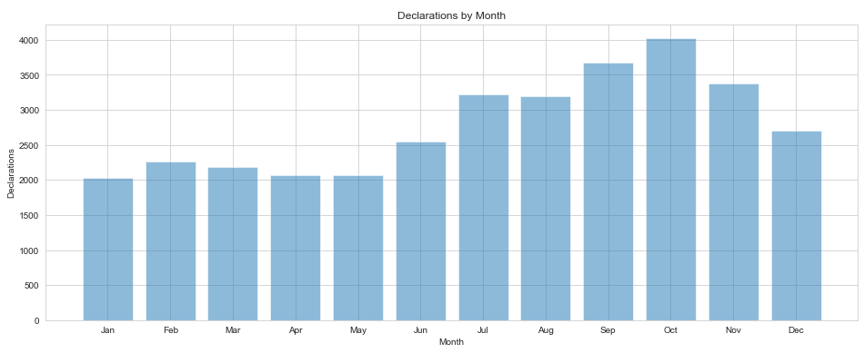
Same data as previously illustrated. When we group the boroughs together and view them on a monthly scale, we can easily see when the issue is at it’s peak. The period from June through October is the most problematic.

Slide 4
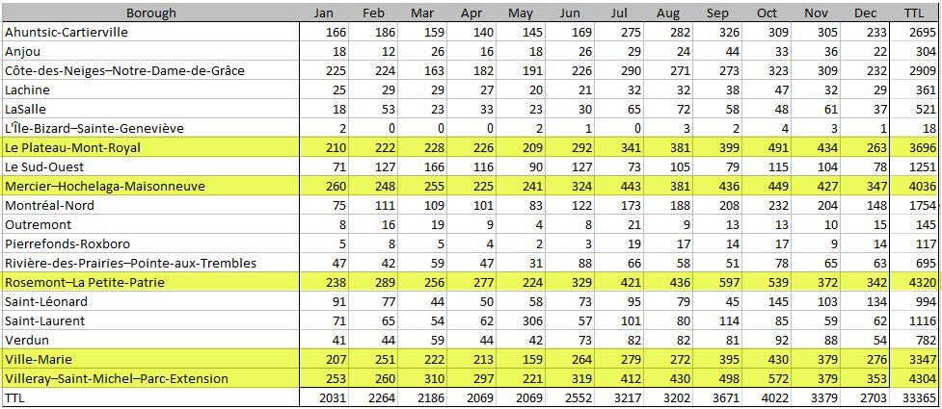
The 5 boroughs in which the issue persisted and ranked the highest on a regular basis were : Plateau-Mont-Royal, Mercier-Hochelaga-Maisonneuve, Rosemont-La Petite Patrie, Ville-Marie and Villeray-Saint-Michel-Parc-Extension.

Slide 5
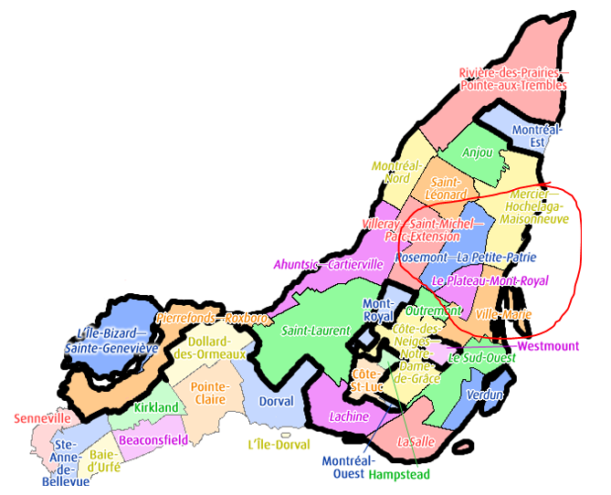
Those 5 boroughs all share common borders.

Slide 6
Dataset Description
Declaration report tracking for our dataset began on the 5th of July 2011.
The data encompasses all official declarations made to the city associated to an extermination. As specified on the city dataset site, any declaration that is not associated to an extermination has been removed from the dataset. Those entries account for 7% of the declarations and would translate to approximately 2335 declarations [2]. The dataset contains a list of over 33000 declarations of confirmed infestations located in the various boroughs. Included in the dataset are 13 columns detailing the specific dates the infestations were declared along with unique declaration ID's per entry. Each record identifies the neighborhood and borough. The specific locations are solely identified by coordinates to ensure the privacy of the residents.
To keep the confidentiality of the affected households, the closest intersection to the household was used to not pinpoint the actual location.
The dataset also includes inspection dates along with the start and end periods for exterminations including the number of visits per household to a maximum of 4.
Columns:
NO_DECLARATION, DATE_DECLARATION, DATE_INSP_VISPRE, NBR_EXTERMIN, DATE_DEBUTTRAIT, DATE_FINTRAIT, No_QR, NOM_QR, NOM_ARROND,
COORD_X, COORD_Y, LONGITUDE, LATITUDE
The city website indicates that the data has a low degree of reliability due to the concern that they were entered manually by a third party, pest control managers, and are not validated by the City of Montreal.
While analysing the data we found numerous entries, approx. 2100, with a lack of inspection dates as well as missing start and end dates for the extermination along with missing values for number of visits required. Since the city indicated that all declarations not associated with an extermination are removed from the dataset, we can conclude that a blank visits field is at minimum equal to 1.

Slide 7
Random Forest
Using regression, use a model in order to determine the features that help determine lead time from the first extermination, in order to determine the recommended waiting duration prior to entering a dwelwing at an intersection where an extermination previously occured. Factors such as the radius from the intersection are not considered in the model.
An alternative regression would entail in determining the number of declarations, although the number of exterminations is capped at four for each declaration. This alternative is not considered in this model. A classification model can be created to determine whether the extermination occured successfully or not with False Positives and True Negatives, as an indicate that an inspection is needed to verify a future reoccurence. ['LAST_DM', 'LAST_DY', 'EPI_DIST_1', 'EPI_DIST_4', 'EPI_DIST_5’] vs [‘D_DIFF_B’]
The lead time if an indication if the extermination was successful. For a short lead time, and with an assumption that all infestation cases are reported, the extermination are assumed to be successful, since subsequent visits did not occur. This is an assumption.
The following internal fields were used to train and produce the prediction :
LAST_DM = DATE_LAST_EXT, LAST_DY = DATE_LAST_EXT
EPI_DIST_1 = DIFF LONG, LAT vs Parc-Laurier, Le Plateau-Mont-Royal
EPI_DIST_4 = DIFF LONG, LAT vs Grande-Prairie, Saint-Leonard
EPI_DIST_5 = DIFF LONG, LAT vs Grenet, Saint-Laurent
Random Forest was used due to it’s flexibility for both regression and classification problems.
https://towardsdatascience.com/the-random-forest-algorithm-d457d499ffcd

Slide 8
Results

Slide 9
Discussion

Slide 10
References
https://www.epa.gov/bedbugs/do-it-yourself-bed-bug-control
https://www.canada.ca/en/health-canada/services/pest-control-tips/bedbugs-how-do-i-get-rid-them.html
https://en.wikipedia.org/wiki/Boroughs_of_Montreal
https://www.webmd.com/skin-problems-and-treatments/guide/bedbugs-infestation#1

