Slide 1

<EPAM> Training
final project
“Interpol”

Slide 2


Application features
USER interface:
Registration, login/logout;
Mail informing about registration;
Session activating after registration or logging;
Redirecting to the main page were information about the last added person performed;
Opportunity to watch persons who are missed/wanted/found or missed/wanted by region;
Opportunity to pass the test

Slide 3
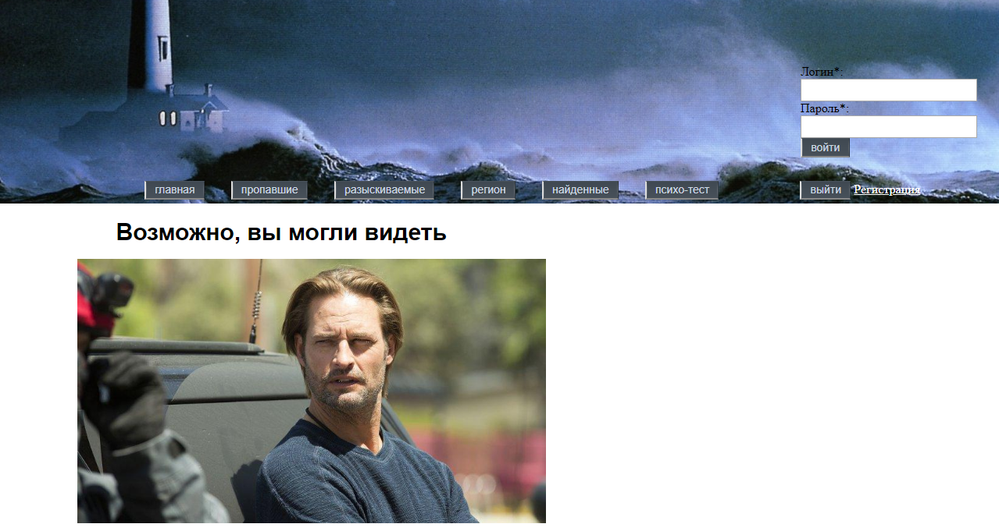
User interface

Slide 4

Application features
Logged USER interface:
Opportunity to testify about wanted person;
Opportunity to testify about missed person;
Opportunity to watch his testimonies before admin watches it;
Opportunity to watch his testimonies in archive after admin watches it and assigns it’s wealth;
Opportunity to watch user’s balance;
Opportunity to change language;

Slide 5
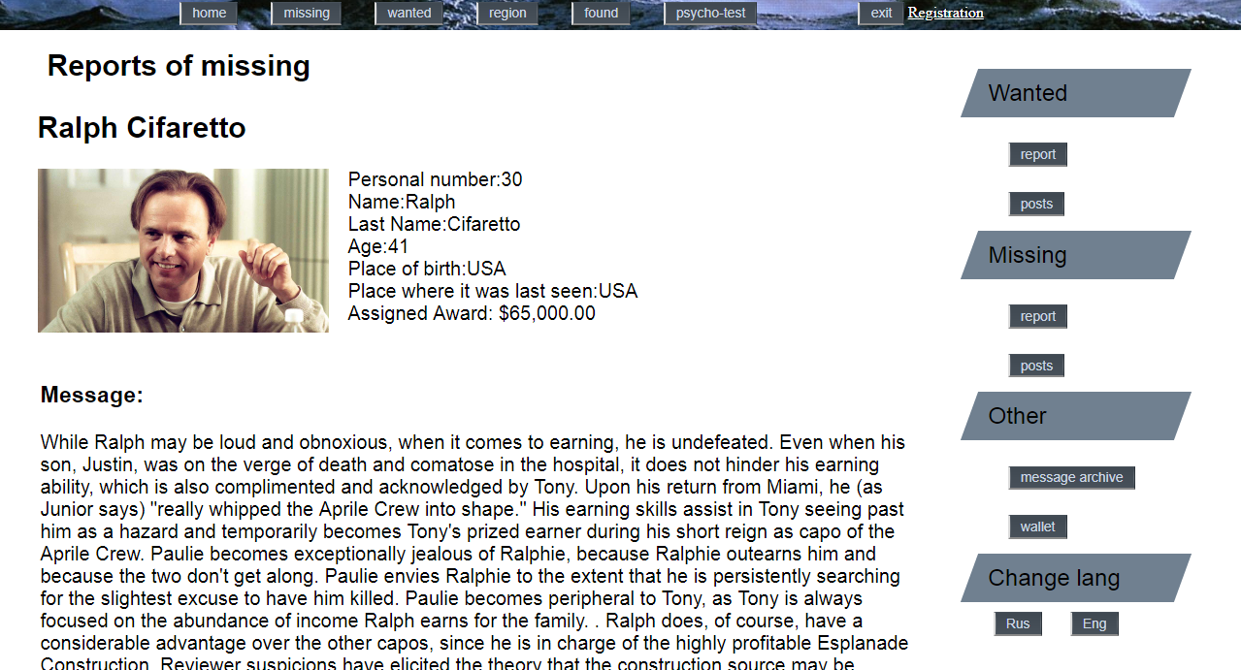
Logged user interface

Slide 6

Application features
Admin interface:
Opportunity to create/delete/edit wanted person;
Opportunity to create/delete/edit missed person;
Opportunity to watch user’s testimonies and set points for it;
Opportunity to set person found;
Opportunity to watch testimonies archive;

Slide 7
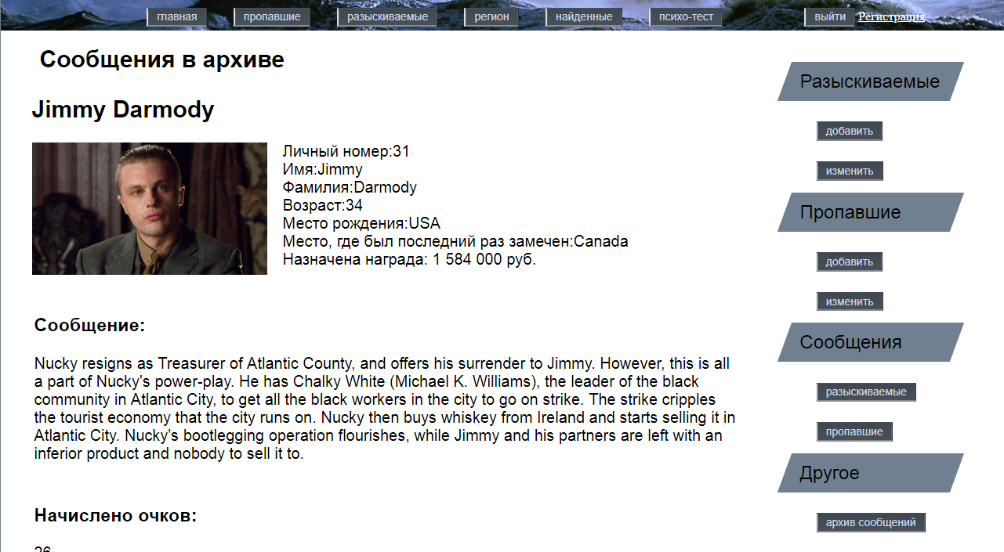
Admin interface

Slide 8

Application features
Application logic:
All users set testimonies about any person they have seen. Admin watches these testimonies and sets 0-99 points depending of it’s wealth. When the person is got, admin sets person as “found” and application counts all the points about the person and after it divides guaranteed award between all the users dependency of the points they have earned. When admin watches testimonies and sets points, testimonies sets as “watched” and go to archive.

Slide 9

Application features
Application protection:
F5 update protection;
SQL injection protection;
JS injection protection;
Client/server input validation;

Slide 10
Application features
Other:
Informing user about registration with e-mail message;
Opportunity to upload image files;
Session activating just for logged users;
Opportunity to change language for user;
Pagination;

Slide 11
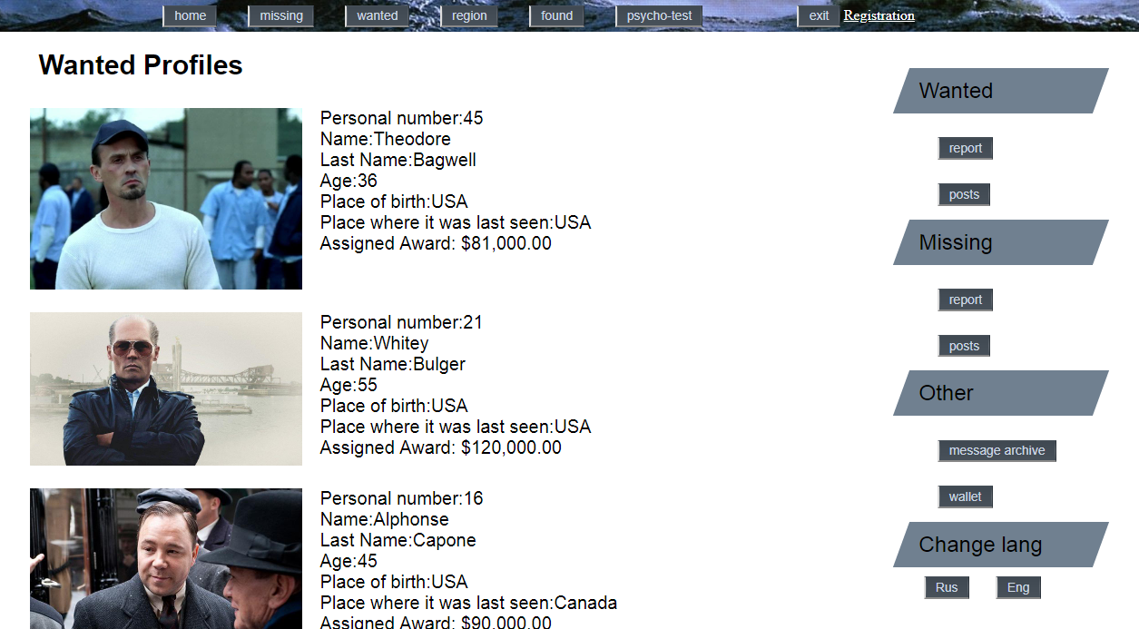
Application interface

Slide 12
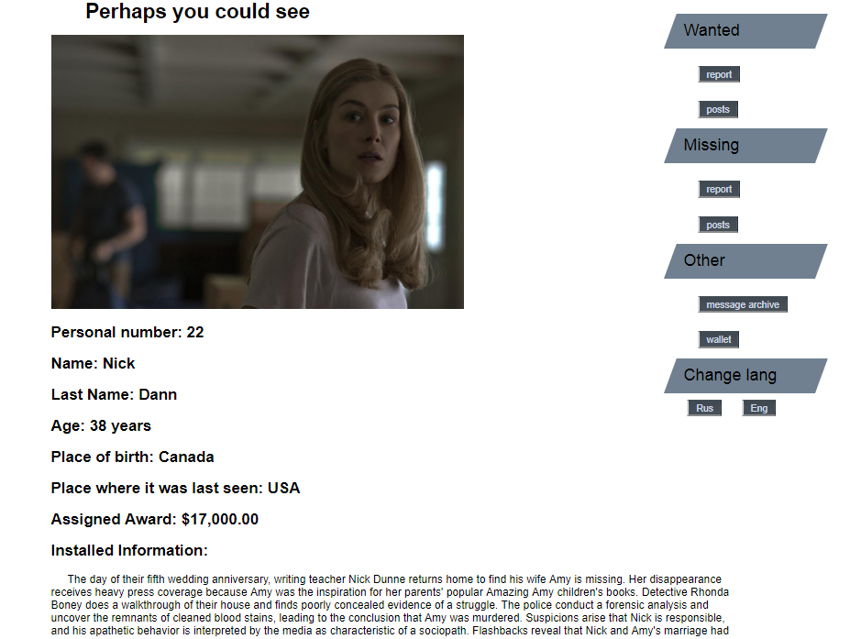
Application interface

Slide 13
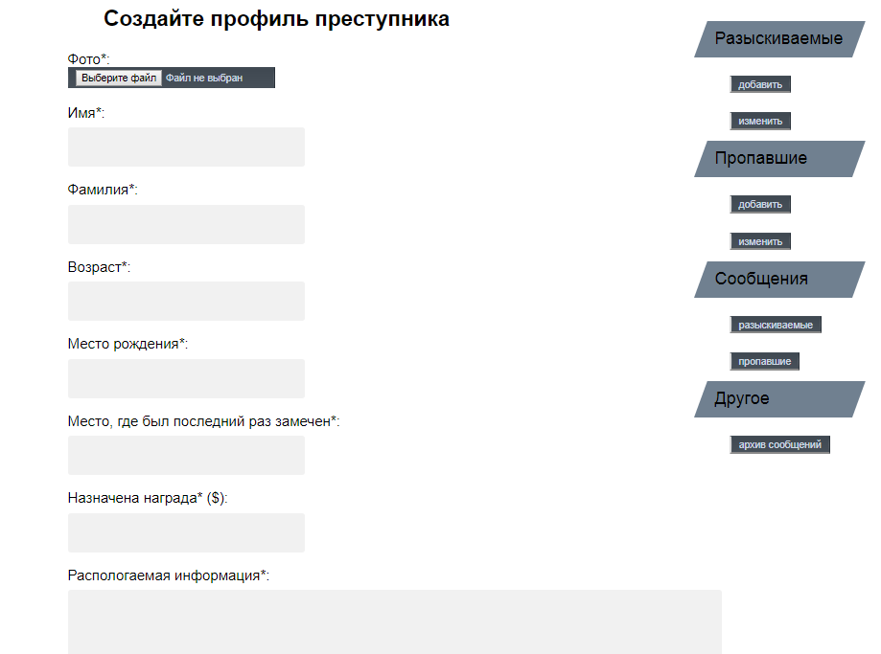
Application interface

Slide 14
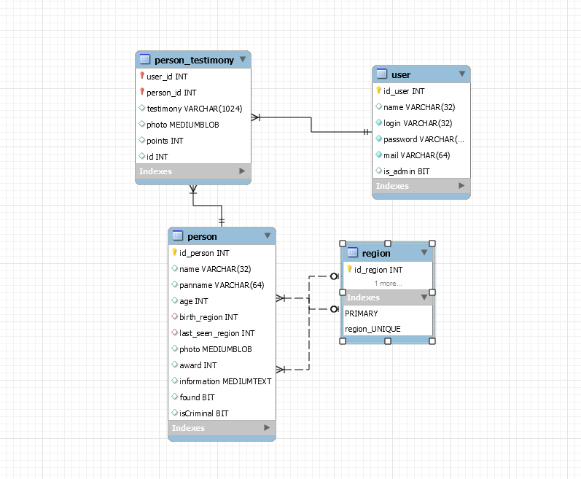
Application DB schema

Slide 15
Thanks for your attention,
good luck!

