Slide 1


Biological Data Analysis BIO 302
Exploratory Data Analysis
Richard Telford
EECRG, Dept. Biology
richard.telford@bio.uib.no

Slide 2
Bio302
Revise ordinary least squares regression and its assumptions
Graphical methods for testing assumptions of OLS
Introduce methods that work when OLS assumptions are violated

Slide 3
Aims
To give you enough statistical theory and practice to
be able to run the statistics needed for your theses
understand the statistical methods used in the literature
Caveat: you are working on a very diverse range of problems. Some statistical methods you might need will not be covered in enough depth, others not at all.

Slide 4
Why do biological data-analysis?
Summarize - Describe nature
Simplify - Reduce a complex nature
Test - Test hypotheses
Verify - Is it important in nature?
Predict - Say something about the future
Generalize - A statement about nature.

Slide 5
Exploratory Data Analysis
Distinct from confirmatory data analysis
Range of predominantly graphical tools
Hypotheses generation
Outlier detection
Suggest appropriate data transformations
Essential first step of any analysis

Slide 6
Exploratory + Confirmatory Analysis
Risk of data dredging
  Searching for interesting patterns then testing if they are statistically significant
  Raised risk of falsely finding statistically significant result
Well designed study has two phases
  Gather small initial data set
  Use exploratory data analysis on initial dataset to determine features of interest and statistical protocol
  Gather new data and test hypotheses with protocol developed in first phase

Slide 7
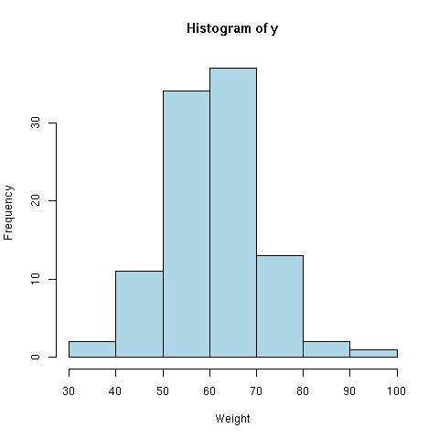
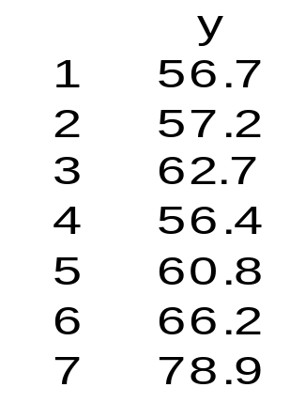
Summary of data
Distribution:
  the shape of our data
  y = weight (kg)
hist(y)

Slide 8
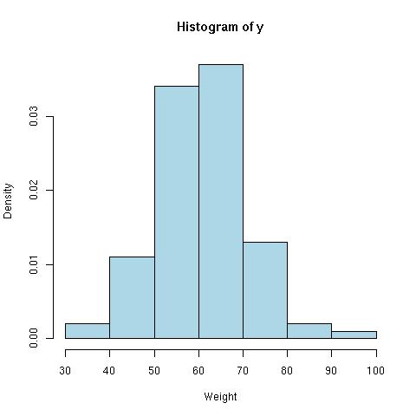
Summary of data
Frequency:
  Observations in interval
  n_{i} = # obs.
Relative frequency:
  Frequency / tot. # obs.
  p(y_{i}) = n_{i} / N
Density:
  h = width of interval
  D = p(y_{i}) / h

Slide 9

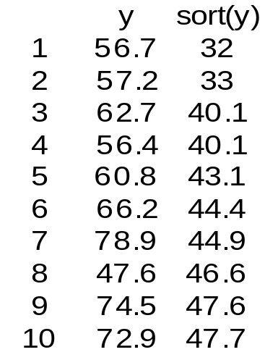
Central points
Mean:
  μ = n⁻¹ Σy_{i} = Σp(y_{i})y_{i}
Median:
  Sort from min to max
  The observation in the middle is the median

Slide 10
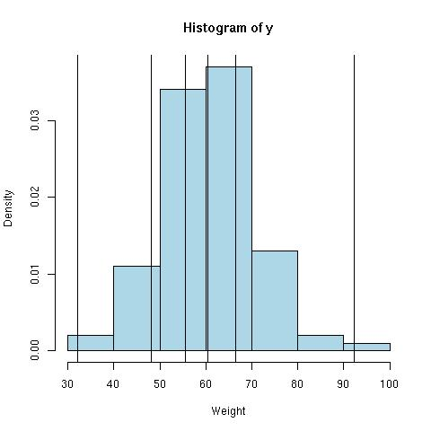
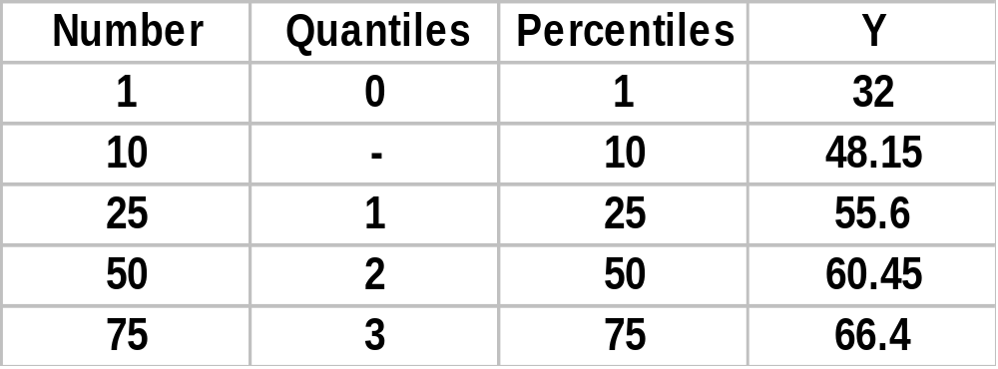
Quantiles/percentiles
Median
  50 percentile
  2 quantile
quantile(y,prob=c(0,0.1,0.25,0.5,0.75,1))

Slide 11
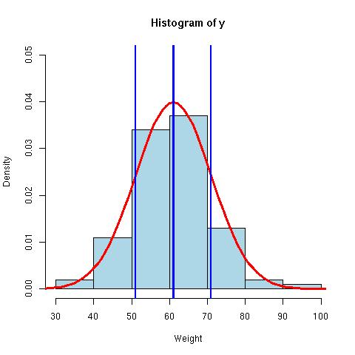
Spread
Describe observations around a central point.
Absolute difference:
  s = Σ|y_{i} - μ|
Variance:
  s² = (n-1)⁻¹Σ(y_{i} – μ)²
  The average squared distance around the mean.
Standard deviation:
  SD = sqrt(s²)

Slide 12
Standard deviation = √{(n-1)⁻¹Σ(y_{i} – μ)²}
μ ± 1*SD = 68% of observations
μ ± 1.96*SD = 95% of observations
μ ± 1*SD = point of inflection

Slide 13
Summary of data
summary(y)
sqrt(var(y))
sd(y)
  10.32

Slide 14
Standard Deviation vs Standard Error
Standard deviation (SD)
SD = √{(n-1)⁻¹Σ(y_{i} – μ)²}
Spread of observations
μ ± 1*SD
  (40.8, 81.3)
Standard Error (SE)
SE = SD/√n
Uncertainty of mean
μ ± 1.96*SE (95%conf.int)
  (59.0, 63.1)
  mean(y)+1.96*sd(y)/sqrt(length(y))

Slide 15
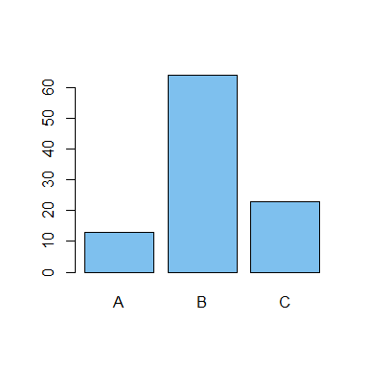
Categorical variables
Number of levels
  nlevels()
Frequency
Relative frequency
Levels A B C
Freq 13 64 23
Rel.freq 0.13 0.64 0.23
table(y1)
plot(y1)

Slide 16
Summary in R
summary(y)
var(y)
sd(y) = sqrt(var(y))
plot(y)
hist(y)

Slide 17
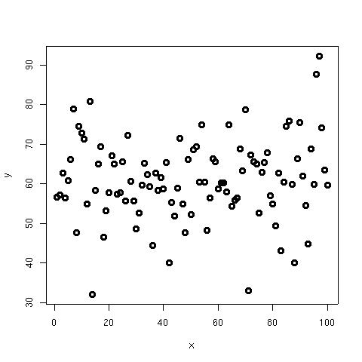
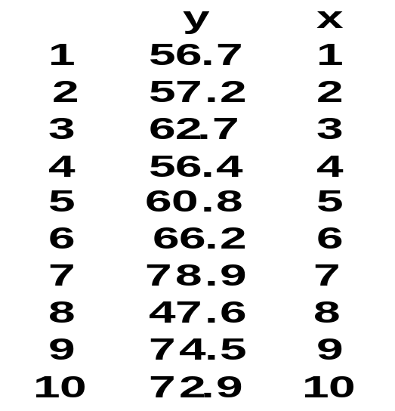
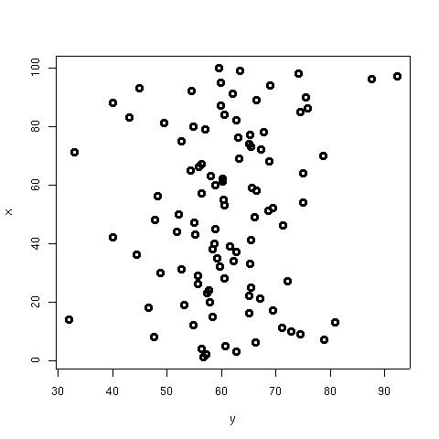
Summary of several variables
Individual summary
Combined summary
  Association
  covariance
  correlation

Slide 18
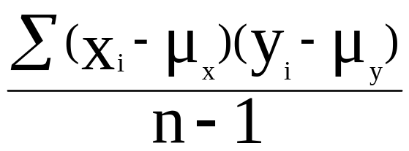
Covariance
The association between two variables:
  -inf, 0, +inf
  + = positive association
  - = negative association
  var(x,y) 31.9
  cov(x,y) 31.9
S_{xy} = S_{yx}

Slide 19
Correlation
Standardised association
  -1, 0, 1
  + = positive association
  - = negative association
  cor(x,y) 0.107
S_{xy} = covariance
S_{x}² = variance of x
S_{y}² = variance of y
r_{xy} = S_{xy} / √(S_{x}² S_{y}²)
r_{xy} = r_{yx}

Slide 20
Covariance vs. Correlation
Covariance:
    -inf, 0, +inf
    scale dependent
    - test
  var(x,y) 31.9
Correlation:
    -1, 0, 1
    scale invariant
    + test
  cor(x,y) 0.107
  cor.test(x,y)
    p-value = 0.27

Slide 21
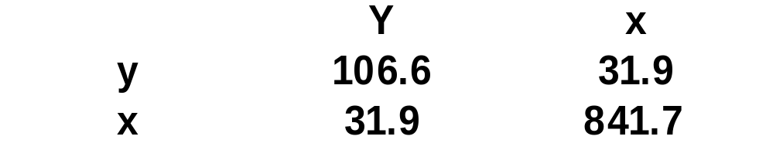
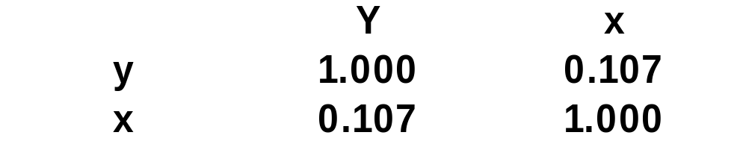
Covariance & Correlation matrix
y.df (data.frame with observations)
var(y.df)
cor(y.df)

Slide 22
Summary
summary(y)
var(y)
sd(y)
cor(x,y)
cor.test(x,y)
hist(y)
plot(x,y)

Slide 23
Square bracket
x <- matrix(1:9,ncol=3)
x
  1 4 7
  2 5 8
  3 6 9
x[row,col]
x[2,3]
  8
x[1:2,1]
  1 2
x[2,2:3]
  5 8
x[position]
x <- 1:10
x
  1 2 3 4 5 6 7 8 9 10
x[5:6]
  5 6
x[6]<-0
x
  1 2 3 4 5 0 7 8 9 10

