Slide 1


Linear Mixed Effects
Richard Telford
EECRG, Dept. Biology
richard.telford@bio.uib.no

Slide 2
Assumptions of Least Squares
1. The relationship between the response and the predictors is ~linear.
2. The residuals have a mean of zero.
3. The residuals have constant variance (not heteroscedastic).
4. The residuals are independent (uncorrelated).
5. The residuals are normally distributed.
Grouped data from e.g.
  hierarchal sampling
  repeated measurements
  pseudoreplication
need special treatment – mixed effect models

Slide 3
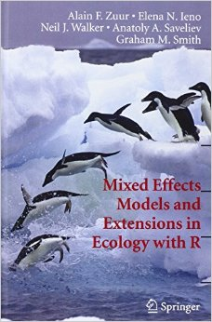
Recommended reading
Harrison et al. (2018) A brief introduction to mixed effects modelling and multi-model inference in ecology. PeerJ 6:e4794 https://doi.org/10.7717/peerj.4794
Bolker et al. 2009. Generalized linear mixed models: a practical guide for ecology and evolution. Trends in Ecology & Evolution 24: 127-135.

Slide 4
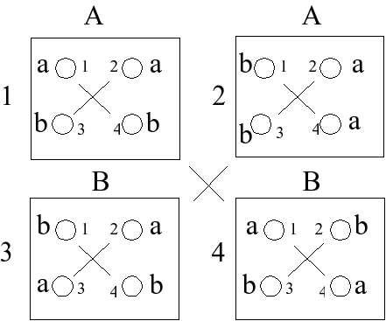
Clustered data
Clustered data
  Frequent in biology
  Experiments
  Field studies
Pinheiro, J.C., and Bates, D.M. (2000) Mixed-Effects Models in S and S-PLUS, Springer.

Slide 5
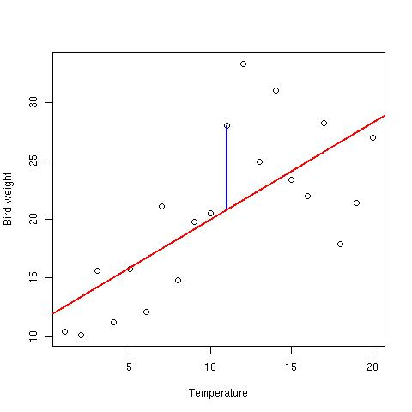
Fixed & random effects
y_{i} = β₀ + β₁x_{i} + ε_{i}
Fixed effects:
  Effect that is shared by all observations
Random effects:
  Effects that is particular to an observation (residuals) or group of observations

Slide 6
Fixed and Random Effects
Clustered data have a more complex error structure
y_{ij} = β₀ + b_{0j} + β₁x_{ij} + ε_{ij}
b₀ is the cluster specific error
Could implement cluster as a fixed effect
uses many degrees-of-freedom

Slide 7
Fixed or Random effects
Should fixed or random effects be used?
Fixed | Random
Interested in effect size Factor levels informative | Factor levels come from a population of levels Are there data on enough levels to calculate the variance of the population of effects
Mixed effect models cope better with unbalanced designs than analysis of variance

Slide 8
Fixed or random effects
Fixed effect | Random Effect
Drug administered or not Insecticide sprayed or not Nutrient added or not Male or female Upland or lowland Wet or dry Juvenile vs adult | Brood (litter) Genotype Block within a field Split plot within a plot Household Family Individual with repeated measurements
Depending on experiment design and aim, some of these random effects could be treated as fixed effects
"one modeller's random effect is another modeller's fixed effect"

Slide 9
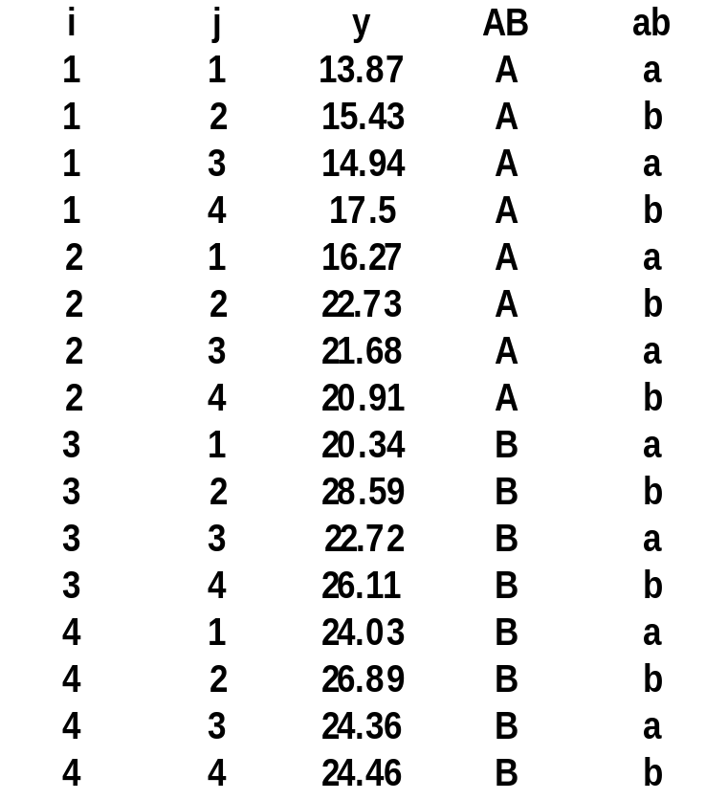
Linear Mixed Effect
y_{ij} = β₀ + b_{0i} + ε_{ij}
i = 1, ..., m groups
j = 1, ..., n_{i} observations

Slide 10
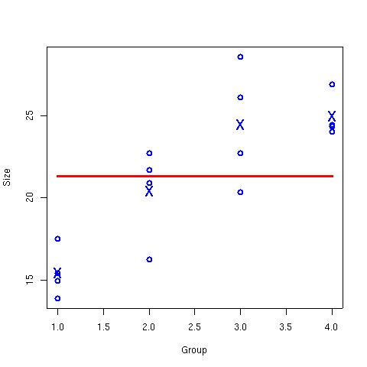
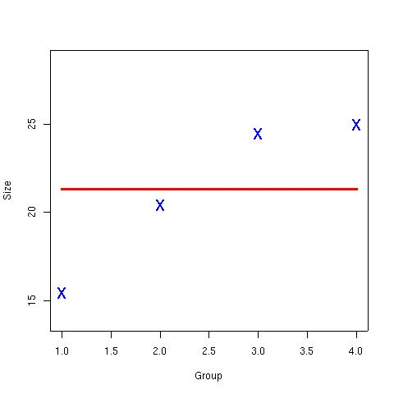
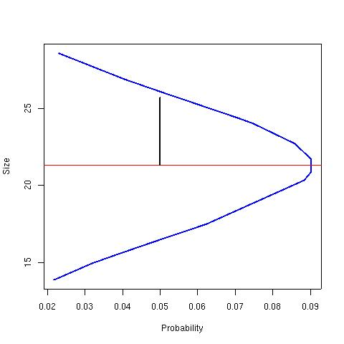
Linear Mixed Model
  y_{ij} = β₀ + b_{0i} + ε_{ij}
Cluster-specific random variance:
  b_{0i} ~ N(0,σ₀²)‏

Slide 11
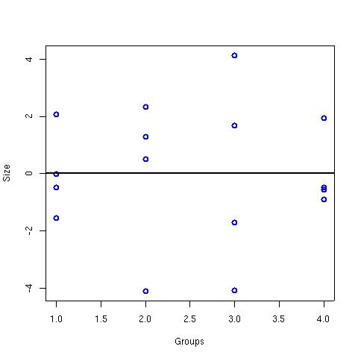
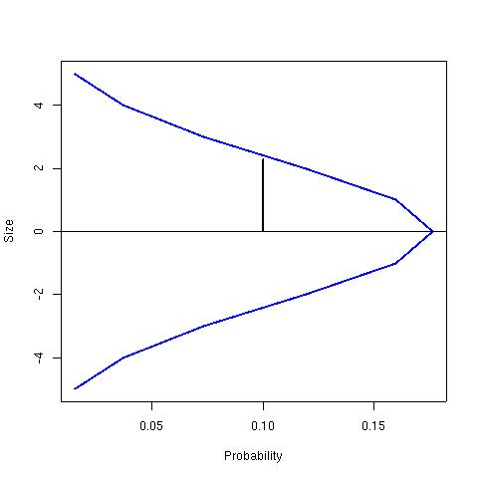
Linear Mixed Model
  y_{ij} = β₀ + b_{0i} + ε_{ij}
Residual variance:
ε_{i} ~N(0,σ²)‏

Slide 12
Variance of y
Mixed effect model:
y_{ij} = β₀ + b_{0i} + ε_{ij}
  b_{0i} ~ N(0,σ₀²)‏
  ε_{i} ~N(0,σ²)‏
var(y_{ij}) = σ₀² + σ²
SE(β₀) = √(m⁻¹σ₀² + n⁻¹σ²)‏
Linear Model:
y_{i} = β₀ + ε_{i}
var(y_{i}) = σ²
SE(β₀) = √(n⁻¹σ²)‏

Slide 13
Linear Mixed Effect in R
library(nlme)‏
fit.lme←lme(y~+1, data = lme_data, random=~+1|id)‏
summary(fit.lme)‏
Random effects:
Formula: ~+1 | id
(Intercept) Residual
StdDev: 4.223337 2.521703
Fixed effects: y ~ +1
Value Std.Error DF t-value p-value
(Intercept) 21.30225 2.203765 12 9.666298 0
Also lmer in package lme4

Slide 14
Inner and outer predictor variables
Inner variable:
  Vary within clusters
Outer variable:
  vary between clusters
C
C
C
T
T
T
C
T

Slide 15
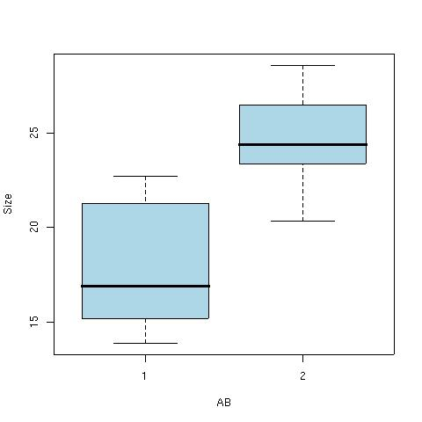
Fixed outer variable
  y_{ij} = β₀ + b_{oj} + β₁x_{ij} + ε_{ij}
fit.lme<-lme(y~AB,random=~+1|id)‏
anova(fit.lme,type="m")‏
numDF denDF F-value p-value
(Intercept) 1 12 103.4288 <.0001
AB 1 2 7.3882 0.1129
summary(fit.lme)‏
Random effects:
Formula: ~+1 | id
(Intercept) Residual
StdDev: 2.148760 2.521805

Slide 16
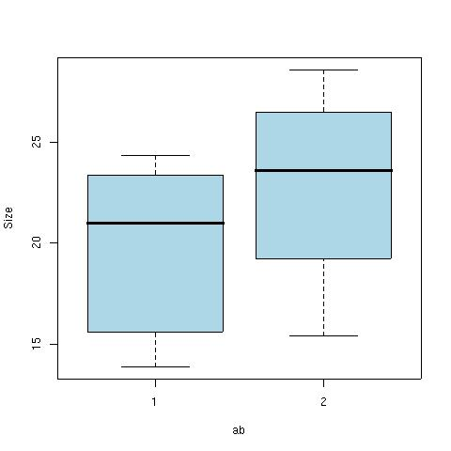
Fixed inner variable
  y_{ij} = β₀ + b_{oj} + β₁x_{ij} + ε_{ij}
fit.lme<-lme(y~ab,random=~+1|id)‏
anova(fit.lme,type="m")‏
numDF denDF F-value p-value
(Intercept) 1 11 93.43732 <.0001
ab 1 11 10.46627 0.0079

Slide 17
Fixed inner variable
summary(fit.lme)‏
Random effects:
Formula: ~+1 | id
(Intercept) Residual
StdDev: 4.305534 1.885412
Fixed effects: y ~ ab
Value Std.Error DF t-value p-value
(Intercept) 19.777347 2.2536091 11 8.775855 0.0000
ab2 3.049806 0.9427061 11 3.235161 0.0079

Slide 18
Inner & outer fixed variable
fit.lme<-lme(y~ab*AB,random=~+1|id)‏
anova(fit.lme,type="m")‏
numDF denDF F-value p-value
(Intercept) 1 10 292.28756 <.0001
ab 1 10 9.87600 0.0105
AB 1 2 7.38452 0.1129
ab:AB 1 10 0.37960 0.5516
fit.lme<-lme(y~ab+AB,random=~+1|id)‏
anova(fit.lme,type="m")‏
numDF denDF F-value p-value
(Intercept) 1 11 80.75140 <.0001
ab 1 11 10.46628 0.0079
AB 1 2 7.38457 0.1129

Slide 19
Inner & outer fixed variable
Outer variable
Few replicates
Not significant
Inner variable
Many replicates
Significant

Slide 20
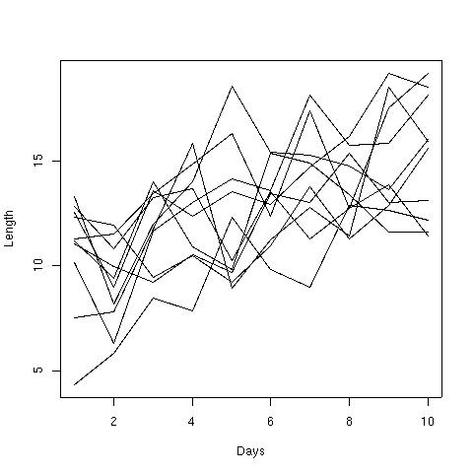
Inner continuous predictor
len = length
days = predictor
i = 1, ..., 10
j = 1, ..., 10
  y_{ij} = β₀ + b_{oj} + β₁x_{ij} + ε_{ij}

Slide 21
Inner continuous predictor
Random intercept:
y_{ij} = β₀ + b_{oj} + β₁x_{ij} + ε_{ij}
fit.lme <- lme(len~days,random=~+1|id)‏
Random slope:
y_{ij} = β₀ + b_{oj} + β₁x_{ij} + b_{1j}x_{ij}+ ε_{ij}
fit1.lme <- lme(len~days,random=~days|id)‏

Slide 22
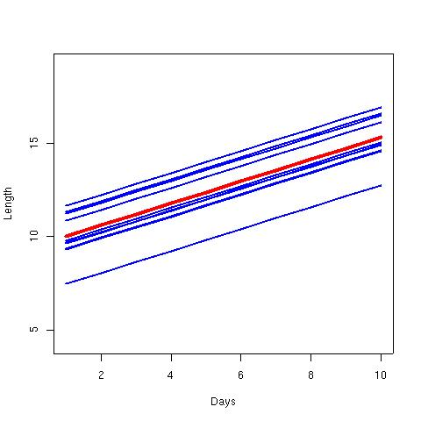
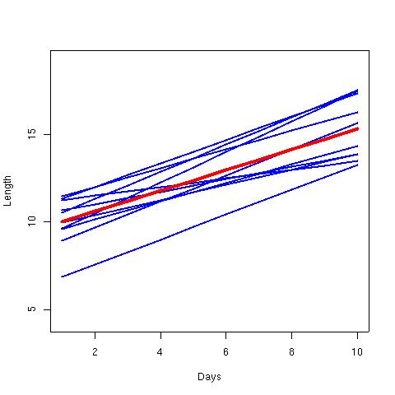
Inner continuous predictor
Random intercept:
Random slope:

Slide 23
Inner continuous predictor
anova(fit.lme,fit.lme)‏
Model df AIC BIC logLik Test L.Ratio p-value
fit.lme 1 4 456.199 466.539 -224.099
fit1.lme 2 6 455.875 471.385 -221.938 1 vs 2 4.323357 0.115
We select model without random slope
AIC & BIC low values indicate best model
Difference not significant

Slide 24
Plot
fit.lme<-lme(len~days,random=~+1|id)‏
plot(days,len,type="n")‏
points(days[1:10],predict(fit.lme,level=0)[1:10],type="l",col="red",lwd=4)‏
sapply(1:10,function(v){
lines(days[id==v],predict(fit.lme,level=1)[id==v],type="l",col="blue",lwd=2)
})‏

Slide 25
lme vs lmer
lme
older, slower
library(nlme)
lme(y~x, random=~1|id)
Normal distribution only
Correlation structures for temporal and spatial autocorrelation
P-values on coefficients may not be meaningful
lmer
new, faster
library(lme4)
lme(y ~ x + (1|id))
Any distribution family
No correlation structure
No p-values on coefficients
More complex random effects possible

Slide 26
More mixed effect models
glmer – accepts non-normal distributions e.g. binomial, Poisson
nlme / nlmer – non-linear mixed effect model
gamm / gamm4 – mixed effect GAM
  “gamm assumes that you know what you are doing!”
llme – local linear mixed effect model
Hierarchical Bayesian models

Slide 27
Errors and warnings
Errors and warnings are common when fitting mixed effect models
Take them seriously – can indicate serious problems with the model
Scaling predictors can help with some problems
Advice on http://glmm.wikidot.com/FAQ

Slide 28
Model specifications
(1|group) | random group intercept
(x|group) = (1+x|group) | random slope of x within group with correlated intercept
(0+x|group) = (-1+x|group) | random slope of x within group: no variation in intercept
(1|group) + (0+x|group) | uncorrelated random intercept and random slope within group
(1|site/block) = (1|site)+(1|site:block) | intercept varying among sites and among blocks within sites (nested random effects)
site+(1|site:block) | fixed effect of sites plus random variation in intercept among blocks within sites
(x|site/block) = (x|site)+(x|site:block) | slope and intercept varying among sites and among blocks within sites
(x1|site)+(x2|block) | two different effects, varying at different levels
x*site+(x|site:block) | fixed effect variation of slope and intercept varying among sites and random variation of slope and intercept among blocks within sites
(1|group1)+(1|group2) | intercept varying among crossed random effects (e.g. site, year)

