Slide 1


Spatial and Temporal Patterns
Richard Telford

Slide 2
Assumptions of linear models
1. The relationship between the response and the predictors is ~linear.
2. The residuals have a mean of zero.
3. The residuals have constant variance (not heteroscedastic).
4. The residuals are independent (uncorrelated).
5. The residuals are normally distributed.
Spatial or temporal autocorrelation violates this assumption
Residuals are not independent – do not contribute a full degree of freedom each

Slide 3
Autocorrelation pervades biological data
Response variable autocorrelated because
predictor variable is autocorrelated
residuals are independent – not a problem
nuisance variables are autocorrelated
add extra predictors until autocorrelation is accounted for
of contagious processes (e.g. dispersal)
Potential problem for time series data and spatial data.

Slide 4
Effect?
Standard statistical tests become too liberal. Reject H₀ more often than the data justify. Type I error.
Because observations are not independent, fewer actual degrees of freedom, or lower “effective sample size”: n’ instead of n.
t statistic = β₀/se(β₀)
se=standard deviation/sqrt(n)
if n is too large, the t statistic is inflated, p value too low
Estimated coefficients are unbiased
Confidence intervals too narrow

Slide 5
What not to do?
Adjust the significance level? E.g. consider 99% instead of 95%?
But we don’t how much to adjust. Could end up with a test that is too conservative
Drop observations to include only “independent samples?”
Wastes data and easy to mistake “critical distance to independence”

Slide 6
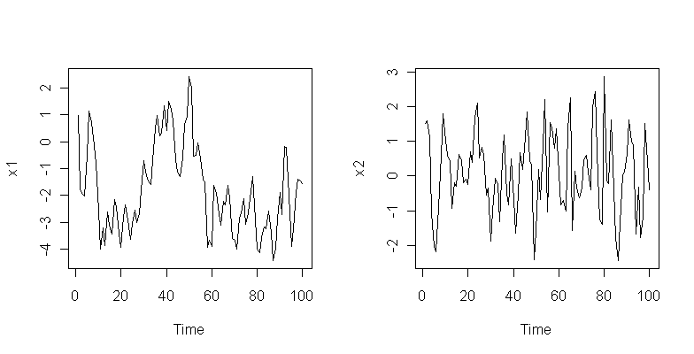
Effective sample size < number of observations
First order autoregressive model y_{i} = ρ₁y_{i-1}+e_{i}
N_{eff} = N(1-ρ₁)/(1+ρ₁)
.
ρ₁ = 0.9, N_{eff} = 5.3
ρ₁ = 0.3, N_{eff} = 53.8
x1<-arima.sim(list(ar=.9),n=100)
plot(x1)

Slide 7
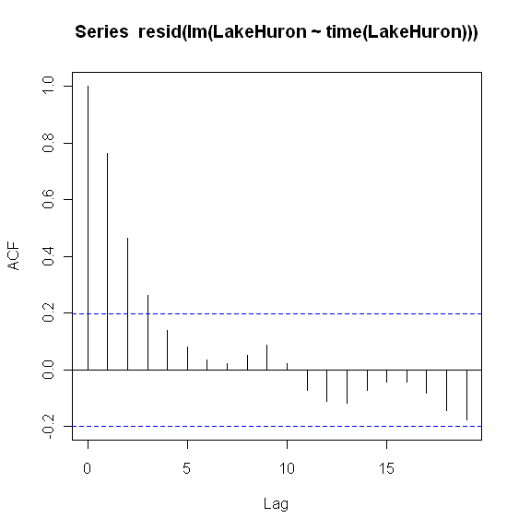
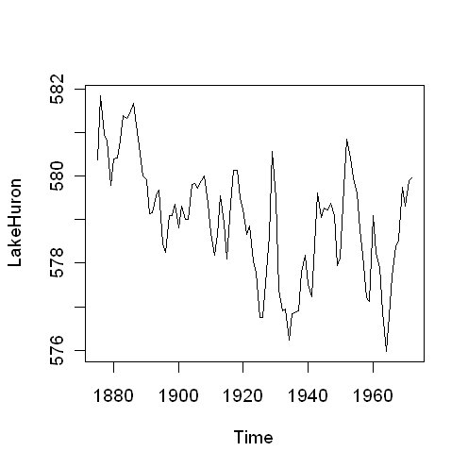
Autocorrelation in the residuals
>mod1<-lm(LakeHuron~time(LakeHuron)))
> summary(mod1)
Coefficients:
Estimate Std. Error t value Pr(>|t|)
(Intercept) 625.554918 7.764293 80.568 < 2e-16 ***
time(LakeHuron) -0.024201 0.004036 -5.996 3.55e-08 ***
> acf(resid(mod1))#Graphical check

Slide 8
Autocorrelation Function
Autocorrelation function: the correlation of the series with its lagged self
Correlation at lag 0 is always one
Autoregressive processes
y_{i} = ρ₁y_{i-1}+e_{i}
with +ve autocorrelation have exponentially declining ACF
With negative autocorrelation, have oscillating ACF, exponentially declining in magnitude

Slide 9
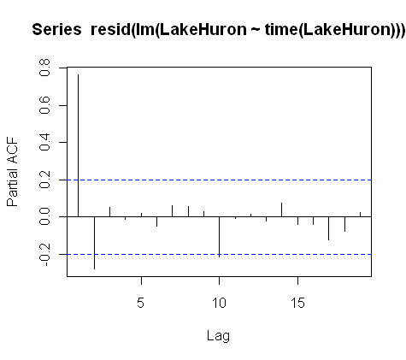
Partial Autocorrelation Function
>pacf(resid(mod1))
The correlation of the series with itself, lagged k steps with effect of autocorrelation at steps <k removed
PACF at lag 0 is not defined
PACF at lag 1 == ACF at lag 1
Autoregressive processes
y_{i} = ρ₁y_{i-1}+e_{i}
will have spikes in the PACF. The number of significant spikes indicate the order of the process

Slide 10
Identifying the autocorrelation process
Nonstationary series have an ACF that remains significant at many lags, rather than quickly declining to zero.
Autoregressive processes have an exponentially declining ACF and spikes in the first one or more lags of the PACF. The number of spikes indicates the order of the autoregression.
Moving average processes have spikes in the first one or more lags of the ACF and an exponentially declining PACF. The number of spikes indicates the order of the moving average.
Mixed (ARMA) processes typically show exponential declines in both the ACF and the PACF

Slide 11
Identifying the autocorrelation process
Fitting an autoregressive model
>ar(mod1)
Call:
ar(x = resid(mod1))
Coefficients:
1 2
0.9714 -0.2754
Order selected 2
More general models with autoregressive, integration and moving average components can be fitted with ARIMA
Need to use AIC to select best model

Slide 12
Durbin-Watson test for autocorrelation
Tests residuals for autocorrelation
Durbin-Watson statistic always between 0 and 4
==2 No autocorrelation
<2 Positive autocorrelation
>2 Negative autocorrelation
>library(lmtest)
> dwtest(mod1)
Durbin-Watson test
data: mod1
DW = 0.4395, p-value < 2.2e-16
alternative hypothesis: true autocorrelation is greater than 0

Slide 13
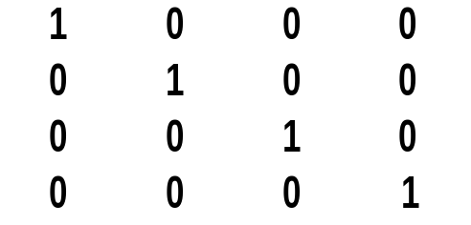
Autocorrelation and the Weight Matrix
Weight Matrix for uncorrelated observations
Weight Matrix for correlated observations
1 | 0.8 | 0.64 | 0.51
0.8 | 1 | 0.8 | 0.64
0.64 | 0.8 | 1 | 0.8
0.51 | 0.64 | 0.8 | 1
Off diagonal terms are zero
Off diagonal terms can be non-zero

Slide 14
gls with corAR1
First order autoregressive model - Needs regular timesteps
> year<-time(LakeHuron)
> fit.gls<-gls(LakeHuron~year)
> summary(fit.gls)
Coefficients:
Value Std.Error t-value p-value
(Intercept) 625.5549 7.764293 80.56817 0
year -0.0242 0.004036 -5.99615 0
>
> fit2.gls<-gls(LakeHuron~year, corr=corAR1())
> summary(fit2.gls)
Correlation Structure: AR(1)
Formula: ~1
Parameter estimate(s):
Phi
0.8247674
Coefficients:
Value Std.Error t-value p-value
(Intercept) 616.4887 24.362632 25.304683 0.0000
year -0.0194 0.012664 -1.534616 0.1282

Slide 15
Part of the weights matrix
> round(corMatrix(fit2.gls$modelStruct$corStruct)[1:10,1:10],3)
[,1] [,2] [,3] [,4] [,5] [,6] [,7] [,8] [,9] [,10]
[1,] 1.000 0.825 0.680 0.561 0.463 0.382 0.315 0.260 0.214 0.177
[2,] 0.825 1.000 0.825 0.680 0.561 0.463 0.382 0.315 0.260 0.214
[3,] 0.680 0.825 1.000 0.825 0.680 0.561 0.463 0.382 0.315 0.260
[4,] 0.561 0.680 0.825 1.000 0.825 0.680 0.561 0.463 0.382 0.315
[5,] 0.463 0.561 0.680 0.825 1.000 0.825 0.680 0.561 0.463 0.382
[6,] 0.382 0.463 0.561 0.680 0.825 1.000 0.825 0.680 0.561 0.463
[7,] 0.315 0.382 0.463 0.561 0.680 0.825 1.000 0.825 0.680 0.561
[8,] 0.260 0.315 0.382 0.463 0.561 0.680 0.825 1.000 0.825 0.680
[9,] 0.214 0.260 0.315 0.382 0.463 0.561 0.680 0.825 1.000 0.825
[10,] 0.177 0.214 0.260 0.315 0.382 0.463 0.561 0.680 0.825 1.000

Slide 16
anova to compare models
> anova(fit.gls,fit2.gls)
Model df AIC BIC logLik Test L.Ratio p-value
fit.gls 1 3 317.8 325.5 -155.90
fit2.gls 2 4 225.8 236.1 -108.92 1 vs 2 93.9752 <.0001

Slide 17
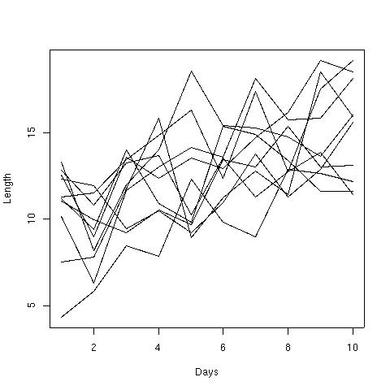
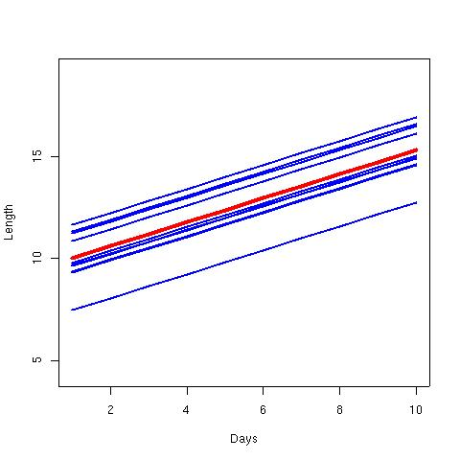
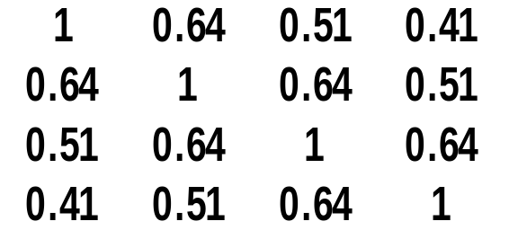
Repeated measurements (LME)
y = length
x = days
Yesterday observation influences today?
i = 1, ..., 10
Weight (W)

Slide 18
Repeated measurements (LME)
Autoregressive lag-1
library(nlme)
fit.lme<-lme(len~days,random=~+1|id)
fit.lme<-lme(len~days,random=~+1|id,corr=corAR1())
Model df AIC BIC logLik Test L.Ratio p-value
fit.lme 1 4 456.1987 466.5386 -224.0994
fit1.lme 2 5 456.2633 469.1882 -223.1317 1 vs 2 1.935395 0.1642

Slide 19
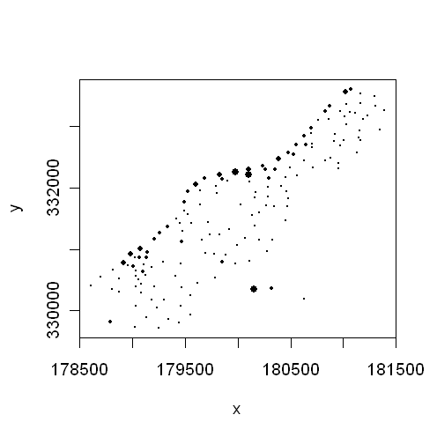
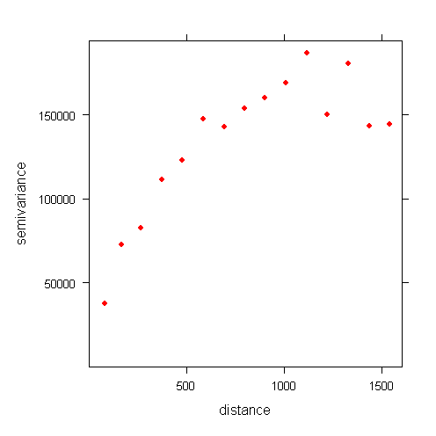
Detecting Spatial Autocorrelation
Zinc concentrations on a floodplain
data(meuse)
attach(meuse)
plot(x,y,cex=zinc/max(zinc), pch=16)
Variogram of zinc concentrations
vg<-variogram(zinc~1, ~x+y, data=meuse)
plot(vg, pch=16, col=2)

Slide 20

The Variogram
Range
Sill
Average squared difference between points a given distance apart
Nugget

Slide 21
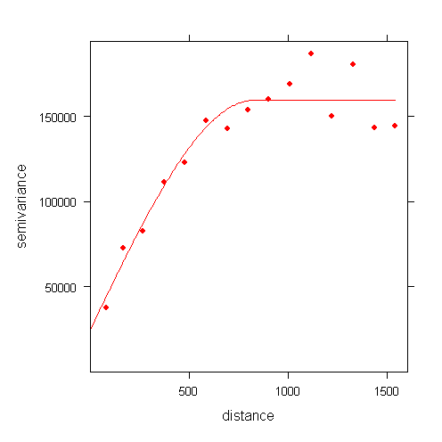
Variogram Models
Several different models
Spherical model
Circular model
Exponential model
Gaussian model
data(meuse)
attach(meuse)
vg<-variogram(zinc~1, ~x+y, data=meuse)
fit.vg<-fit.variogram(vg, vgm(psill=100000, "Sph", range=900, nugget=30000))
plot(vg,model=fit.vg, pch=16, col=2)

Slide 22
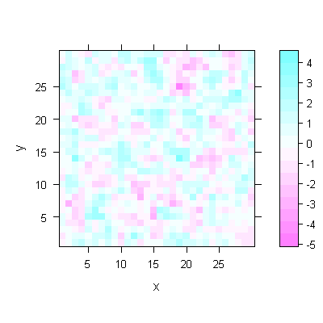
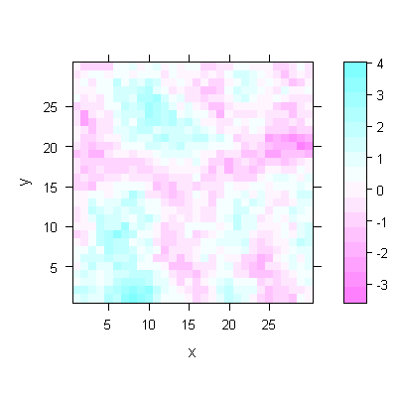
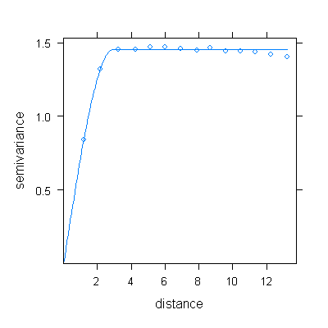
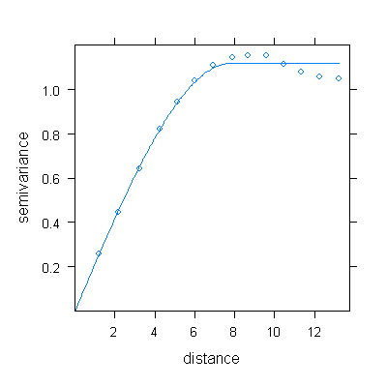

Slide 23
gls and correlation structures
corAR1 | autoregressive process of order 1. Requires equal time steps.
corARMA | autoregressive moving average process, with arbitrary orders for the autoregressive and moving average components. A generalisation of a corAR1 structure. Requires equal time steps
corCAR1 | continuous autoregressive process (AR(1) process for a continuous time covariate – uneven time steps allowed).
corExp | exponential spatial correlation.
corGaus | Gaussian spatial correlation.
corLin | linear spatial correlation.
corSpher | spherical spatial correlation.
Spatial models. Can be used in one dimensional case – eg. time series

Slide 24
Conclusions
Do not ignore autocorrelation
It can seriously bias your interpretations
Effect sizes are unbiased but uncertain
An incorrectly specified autocorrelation structure is usually better than incorrectly assuming no autocorrelation

