Slide 1

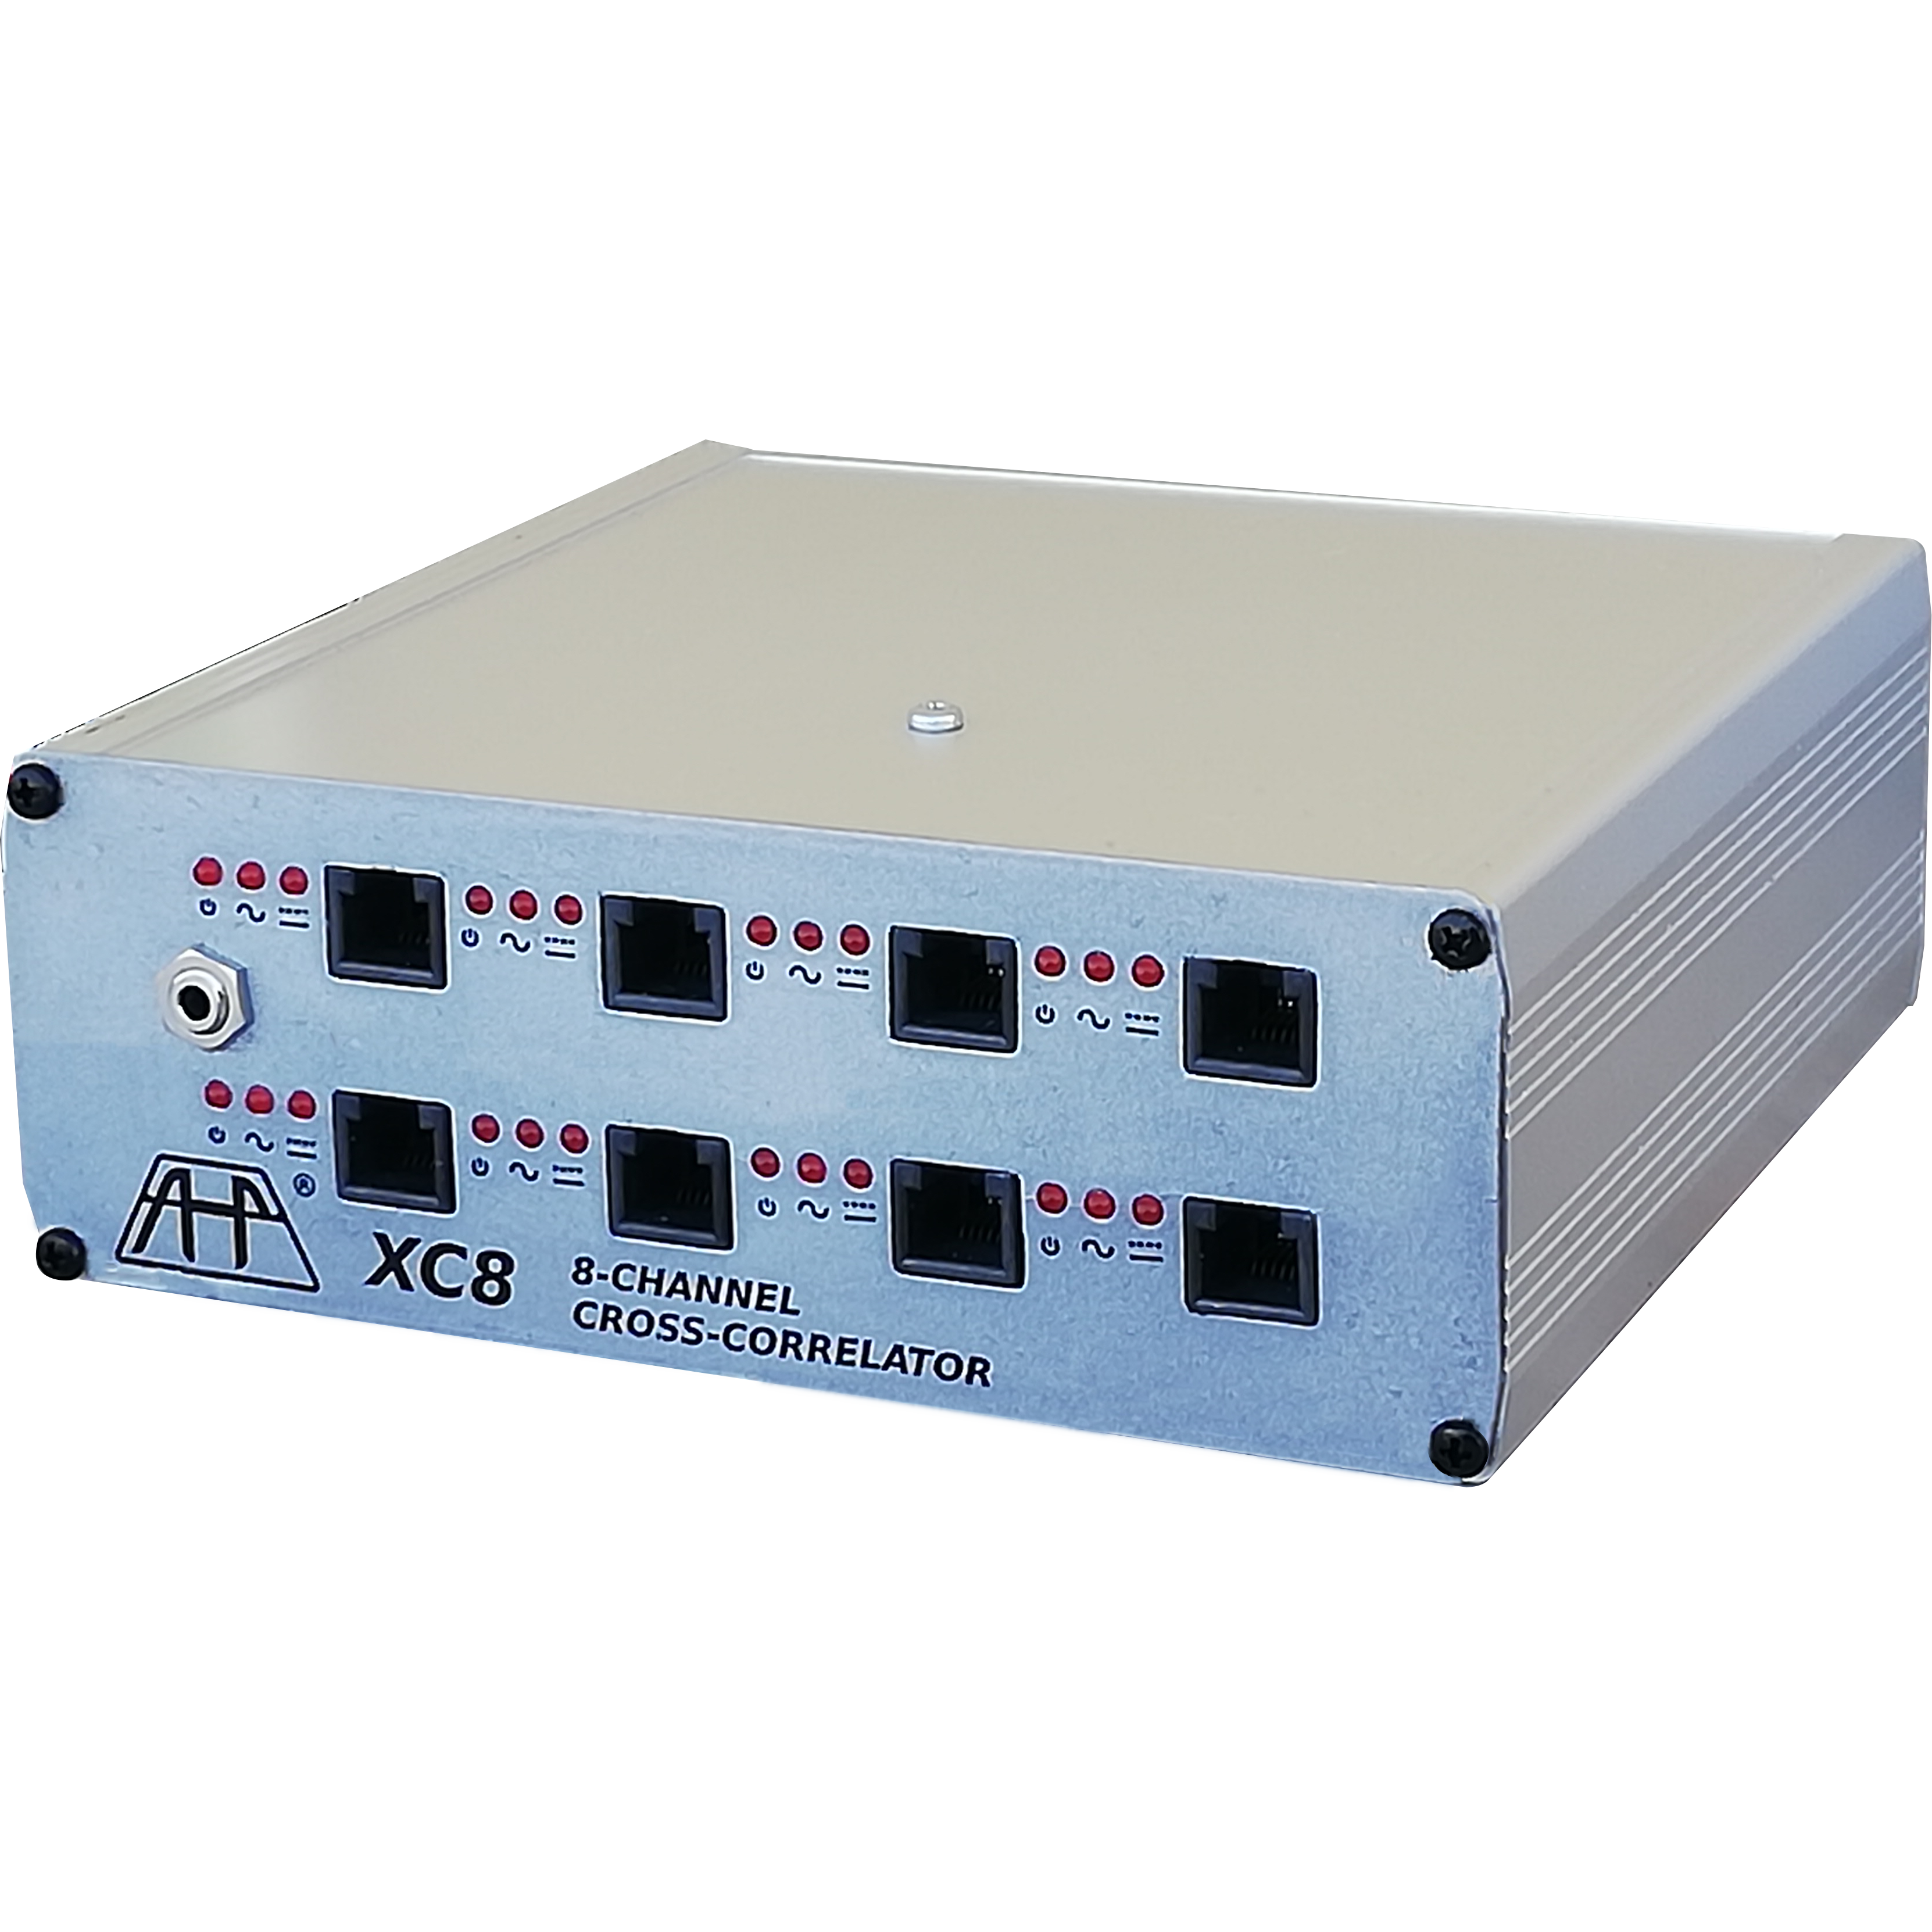
XC8 Cross-correlator
Intensity correlator XC8
TOC:
Intensity correlation, meaning
  Correlation degree
  Autocorrelation
  Cross-correlation
Working principles
Characteristics
Challenging factors
Sensors supported
  Optical
  Radio
  Geiger
Applications
  Interferometry
  Spectrography

