Slide 1
Option C - Dynamic Routing VRPTW
Full Python project with OR-Tools, Simulated Annealing, KPIs, and dynamic re-routing
Problem covered
Deliverables
Methods
• VRPTW
• Real-time re-routing
• New urgent order
• Traffic incident
• Python code only in /code
• Benchmark comparison C1 / R1 / RC1
• KPI charts and route maps
• IEEE-style PDF report
• Slides presentation
• OR-Tools
• Simulated Annealing
• Greedy baseline

Slide 2
Methodology kept simple and solid
OR-Tools is the main solver for VRPTW with time windows and vehicle capacity.
A greedy baseline is used as a reference to show the gain from optimization.
Simulated Annealing is the comparison metaheuristic: swap, insert, reverse, accept or reject with temperature.
Dynamic scenario = one urgent order + one traffic zone that inflates travel times.

Slide 3
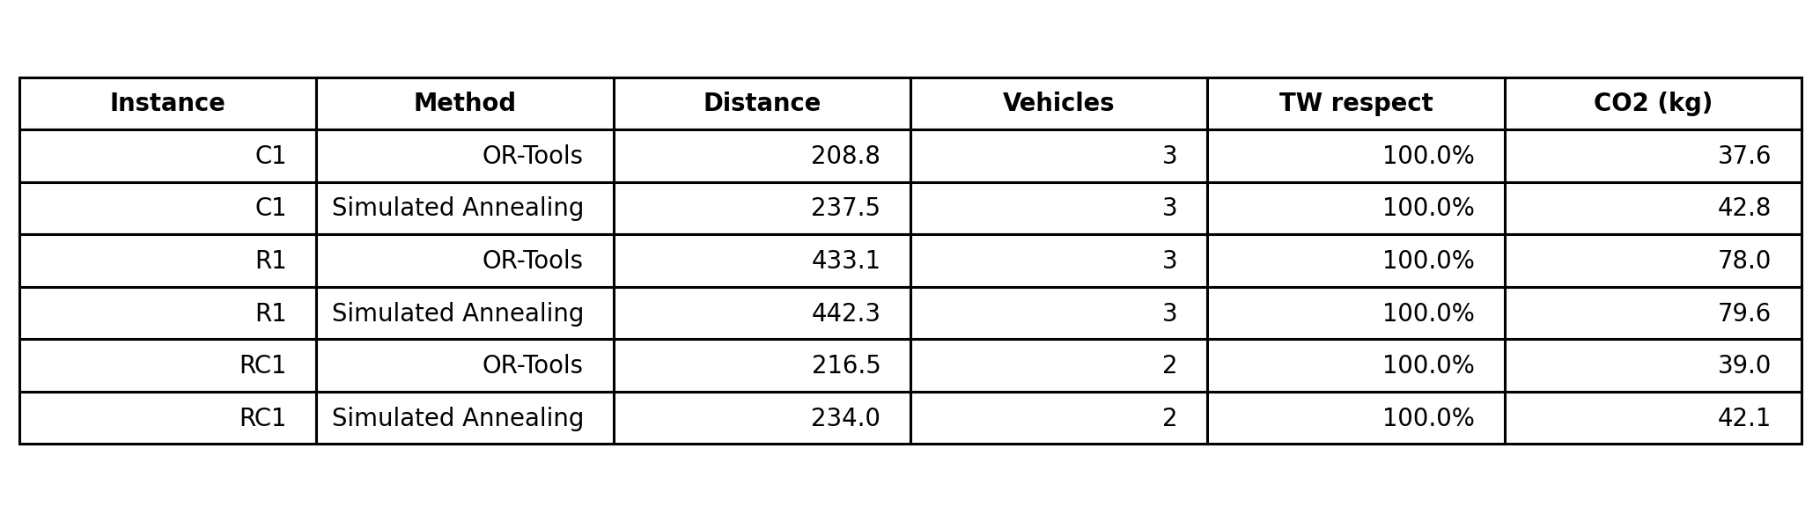
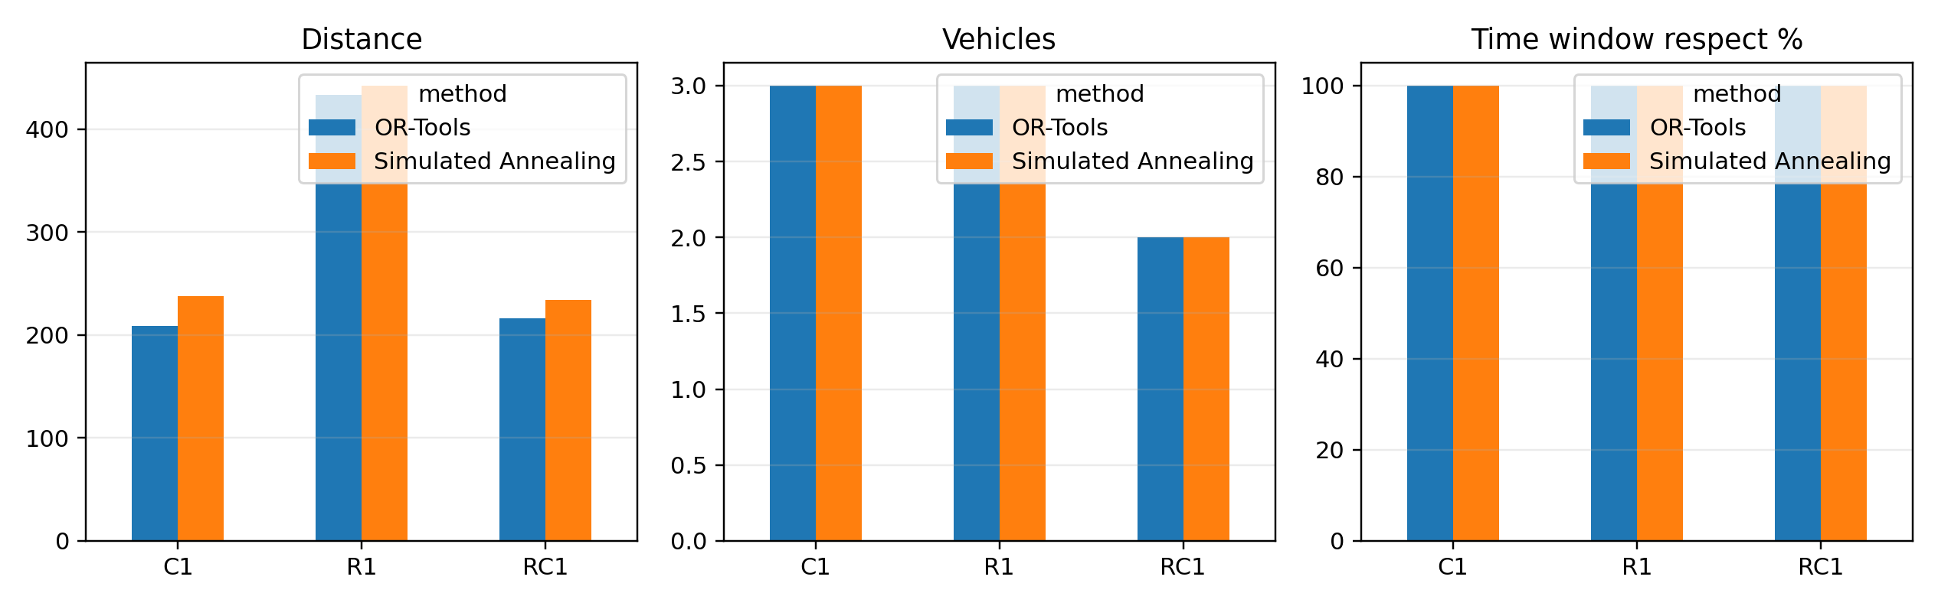
Benchmark comparison on C1, R1 and RC1
KPIs: total distance, vehicles used, time-window respect, estimated CO2

Slide 4
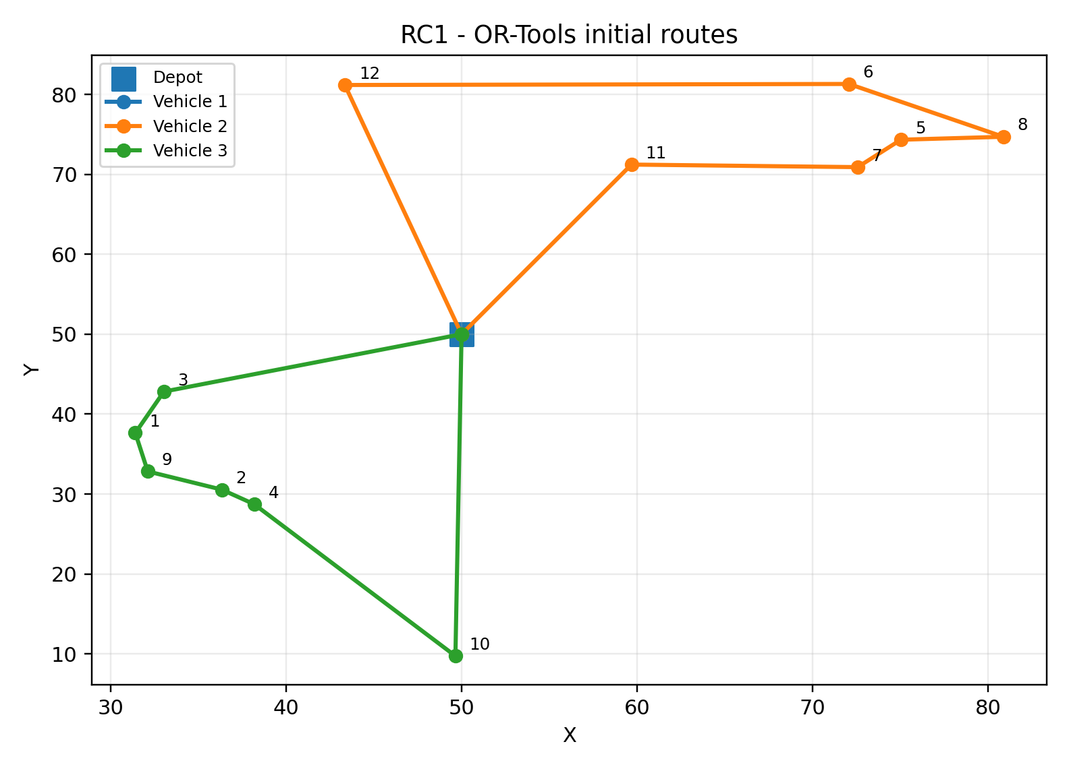
Initial optimized routes (RC1)

Slide 5
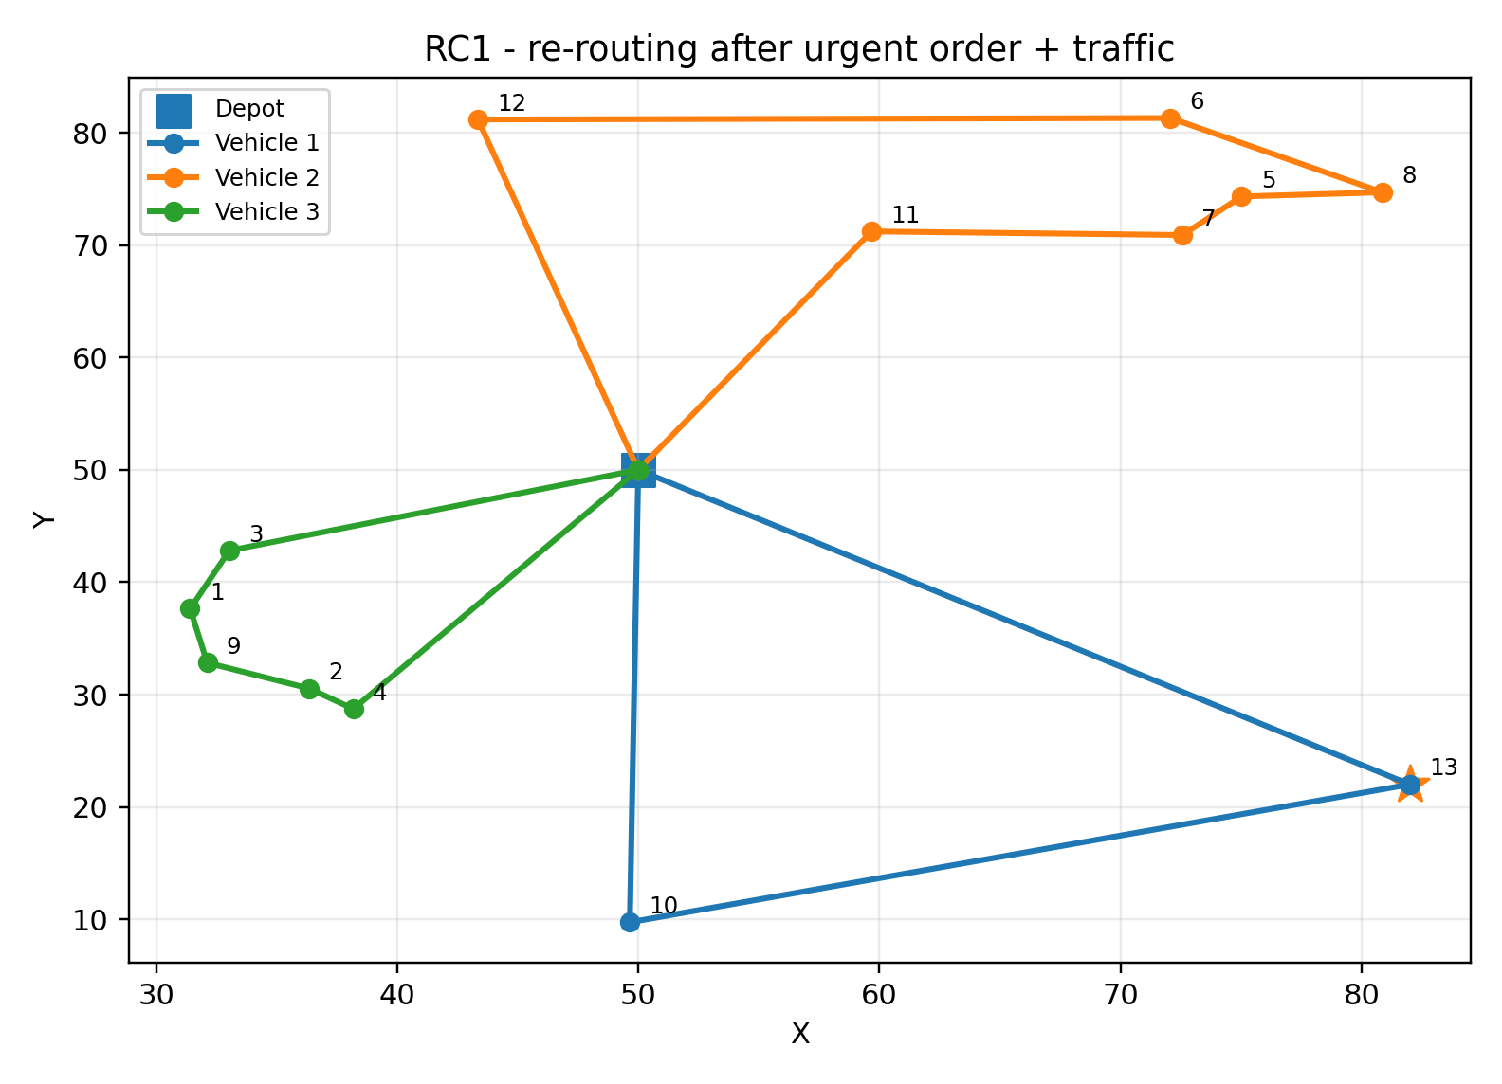
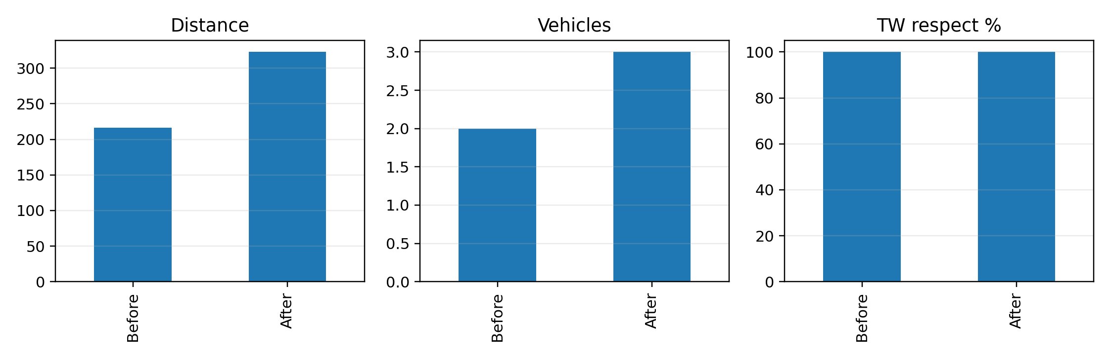
Dynamic re-routing after urgent order + traffic
Main takeaway:
The fleet uses one more vehicle after the disruption, and the total distance increases significantly, which confirms the impact of dynamic events on routing.

Slide 6
Interpretation
OR-Tools consistently beats the baseline and slightly outperforms the metaheuristic on total distance.
The metaheuristic remains acceptable as a custom comparison method and is easy to explain in an oral defense.
The project now clearly covers: VRPTW, dynamic re-routing, new orders, incidents, KPIs, and benchmark instances.
Everything is kept in Python in the code folder, ready for GitHub submission.

