Slide 1
Final Project PSE 2019-2020
Heart Disease Presence Prediction
TEAM H
Ilias Chatzistefanidis 2351
Argyris Adam 2309
Eleni Koutsoni 2371

Slide 2

Machine Learning Applications In Healthcare
Machine Learning is used across many spheres around the world. The healthcare industry is no exception. Machine Learning can play an essential role in:
1. Identifying Diseases and Diagnosis
2. Drug Discovery and Manufacturing
3. Personalized Medicine
4. Machine Learning-based Behavioral Modification
5. Smart Health Records
6. Better Radiotherapy
7. Outbreak Prediction
Such information, if predicted well in advance, can provide important insights to doctors who can then adapt their diagnosis and treatment per patient basis.

Slide 3

The Dataset: UCI Heart Disease Dataset
Independent Variables
age : age in years
sex : (1 = male ; 0 = female)
cp : chest pain type
trestbps : resting blood pressure ( in mm Hg)
chol : serum cholestoral in mg/dl
fbs : fasting blood sugar > 120 mg/dl ( 1=True 0 = False)
restecg : resting electrodiographic results
thalach : maximum heart rate achieved
exang : exercise induced angina ( 1 = yes ; 0 = no)
oldpeak : ST depression induced by exercise relative to rest
slope : the slope of the peak exercise ST segment
ca : number of major vessels (0-3) colored by flourosopy
thal : 3 = normal ; 6 = fixed defect; 7 = reversable defect
Dependent/Target Variable
target : 1 or 0 ( Presence/Absence)
The Goal
Our goal in this project is to use different Machine Learning algorithms to decide which are the best in order to predict the presence/absence of a heart disease in a patient.

Slide 4
PCA Analysis
 | Sd | Prop. of Var | Cum. Prop.
PC1 | 1.745632 | 0.217659 | 0.217659
PC2 | 1.330982 | 0.126537 | 0.344196
PC3 | 1.106627 | 0.087473 | 0.431669
PC4 | 1.089366 | 0.084766 | 0.516435
PC5 | 1.055375 | 0.079558 | 0.595993
PC6 | 0.985119 | 0.069319 | 0.665311
PC7 | 0.957320 | 0.065462 | 0.730773
PC8 | 0.901881 | 0.058099 | 0.788872
PC9 | 0.864518 | 0.053385 | 0.842257
We need to find the best low-dimensional representation of the variation
We will retain 8 components in order at least 75% of the variance to be explained

Slide 5
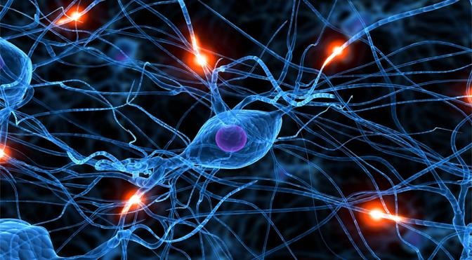
Methods
We first consider traditional ML methods:
Multiple Linear Regression
Logistic Regression
Ridge Classifier
K-Nearest Neighbours Classifier
Support Vector Machine (SVM)
Kernel SVM
Naive Bayes Algorithm
Decision Tree Classifier
Random Forest Classifier
We then employ deep learning and train two neural networks:
MLPClassifier (Multilayer Perceptron Classifier)
Keras Neural Network

Slide 6
An insight to our traditional methods
Multiple Linear Regression | Assumes that the relationship between the dependent variable y and the p-vector of regressors x is linear.
Logistic Regression | Predicts outcome that takes only 2 values better than Linear Regression using a sigmoid function
Ridge Classifier | Useful to mitigate the problem of multicollinearity in linear regression, which commonly occurs in models with large numbers of parameters,in exchange for a tolerable amount of bias.
k-NN | A learning algorithm that calculates the closeness of two examples by a distance function. (Euclidean distance, Negative cos similarity, Chebychev ...)
SVM | It relies on the definition of hyperplanes and the definition of a margin(hard or soft) which separates classes of variables.
Kernel SVM | Mathematical functions that are defined as the kernel.(linear, nonlinear, polynomial, radial basis function (RBF), and sigmoid)
Naive Bayes Algorithm | Simple "probabilistic classifier" based on applying Bayes' theorem with strong (naïve) independence assumptions between the features.
Decision Tree Classifier | A decision tree is an acyclic graph that can be used to make decisions.
Random Forest Classifier | After training, we have B decision trees. The prediction for a new example x is obtained as the average of B predictions, avoiding overfitting

Slide 7
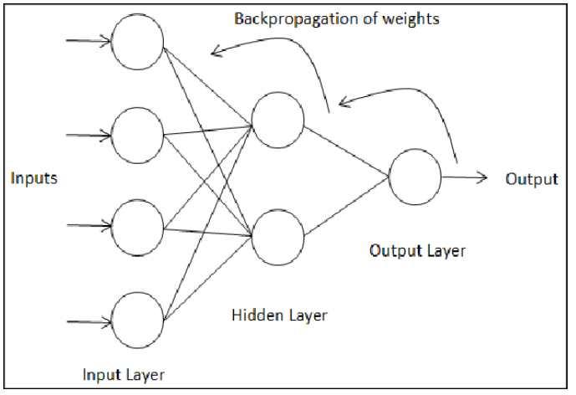
An insight to our Neural Networks
An artificial neural network is a combination of multiple neurons connected creating a network that has :
input layer
one or more hidden layers
output layer
We work through each layer of our network calculating the outputs for each neuron. All of the outputs from one layer become inputs to the neurons on the next layer. This process is called forward propagation.
We propagate error backwards from the output back into the network to update our weights. This is called backpropagation.
MLP Classifier | Artificial neural network that works efficiently with non-linearly separable data.
Keras Neural Network | A powerful Python library for developing and evaluating deep learning models. It wraps the efficient numerical computation libraries Theano and TensorFlow.

Slide 8
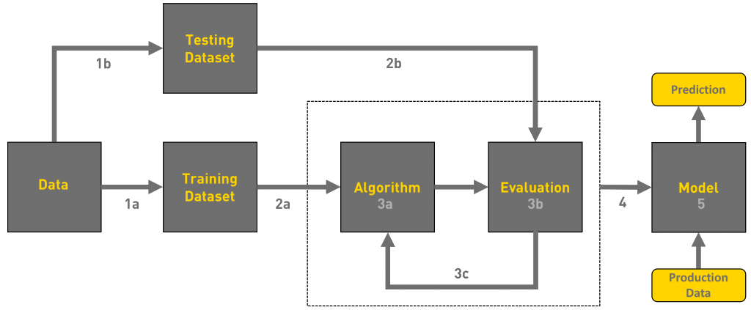
Workflow

Slide 9
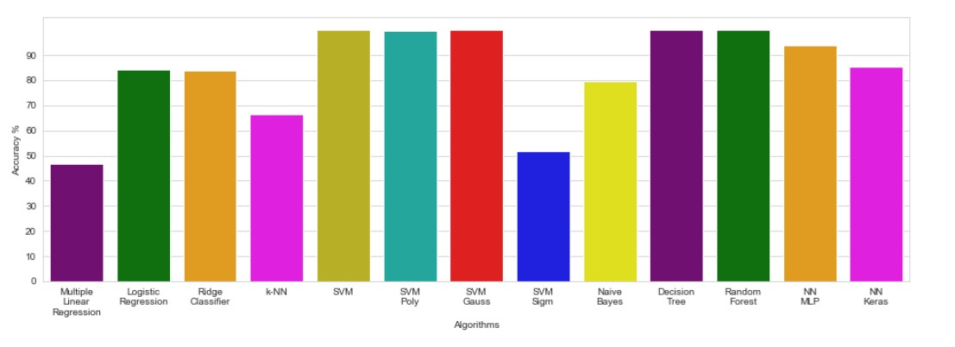
Experiments and Results
A visualization of our results based on training accuracy

Slide 10
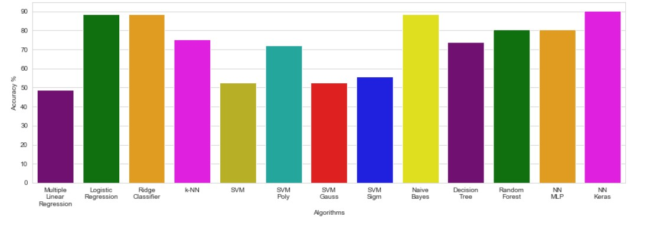
Experiments and Results
A visualization of our results based on testing accuracy

Slide 11
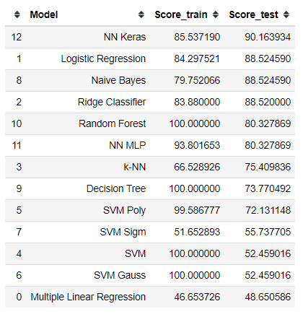
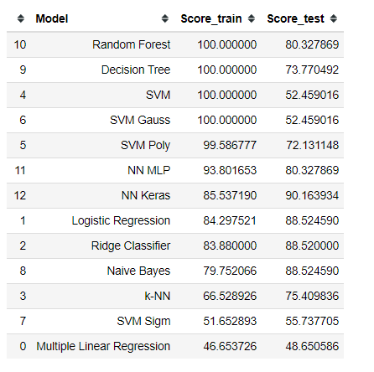
Experiments and Results
We need to check which methods are more stable.

Slide 12
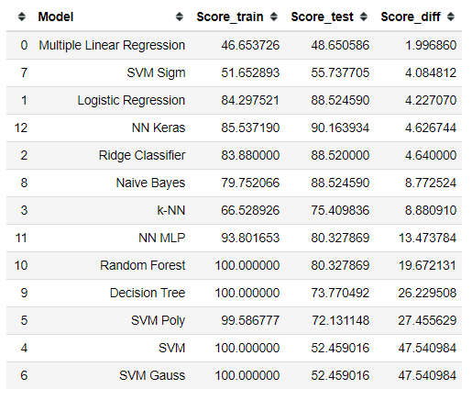
Experiments and Results
Stability equation
(|score_train - score_test|)

Slide 13
Conclusions
From the above results we observe that :
In some models the accuracy of the training is way greater than the accuracy of testing, this is called overfitting. In this case, we can not trust this model in the classification.
Thus, taking into consideration the testing accuracy and minimum reminder of our stability equation(|score_train - score_test|) we are able to decide which models are the best for our data.

Slide 14
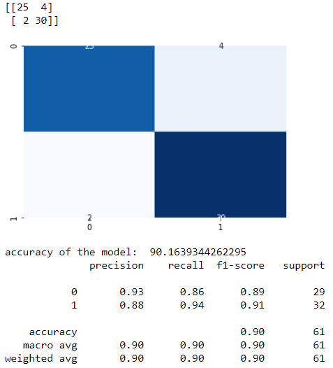
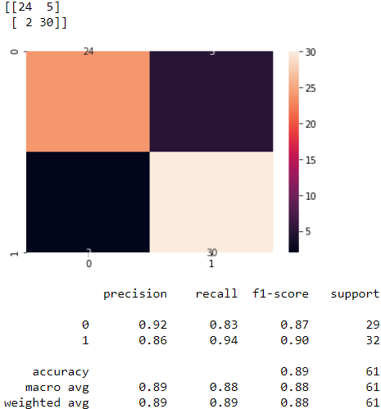

Conclusions
We conclude that the best three models are :
Neural Network Keras Logistic Regression Ridge Classifier

Slide 16
Thank you for your time!
References
Detrano, R., Janosi, A., Steinbrunn, W., Pfisterer, M., Schmid, J., Sandhu, S., Guppy, K., Lee, S., Froelicher,
V. (1989). International application of a new probability algorithm for the diagnosis of coronary artery disease.
American Journal of Cardiology, 64,304–310.
Jaymin Patel, Prof.TejalUpadhyay, Dr. Samir Patel(2016). Heart Disease Prediction Using Machine learning and
Data Mining Technique.
S. Valle, W. Li, S.J. Qin Selection of the number of principal components: the variance of the reconstruction
error criterion with a comparison to other methods Industrial and Engineering Chemistry Research, 38 (1999), pp.
4389-4401
N. Christianini, J. Shawe-Taylor An Introduction to Support Vector Machines and Other Kernel-Based Learning
Methods, Cambridge university press, UK (2000)
Burkov, A.: The Hundred-Page Machine Learning Book, Quebec (2019)
L. Breimann: Random forests Mach. Learn., 45 (2001), pp. 5-32
Scott Robinson: Introduction to Neural Networks with Scikit-Learn, January 29, 2018

