Slide 1
Futbol Analytics Club

Slide 2


AGREF
Player Management Agency
One of the most important in Peru

Slide 3
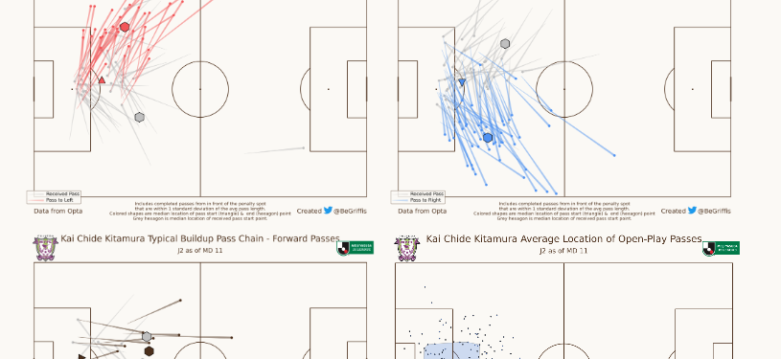
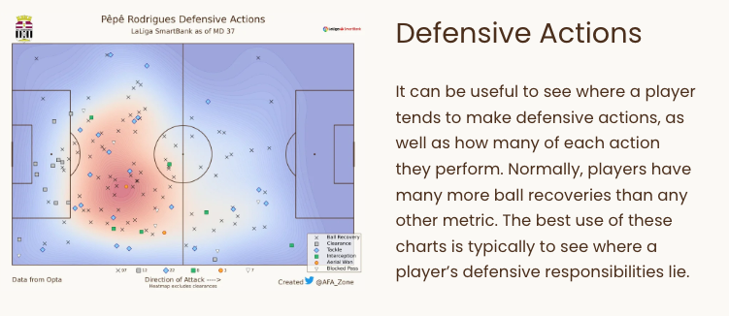
Project Scope
Individual Post-Game Performance Reports
Automated & Python based
PDF format
Based on events data (whoscored.com) and general data (fbref.com)
See ‘Project Scope Doc’ for Specifics

Slide 4
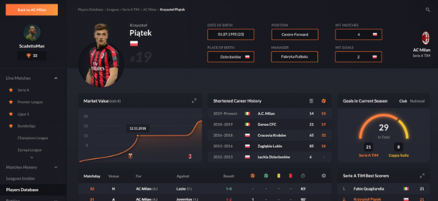
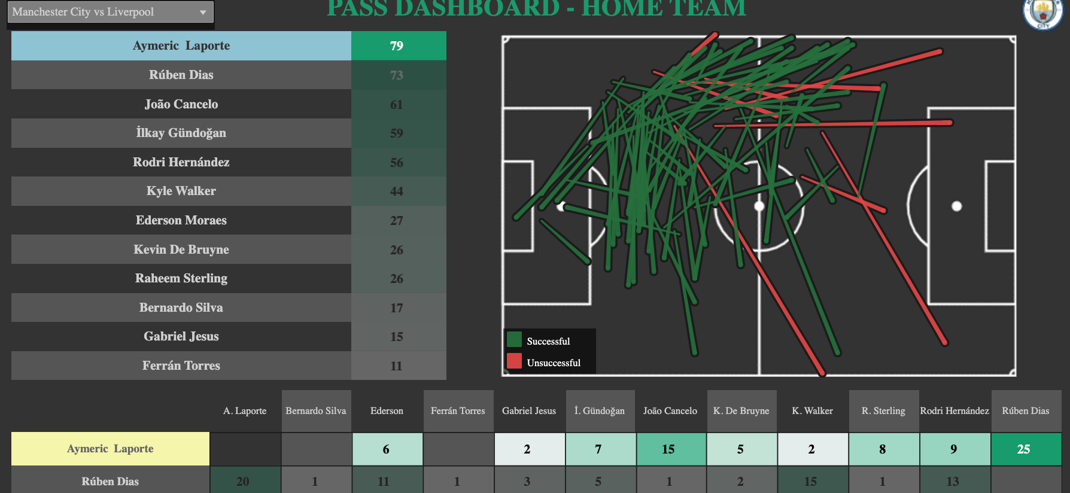
Project Scope
Tableau Dashboard
Similar Idea but seeking interactivity
Option to see full-season visualizations and analysis.

Slide 5
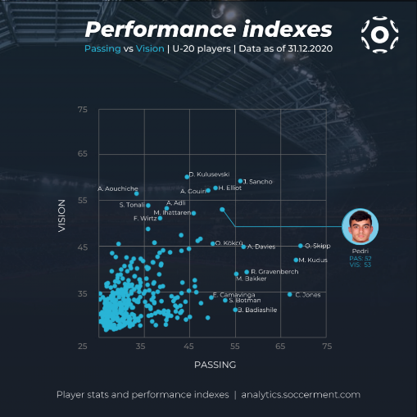
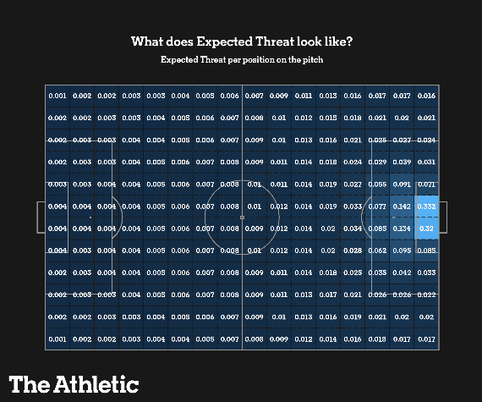
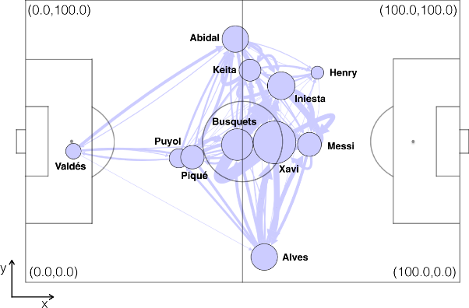
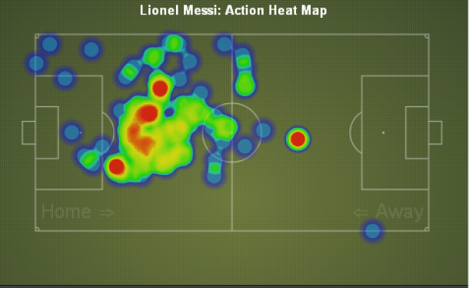

Slide 6
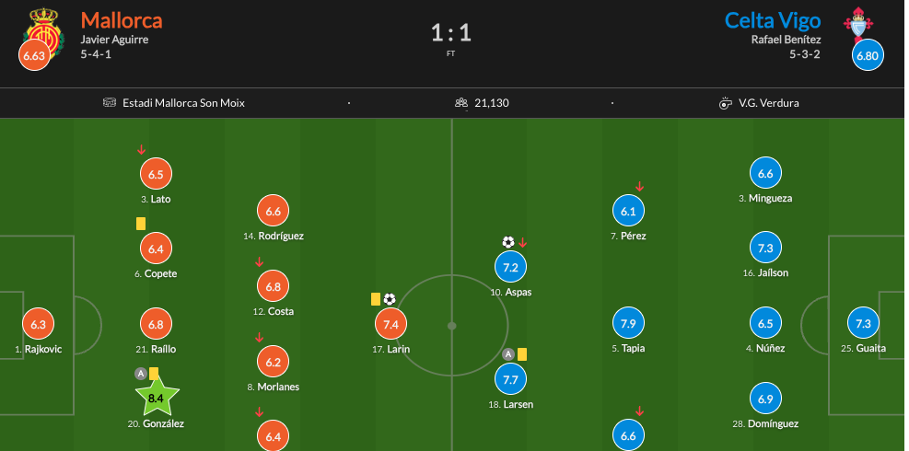
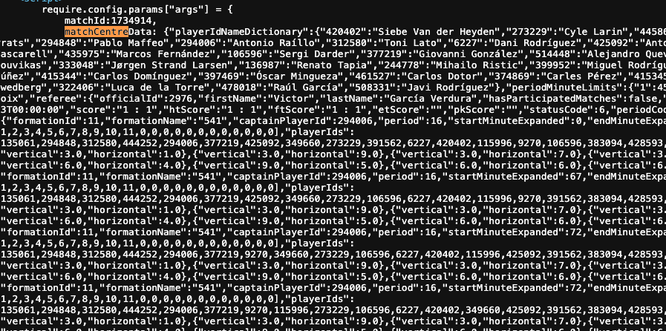
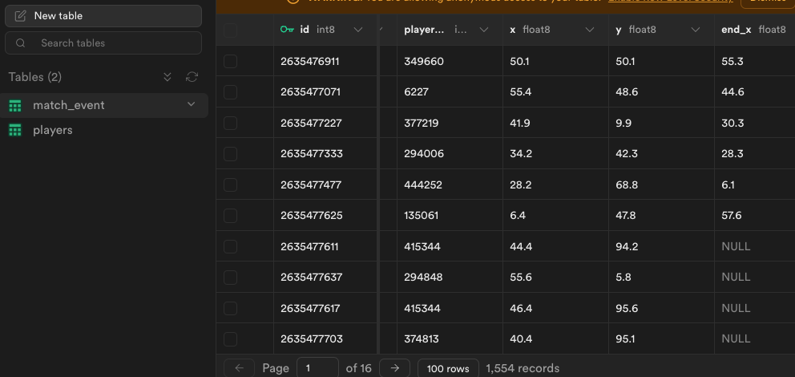
Data Gathering
Whoscored.- Web Scraping Pipeline for Events Data
FBREF Scraper for Standard Performance Data

Slide 7


SPORTING CRISTAL

Slide 8

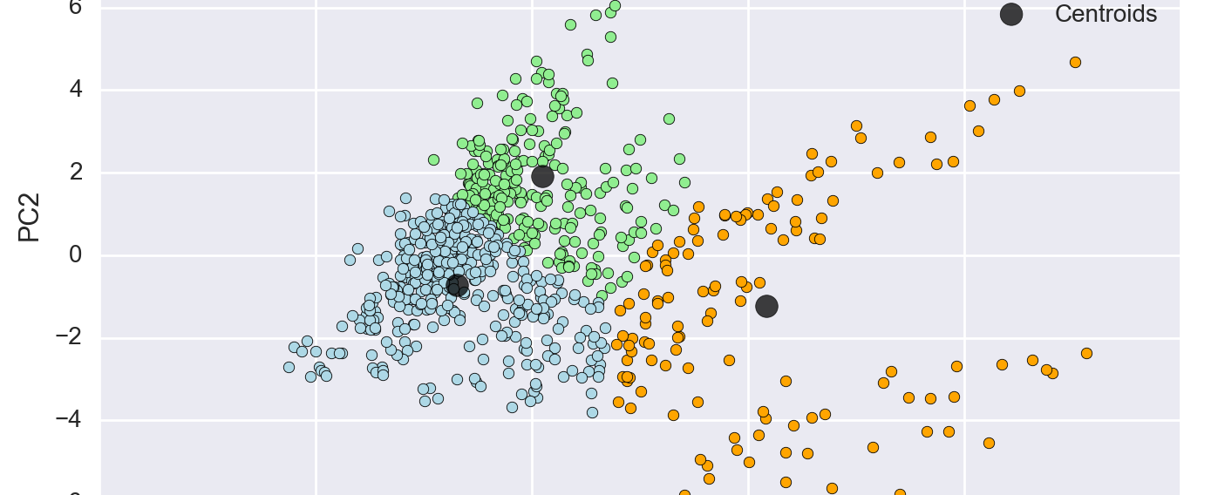
Project Scope
Fast-paced
Mainly GPS and Nutrition data
Weekly tasks, currently working on clustering and PCA.

