Slide 1
Code Refactoring in Javascript

Slide 2
Agenda
Introduction to Refactoring
Initial setup exercise
  - break -
Refactoring examples
You own refactoring journey

Slide 3
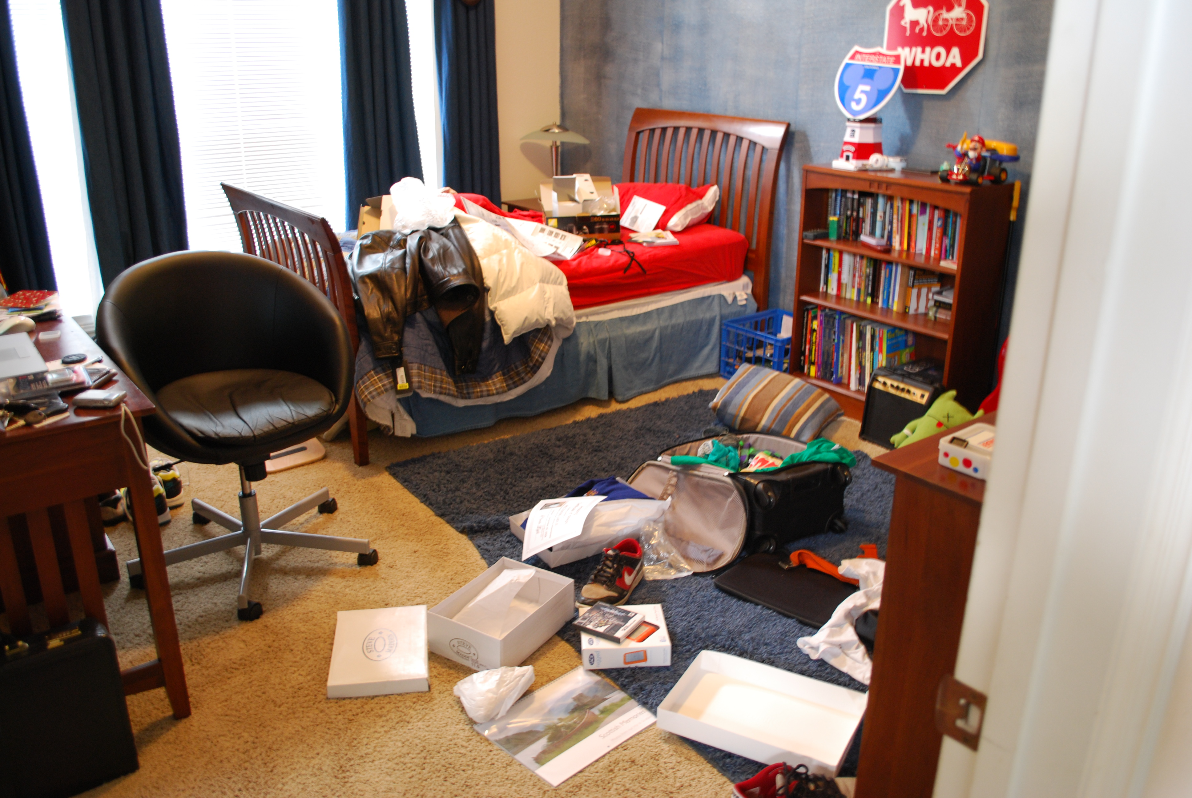
Where are my black socks?

Slide 4

Where are my black socks?

Slide 5
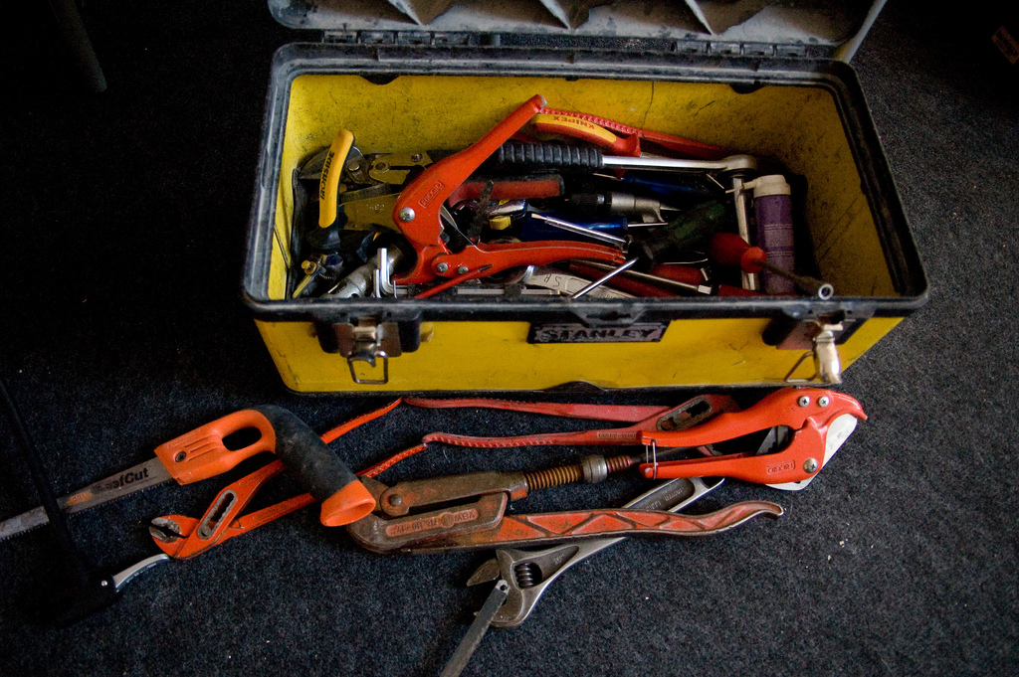
I need a 12mm spanner...

Slide 6
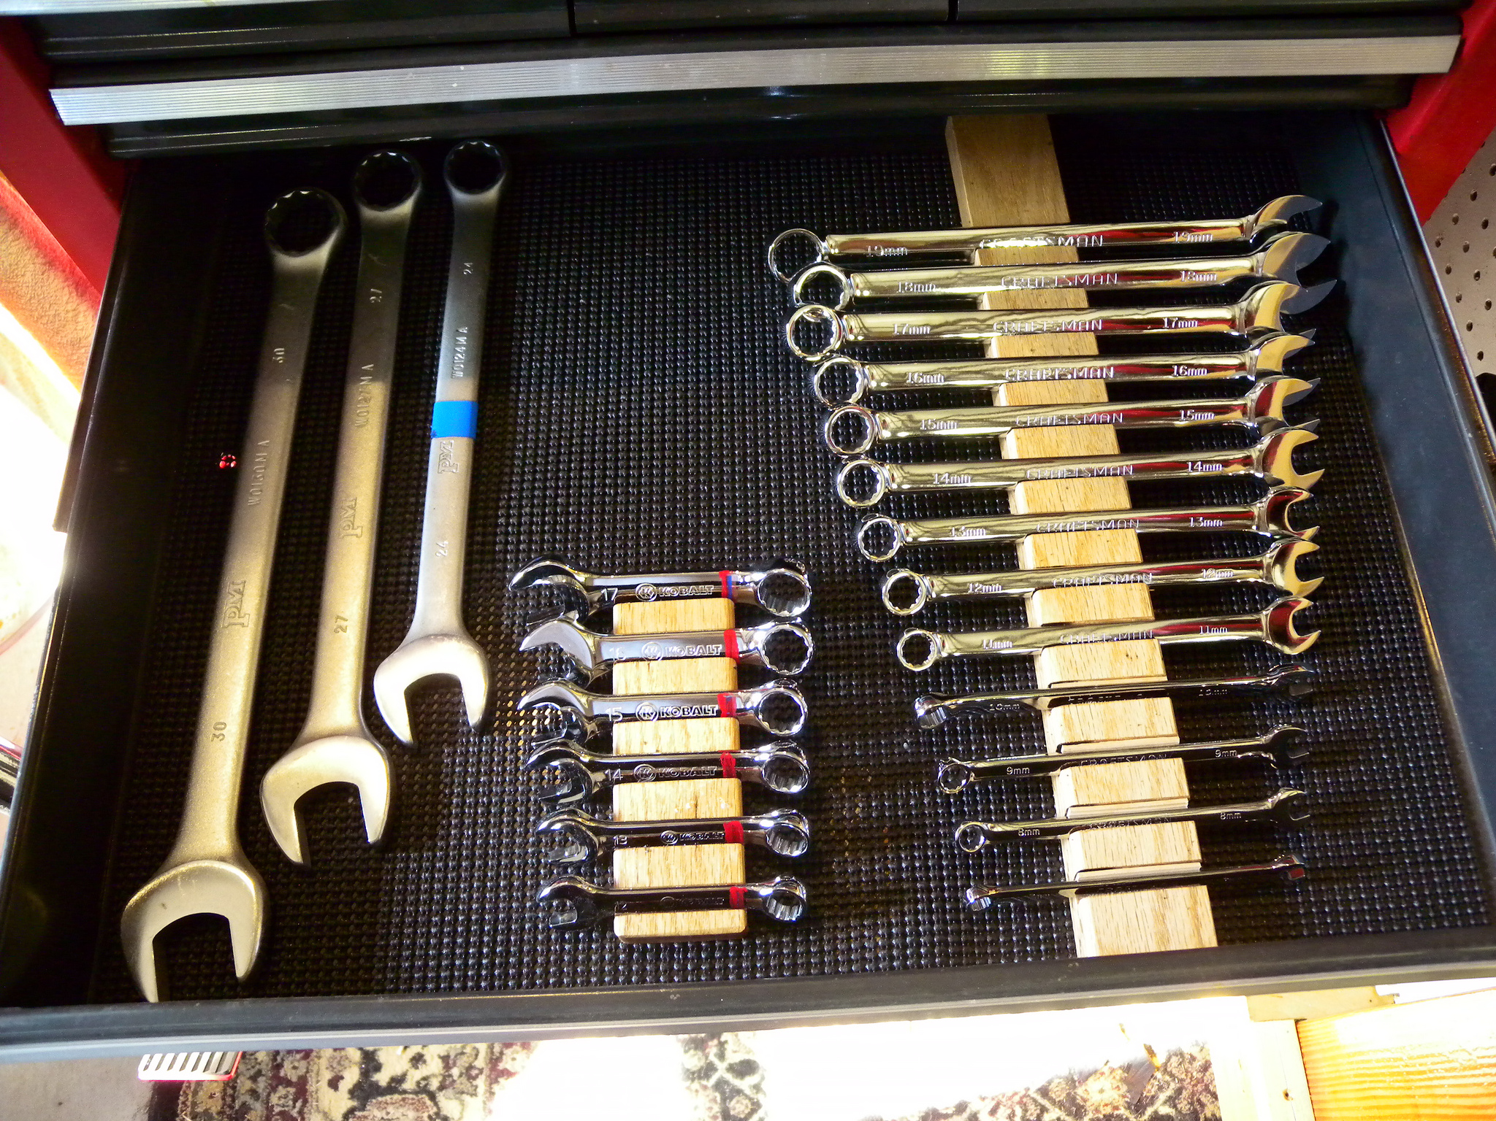
I need a 12mm spanner...

Slide 7

Coding activity
Writing code
Reading code

Slide 8
“Any fool can write code that a computer can understand. Good programmers write code that humans can understand.”
- Martin Fowler

Slide 9



Refactoring

Slide 10
Refactoring
“Refactoring is the process of changing a software system in such a way that it does not alter the external behavior of the code yet improves its internal structure.”
- Martin Fowler

Slide 11
Hello demo exercise
Set up in pairs
...and exchange keyboard often!
Get the codebase
$ git clone github.com/iliasbartolini/code_refactoring
$ cd code_refactoring
$ npm install
$ npm test
Check the /1_hello/ example

Slide 12
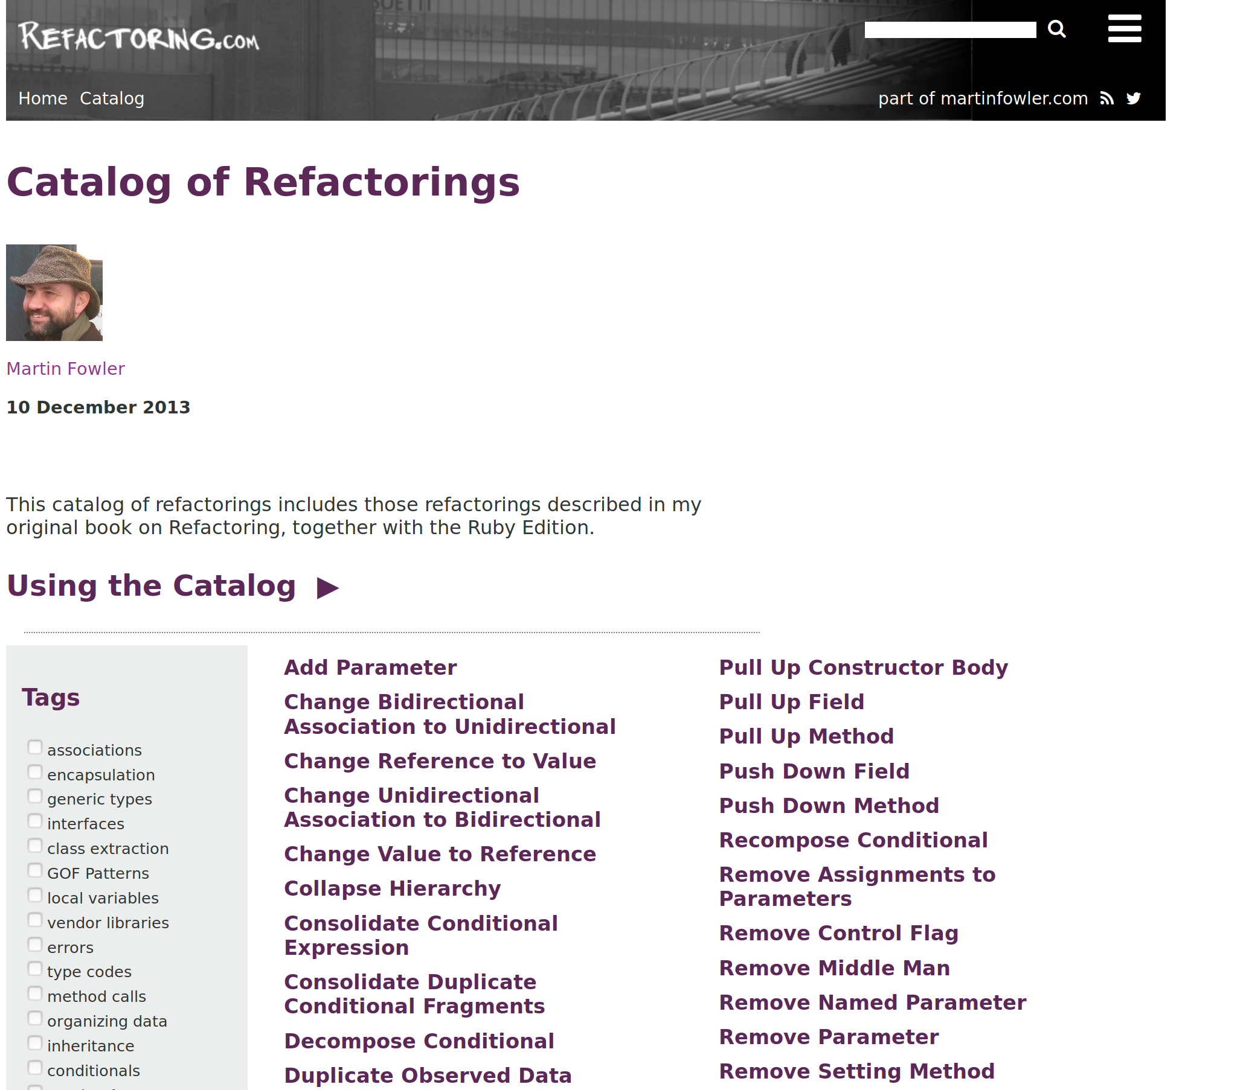
See: https://refactoring.com/catalog/

Slide 13
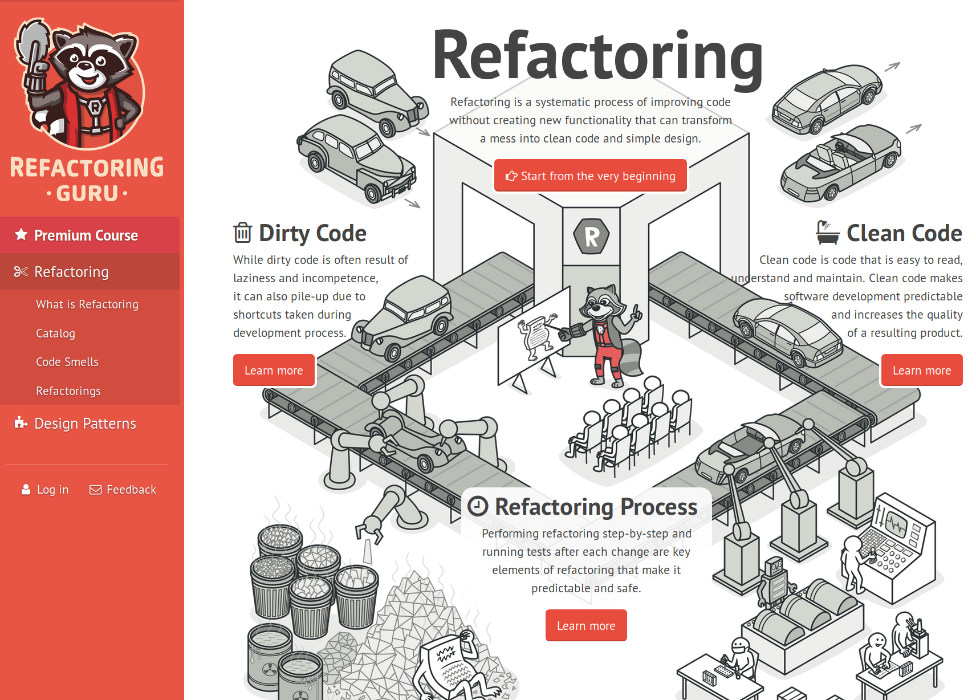
See: https://refactoring.guru

Slide 14
Let’s see...
Rename method, variable, class, …
Replace magic numbers
Extract / Inline method or function
Extract / Inline variable
Move method, Extract class
Replace if/switch with polymorphism
Pull up / Push down method, Extract interface
Replace inheritance with delegation

Slide 15
Hello demo exercise
Set up in pairs
...and exchange keyboard often!
Get the codebase
$ git clone github.com/iliasbartolini/code_refactoring
$ cd code_refactoring
$ npm install
$ npm test
Check the /1_hello/ example

Slide 16
Hello demo exercise
Set up in pairs
...and exchange keyboard often!
Get the codebase
$ git clone github.com/iliasbartolini/code_refactoring
$ cd code_refactoring
$ npm install
$ npm test
Check the /1_hello/ example

Slide 17
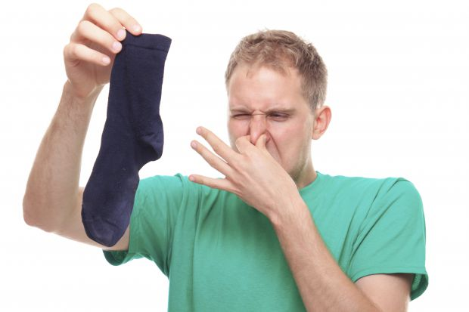
Smells...
Source: iStock Michał Ludwiczak

Slide 18
Code smells and refactoring
  Symptom
Duplicated code
Long function/class
Long list of parameters
Code “envy”
Divergent changes
Common if/switch lists
Speculative generic code
Code comments
//are like a deodorant
  Treatment
Extract duplicate part
Extract & split
Introduce class
Move responsibility
Split responsibilities
Introduce polymorphism, ...
Delete, delete, delete
Rename / Extract method

Slide 19
Practice!
Check the examples in order
/2_date_parser/
/3_direction/

Slide 20
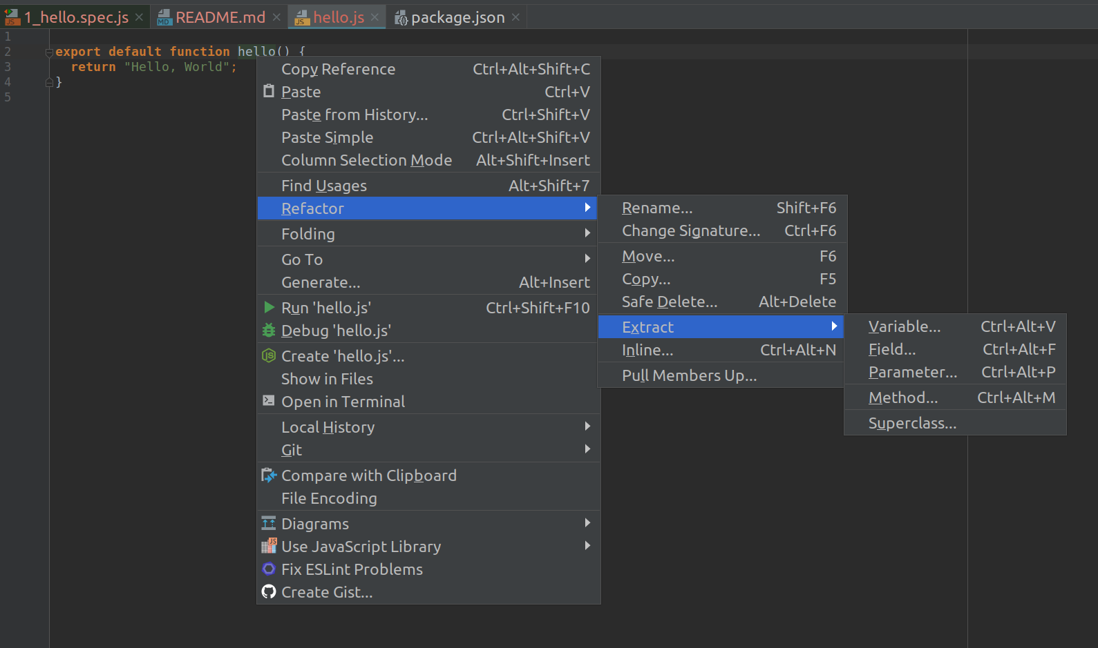
Tools & Language support

Slide 21

Let’s focus on baby steps!
Identify a smell
Make a refactoring
Run tests!
Repeat
Write down the list of
smells you see and refactoring you apply
Remember to swap keyboard ;)

Slide 22
Practice!
Check the examples in order
/4_order_receipt/
/5_rover/

Slide 23
Myths
“Refactoring takes time”

Slide 24
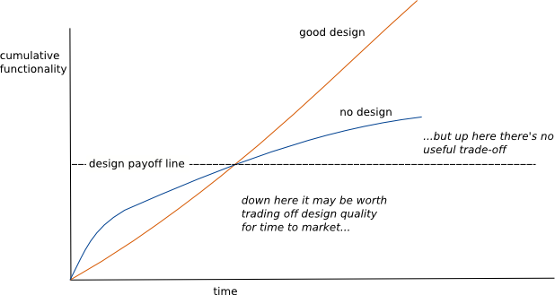
Good design makes you faster
https://www.martinfowler.com/bliki/DesignStaminaHypothesis.html

Slide 25
Myths
“You don’t need to refactor
your test code”

Slide 26
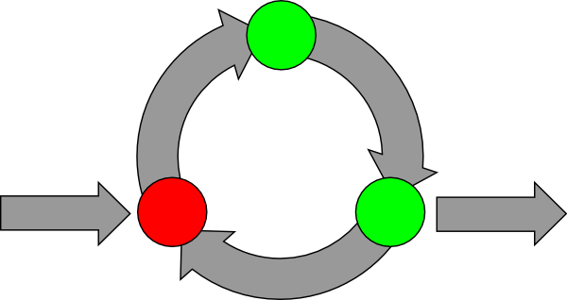
TDD
Test Driven Development
Add more tests
Write a
test first
Commit
Refactor
Implement
solution

Slide 27
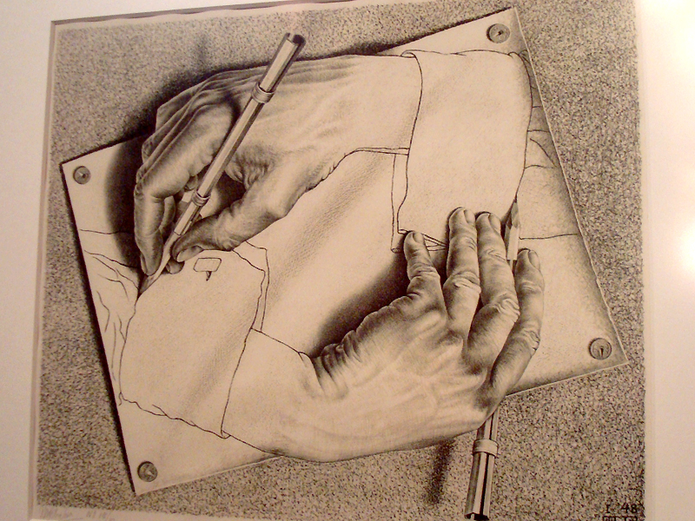
“Test code” is “code”
...and should be maintained
with the same quality criteria

Slide 28
Myths
“We need to stop the project
for this refactoring”

Slide 29
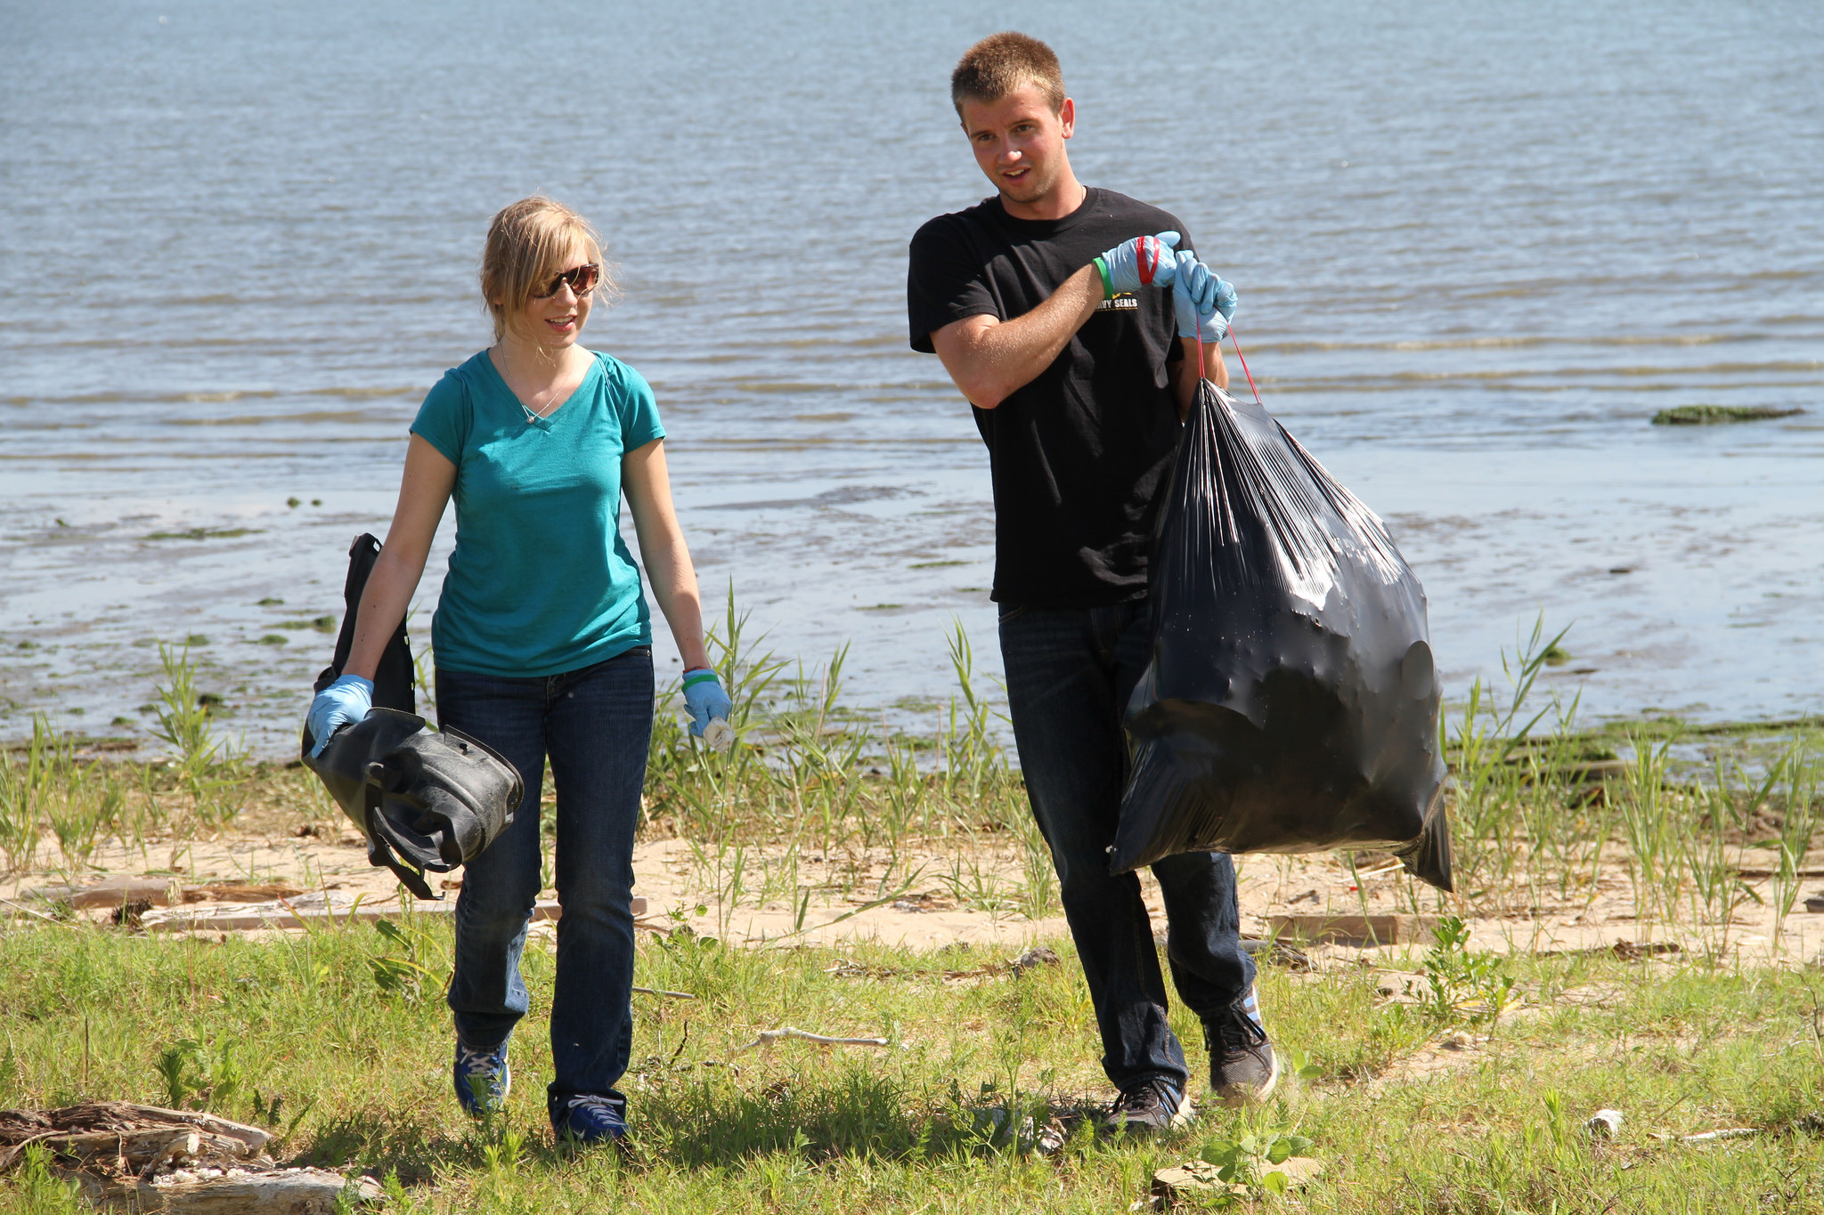
Boy scout rule
“Leave the campground
cleaner than you found it.”

Slide 30
Summary
Change code in “baby steps”
Make use of a test suite
Learn to identify “smells”
Try to make your code “obvious”
Continuously improve the “code design”
Practice, practice, practice makes perfect
:)

Slide 31
Feedback
bit.ly / f5-feedback
Thank you! :)

Slide 32
This work is licensed under a Creative Commons Attribution-ShareAlike 3.0 Unported License.
It makes use of the works of...
Slides template:
Mateus Machado Luna
Images credits: https://www.flickr.com/photos/dietjay/3140774470/ https://www.flickr.com/photos/147489968@N06/ https://www.flickr.com/photos/silvertje/2197752384/ https://www.flickr.com/photos/mtneer_man/7819976694/ https://www.flickr.com/photos/lingoflora/2331681471/

Slide 33
Hello demo exercise
Set up in pairs
...and exchange keyboard often!
Get the codebase
$ git clone github.com/iliasbartolini/code_refactoring
$ cd code_refactoring
$ npm install
$ npm test
Check the /1_hello/ example

